Slide 1
P: Problems
P: Programming
P: Programming Language
P: Programming Contest

Slide 2
How will society handle the massive wave of unemployment as AI and automation take over human jobs?
How does the brain create thoughts and feelings? Is brain and mind different?
What is the secret behind the pattern of prime numbers, and can we ever fully understand it?
How can a democracy stay strong when people are divided and trust is fading?
How can we reduce the gap between the rich and the poor without slowing progress?
Can we color any map using no more than four colors so that no two neighboring regions have the same color?
2^{136,279,841} − 1 is a prime number?
Problems
The motivation of human creativity.
Mother of every new idea.
Human asks problems.
And human finds solutions.
The history of human civilization is the history of problems.

Slide 3
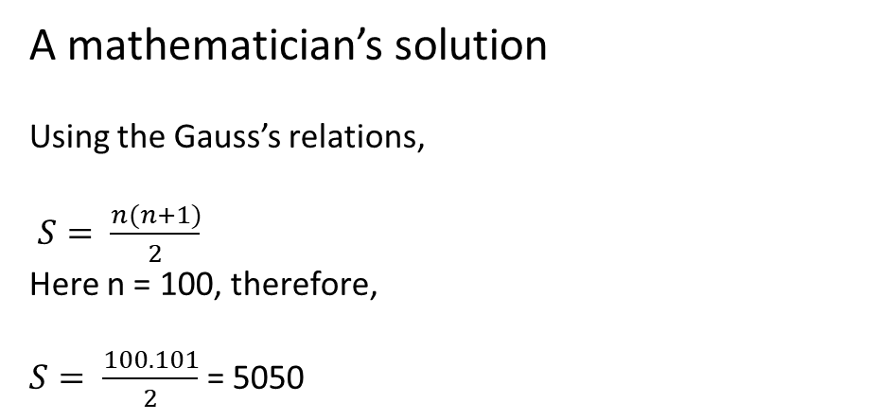
A mathematician’s solution
Using the Gauss’s relations,
$S= \frac{n(n+1)}{2}$
Here n = 100, therefore,
$S= \frac{100. 101}{2}$ = 5050
1 + 2 + 3 + … + 100 = ?
A C Scientist’s approach
S = 0
for i in range(101):
S = S + i
print(S)

Slide 4
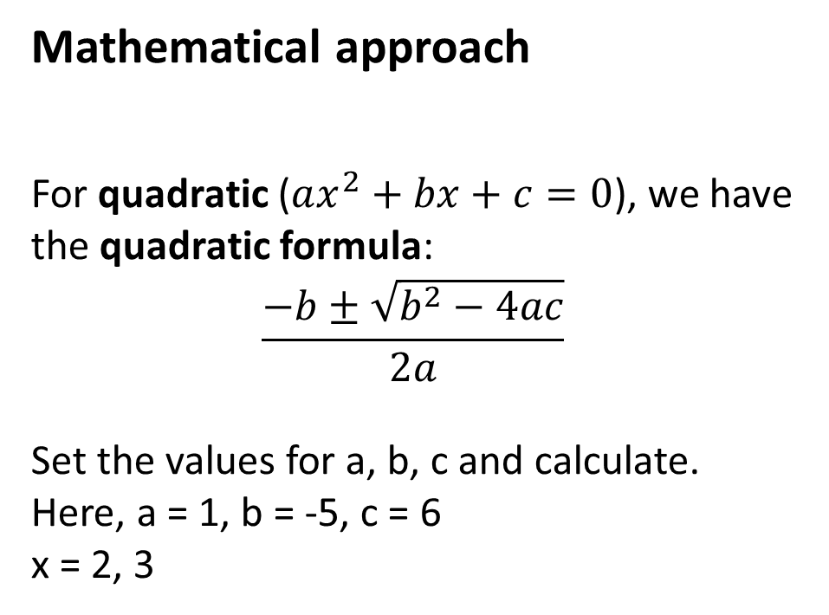
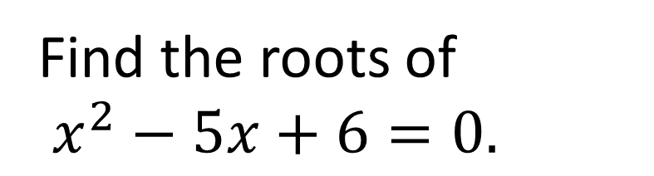
Mathematical approach
For quadratic ($ax^{2}+bx+c=0$), we have the quadratic formula:
$$\frac{−b±\sqrt{b^{2}−4ac}}{2a}$$
Set the values for a, b, c and calculate. Here, a = 1, b = -5, c = 6
x = 2, 3
Find the roots of
$x^{2}−5x+6=0.$

Slide 5
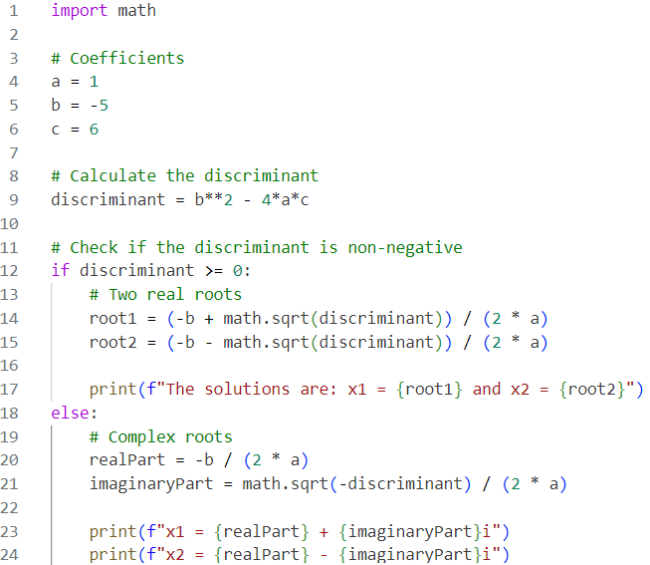
Computational Approach I
Just Use the quadratic formula and code it! Easy-peasy!

Slide 6
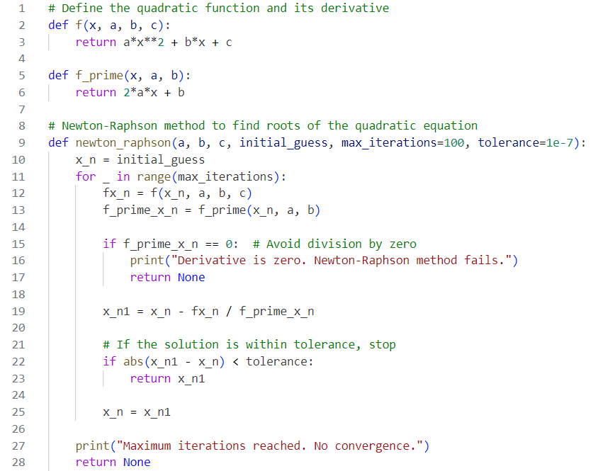
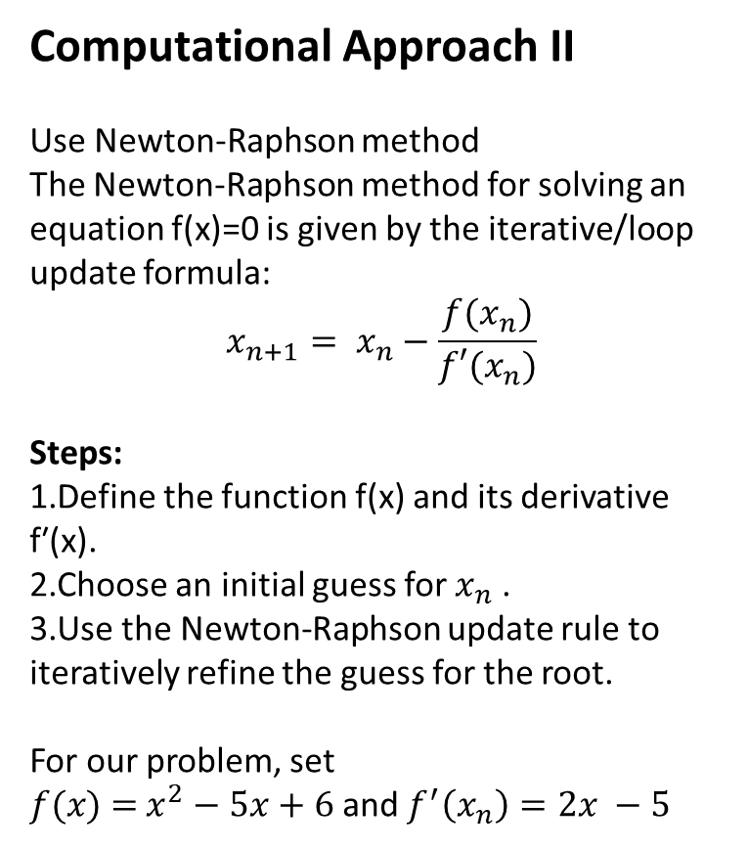
Computational Approach II
Use Newton-Raphson method
The Newton-Raphson method for solving an equation f(x)=0 is given by the iterative/loop update formula:
$$x_{n+1}= x_{n}−\frac{f(x_{n})}{f′(x_{n})}$$
Steps:
Define the function f(x) and its derivative f′(x).
Choose an initial guess for $x_{n}$ ​.
Use the Newton-Raphson update rule to iteratively refine the guess for the root.
For our problem, set
$f(x)$ $=$ $x^{2}−5x+6$ and $f^{′}\left(x_{n}\right)=2x −5$

Slide 7
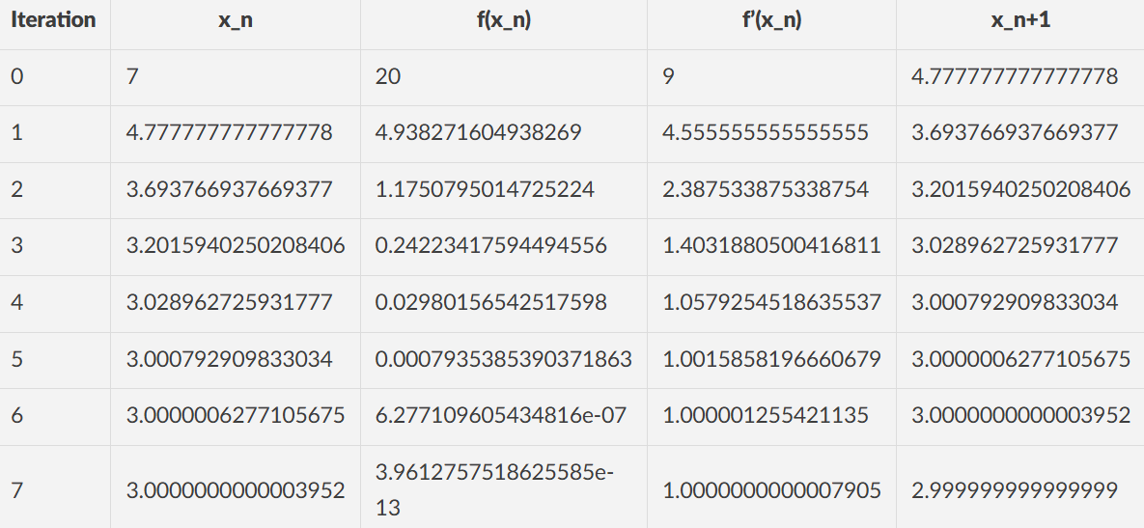

Slide 8
Computational Duality
"Mathematical-Computational Symbiosis" – Mutual benefit.
"Formalism-Algorithm Duality" – Bridge between mathematical formalism and computational implementation.
"Theoretical-Practical Confluence" – Showing their merging influences.
Computer has limited/NO capacity to prove mathematical theorem. But it can help mathematical framework through faster computation.
Mathematics has many computational frameworks but is NOT time efficient.

Slide 9
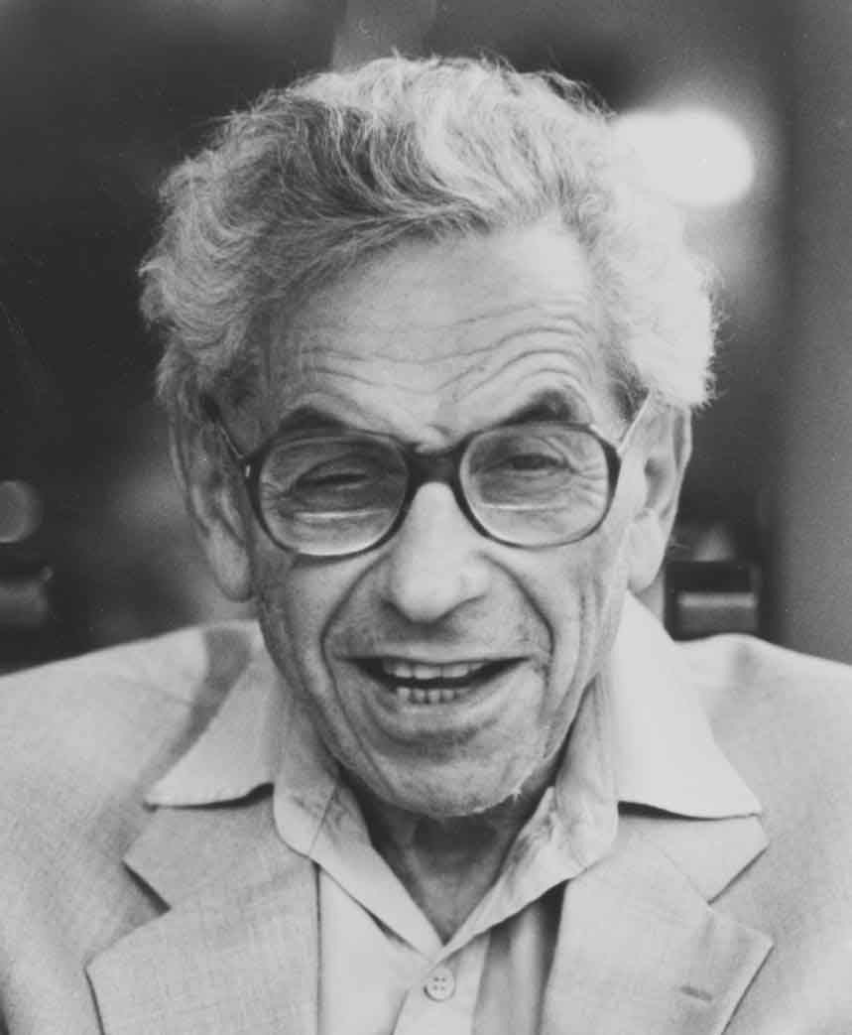

Slide 10
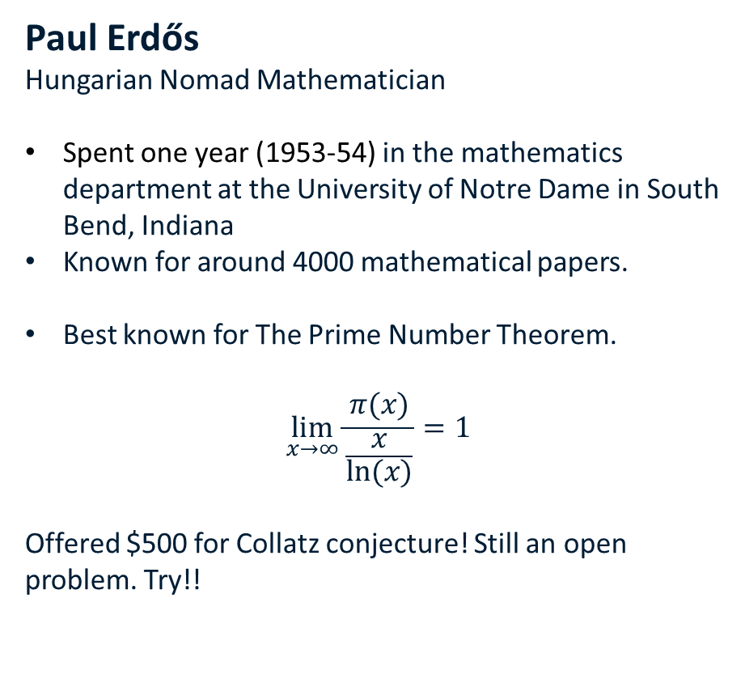
Paul Erdős
Hungarian Nomad Mathematician
Spent one year (1953-54) in the mathematics department at the University of Notre Dame in South Bend, Indiana
Known for around 4000 mathematical papers.
Best known for The Prime Number Theorem.
$$\lim_{x→∞}{\frac{π(x)}{\frac{x}{ln⁡(x)}}=1}$$
Offered $500 for Collatz conjecture! Still an open problem. Try!!

Slide 11
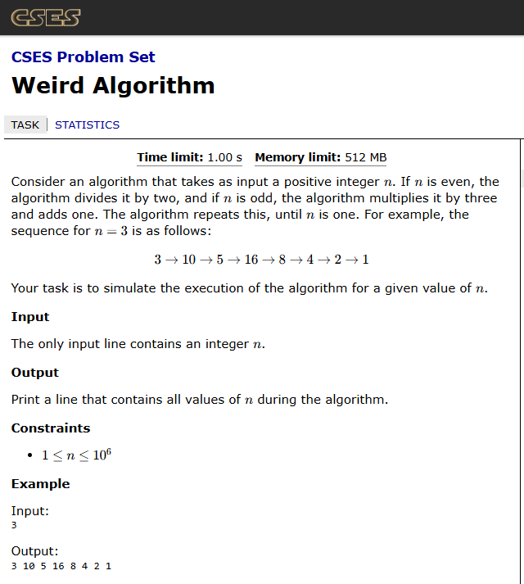
The 3n + 1 problem vs
Collatz Conjecture
3n + 1 problem: A computational problem
You will given a positive integer n.
If n is even, repeat the process
If n is odd, find 3n + 1 and repeat the process
If n is 1, stop
Collatz Conjecture: A mathematical quest
This process will eventually reach the number 1, regardless of which positive integer is chosen initially.

Slide 12
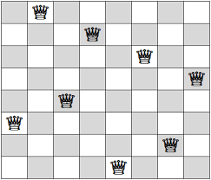
8-Queen Problem
Most famous variant:
You are given an 8×8 chess board. You have to place eight queens on it so that no two queens are attacking each other. Find the number of valid configuration.
Variant 2:
You are given a configuration. Now you have to verify if it is a valid one.
Gauss first solved this problem using backtracking.

Slide 13
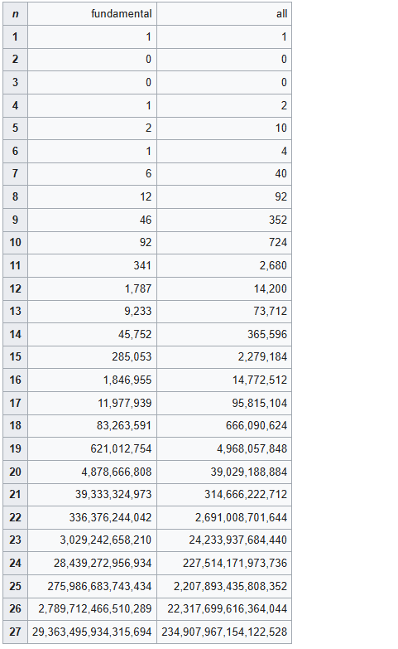
Beyond 8 Queen problem: N-Queen problem
Now, you are given an integer for N. You have to find the number of valid configuration.
Can we find the number of valid configurations for any arbitrary n?
It’s a pure computational problem. So far we computed up to N = 27. But it requires parallel computing.
Algorithm is NOT always enough.

Slide 14
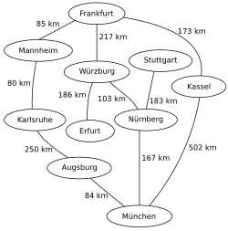
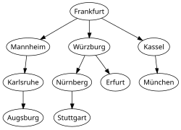
Two problems from graph search
Minimum number of hop of a city from Frankfurt.
This requires a BFS. Need to restructure the graph.
DON’T need all those distance values.
2. What is the minimum distance of a city from Frankfurt?
This is almost BFS, but modified BFS.
The algorithm is called Dijkstra.
Need all the distances values.

Slide 15
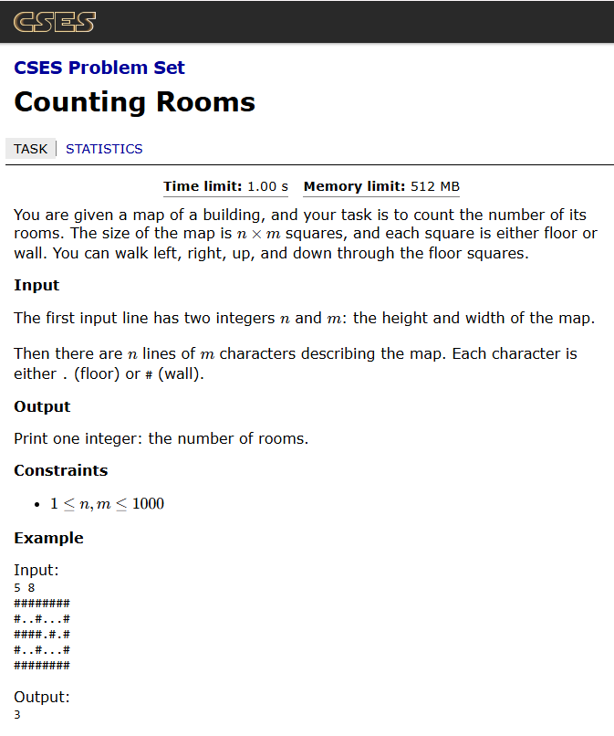
Another Graph search problem
Finding out the number of rooms.
You are given a map of floor. There are walls. A room is a place where you can freely move. Now find out the number of rooms.
Use DFS.
A fancy name for this problem is flood-fill. You use it a lot in painting.

Slide 16
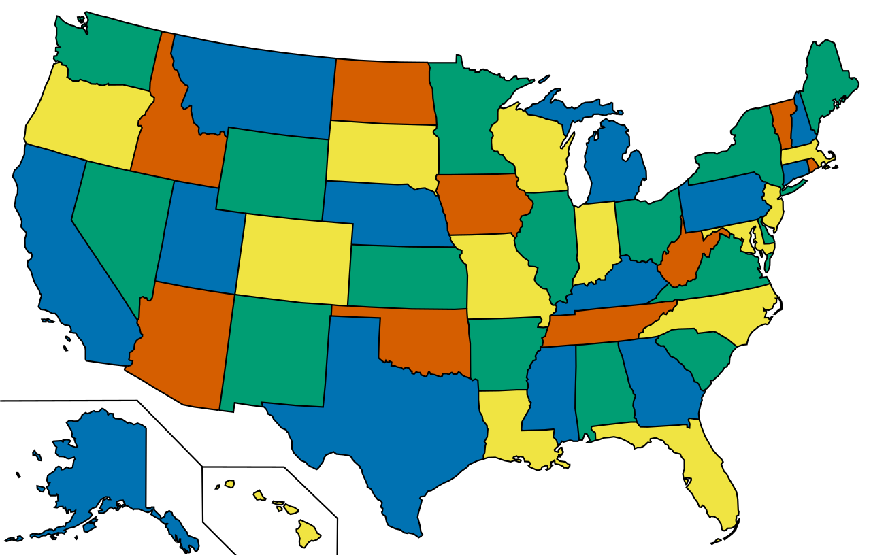
The Four Color Problem
(Not a problem anymore)
It’s solved!
Theorem: Any map drawn on a plane can be colored with at most four colors in such a way that no two adjacent regions share the same color.
A purely mathematical problem.
But not solved purely by human. Needed computational help. The first proof of human-computer collaboration.

Slide 17
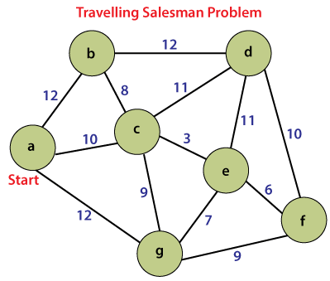
The TSP: A really Hard Problem
A salesman needs to visit n cities, starting from a given city (a) , visiting each city exactly once, and returning to the starting city.
The goal is to find the shortest possible route that minimizes the total travel distance (or cost).
Solution Approaches
Algorithms (for small n):
Brute Force: Check all (n−1)! possible routes (exponential time).
Dynamic Programming (Held-Karp Algorithm): Solves in O(n² 2^{n}) time.

Slide 18
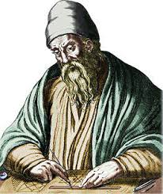

We can generate primes by Sieve of Eratosthenes. Its simple yet beautiful!
There is no largest prime! We have a proof of that. One of the earliest and fanciest proof. You know that?
The largest prime so far:
2^{136,279,841} − 1
Found in October 12, 2024 by GIMPS(Great Internet Mersenne Prime Search). The man is Luke Durant.
Problems in Primes
Generate all the primes within 100, 1000, 10000…
What is the largest prime. (solved!)
What is the largest prime so far…
How to verify a number is a prime or not?

Slide 19
Primality Testing
How do you test a number n is prime or not?
Easy Solution:
Just divide all the number from 2 to n-1. If found any number then n is composite, otherwise prime.
But this is slow.

Slide 20
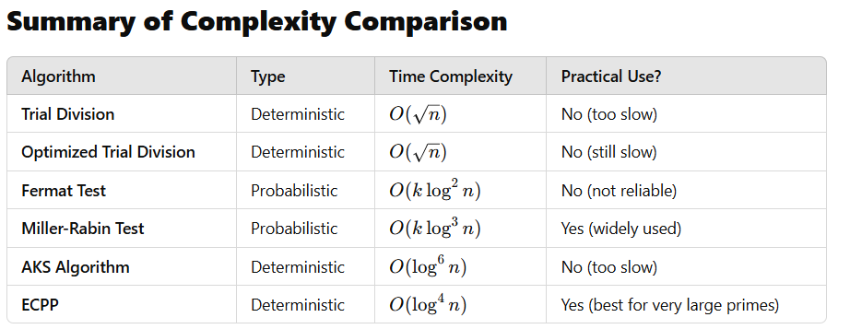

Slide 21
Programming Language
The real way to use a computer
For programming competition:
Choose any programming language that has three qualities:
Easy to use
Fast Compilation
Big Community
What is language?!
Natural Language
Formal Language
There is language, that’s why there are problems!
We live in a language mediated reality.
Make your language better!

Slide 22



The three Programming Languages
The C languages : Interface to the machine
The Python : The interface to the AI/ML
The JavaScript : The interface to the web

Slide 23

Lisp: The other kind of Programming Language
Declarative
Focuses what to compute NOT how to compute
Functional
Prefers functions, therefore recursion rather than looping.
Uses in AI research
Immutability
Memory friendly

Slide 24
CP: Competitive Programming
Why Programming Contest? There are two reasons:
To ensure competitiveness
To foster problem solving capacity, therefore creativity
Most likely it will NOT give you:
The best job
A Nobel Prize
A ministry
But it will make you:
Smarter
Visionary
Thoughtful
What is my suggestion?
Why do I do programming?

Slide 25
Start learning a programming language. Start with python. Learn everything up to function. Don’t hurry! Understand every bit! But only learning is NOT enough. Need Practice.
Buy three books.
Start solving programming. Take easy problems first. Spend one/two months with easy problems. Don’t stay there for long or forever!
Now start reading data structures. Start with linked list, queue, priority queue and stack. Try to solve problems that requires these data structures.
But you will find eventually that you need to learn graphs. All these data structures are almost useless alone but powerful with graphs.
But before going to the graph, practice some problems with backtracking. It will give the power of recursion. In this stage you may want to explore dynamic programming or DP. But please don’t.
How to CP
The three books:
Competitive Programming 3: Steven Halim
Programming Challenges
Competitive Programmer's Handbook
Easy problems topics:
What is an easy problem? The problem you can solve immediately. Do:
Searching: Linear, Binary
Sorting: Quick Sort, Merge sort, Bubble Sort
Basic Math: Number theoretic Problem
Geometry: Easy Geometry

Slide 26
Graph Before DP:
Start with Search algorithms. Whatever First Search. Shortest Paths. Circuits.
Tree: Binary Tree, Heap, BST
MST, Top Sort
Graph Coloring Problems
Start exploring graph.
Now Start exploring DP. Don’t touch DP before you understand the DAGs
Go deep in graph and DP. Start solving hard problems.
Explore some geometric problems, game theory and other spinoffs.
Graph After DP:
Articulation Point
Connectivity
Flow: Max flow, min cuts and variants.

Slide 27





Start with cses.fi
When you are done with introductory problems of cses then start codeforces division 3 and 2. After each contest analyze the solution. Codeforces is a key player in PC and will be a key player on WW3
Don’t forget about Uva from the very beginning of your CP journey.
BTW, tocoder is another platform. They are American!
Where to practice: The online judges
A lot of problems
And an automated judging system

Slide 28




Community
Practice in a group.
Create discussion group.
Create reading group.
CLUB
Create your own online community.
Onsite Contest
Create your own team.
Target for NCPC 2026.
Win ICPC within 2030

