Slide 1
Group - 9
PRESENTATION

Slide 2
Presenting
Istiaque Ahemed
S. Anan Ridwan Shanto
Dipwanita Mallick
Aktia Sadia Anika

Slide 3
Social Media Trend Detection Using
Dynamic ClusTeRing
Machine Learning

Slide 4

INTroDuction
Social Media Dynamic Dataset
Unsupervised Machine Learning
Dynamic Data Collection
Data Processing
Dynamic Clustering
Trend Detection
Comparison

Slide 5
Data Collection
Tweepy API for twitter post collection
Facebook Graph API
Beautiful Soup and Requests for web scrapping
Praw For Reddit
Pandas convert to stable dataframes
Kaggle Dataset TwitterSentiment(1.6 Million Posts, 10,000 Trained)
Kaggle Visual_Trend(60000 Posts)

Slide 6
Data Processing
Remove Special Characters & Garbage values
Remove Duplicate Values
Remove Null Values
Remove of Stopwords
Stemming by PorterStemmer
Data Encoding: Textual Data -> Numerical

Slide 7
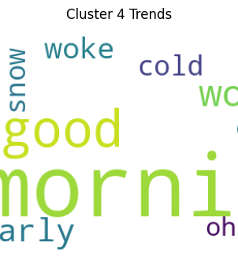
Term FrequEncy-Inverse Document FRequency Vectorizer
Assign Unique Value to Each Words
Score on Importance of Words
TF: Frequency of Words in a Document
IDF: Importance of Less Common Words
TF-IDF: Higher -> Words common in Document
Lower -> Common Words Everywhere

Slide 8
Dynamic Clustering Algorithms
K-Means:
Select k number of clusters
Initialize with Random k points
Calculate closest points to Clusters
Calculate Centroids
Calculate closest points
Repeat
DBSCAN:
Select Circle Radius and Sample
Random Points, Calculate Center Points
Select Center Points, Add Clusters with Samples
Identify the Noise
Select Different Clusters
Repeat

Slide 9
Trend Detection
Arrange Words with TF-IDF vectorizer score
Sort through Each Cluster
Find the most frequent words in each Cluster
Represent the Words in WordCloud
Scatterplot K-Means and DBSCAN
Calculate the Silhouette Score

Slide 10
Result & Finding
K-Means:
Silhouette Score: 0.1266461055557681
Not a good Score
K clusters are predefined
Not suitable for Dynamic Datasets
Elbow Method Needed
DBSCAN:
Silhouette Score: 0.5151
A good score
eps and n_samples can be default
Suitable for Dynamic Datasets
Eps can be calculated by Nearest Neighbour

Slide 11
Conclusion
Unsupervised Learning without Label greatly suited for Clustering.
NLP techniques like TF-IDF or Word2Vec needed for Vector Representation.
Static Dataset K-Means easier to Implement.
Dynamic Dataset DBSCAN or HDBSCAN better.
Find the max Silhouette Score.
Tune the user defined values for both Algorithms
Classical ML or Decision Tree could be verified.

Slide 12
THANK YOU

