Slide 1
GONEEDY
SUPPLY MANAGEMENT SYSTEM

Slide 2
SCOPE
This presentation will demonstrate the supply chain system. As part of the scope of this project will have a dedicated server to completely handle the end use, database to store all the information and client side application both mobile app and website.
Mobile app: is going to used by the end use mostly to set the necessary information like pickup and drop-off location, goods or material information, type of transportation used etc.
Webside: used by the backend team (mostly) to track and manage the flow of work and data management.

Slide 3
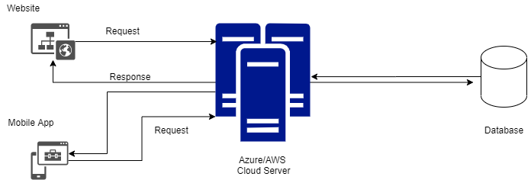
Backend Architecture
Website or Mobile app will make a request to the server using API.
Here server will be used as a Azure or AWS cloud.
Mysql database will be used to store the data.

Slide 4
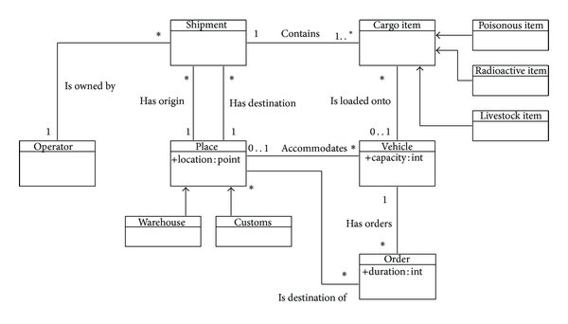
Class Diagram
It’s a sample class diagram
Table column will get filled or decided at the time of development.
On left side diagram only showing how table structure will look like, table will be a dynamic development and frequently change during the development till last release.

Slide 5
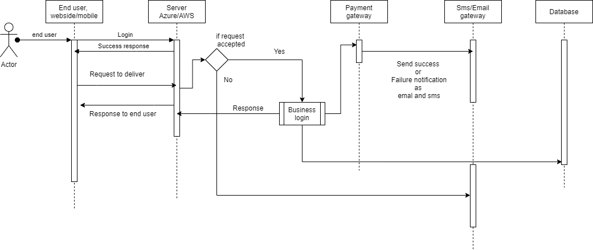
Application sequence diagram
Below diagram will explain the application flow.

Slide 6
Flow of the Build
Code checkout
Package restore
Package Build
On the left side diagram it will demonstrate the build flow for both mobile and web application.
For application management will use CI/CD along with Azure/AWS system.
Package publish
Docker login to DevOps image registry
Docker login to Enterprise shared image registry
Azure Key Vault login to download base image version
Send confirmation mail
Azure container registry
Making docker image using the Dockerfile and tagging it with current timestamp
Push image

Slide 7
CD through Octopus
Source
Container registry or Nugget Feed
Octopus is a paid version available in the market.
This will demonstrate how CD will work in the cloud with Azure/AWS.
Continuously monitoring for latest version
Octopus agent matches the tag defined in octopus deployment process and deploys accordingly.
Automated deployment to DEV
SIT
UAT
DEV
ApprovalStep
ApprovalStep
Approved
Approved
Reject
Reject
Stop
Stop

Slide 8
Actor: Here actor will be any client in this application it will be either mobile application or web application.
First client will get authenticated to use the application. Authentication will be done by using JWT or OAuth authentication mechanism.
Client also can authenticate using social medial like google, facebook, linkedIn etc.
Once authentication done end user can use the application to make request to deliver their goods. Application has some business rule like pickup, drop-off location, goods type, goods brief detail etc.
Once all the business rules get satisfied then only server will allow the user to place a request.
Application will use either AWS or Azure cloud server to manage the application.

Slide 9
All the order related data like delivery detail, sender detail, date, place etc will be save in the cloud database i.e. MySql.
After order get placed, then depending on the client setting payment will be processed.
If payment option is online, then application will use the integrated payment gateway to complete the payment option.
On success or failure of the payment user (both: sender or receiver) will receive the sms, email and in mobile application push notification will get received.
Mobile / Web will contain the tracking mechanism to track the order based on the order id generated on the time of order placement.

Slide 10
AWS cloud and hosting detail
AWS Linux Cloud | RAM | vCPU | Space | Transfer | Monthly
AWS V1 | 512 MB | 1 | 20 GB | 512 GB | 650/mo
AWS V2 | 1 GB | 1 | 40 GB | 1 TB | 860/mo
AWS V3 | 2 GB | 1 | 60 GB | 1.5 TB | 1,440/mo
AWS V4 | 4 GB | 2 | 80 GB | 2 TB | 2,880/mo
AWS V5 | 8 GB | 2 | 160 GB | 2.5 TB | 5,760/mo
AWS V6 | 16 GB | 4 | 320 GB | 3 TB | 10,800/mo
AWS V7 | 32 GB | 8 | 640 GB | 3.5 TB | 21,600/mo

Slide 11
Azure | AWS
One D2 v3 Windows Server VM | One m5.large Windows Server VM
US West 2 region | US West (Oregon) region
744 hours/month for 12 months | 744 hours/month for 12 months
Uses the Azure Hybrid Benefit to pay reduced compute rate (SUSE Linux Enterprise Basic rate) for 3-year Reserved Instances. Software Assurance is required. | Uses Windows Server Reserved Instances rate under standard 3-year term with upfront payment.
Free extended security updates in Azure for Windows Server 2008 and 2008 R2 VMs. | Extended security updates cost is based on Windows Server Standard open NL ERP pricing in USD.
As per our analysis we found that AWS or Azure both are almost having same coasting.
It’s completely depending on the RAM, CPU or the resources used.
Based on the application that we are going to use we recommend to go with good ram, cpu and database.

Slide 12
TECHNOLOGY STACK

Slide 13
Mobile App - FLUTTER
Flutter is Google’s UI toolkit for building beautiful, natively compiled applications for mobile, web, and desktop from a single codebase.
Fast Development: Paint your app to life in milliseconds with Stateful Hot Reload. Use a rich set of fully-customizable widgets to build native interfaces in minutes.
Expressive and Flexible UI: Quickly ship features with a focus on native end-user experiences. Layered architecture allows for full customization, which results in incredibly fast rendering and expressive and flexible designs.
Native Performance: Flutter’s widgets incorporate all critical platform differences such as scrolling, navigation, icons and fonts, and your Flutter code is compiled to native ARM machine code using Dart's native compilers.

Slide 14
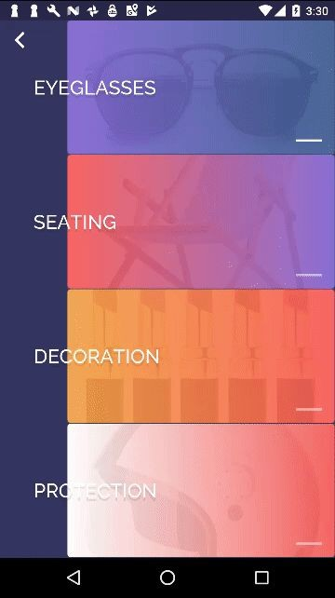
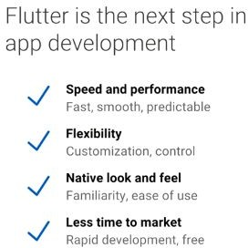

What Flutter is ?

Slide 15
Web App development
There are lot’s of framework is available now in the market e.g. Angular, React, VueJs etc.
For the development of GoNeedy web app we will use Angular 10.

Slide 16

Why Angular -
Develop and manage by Google team.
Because of huge community it’s very easy to get answer or solution for the complete problems.
Learning curve is very less if developer is aware of any server side technology like Java, C# etc as Angular uses Typescript internally. And later at the time of deployment to production typescript get transpiled to native javascript.
There is very good support with npm and bootstrap.

Slide 17
Time Estimates
Database
Server Infrastructure
Front – end
Mobile Applications – total 4 – 6 months.
Quotation – Will be submitted shared after we receive full project details.

Slide 18
Azure & AWS pricing site link
Azure pricing complete list
https://azure.microsoft.com/en-in/pricing/details/app-service/linux/
AWS pricing complete list
https://aws.amazon.com/ec2/pricing/

Slide 19
Thank you
Prepared by: Md Istiyak
Mob: +91-9100544384 Team BottomHalf

