Slide 1




Bioinfo matika
October 6th 2018

Slide 2
Content
Sequences – string
Library BioStrings
Central dogma of molecular biology
Transcription, translation, open reading frame (ORF)
__________________________________________________
Mutations
Distance/difference between two DNA sequences
__________________________________________________
Genomic ranges
__________________________________________________
Break
__________________________________________________
Final assignment: finding a motif in a bacterial genome

Slide 3
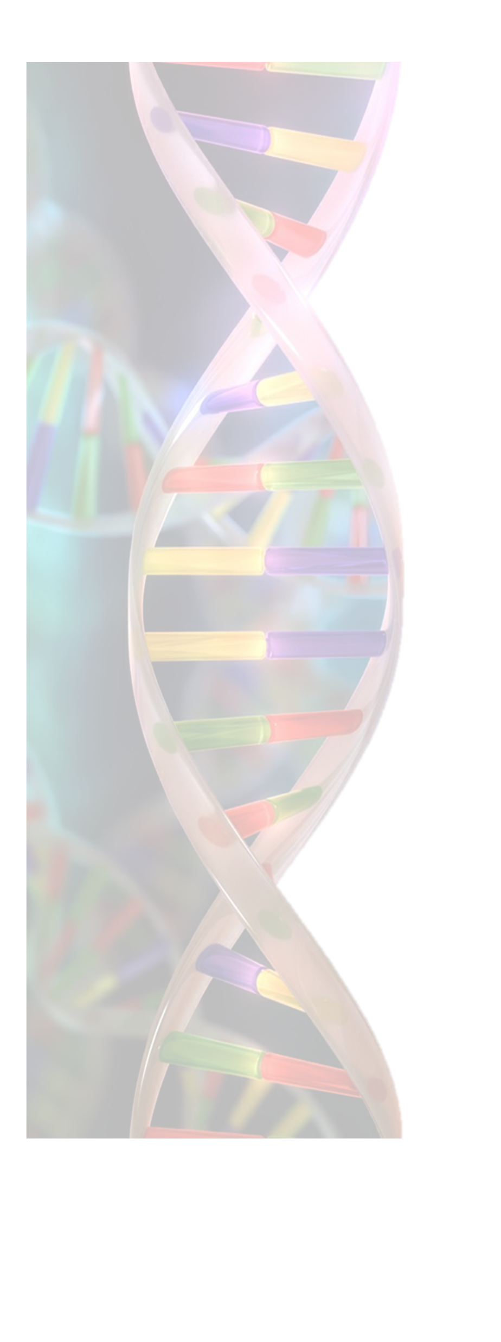
String
A sequence of characters (char)
s = “some text”
substring = substr(s, start, end)
1

Slide 4
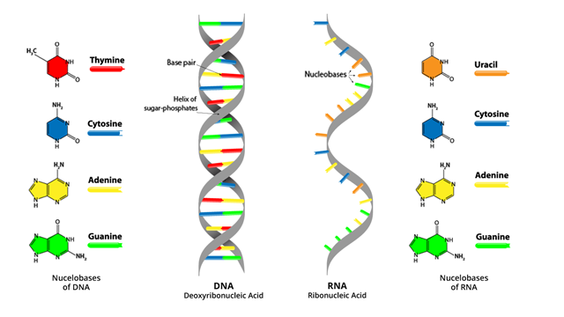
DNA/RNA/proteins
Source: www.technologynetworks.com
2

Slide 5
BioStrings
string = sequence
DNAString: DNA sequence
RNAString: RNA sequence
AAString: aminoacid sequence (proteins)
s = “ACGT”
DNAseq = DNAString(s)
Difference?
DNAString is a special data structure with its own methods
3

Slide 6
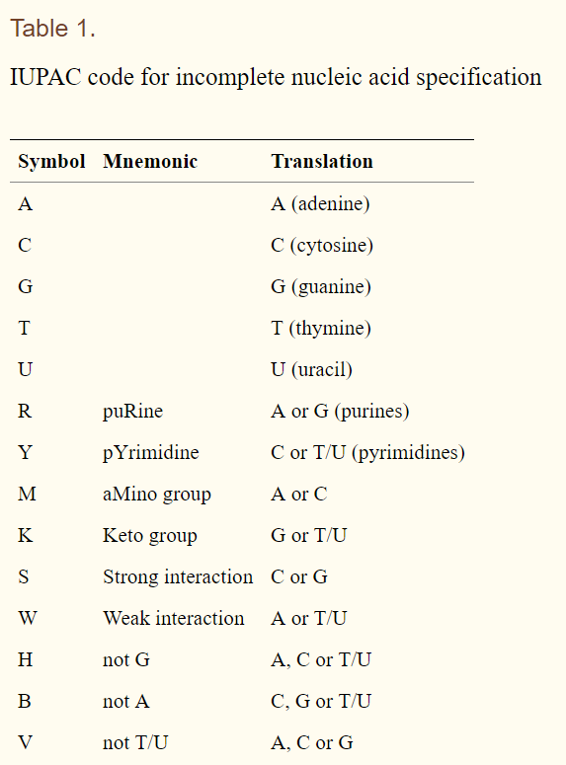
DNA String
IUPAC (extended)
"-" (the gap letter)
"+" (the hard masking letter)
"." (the not a letter or not available letter)
"*" (the stop letter)
4

Slide 7
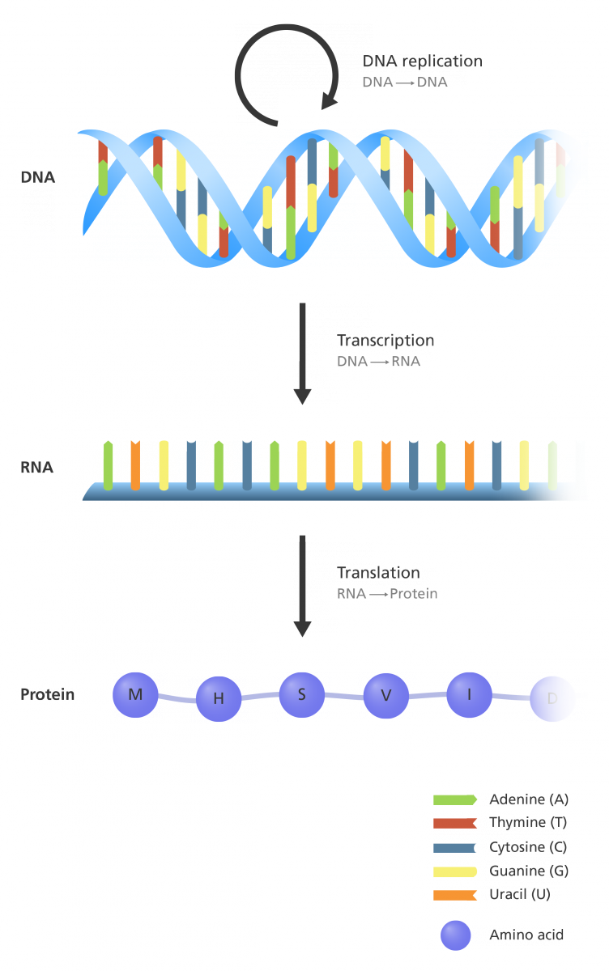
The central dogma of molecular biology
Useful functions:
reverse
complement
reverseComplement
translate
5

Slide 8
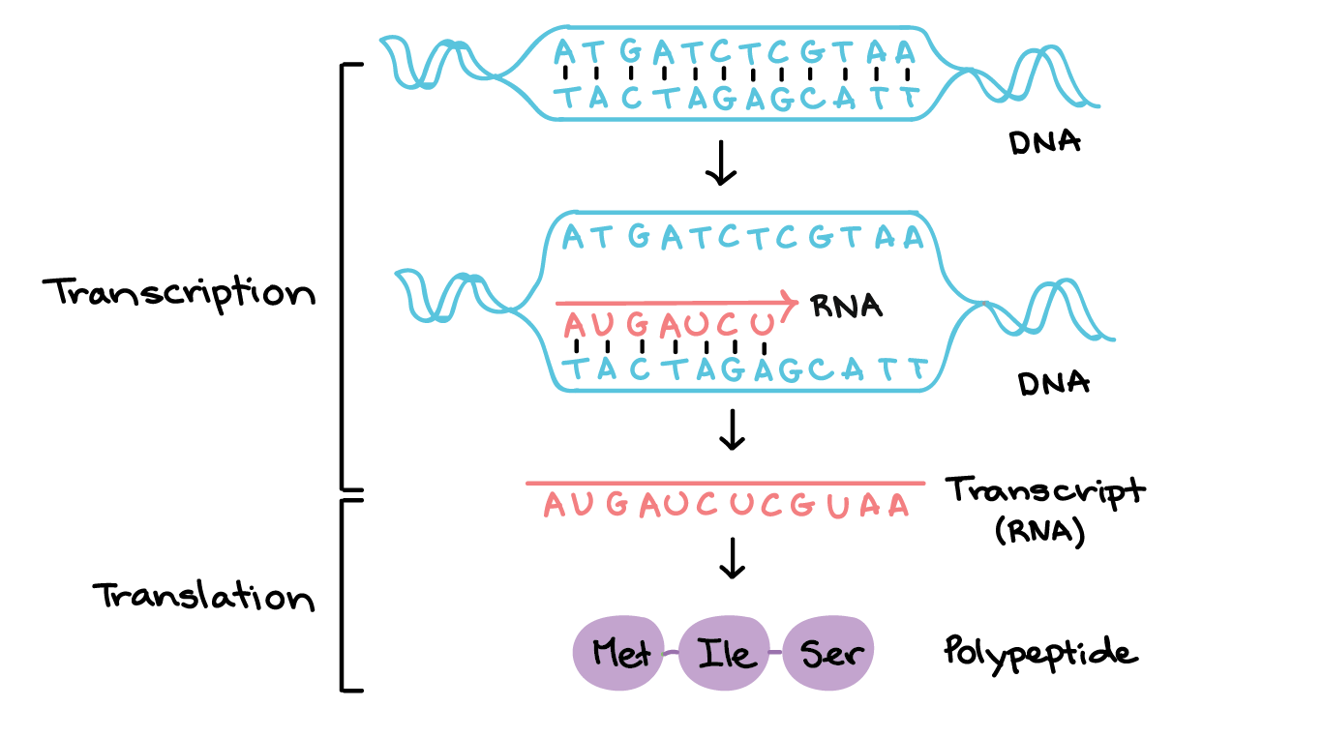
Transcription and translation
source: khanacademy
6

Slide 9
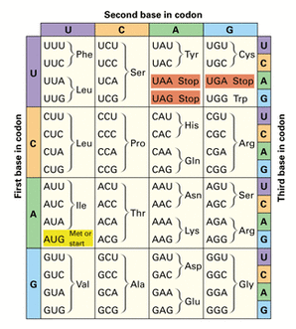
Genetic code
20 amino acids
64 codons
3 stop codons
source: geneticcontrolandproteinfunction.wordpress.com
7

Slide 10
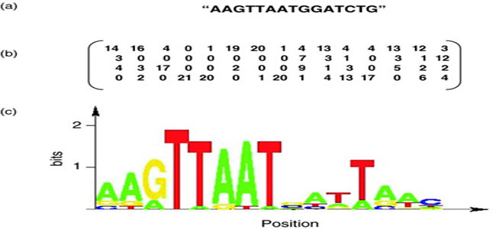
Motifs
The consensus sequence, position weight matrix and sequence logo of a motif
8

Slide 11
ORF
= open reading frame (a sequence of codons uninterrupted by a STOP codon)
There are 3 reading frames
ATGCAATGGGGAAATGTTACCAGGTCCGAACTTATTGAGGTAAGACAGATTTAA
9

Slide 12
The distance between two sequences
10

Slide 13
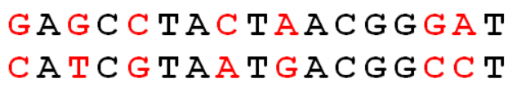
Hamming distance
For two sequences of equal length the number of diferring positions
11

Slide 14
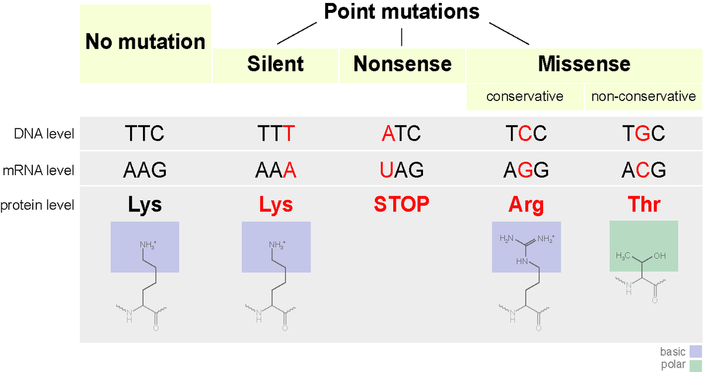
Point mutations
12

Slide 15
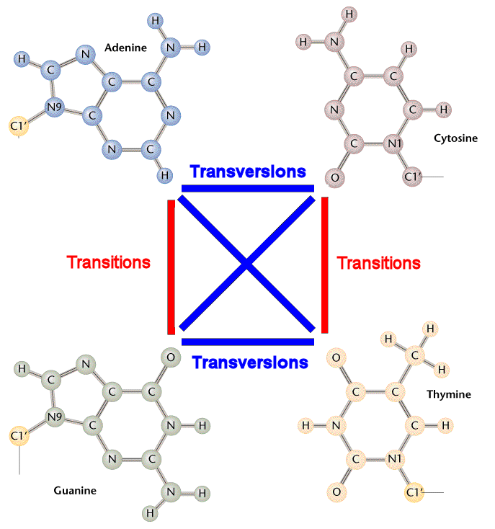
Transitions/transversions
Transition: between A and G, or. C and T
G → A or A → G
C → T or T → C
Transversions
G → T or C
A → T or C
C → A or G
T → A or G
13

Slide 16
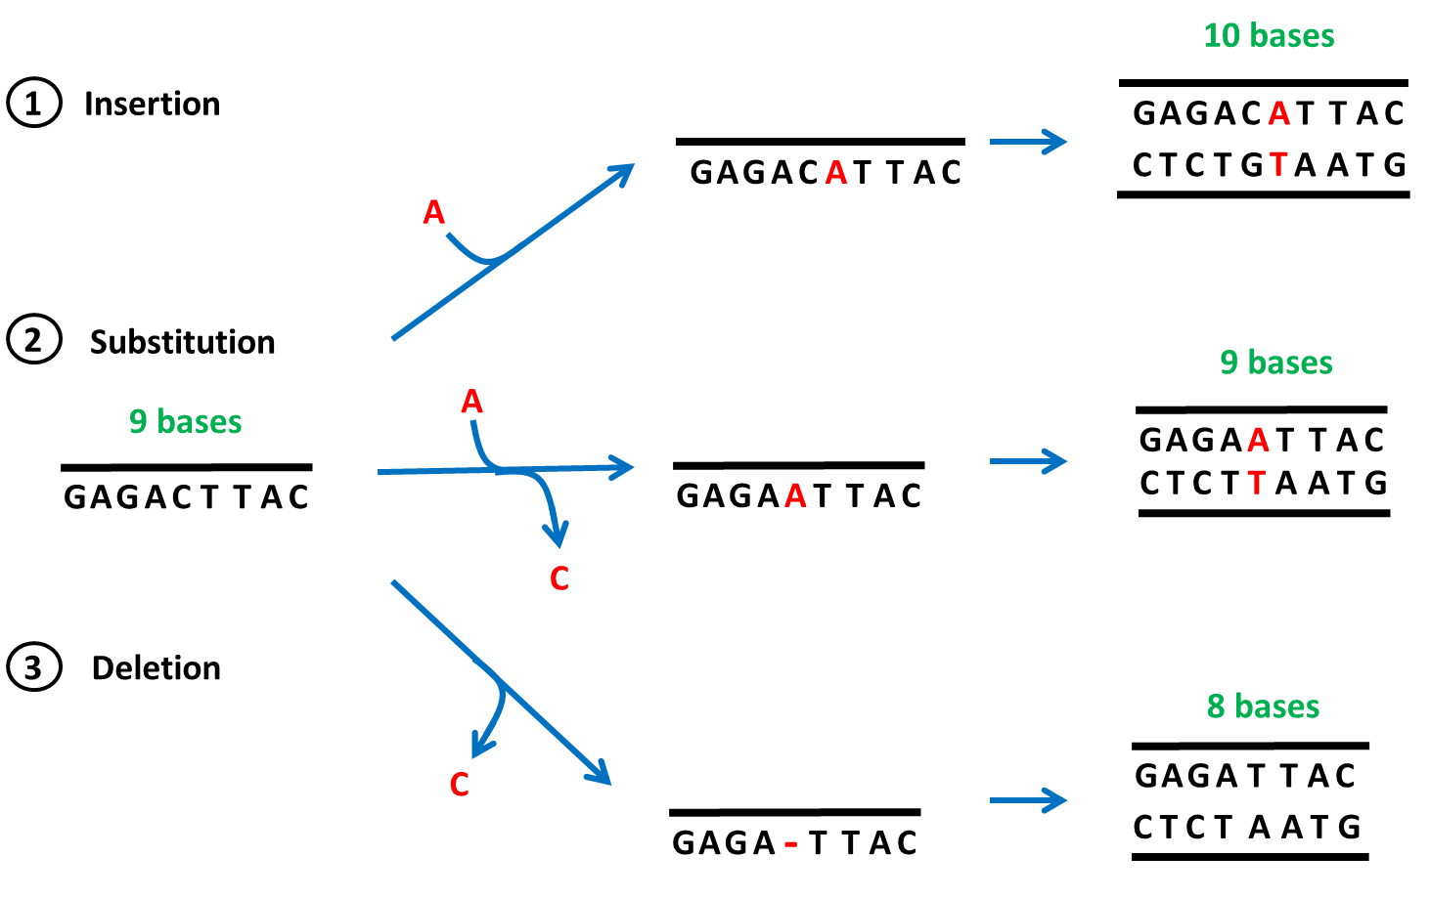
Mutations
Source: www2.le.ac.uk
14

Slide 17
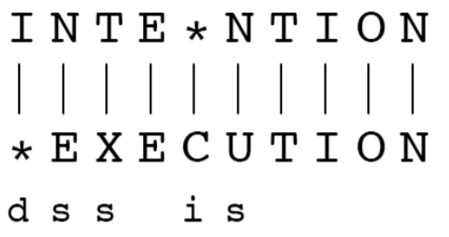
Edit distance
transforming sequences
transformation with the minimal number of changes
operations: insertions
deletions
supstitutions
operations get penalties
Levenshtein edit distance
15

Slide 18
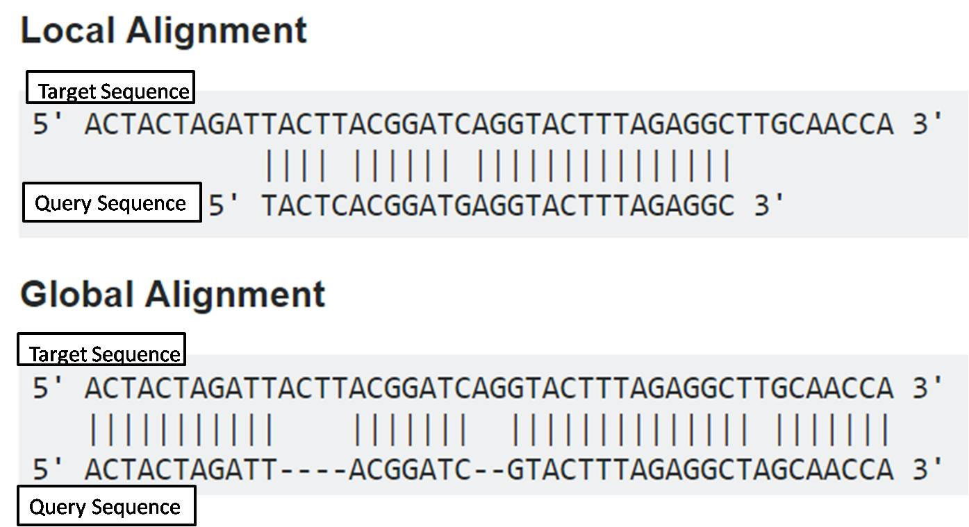
Used to align sequences
16

Slide 19
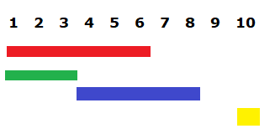
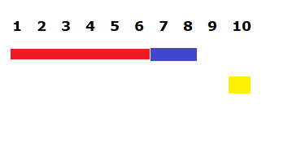
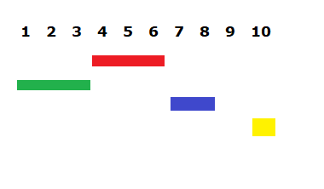
IRanges
reduce
disjoin
17

Slide 20
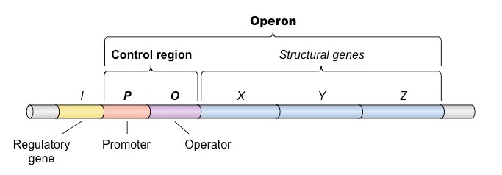
The E. coli genome
4.6 million nucleotides
4288 protein-coding genes
2584 operons
18

Slide 21
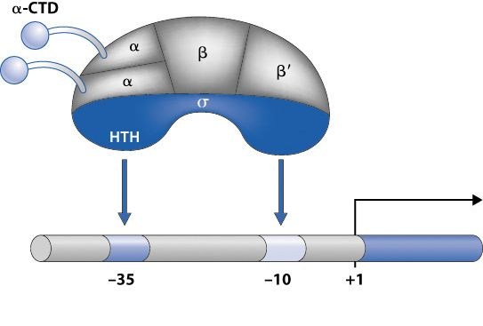
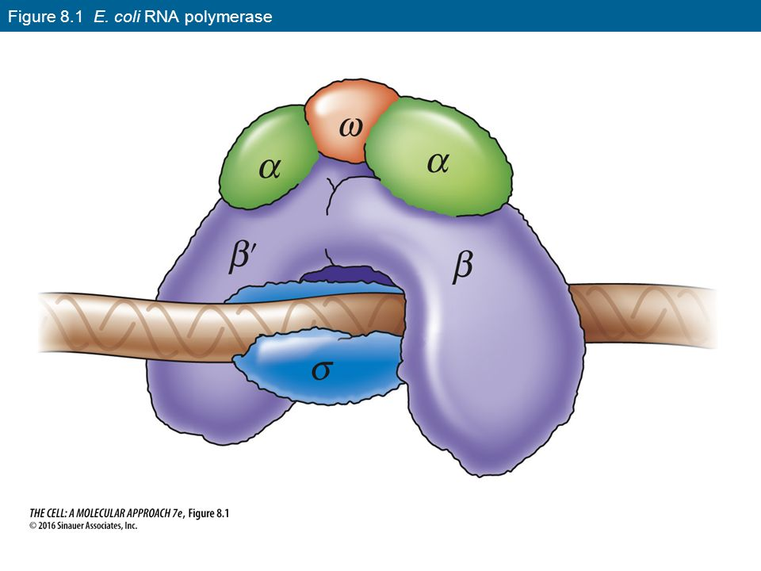
Transcription
Binding of the transcription initiation complex to the promoter
19

Slide 22
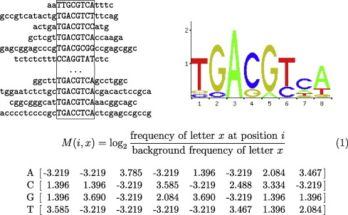
Final assignment
Discovering a motif:
left - a multiple sequence alignment
right - a motif logo
down - logarithmic position weight matrix
20

Slide 23
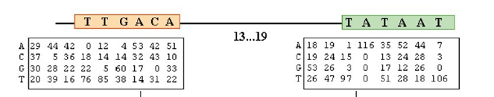
Final assignment
The consensus sequences (TTAGACA and TATAAT) and the position weight matrices for the two motifs in the sigma70 binding site
21

Slide 24
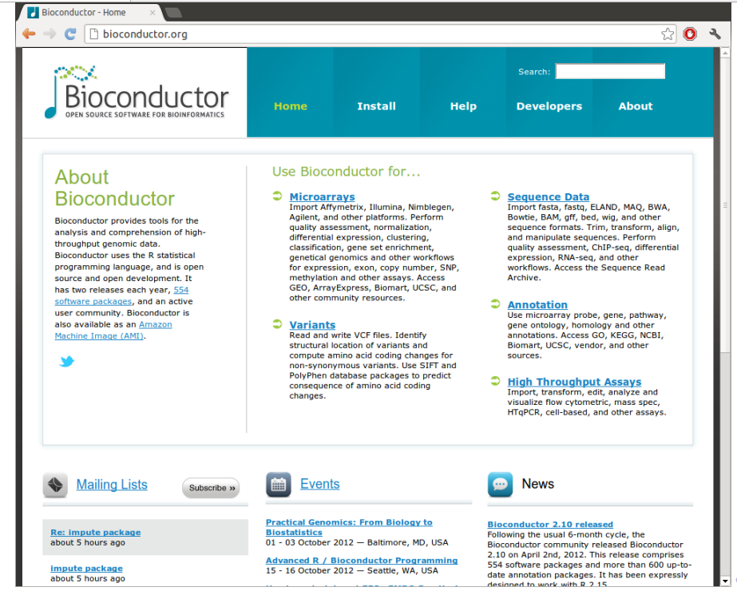
22

