Slide 1

Analysis of the dashboard viewing users
Isura Nimalasiri

Slide 2
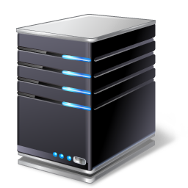



1
User Traffic Analysis/ Server Hits
Dashboard Usage
Active Users
User Domain Analysis
User Territory Analysis
User Engagement Time
2
3
4
6
5

Slide 3
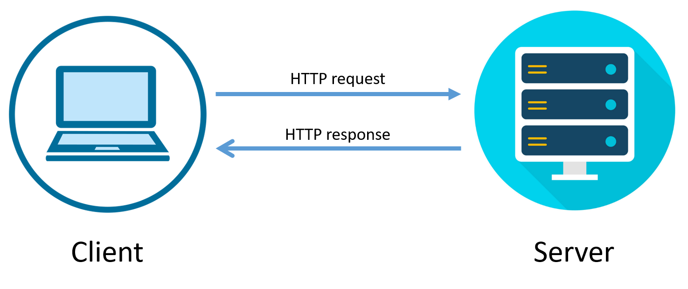

Success Request
======================
Status 500 Request
======================
Top 3 dashboard
+------------+---------------------------+--------------+
|request_year|dashboard_id |error_requests|
+------------+---------------------------+--------------+
|2019 |marketing-channel-overview |92 |
|2020 |marketing-awin-scorecard |24 |
|2019 |weekly-overview |7 |
|2019 |marketing-dis-ret-scorecard|4 |
Validity of Requests
200 - Success
500 - Internal Server Error
+------+---------------------+
|status|sum(user_event_value)|
+------+---------------------+
|200 |171030 |
|500 |143 |
+------+---------------------+

Slide 4
User Traffic Analysis/ Server Hits

Slide 5
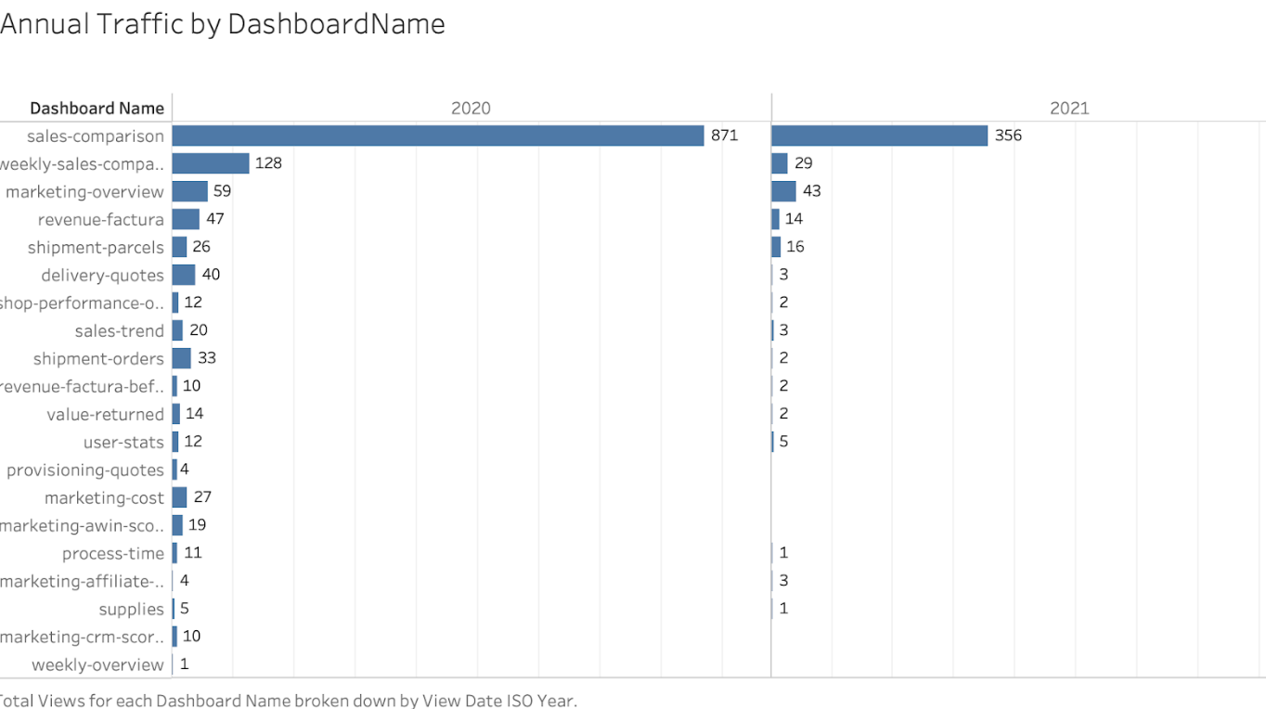

Slide 6
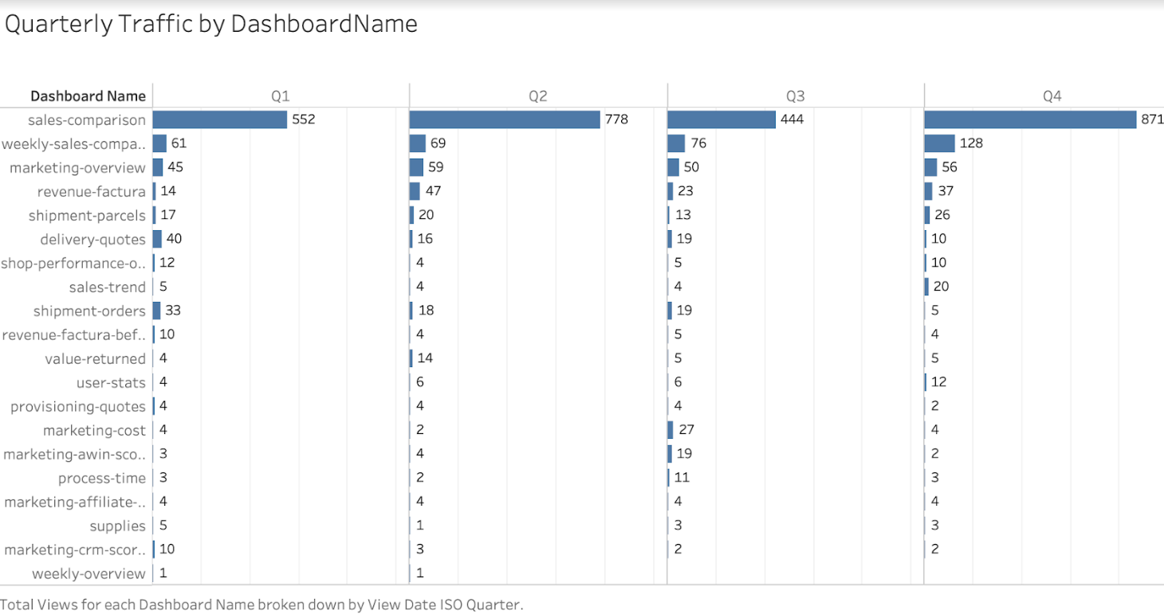

Slide 7
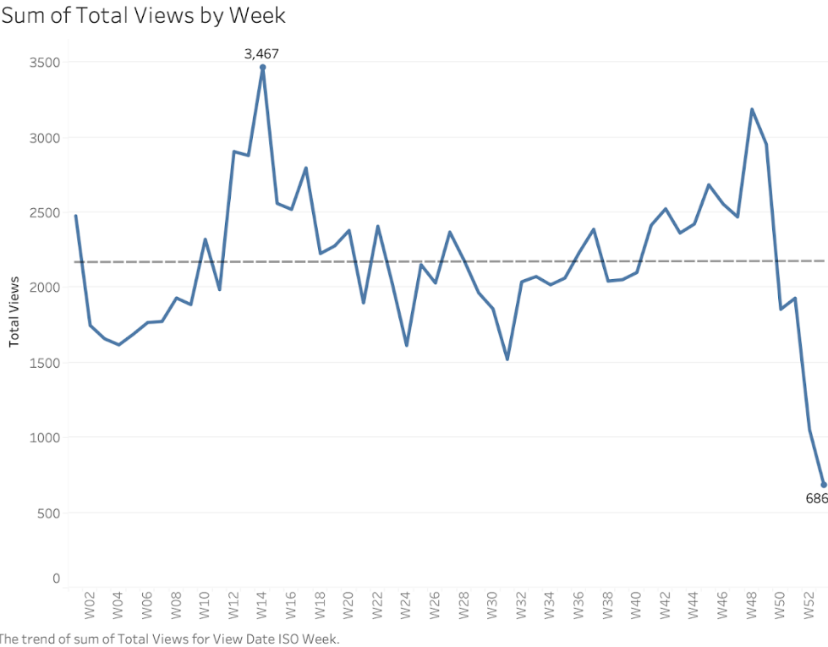

Slide 8
Active Users

Slide 9
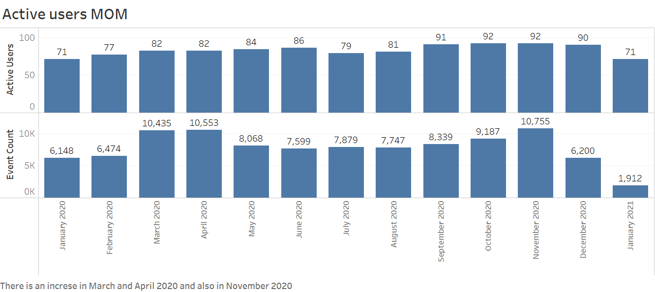

Slide 10
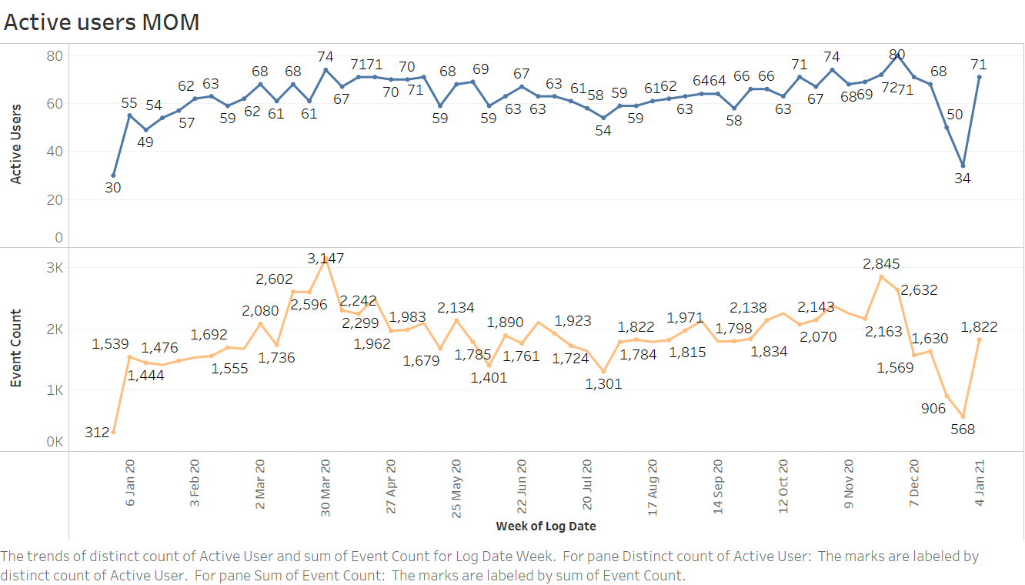

Slide 11
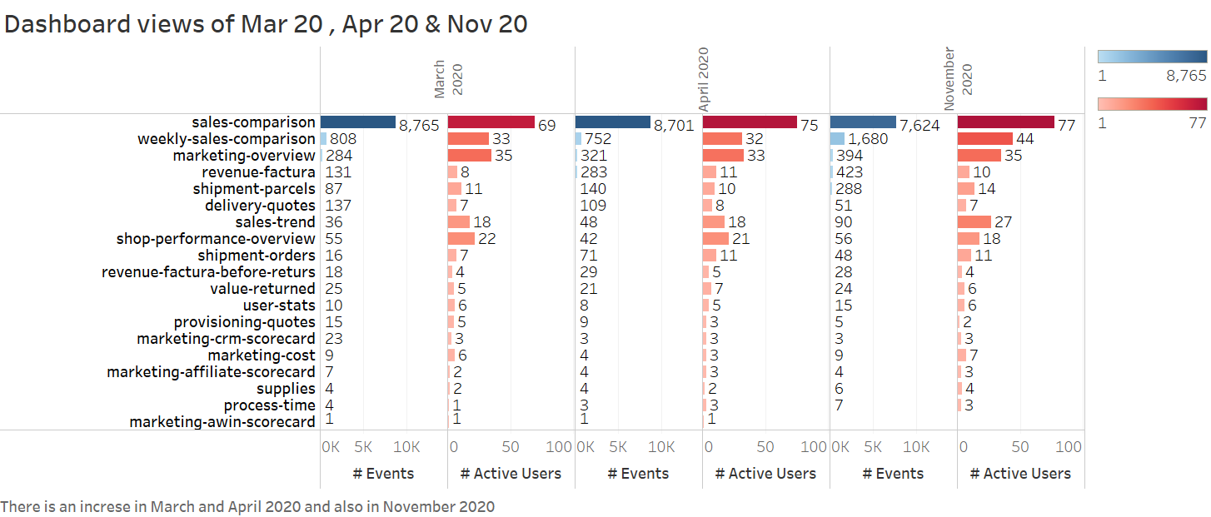

Slide 12
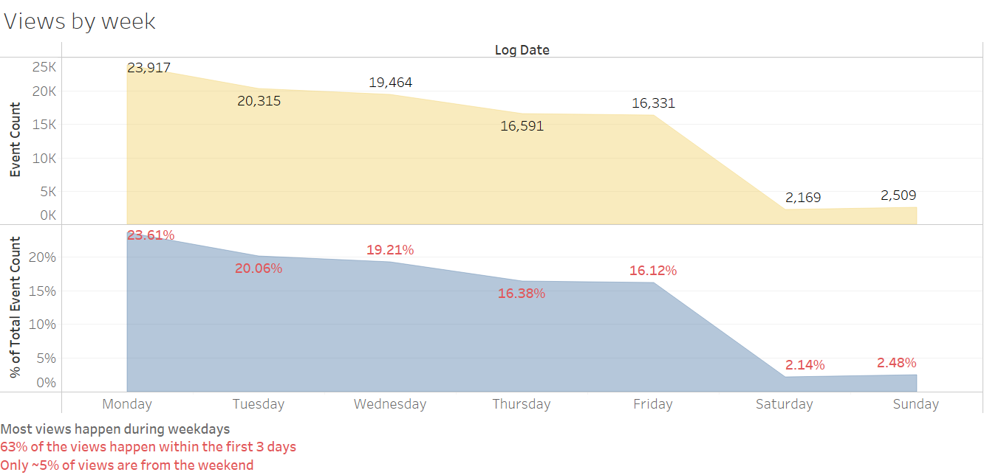

Slide 13
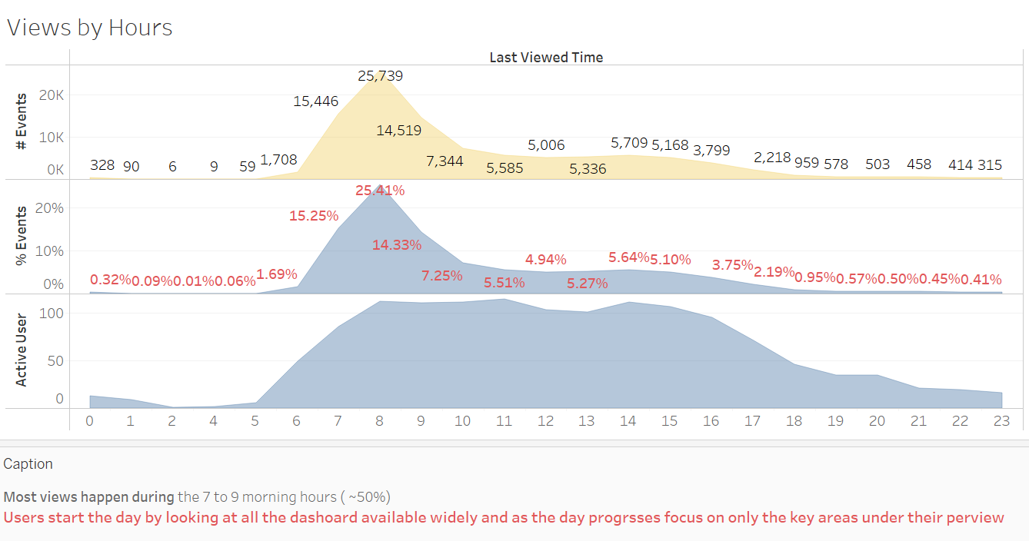

Slide 14
Dashboard Usage

Slide 15
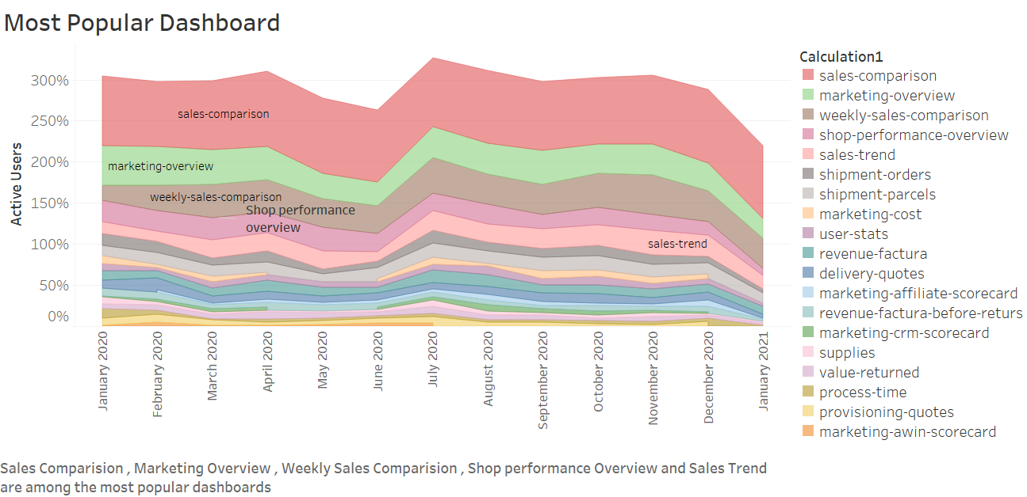

Slide 16
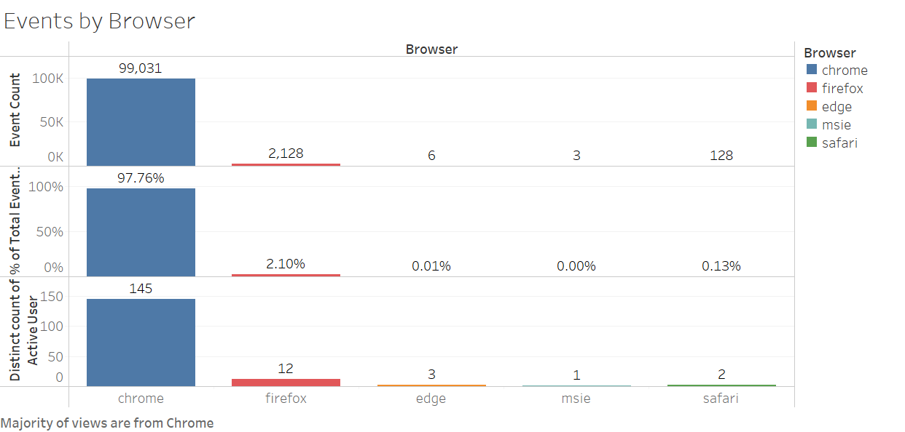

Slide 17
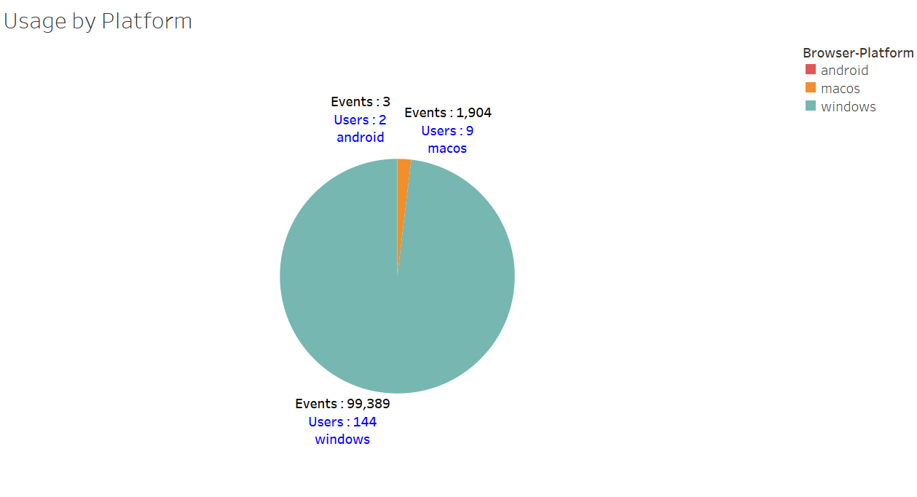

Slide 18
User Engagement

Slide 19
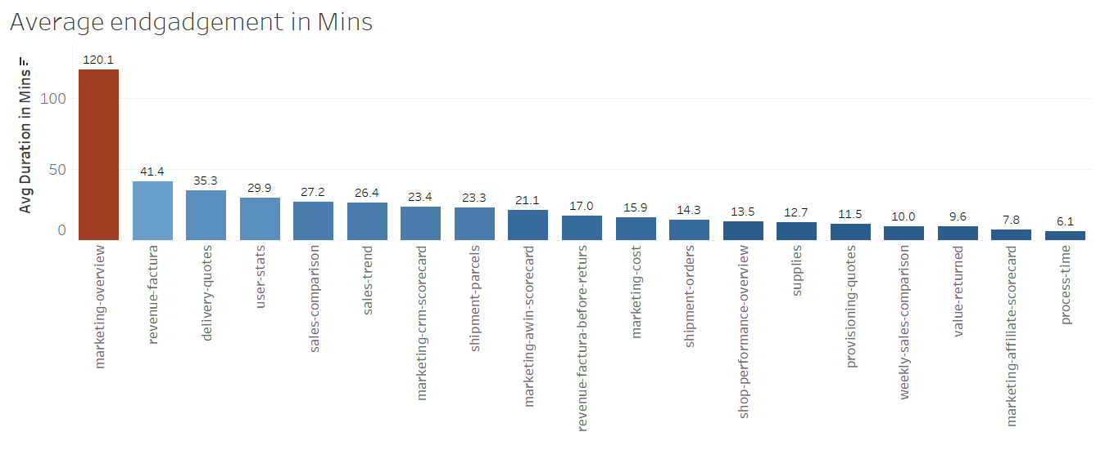

Slide 20
User Domain Analysis

Slide 21
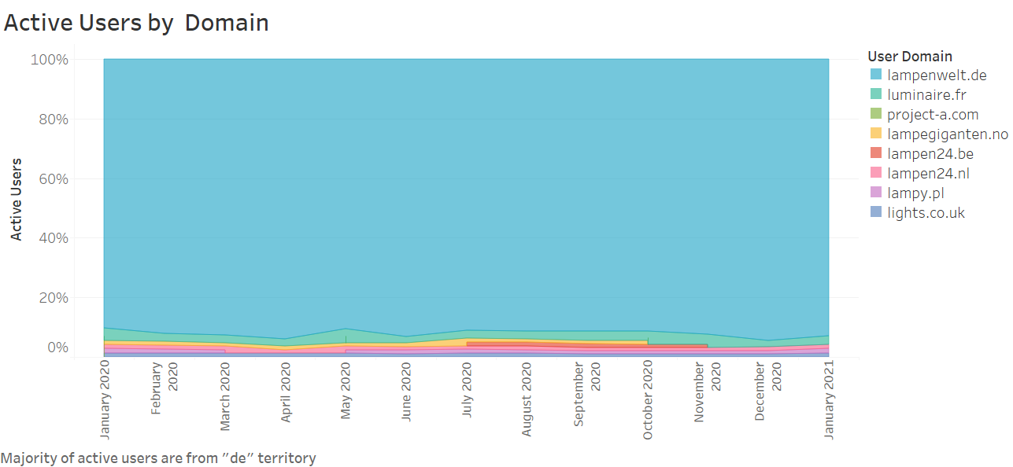
Majority of active users are from "lampenwelt.de“ domain

Slide 22
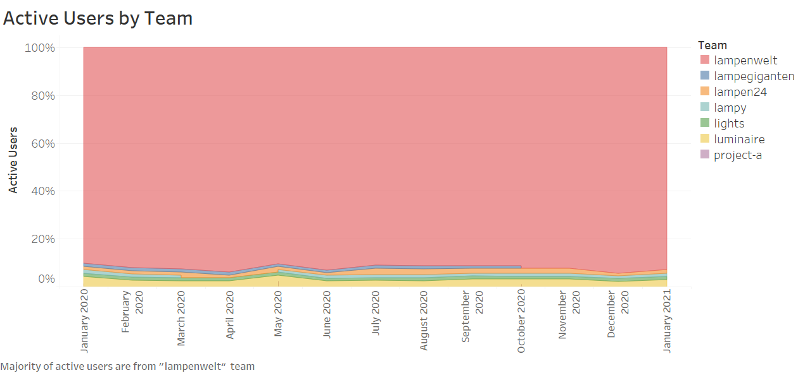

Slide 23
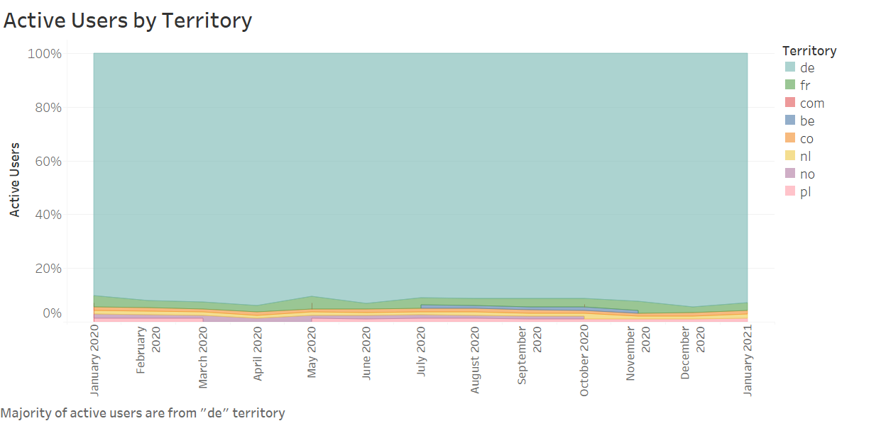

Slide 24
End

