Slide 1
ECMS
13
Core Modules
Enhanced Consultant
Management System
5
App Screens
A Mobile-First Healthcare Platform for
Sri Lankan Medical Consultants
3
Languages
I.G.I. Chathuranga · S16847
H.J. Jayawardhana · S16842
G.S. Vignesh · S16763
C.M.D.D. Silva · S16743
M.V.T. Lakruwan · S16989
5
Team Members
Supervised by Dr. Prabhath Liyanage · IT 3008 IT Seminar · 2026

Slide 2
The Problem
Why Sri Lanka's healthcare system needs ECMS
📋 Paper-Based Workflows
💊 Unsafe Prescribing
Consultants still rely on handwritten prescriptions, manual scheduling, and physical patient files that cannot be accessed at the point of care.
Patient allergy history and past prescriptions are inaccessible at consultation, creating risk of harmful drug interactions.
🌐 No Unified Platform
💰 Manual Revenue Tracking
No single system integrates appointments, prescriptions, patient history, and payments for Sri Lankan consultants.
No digital financial records — consultants manually track fees, resulting in errors, disputes, and no analytics.
🗣️ Language Barriers
Existing systems support only English — excluding the majority of doctors and patients who communicate in Sinhala or Tamil.
• 56.3% internet penetration
• 47% smartphone ownership
• 80.6% rural population
• 1,700 medical professionals emigrated in 2022–23

Slide 3
Our Solution
One app. Every workflow. Every language.
ECMS is a fully integrated, role-based mobile platform that handles the complete consultant lifecycle — from appointment scheduling and QR-based patient check-in, to voice-powered e-prescriptions in Sinhala, Tamil, and English, real-time payment processing, and daily earnings analytics.
🎤
📱
💳
📅
Voice Rx
QR Check-in
Payments
Scheduling
Speak prescriptions in Sinhala, Tamil, or English — NLP converts to digital format instantly
Encrypted unique QR per patient — scan on arrival to load full medical history & alerts
PayHere & Stripe integration, eZcash/mCash support, auto invoices, digital receipts
Set slots, lock sessions, block dates — hospital and patient notified automatically

Slide 4
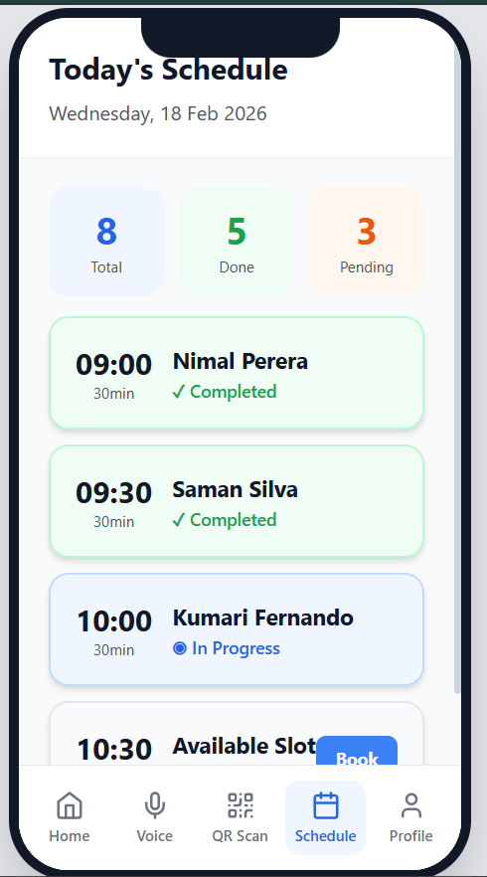
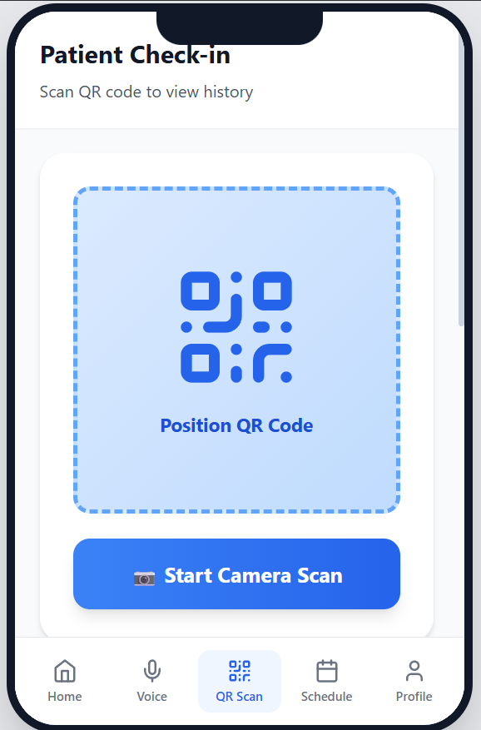
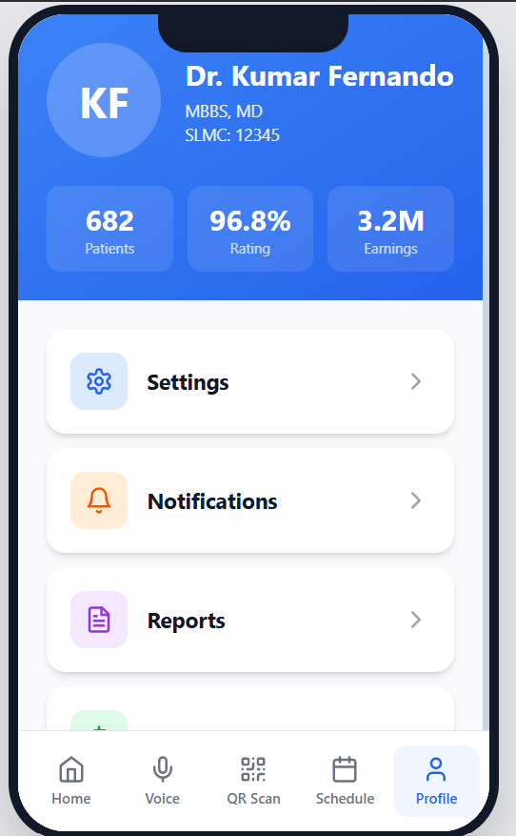
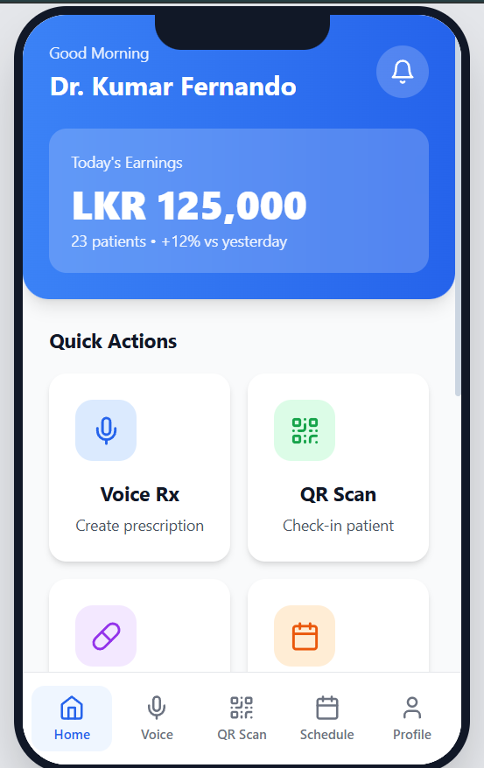
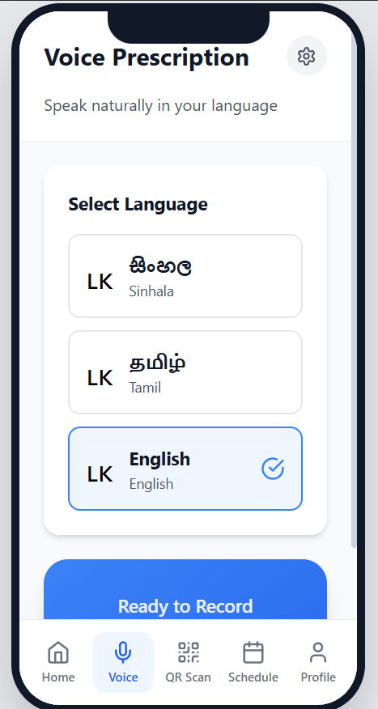
Mobile App — 5 Interactive Screens
Built with React · Tailwind CSS · Lucide Icons
Home Dashboard
Voice Prescription
QR Check-in
Daily Schedule
Doctor Profile
Earnings & quick actions
Multilingual speech-to-Rx
Encrypted patient records
Colour-coded slots
Stats & settings

Slide 5
Screen 1 — Home Dashboard
Real-time earnings, patient queue, and quick actions at a glance
1. Earnings Header
Real-time today's earnings (LKR 125,000), patient count, and daily percentage change vs yesterday.
2. Quick Action Cards
4 contextual action tiles — Voice Rx, QR Scan, Medicine DB, and Schedule. Single tap to navigate.
3. Patient Status Queue
Today's patient list with name, time, ID, and live status badges: Waiting, Done, or Next.
4. Weekly Revenue Chart
Mini bar chart summarising 7-day earnings. Total LKR 735,000 with 8% week-on-week growth indicator.

Slide 6
Screen 2 — Voice Prescription
Sinhala · Tamil · English | Real-time speech-to-text | Medical NLP
Voice-to-Prescription Pipeline
🎤 Voice Input
🔊 STT Engine
🧠 Medical NLP
📄 Rx Draft
1. Language Selector
Three large tap-friendly buttons for Sinhala (සිංහල), Tamil (தமிழ்), and English. Selected language is highlighted with a checkmark.
2. Animated Waveform
Live CSS waveform animation provides visual feedback while the microphone is active — confirms recording is in progress.
3. Generated Prescription
Converted output shown in a monospace block with drug name, dosage, frequency, and duration — ready to review.
4. Approve & Send
One-tap approval sends the prescription to the hospital pharmacy system and the patient's phone simultaneously.

Slide 7
Screen 3 — QR Patient Check-in
Encrypted patient QR | Instant record access | Allergy alerts
1. Camera QR Scanner
Full-viewport camera preview with real-time QR detection. Tap once to activate — no manual ID entry needed.
2. Patient Record Card
Instant card loads with name, ID, age, blood type, and a ✓ Verified badge — pulled from the encrypted QR payload.
3. Allergy Warning Panel
Critical drug allergies (e.g. Penicillin, Sulfa) displayed in a high-contrast red alert block, impossible to overlook.
4. Consultation History
Last three visits with date and reason — scrollable. Tap any row to load the full prescription from that visit.

Slide 8
Screens 4 & 5 — Schedule and Doctor Profile
Daily appointment management and consultant credentials hub
Schedule
3 stat cards — Total, Done, Pending with colour coding
Appointment rows colour-coded by status: ✓ done, ◉ in-progress, ○ upcoming
Book button on empty slots for walk-in additions
30-minute time slots displayed with patient name
Doctor Profile
Credentials card: MBBS, MD, SLMC registration number
3 live stats: 682 patients · 96.8% rating · LKR 3.2M earnings
Navigation to Settings, Notifications, Reports, Payments
Security and Analytics sub-sections

Slide 9
13 Core Modules
Complete feature specification — system design and documented
📅
📋
🏥
💊
📝
Schedule Mgmt
Appointments
Medical Records
E-Prescriptions
Clinical Docs
Set/block/lock slots, auto-notify
Track, mark, add emergency
Prescriptions, labs, history
Digital Rx to phone & pharmacy
Notes, lab requests, follow-ups
🔔
🔒
💳
📊
🎤
Notifications
Security
Payment Collection
Transaction Dash
Voice Command Rx
Reminders, cancellations, alerts
Login, digital signatures, RBAC
Cash, card, eZcash, mCash
Revenue charts, export PDF/Excel
3 languages, templates, auto-fill
💉
📱
🌐
Medicine DB
QR Patient History
Payment Gateway
Drag & drop, search, dosage
Encrypted QR, offline access
PayHere, Stripe, PCI-DSS

Slide 10
Technical Implementation
Stack · Architecture · Security Model
3-Tier Architecture
Tech Stack
Mobile App Layer
Frontend
Backend
React Native / React · Tailwind CSS
React Native
React 18
Tailwind CSS
Lucide Icons
Node.js
REST API
JWT
AES-256
↓ HTTPS / REST
API Server
Node.js · REST API · JWT Auth
↓ HTTPS / REST
Payments
Voice/AI
Data Layer
PayHere (SL)
Stripe
eZcash
PCI-DSS
Google STT
OpenAI Whisper
Medical NLP
PostgreSQL / MySQL · AES-256 Encrypted
🔒 Encrypted QR Codes · Digital Prescription Signatures · Role-Based Access Control · PCI-DSS Compliant · GDPR Compliant

Slide 11
Payment & Financial Module
PayHere (Sri Lanka) · Stripe (International) · eZcash / mCash · PCI-DSS Compliant
Simulated Weekly Revenue (LKR)
💳 Multi-Method Payments
Cash, card, and mobile wallets (eZcash, mCash) all handled within the same session checkout.
💳 Fee Breakdown
Consultation fee, service charges, and platform commission (10–15%) shown as itemised line items.
💳 Transaction IDs & Receipts
Every payment generates a unique transaction ID and sends a digital receipt to the patient instantly.
💳 Payment Status Tracking
Each transaction carries a real-time status: Pending, Completed, or Failed — filterable in the dashboard.

Slide 12
Results & Research Context
What we built · What the research confirmed
Prototype Outcomes
IT Seminar Research Findings
✓ 5 fully interactive mobile screens built in React
2M+
appointments/year on Doc990 platform — validates market demand
✓ 13 functional modules designed and documented
9.5M
patients on HHIMS across 100 state hospitals — scale of need
✓ User flows validated with mock patient & consultant data
✓ Multilingual UI — Sinhala, Tamil, English
47%
smartphone ownership — justifies multi-channel access design
✓ Payment gateway architecture designed (PayHere + Stripe)
✓ QR encryption model documented with GDPR compliance
85%
of pilot hospitals reported improved care quality with digital records

Slide 13
Future Development Roadmap
Phase-based approach from prototype to production
Phase 1
Phase 2
Phase 3
0–6 months
6–12 months
12–24 months
Live STT via Google Cloud Speech / OpenAI Whisper
Hospital EHR system connectivity
SLMC API — real-time doctor verification
Telemedicine module with auto-consultation notes
AI drug interaction checker in medicine DB
Offline-first architecture for low-connectivity areas
Wearable data import (BP, glucose for chronic care)
Multi-hospital / multi-consultant central admin
Full OPD digitization and government hospital integration
Expected outcomes: 30–40% reduction in pharmacy queues · Patient record access in seconds vs 15 minutes · Full trilingual practice management

Slide 14
Thank You
Questions & Discussion
Group 02 — IT 3008 IT Seminar
Supervised by Dr. Prabhath Liyanage
I.G.I. Chathuranga (S16847)
H.J. Jayawardhana (S16842)
G.S. Vignesh (S16763)
C.M.D.D. Silva (S16743)
M.V.T. Lakruwan (S16989)

