Slide 1



Business Analytics Implementation at JJ Trading
Presentation By :
Group 08

Slide 2

Group Members
Student Name | Index No
K.L.D Nayanamini | 22708
K G K P Premalal | 22760
R G I S Senarathne | 22742
K.H.M.S. Dilshani | 22746

Slide 3
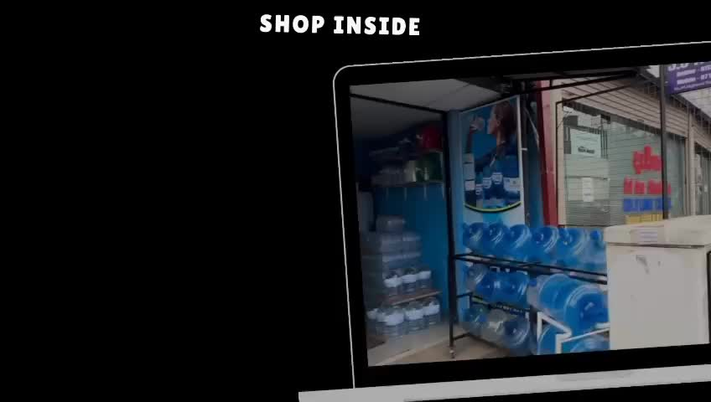
Company Overview
JJ Trading is a bottled water distributor in Homagama, Sri Lanka, offering its own brand (JJ Bottles) and other brands like Crystal and Elephant House.
Caters to B2B clients (shops, offices) and B2C customers (households, individuals).
Operates with a small team managing distribution, warehousing, and customer relations.
The company offers a wide range of bottled water in various sizes, including 500ml, 1.5L, 5L, and 20L bottles.

Slide 4
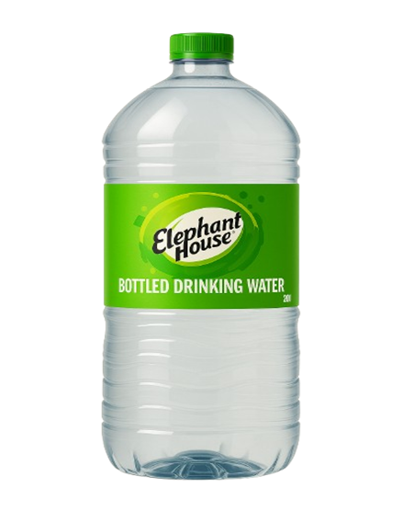


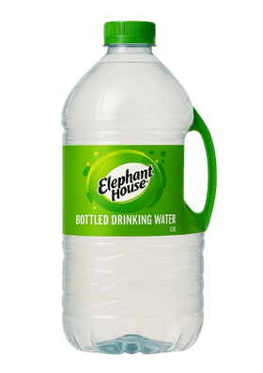

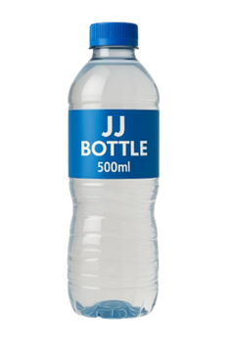
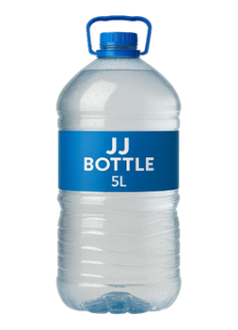
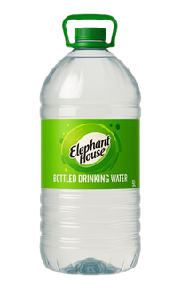
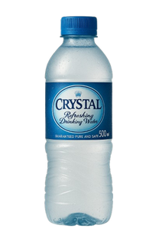
Product Portfolio
JJ Bottle
Crystal
Elephant House

Slide 5

How we Gather Data?
Employee Interviews
we interviewed staff members involved in stock management and order fulfillment to understand their daily challenges
Process Observation
we directly observed the ongoing processes at JJ Trading, which helped us identify inefficiencies in inventory organization and order processing
Discuss with Management
we had conversations with the manager and key employees, they helped us understand main business problems impacting the company’s performance.

Slide 6
Identify Business Problems
1. Manual Stock Counting and Order Processing
2. Difficulty in Forecasting Stock Requirements
Main Business Problems
3. Limited Storage Space and Inefficient Organization
4. Data Security and Inaccuracy Risks

Slide 7
Analytics Type used to Solve the Problem
Descriptive
Diagnostics
Predictive
Prescriptive
Damage rates by supplier, analyze sales losses due to product damages, and understand the difference in performance between brands.
Prescriptive this type of analytics to recommend future stock levels (in liters), suggest supplier shifts based on damage rates, and identify underperforming products and areas for promotional campaigns.
Total sales, total profit, total bottles sold, and the top-performing products and categories.
predictive type of analytics use to identify historical trends to forecast upcoming events or behavior.

Slide 8
DATA AND METHOD USED
JJ_Trading_Sales_Data.xlsx: This file contained structured sales transaction records, including product, quantity, selling price, date, and customer details.
JJ_Trading_Customers.xlsx: This dataset included information about customers, such as names and addresses in areas like Homagama, Kottawa, Pitipana, and Maharagama.
JJ_Trading_Suppliers.xlsx: This file listed supplier information, including supplier names and the brands they supplied (e.g., Elephant House, Crystal, JJ Bottles).
JJ_Trading_Distributor_Shipments.xlsx: This dataset captured stock received from
Main Business Problems
Here we have uploaded Data set , which we used
JJ Trading Excel Data Set – Google Drive

Slide 9
Data Preprocessing Steps
Source Connection – Connected the Excel file to Power BI and loaded the Sales_Data sheet.
Promoted Headers – Converted the first row of the dataset into column headers.
Data Type Changed – Assigned correct data types to each column (Ex: text for product names, decimal for prices, date for the transaction date).
Removed Errors – Filtered out any rows that contained data type or formula errors.
Removed Duplicates – Removed any duplicate sales records based on Order ID or full row values.
Removed Blank Rows – Deleted rows where all fields were empty to keep the dataset clean.
Replaced Values – Performed a several of value replacements:
Removed Unnecessary Columns

Slide 10
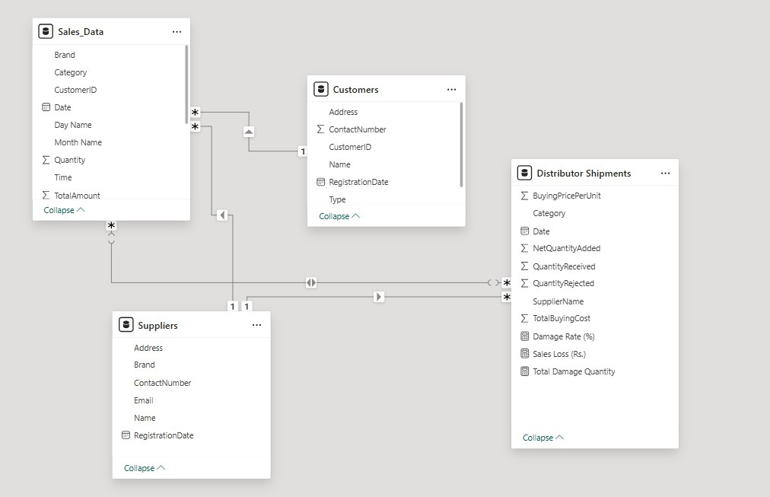
Model View Architecture

Slide 11
Power BI
Python
Tools & Software Used
Streamlit

Slide 12
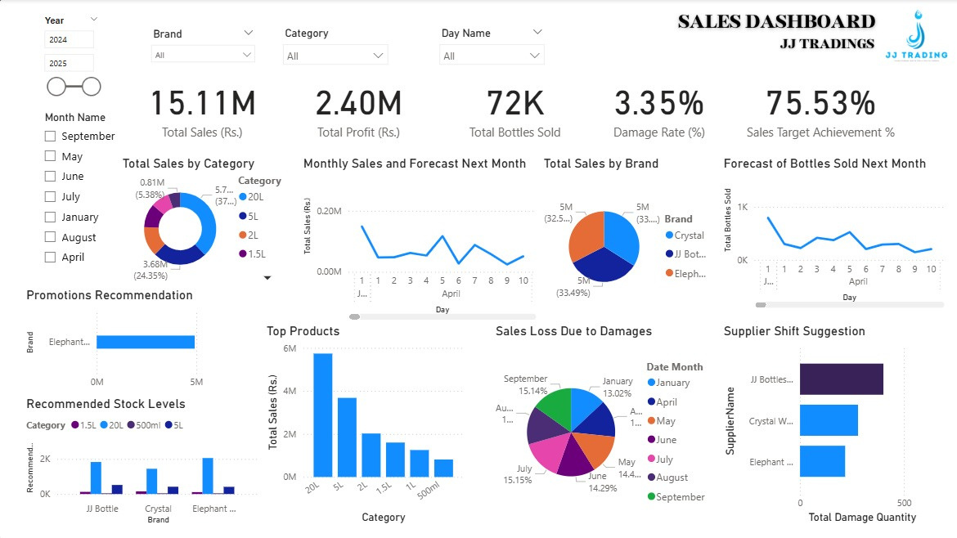
Power BI Implementation

Slide 13


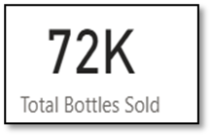

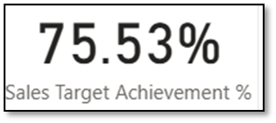
Analytics Types
DESCRIPTIVE ANALYTICS

Slide 14
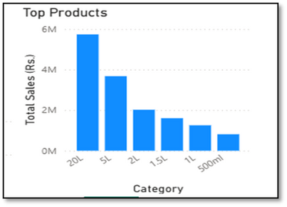
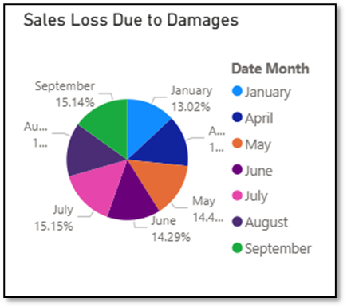
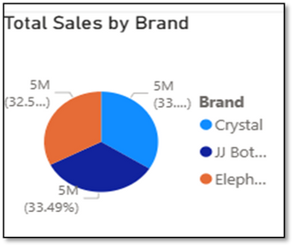
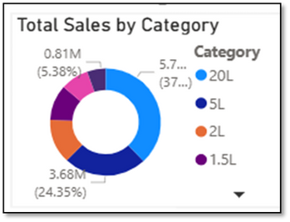
Analytics Types
DESCRIPTIVE ANALYTICS
DIAGNOSTIC ANALYTICS

Slide 15
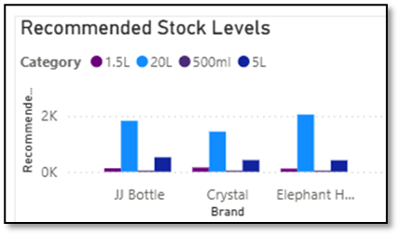
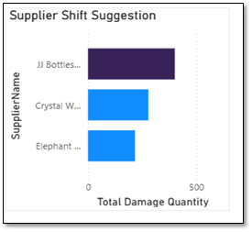
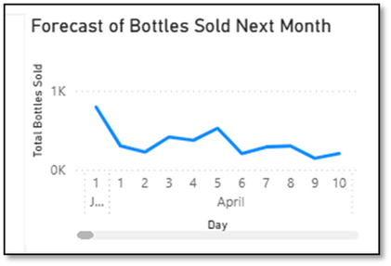
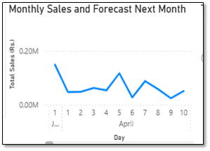
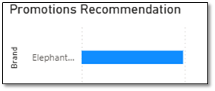
Analytics Types
PREDICTIVE ANALYTICS
PRESCRIPTIVE ANALYTICS

Slide 16
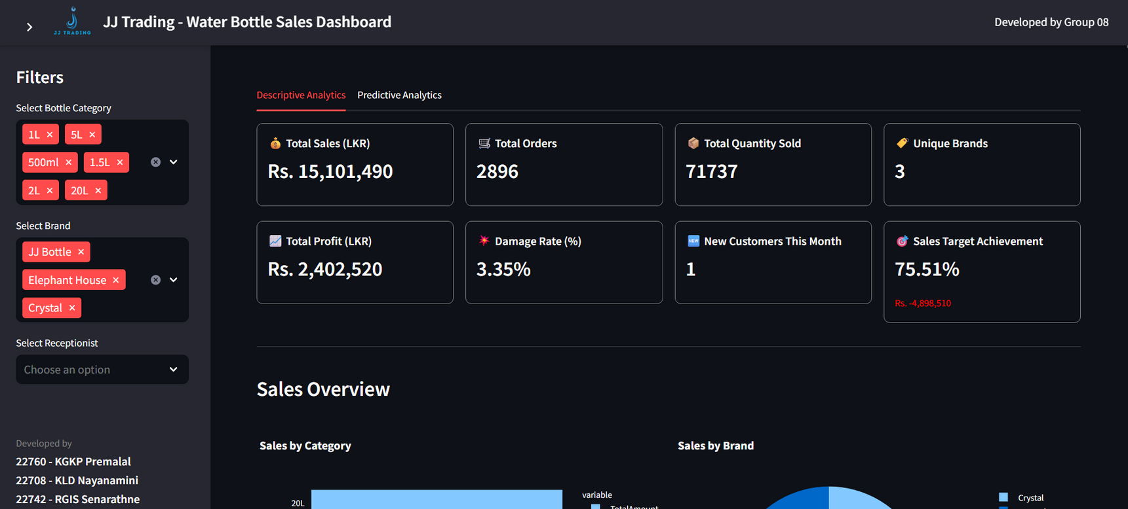
Python Implementation

Slide 17
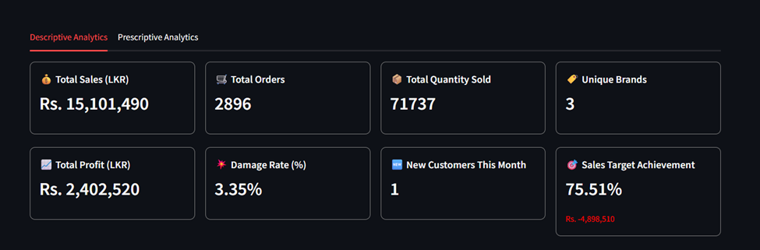
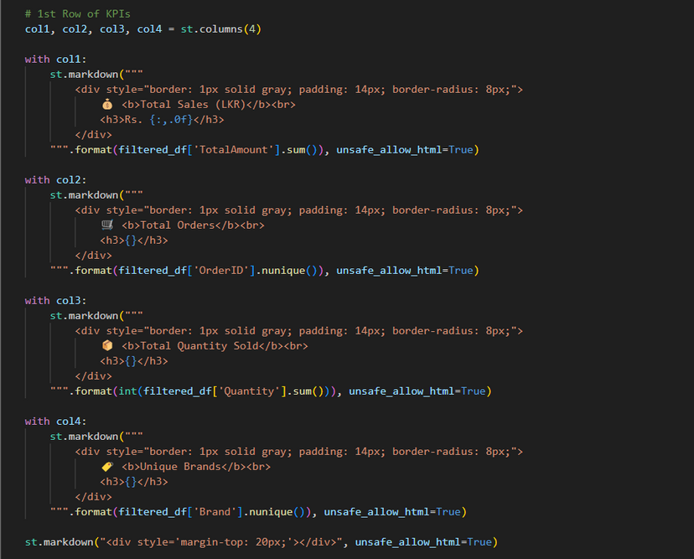
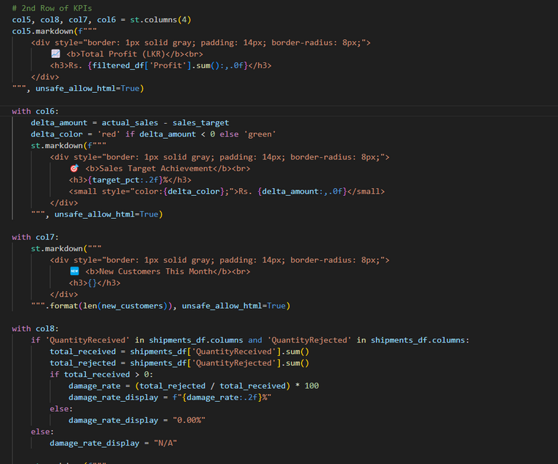
DESCRIPTIVE ANALYSIS
KPI

Slide 18
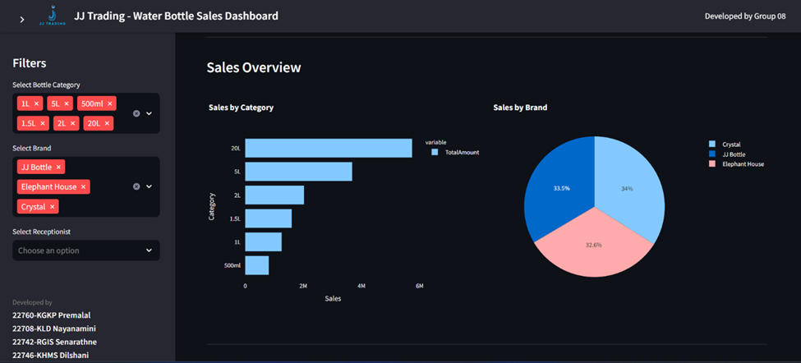
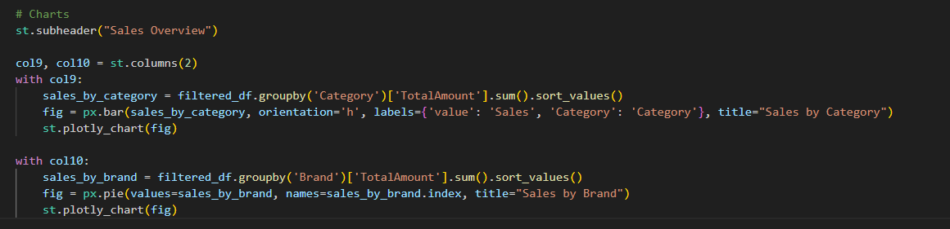
DESCRIPTIVE ANALYSIS
Sales Overview

Slide 19
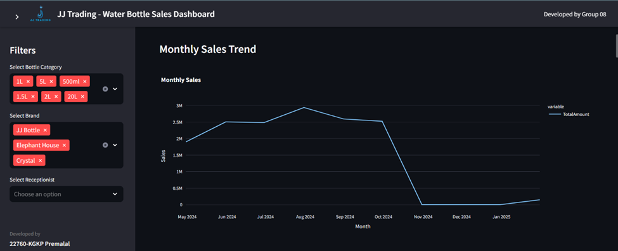
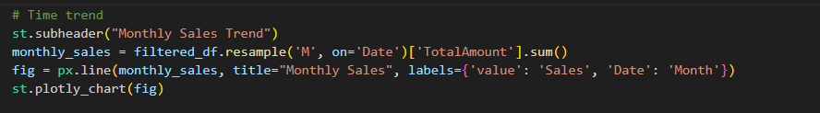
DESCRIPTIVE ANALYSIS
Monthly Sales Trend

Slide 20
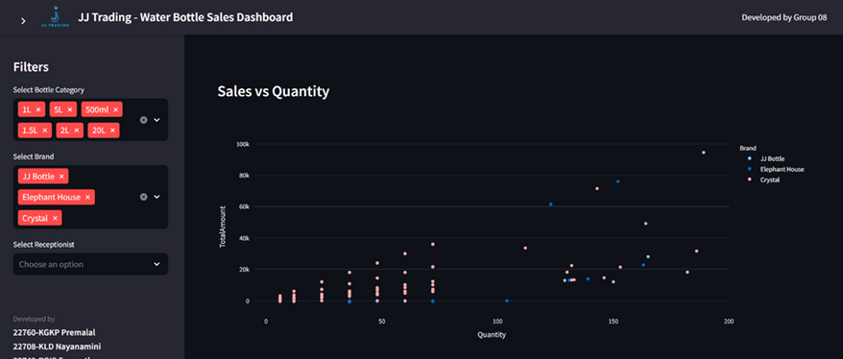
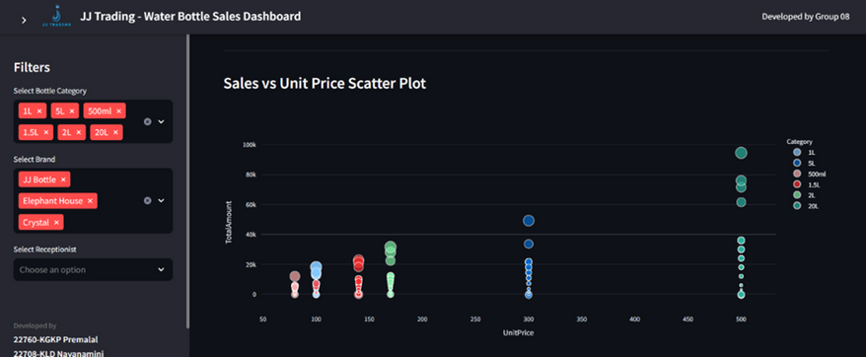
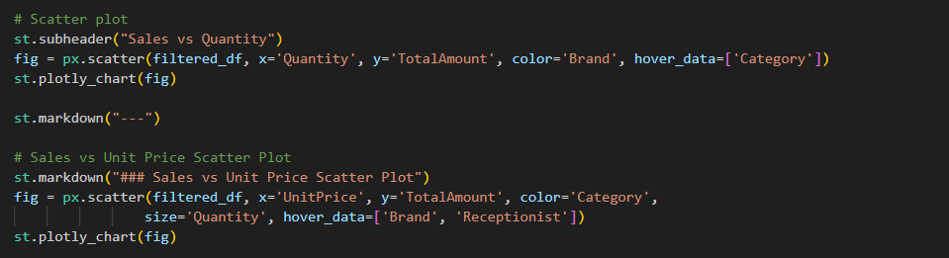
DESCRIPTIVE ANALYSIS
Sales vs Quantity & Sales vs Unitprice Scatterplot

Slide 21
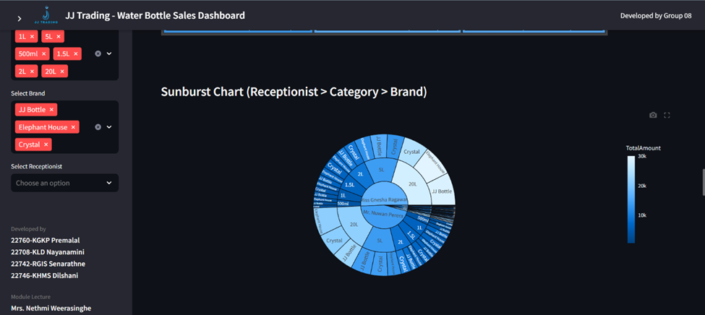
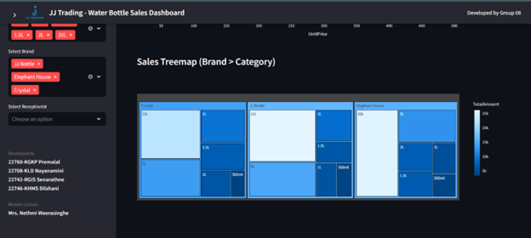
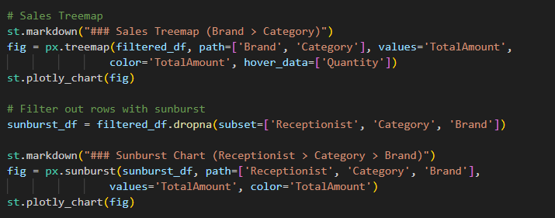
DESCRIPTIVE ANALYSIS
Sales Treemap and Receptionist sunburt chart

Slide 22
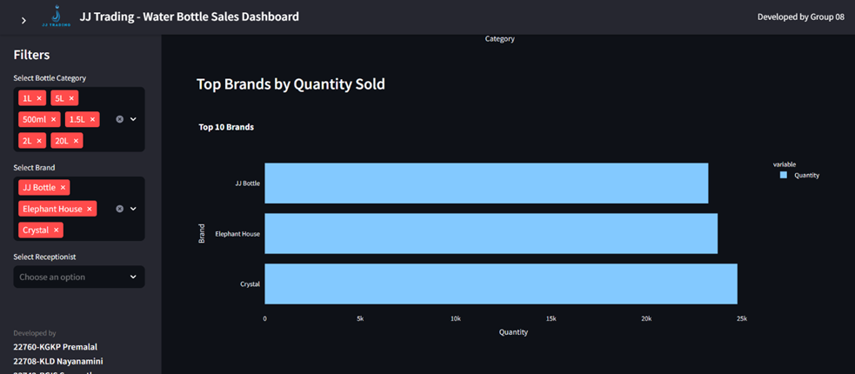
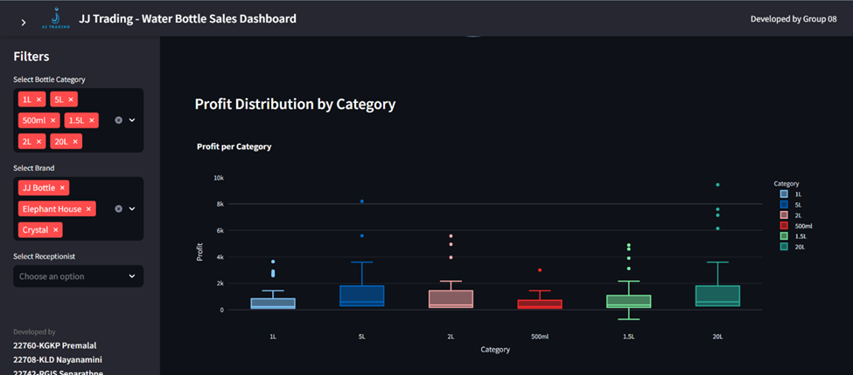
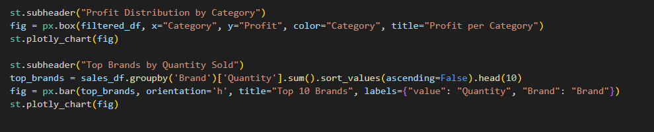
DESCRIPTIVE ANALYSIS
Top brands by sold and profit distribution by category

Slide 23
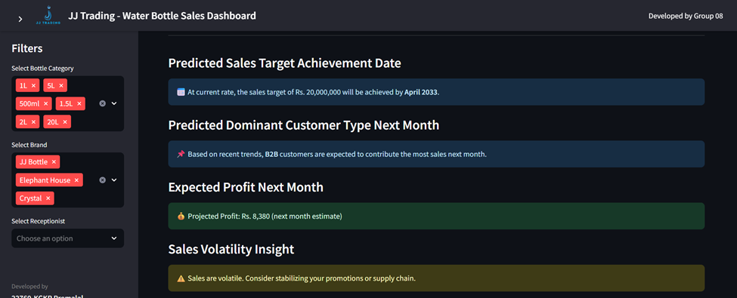
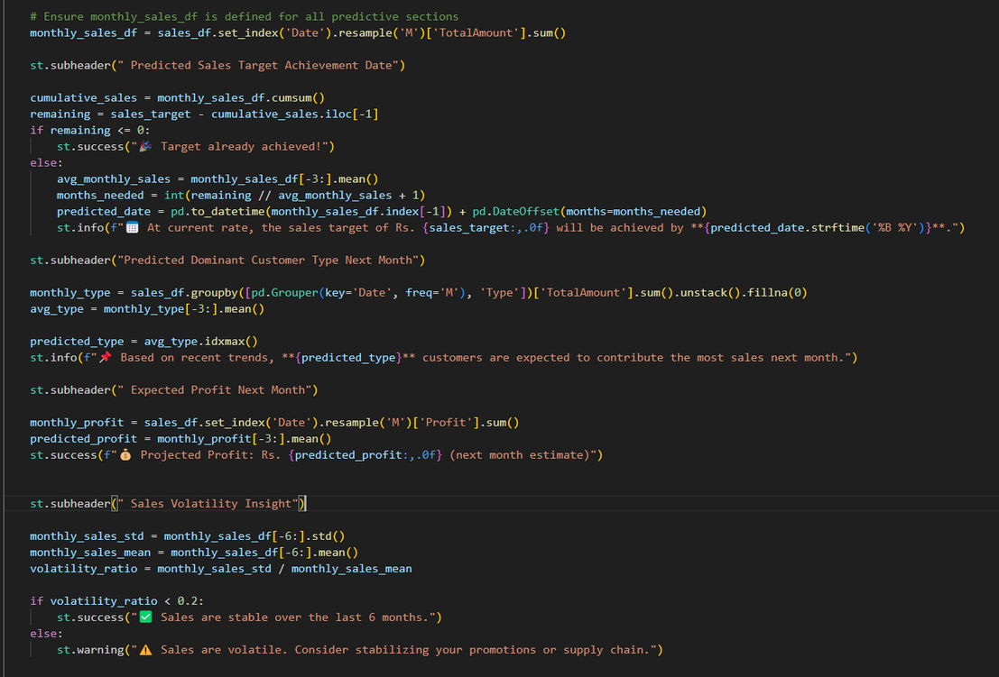
PREDICTIVE ANALYSIS

Slide 24
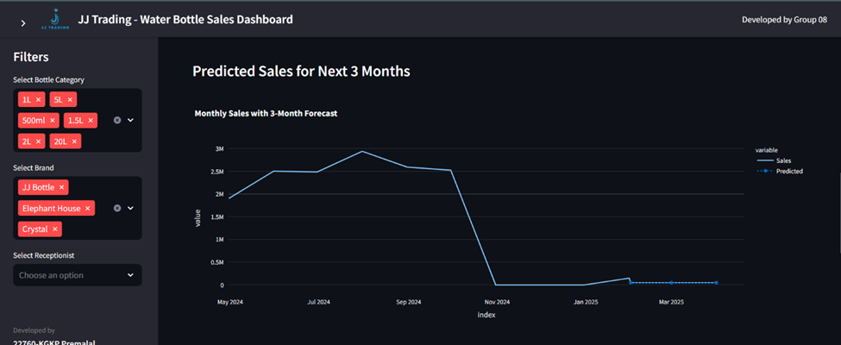
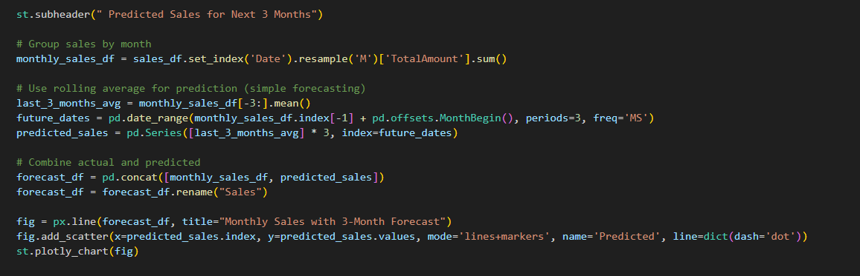
PREDICTIVE ANALYSIS
Predicted Sales for Next 3 Months

Slide 25
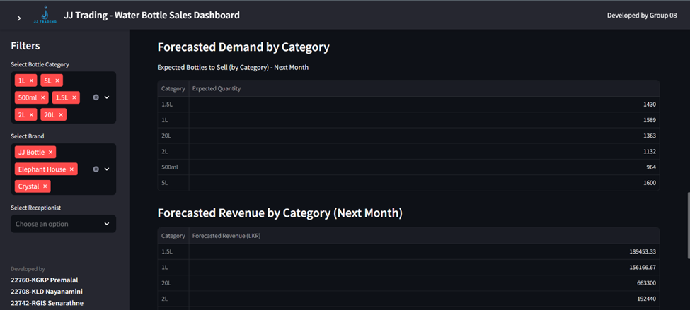
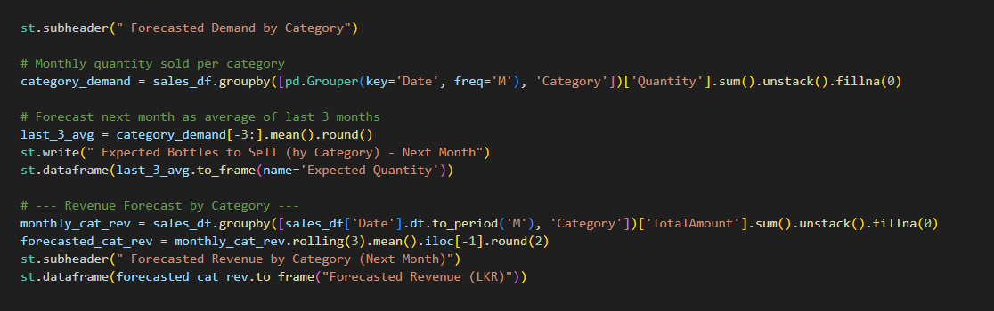
PREDICTIVE ANALYSIS
Forecasted Demand by Category & Revenue by Category

Slide 26
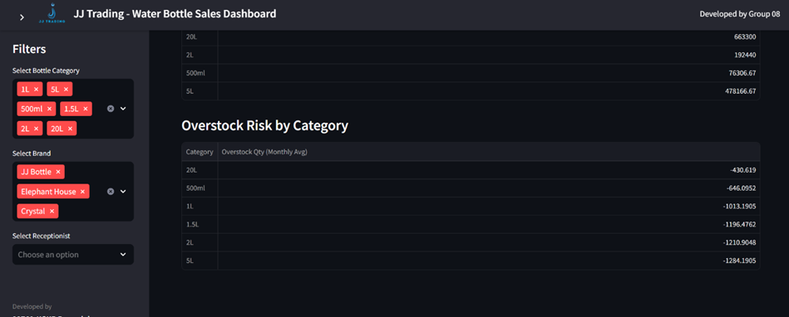
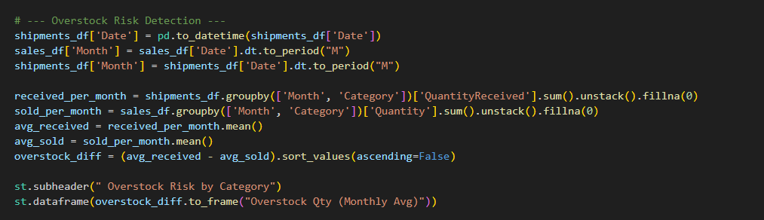
PREDICTIVE ANALYSIS
Overstock Risk by Category

Slide 27

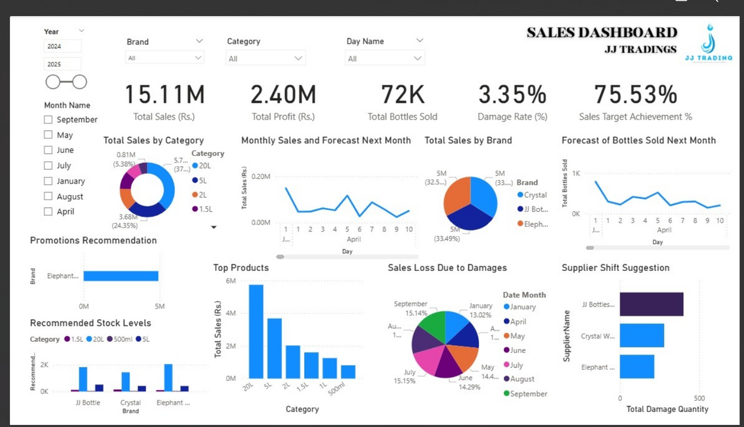
Finding & Insights
Total Sales: RS. 15.11M | Profit: 2.40M | Bottles Sold: 72K
Target Achievement: 75.53%
Top Category: 20L bottles (38% of sales)
Top Brands: Crystal, JJ Bottles, Elephant (each ~33%)
Damage Rate: 3.35% | Highest Loss: July & September
Sales Forecast: Stable trend, 0.20M/day in April
Top Product: 20L bottle (RS. 6M sales)
Stock Needs: Replenish 20L & 5L (JJ, Elephant), 1.5L & 500ml (Crystal)
Promotion Focus: Elephant brand
Supplier Issue: High damages from JJ Bottles — consider switching

Slide 28
Future Recommendations
Implement Real-Time Data Integration
Shift from static data updates to live connections between systems (ERP/POS) and Power BI.
Real-time analytics will enable quicker responses to sales spikes, stockouts, and damage alerts.
Adopt Geospatial & Customer Segmentation Analytics
Use map visuals and cluster analysis to reveal geographic sales patterns and identify underserved areas.
Tailored promotions and optimized delivery routes can be created based on location.
Expand Predictive Models with Machine Learning
Move beyond basic forecasting by training custom machine learning models (e.g., regression, time-series) in Python/R.
Enhance demand forecasting and damage-risk predictions to further reduce costs.
Automate Reporting and Alerts
Set up automated notifications (via email/mobile) for critical KPIs (e.g., damage rate exceeding threshold, stockouts).
Keeps stakeholders informed without requiring manual checks of dashboards.
Invest in Data Governance & Self-Service BI
Establish clear data ownership, version control, and access policies.
Empower business users with “self-service” tools and training for ad-hoc reporting, reducing reliance on IT.

Slide 29
Thank You

