Slide 1
Statıc Analysıs Tools

Slide 2
FxCop
Code violation detection Tools:
FREE
https://www.youtube.com/watch?v=iSOyk7Am1E0
https://www.youtube.com/watch?v=mRO3UJkPsxs

Slide 3
ClockSharp
Code violation detection Tools
FREE
based on code source analysis (to C# 2.0)

Slide 4
Gendarme
Code violation detection Tools
FREE & OPEN SOURCE
https://www.youtube.com/watch?v=8LkeED02GRE

Slide 5
COVERITY PREVENT
Code violation detection Tools
PAID
Quality and Security Defects

Slide 6
PRQA QA·C# commercial product
Code violation detection Tools
PAID
https://www.perforce.com/products/helix-qac

Slide 7
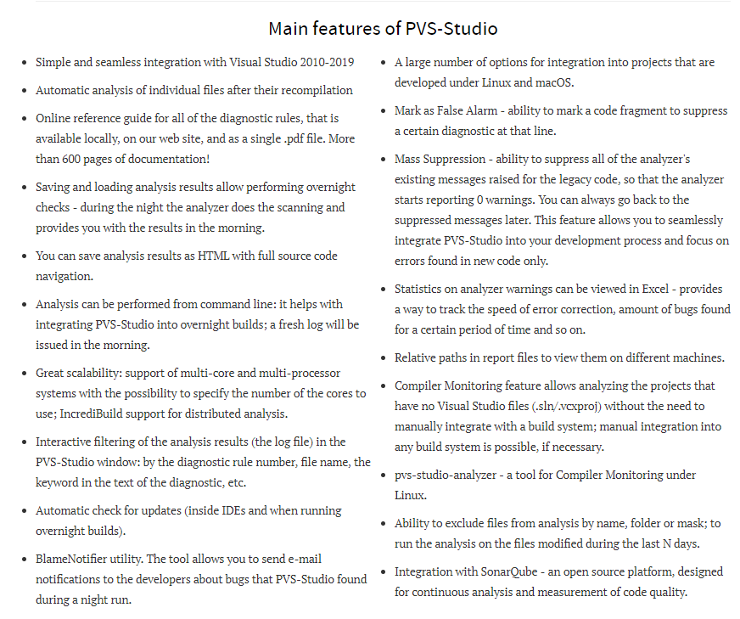
Pvs-studıo analyzer
Code violation detection Tools
PAID
https://www.perforce.com/products/helix-qac

Slide 8
Microsoft Code Analysis Tool .NET (CAT.NET) v1 CTP - 32 bit
Code violation detection Tools
SECURITY!
visual studio addin that helps identification of security flaws

Slide 9
CodeIt.Right
Code violation detection Tools
https://submain.com/products/codeit.right.aspx!

Slide 10
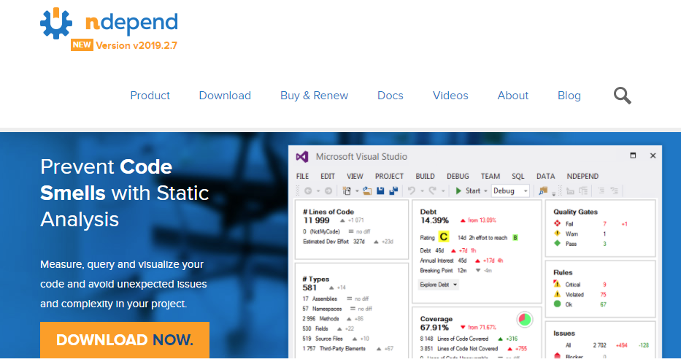
NDepend
Quality Metric Tools:
great visual tool.
Useful for code
metrics, rules, diff,
coupling and
dependency studies.
https://www.youtube.com/watch?v=WJJEf92eTgs

Slide 11
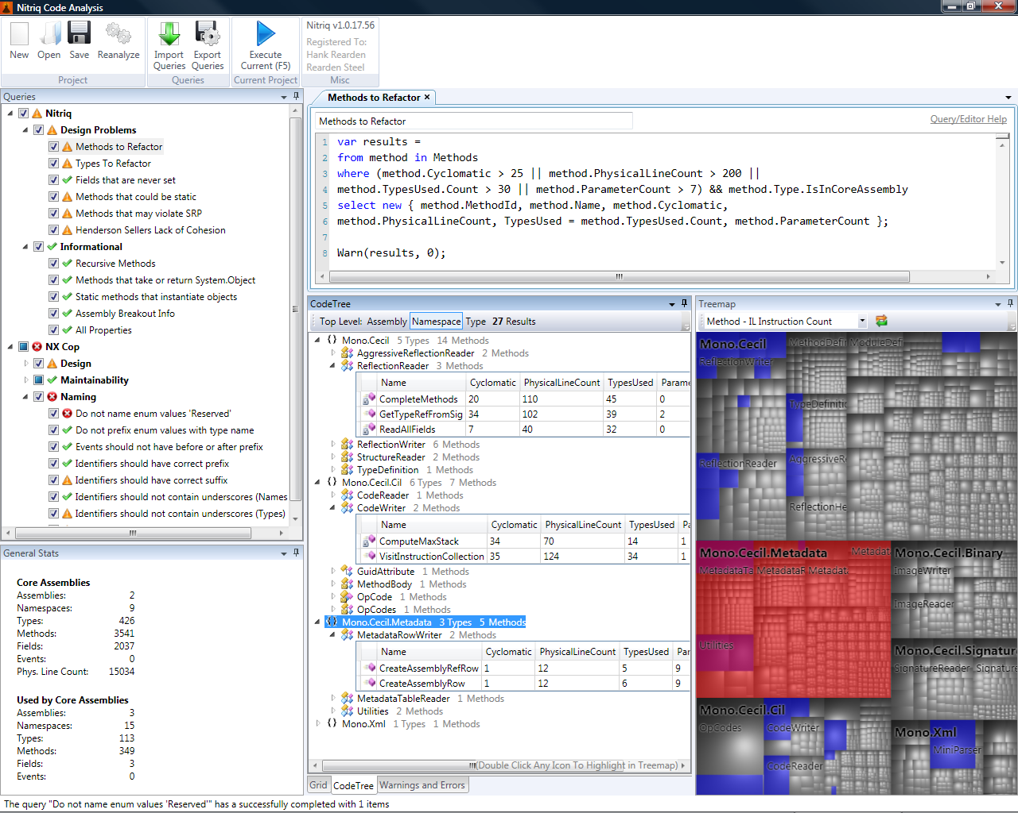
Nitriq
Quality Metric Tools:
free, can easily write your own
metrics/constraints, nice visualizations
http://www.nitriq.com

Slide 12
stylecop
Checking Style Tools:
StyleCop analyzes C# source code to enforce a set of style and consistency rules. StyleCop for ReSharper is an extension for ReSharper that will run StyleCop analysis as you type, display the violations inline in the editor and provide quick fixes for some violations. It will also configure ReSharper to use default settings that match StyleCop rules.
https://github.com/StyleCop/StyleCop.ReSharper
https://stylecop.codeplex.com

Slide 13
Duplication Detection:
Simian, based on source code. Works with plenty languages.
CloneDR, detects parameterized clones only on language boundaries (also handles many languages other than C#)
Clone Detective a Visual Studio plugin. (It uses ConQAT internally)
Atomiq, based on source code, plenty of languages, cool "wheel" visualization

Slide 14
General Refactoring
RESHARPER : https://www.jetbrains.com/resharper/
SONARC#: https://www.sonarsource.com/products/codeanalyzers/sonarcsharp.html
https://www.youtube.com/watch?v=JGm6othB9Kg

