Slide 1


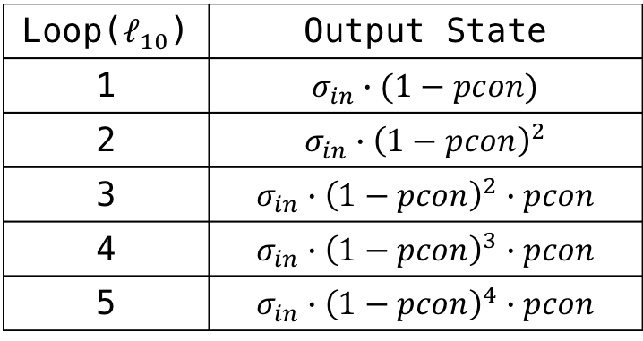
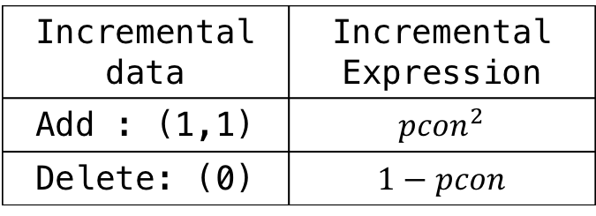


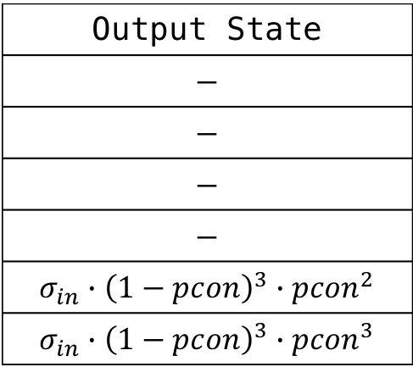
Loop($ℓ_{10}$) | Output State
1 | $$σ_{in}∙(1−pcon)$$
2 | $$σ_{in}∙{\left(1−pcon\right)}^{2}$$
3 | $$σ_{in}∙{\left(1−pcon\right)}^{2}∙pcon$$
4 | $$σ_{in}∙{\left(1−pcon\right)}^{3}∙pcon$$
5 | $$σ_{in}∙{\left(1−pcon\right)}^{4}∙pcon$$
Output State
$$−$$
$$−$$
$$−$$
$$−$$
$$σ_{in}∙{\left(1−pcon\right)}^{3}∙{pcon}^{2}$$
$$σ_{in}∙{\left(1−pcon\right)}^{3}∙{pcon}^{3}$$
$$σ_{L.12}$$
$$σ_{L.12}^{′}$$
$$σ_{L.12}^{′}=σ_{L.12}∙{pcon}^{2}/(1−pcon)$$
Incremental data | Incremental Expression
Add : (1,1) | $${pcon}^{2}$$
Delete: (0) | $$1−pcon$$

