Slide 1
Transparency and Fairness in AI and Big Data Algorithms
Ricci Use Case

Slide 2
The Ricci Dataset
Exam to firefighters to have a promotion ( Captain or Lieutenant )
Features :
Oral, Written and Combine score (Combine score is 60% Written and 40% Oral)
Race (White, Hispanic or Black)
Position for the promotion (Captain or Lieutenant)

Slide 3
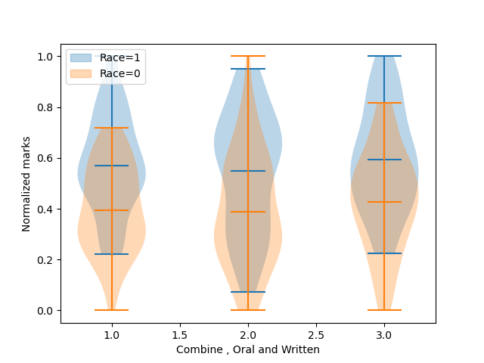
The Ricci Dataset
Race is the sensitive attribute
68 white participant (Race=1) with 41 promotion
50 black and hispanic participant (Race=0) with 15 promotion

Slide 4
Fairness Metrics
Mean difference between privileged and unpriviliged group show the fraction of privileged people which have more positive outocomes, We want him around 0
For the original test set : 0.1
Disparity impact show the rate of positive outcomes over the unprivileged group divide by the rate of positive outcomes over the privileged group. We want it around 1
For the original test set : 0.78

Slide 5
Reweight + Classifier
Reweighing transforms the dataset to have more equity between the privileged and unpivileged groups
Pre processing technique : we need a classifier after reweighting the dataset
With Logistic regression:
Mean difference = 0.025
Disparate impact =1.06
With Random Forest:
Mean difference =1e-16
Disparate impact =1

Slide 6
Grid Search Reduction
In-processing technique
Returning the deterministic classifier with the lowest empirical error subject to fair classification constraints among the candidates searched
Mean difference =0.08
Disparate imapct =0.83

Slide 7
Results
 | Mean difference | Disparate impact
Original | 1.086957e-01 | 0.782609
Reweight + Logistic regression | 2.542373e-02 | 1.058824
Reweight + Random forest | 1.110223e-16 | 1
Grid Search Reduction | 8.091787e-02 | 0.828645

