Slide 1
Transparency and Fairness in AI and Big Data Algorithms
Ricci Use Case

Slide 2
The Ricci Dataset
Exam to firefighters to have a promotion ( Captain or Lieutenant )
Features :
Oral, Written and Combine score (Combine score is 60% Written and 40% Oral)
Race (White, Hispanic or Black)
Position for the promotion (Captain or Lieutenant)

Slide 3
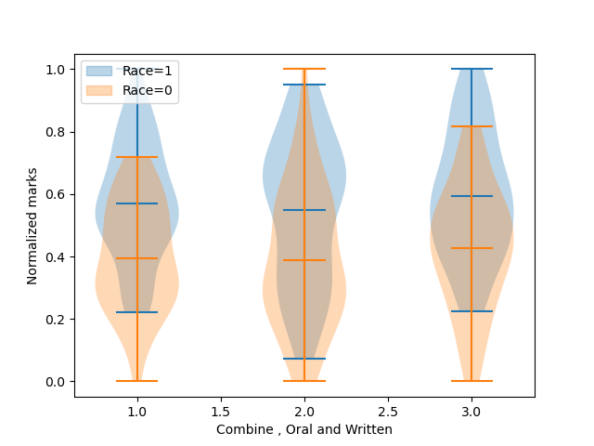
The Ricci Dataset
Race is the sensitive attribute
68 white participant (Race=1) with 41 promotion
50 black and hispanic participant (Race=0) with 15 promotion

Slide 4
Main Fairness Metrics
Mean difference between privileged and unpriviliged group shows the fraction of privileged people which have more positive outocomes, We want him around 0 . For the original test set : 0.1
Disparity impact shows the rate of positive outcomes over the unprivileged group divide by the rate of positive outcomes over the privileged group. We want it around 1. For the original test set : 0.78
Average odd difference is the average of difference in false positive rates and true positive rates between unprivileged and privileged groups. We want it around 0. For the original test set : -0.169444
Balanced accuracy is the mean between true positive rate and true negative rate. For the original test set : 0.872340

Slide 5
Reweight + Classifier
Reweighing transforms the dataset to have more equity between the privileged and unpivileged groups
Pre processing technique : we need a classifier after reweighting the dataset
With Logistic regression:
Mean difference = 0.025
Disparate impact =1.06
With Random Forest:
Mean difference =1e-16
Disparate impact =1

Slide 6
Grid Search Reduction
In-processing technique
Returning the deterministic classifier with the lowest empirical error subject to fair classification constraints among the candidates searched
Mean difference =0.08
Disparate imapct =0.83

Slide 7
Results
 | Original (Random Forest) | Reweight + Logistic Regression | Reweight +Random Forest | GridSearchReduction
Balanced accuracy | 0.886 | 0.989 | 1.000 | 0.864
Mean difference | -0.329 | 0.017 | 0.000 | -0.321
Disparate impact | 0.549 | 1.038 | 1.000 | 0.571
Average odds difference | -0.147 | 0.019 | 0.000 | -0.149
Equal opportunity difference | 0.000 | 0.037 | 0.000 | 0.000
Theil index | 0.035 | 0.012 | 0.000 | 0.040

Slide 8
Conclusion

