Slide 1
Transparency and Fairness in AI and Big Data Algorithms
Ricci Use Case

Slide 2
The Ricci Dataset
Exam to firefighters to have a promotion ( Captain or Lieutenant )
Features :
Oral, Written and Combine score (Combine score is 60% Written and 40% Oral)
Race (White, Hispanic or Black)
Position for the promotion (Captain or Lieutenant)

Slide 3
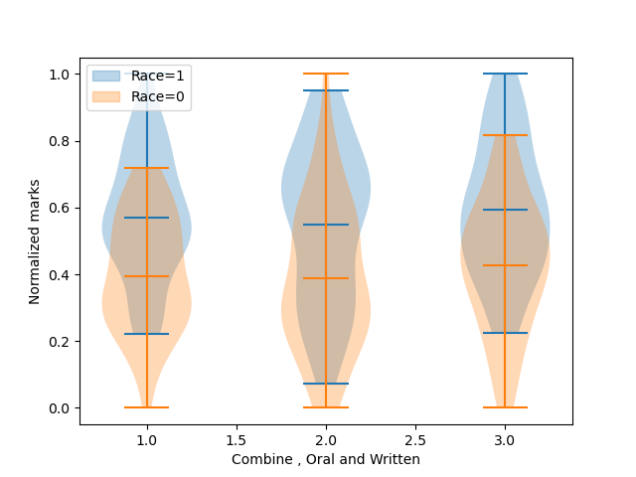
The Ricci Dataset
Race is the sensitive attribute
68 white participant (Race=1) with 41 promotion
50 black and hispanic participant (Race=0) with 15 promotion

