Slide 1
NEEDS FIXING !!!!!
Huffman Trees

Slide 2
Compression
What’s it good for?
Files on disk
Transferring data
Downsides of compressing data?

Slide 3
Fixed Length Codes
With ascii, how many bits or bytes would it take to encode a file with 100 characters?
Ascii requires (log2 128) to encode a letter (not extended ascii)
Ascii is a fixed length coding scheme
ZULU requires 7*4 bits or 28 bits
MEEK requires 7*4 bits or 28 bits

Slide 4
Huffman Codes
Simple way to compress data.
Not always the best.
Provides a unique way of using Binary Tree to “compress” data.
Each letter gets a unique binary code. (variable length)

Slide 5
Huffman Codes
Binary trees can be used in an interesting way to construct minimal length encodings (paths) for messages when the frequency of letters used in the messages is known.
A special kind of binary tree, called a Huffman coding tree is used to accomplish this.
Follow a path to a leaf, the bit string compiled on the trip to the leaf is your “unique” identifier

Slide 6
Huffman Codes
Letter | Frequency | Letter | Frequency
A | 77 | N | 67
B | 17 | O | 67
C | 32 | P | 20
D | 42 | Q | 5
E | 120 | R | 59
F | 24 | S | 67
G | 17 | T | 85
H | 50 | U | 37
I | 76 | V | 12
J | 4 | W | 22
K | 7 | X | 4
L | 42 | Y | 22
M | 24 | X | 2
Using Huffman Codes :
ZULU could still be encoded using 28 bits, but....
MEEK would probably be much smaller because of the high letter frequency
Example...

Slide 7
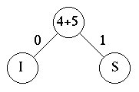
Huffman Codes
To build the Huffman tree, we sort the frequencies (of the letters) into increasing order (4, 5, 7, 8, 12, 29).
Then we choose the two smallest values, 4 and 5, and construct a binary tree with labeled edges:
Letter | Frequency
S | 4
I | 5
N | 7
T | 8
P | 12
E | 29

Slide 8
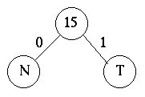
Huffman Codes
Next, we replace the two smallest values 4 and 5 with their sum, getting a new sequence, (7, 8, 9, 12, 29).
We again take the two smallest values and construct a labeled binary tree:
Letter | Frequency
N | 7
T | 8
S,I | 9
P | 12
E | 29

Slide 9
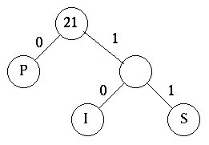
Huffman Tree
We now have the frequencies (15, 9, 12, 29)
Which must be sorted into (9, 12, 15, 29)
The two lowest are selected once again.

Slide 10
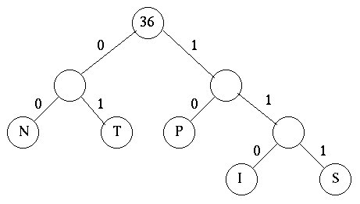
Huffman Tree
Now, we combine the two lowest which are 15 and 21 to give the tree below:

Slide 11
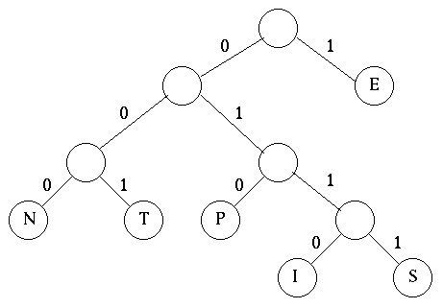
Huffman Tree
The two remaining frequencies, 36 and 29, are now combined into the final tree. Notice that it does not make any difference which one is placed as the left subtree and which in the right subtree.

Slide 12
Huffman Code
From this final tree, we find the encoding for this alphabet:
Letter | Code
E | 1
I | 0110
P | 010
N | 000
S | 0111
T | 001

Slide 13
Huffman Code
Using this code, a message like SENT would be coded as 01111000001.
This code is called a prefix encoding. As soon as a 1 is read, you know it is an E.
0110 is an I - you do not need to see any more bits.
When a 01 is seen, it is either I or P or S, etc.

Slide 14
Huffman Code
If a message had been coded in the "normal" way, each letter would have required 8 bits.
If the entire message is 65 characters long so 520 bits would be needed to code the message (8*65).
The Huffman code would require much less.

