Slide 1
Hashing
Lecture based on information from http://www.nist.gov/dads/

Slide 2
Uses of Hashing
Cryptographic: 1 Way Hash
Error Correction
Checking for changes (file(s) or directory(s))
Hash table (constant time lookup)

Slide 3
Cryptographic: 1 Way Hash
It’s kind of like encrypting, accept you cannot “un-encrypt” the value ?? (what?)
You can use 1 way encryption functions for things like Authentication, Digital Signatures, Fingerprinting and more.
Some common functions are MD5, SHA-1 , SHA-2 and many more.

Slide 4

Cryptographic: 1 Way Hash
Example:
You register at a website.
Your password gets hashed using a 1-way hash (sha-1 for example) and saved in a database.
You go log in at that website.
Your password gets hashed again.
The hashed password gets compared to the value in the database.
If they match, you have just authenticated.
'5baa61e4c9b93f3f0682250b6cf8331b7ee68fd8'
‘password’

Slide 5
Cryptographic: 1 Way Hash
Example:
'5baa61e4c9b93f3f0682250b6cf8331b7ee68fd8
You register at a website.
Your password gets hashed using a 1-way hash (sha-1 for example) and saved in a database.
You go log in at that website.
Your password gets hashed again.
The hashed password gets compared to the value in the database.
If they match, you have just authenticated.
'5baa61e4c9b93f3f0682250b6cf8331b7ee68fd8'
password
'5baa61e4c9b93f3f0682250b6cf8331b7ee68fd8'

Slide 6

Cryptographic: 1 Way Hash
Example:
You register at a website.
Your password gets hashed using a 1-way hash (sha-1 for example) and saved in a database.
You go log in at that website.
Your password gets hashed again.
The hashed password gets compared to the value in the database.
If they match, you have just authenticated.
'5baa61e4c9b93f3f0682250b6cf8331b7ee68fd8'
'5baa61e4c9b93f3f0682250b6cf8331b7ee68fd8'

Slide 7
Error Correction
Example (over simplified):
1. Given a simplified
Internet packet.
Source Address | Destination Address | Other Packet Info
TCP Header | TCP Data
2. Add specific info.
22.34.223.45 | 120.52.201.17 | Other Packet Info
TCP Header | This is my api call with sensitive info.
3. Calculate Checksum.
22.34.223.45 | 120.52.201.17 | Other Packet Info
TCP Header | This is my api call with sensitive info.
0a26bcabd165ccd467505e4a066a2afc5856aaf6

Slide 8
Error Correction
Example (over simplified):
1. Given a simplified
Internet packet.
Source Address | Destination Address | Other Packet Info
TCP Header | TCP Data
2. Add specific info.
22.34.223.45 | 120.52.201.17 | Other Packet Info
TCP Header | This is my api call with sensitive info.
3. Calculate Checksum.
22.34.223.45 | 120.52.201.17 | Other Packet Info
TCP Header | This is my api call with sensitive info. | 0a26bcabd165ccd467505e4a066a2afc5856aaf6
TCP Header | This is my api call with sensitive info.
TCP Header | This is my api call with sensitive info.
0a26bcabd165ccd467505e4a066a2afc5856aaf6

Slide 9

Error Correction
Example (over simplified):
22.34.223.45 | 120.52.201.17 | Other Packet Info
TCP Header | This is my api call with sensitive info. | 0a26bcabd165ccd467505e4a066a2afc5856aaf6

Slide 10
Error Correction
Example (over simplified):
0a26bcabd165ccd467505e4a066a2afc5856aaf6
0a26bcabd165ccd467505e4a066a2afc5856aaf6

Slide 11
Error Correction
Example (over simplified):
0a26bcabd165ccd467505e4a066a2afc5856aaf6
0a26bcabd165ccd467505e4a066a2afc5856aaf6

Slide 12
Error Correction
Example (over simplified):
X
0a26bcabd165ccd467505e4a066a2afc5856aaf6
0a26bcabd165ccd467454e4a066a2afc5856a000
Request Packet Again

Slide 13
Check For Changes
Example:
A cryptographic hash function (CHF) is a mathematical algorithm that maps data of arbitrary size (often called the "message") to a bit array of a fixed size (the "hash value", "hash", or "message digest"). It is a one-way function, that is, a function which is practically infeasible to invert.[1] Ideally, the only way to find a message that produces a given hash is to attempt a brute-force search of possible inputs to see if they produce a match, or use a rainbow table of matched hashes. Cryptographic hash functions are a basic tool of modern cryptography.
A cryptographic hash function (CHF) is a mathematical algorithm that maps data of arbitrary size (often called the "message") to a bit array of a fixed size (the "hash value", "hash", or "message digest"). It is a one-way function, that is, a function which is practically infeasible to invert.[1] Ideally, the only way to find a message that produces a given hash is to attempt a brute-force search of possible inputs to see if they produce a match, or use a rainbow table of matched hashes. Cryptographic hash functions are a basic tool of modern cryptography[2].
9f9a3c2bc5523193b679cee97a63d0713b7b4792
6b6b17b13c073b4011c36edc4299c09b54e8b2b4
37 out of 40 characters are different

Slide 14
Check For Changes
Example:
A cryptographic hash function (CHF) is a mathematical algorithm that maps data of arbitrary size (often called the "message") to a bit array of a fixed size (the "hash value", "hash", or "message digest"). It is a one-way function, that is, a function which is practically infeasible to invert.[1] Ideally, the only way to find a message that produces a given hash is to attempt a brute-force search of possible inputs to see if they produce a match, or use a rainbow table of matched hashes. Cryptographic hash functions are a basic tool of modern cryptography .
A cryptographic hash function (CHF) is a mathematical algorithm that maps data of arbitrary size (often called the "message") to a bit array of a fixed size (the "hash value", "hash", or "message digest"). It is a one-way function, that is, a function which is practically infeasible to invert.[1] Ideally, the only way to find a message that produces a given hash is to attempt a brute-force search of possible inputs to see if they produce a match, or use a rainbow table of matched hashes. Cryptographic hash functions are a basic tool of modern cryptography.
9f9a3c2bc5523193b679cee97a63d0713b7b4792
ee1a572e6af4ceee3cca5a0b0cdf64c894c5b7a5
37 out of 40 characters are different

Slide 15
Hash Table
I’ve given you 3 examples of using 1-way hashes (cryptographic hashing).
Passwords
Checksums
File differences
The packet example was very simplified, but the other two were pretty much spot on.
However, these examples are not our goal.
Our goal is to understand what a “hash table” is, and how it works.

Slide 16
Hash Table
When we say: “hash table” you should think of a data structure that is a “constant time lookup table”.
In many languages they are “built in”, given to us like an array or a struct.
In Python they are called dictionaries
In C++ we call them Maps (but we need the STL library to use them)
In Php they are called associative arrays.
But how are these implemented behind the scenes?
Let’s start with some terms.

Slide 17
Hashing - Terms
Hash Table - is an array which keys are mapped to array positions by a hash function (this is also called a “dictionary” in some contexts).
Key - The part of a group of data by which it is sorted, indexed, cross referenced. The key needs to be a unique representation for a set of data items.
Hash Function - a function H, that receives some input x, and turns it into an integer value i (array index) . The returned integer value can be adjusted to fit an array by using modulus (H(x) i % array_size).
Collision - When two or more items should be kept in the same location, especially in hash tables, that is, when two or more different keys hash to the same value.

Slide 18
Hashing - Terms
Collision Resolution Scheme - A way of handling collisions, that is, when two or more items should be kept in the same location.
Collision Resolution Schemes are divided into:
open addressing
chaining.
Perfect hashing - avoids collisions but may be time-consuming to create.
Load Factor - The number of elements in a hash table divided by the number of slots. Usually written as α (alpha).
More later…

Slide 19
Hash Function
Any well-defined procedure or mathematical function for turning some kind of data into a relatively small integer, that may serve as an index into an array.
The values returned by a hash function are called:
Hash values
Hash codes
Hash sums
or simply hashes
List of hash functions from Wikipedia (cryptographic, non-cryptographic, checksums, etc).
Hash Function definition and examples on Wikipedia

Slide 20
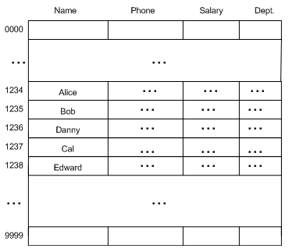
Example Hash Function
If we design the proper hash function, we could (in theory) insert and retrieve info in O(1) time.
For example our hash function here is:
H(x) = last four digits of x
Where x = ssn.
http://msdn.microsoft.com/

Slide 21
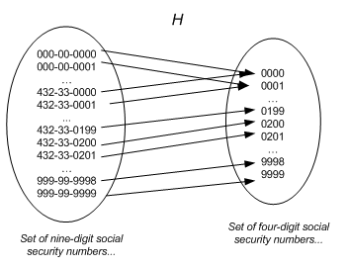
Basic Idea
In other words, our hash function h(x) “maps” a social security number to a specific value.
See any problems??
http://msdn.microsoft.com/

Slide 22
Hash Function
Assume that the hash table has size M
There is a hash function H, which maps an element to a value p in 0,…,M-1, and the element is placed in position p in the hash table.
If H(i) = k, then the element is added to HashTable[k].
The simplest example is the mod function:
H(i) = i modulo M

Slide 23
Basic Example
Hash function: i % M
Size of hashtable: M = 5
List of values: 11, 13, 19, 18
0
1
2
3
4
11
13
19
11 mod 5 = 1
13 mod 5 = 3
19 mod 5 = 4
18 mod 5 = 3
Where does 8 go??

Slide 24
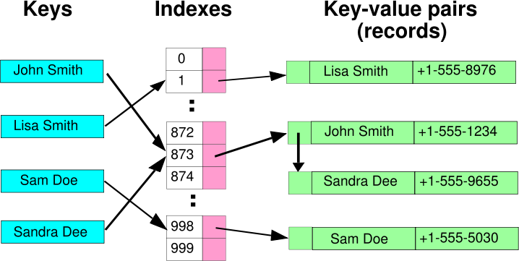
Collision
What is a collision?
http://msdn.microsoft.com/

Slide 25
Collision
Hash functions are chosen so that the hash values are spread over 0,…,M-1 (distributed over whole table) and there are only minimal collisions.
If we have a hash function that never results in a collision we have that’s called a “Perfect Hash”
Typically, collisions exist and must be dealt with.
Dealing with collisions is called “Collision Resolution”

Slide 26
Collision Resolution
Two major classes of collision resolution
Open Addressing
Chaining

Slide 27
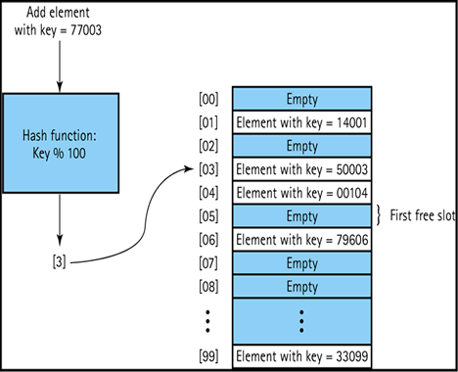
Open addressing
Open Addressing places the hashed value IN the hash table
http://faculty.juniata.edu/kruse/cs2java/hashing.htm

Slide 28
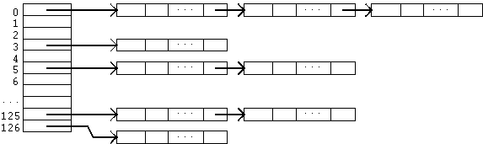
Chaining
Chaining places the hashed value in a list POINTED to by the hash table
http://faculty.juniata.edu/kruse/cs2java/hashing.htm

Slide 29
Chaining
Separate Chaining - A scheme in which each position in the hash table has a list to handle collisions.
Each position may be just a link to the list (direct chaining) or may be an item and a link, essentially, the head of a list.
In the latter, one item is in the table, and other colliding items are in the list.
Direct Chaining - A collision resolution scheme in which the hash table is an array of links to lists.
Each list holds all the items with the same hash value.
We will discuss “chaining” as a generic concept and leave the “direct” and
“separate” to an implementation “choice”.

Slide 30
Chaining (collision resolution)
M = 9
Insert 12
h(12 mod 9) = 3
Insert 10
h(10 mod 9) = 1
insert 13
h(13 mod 9) = 4
insert 19
h(19 mod 9) = 1
insert 28
h(28 mod 9) = 1
12
0
1
2
3
4
5
6
7
8
collision
19
28
10
13
19
28

Slide 31
Collision Resolution
Open Addressing - A class of collision resolution schemes in which all items are stored within the hash table.
In case of collision, other positions are computed and checked (a probe sequence) until an empty position is found.
Some ways of computing possible new positions are less efficient because of clustering.
Three methods of Open Addressing Collision Resolution are
linear probing
quadratic probing
double hashing
Probe Sequence - The list of locations which a method for open addressing produces as alternatives in case of a collision.
Open addressing has the possibility of clustering values in the hash table

Slide 32
Clustering
The tendency for entries in a hash table which uses open addressing to be stored together (in close proximity), even when the table has ample empty space to spread them out.
Primary Clustering - The tendency for some collision resolution schemes to create long runs of filled slots at the hash function position.
Secondary Clustering - The tendency for some collision resolution schemes to create long probe sequences of filled slots.

Slide 33
Linear Probing
A hash table in which a collision is resolved by putting the item in the next empty place in the array following the occupied place. Even with a moderate load factor, primary clustering tends to slow retrieval.

Slide 34
Quadratic Probing
A method of open addressing for a hash table in which a collision is resolved by putting the item in the next empty place given by a probe sequence. The space between places in the sequence increases quadratically.
The space between places in the sequence increases quadratically.
(h(K) + i²) mod m

Slide 35
Pseudo Random Probing
You tell me….

Slide 36
Double Hashing
A method of open addressing for a hash table in which a collision is resolved by searching the table for an empty place at intervals given by a different hash function, thus minimizing clustering.
Example: 1 + k mod (m-1) could be your second hash function
Helps with secondary clustering

Slide 37
Probing (collision resolution)
M = 9
Insert 12
h(12 mod 9) = 3
Insert 10
h(10 mod 9) = 1
insert 13
h(13 mod 9) = 4
insert 19
h(19 mod 9) = 1
insert 28
h(28 mod 9) = 1
12
0
1
2
3
4
5
6
7
8
collision
19
28
10
13
19
28

Slide 38
Probing (collision resolution)
M = 9
0
1
2
3
4
5
6
7
8
10
19
12
13
28
Cluster

Slide 39
Hashing Functions
What makes a good hash function?
Any key is as likely to hash to any of the 1 … m slots as any other.
This means even keys that are very similar will hash to widely different locations.
Types of functions
Perfect Hash
Use key value as index
Interpret keys as numbers
Direct Access
Multiplication
Division

Slide 40
Perfect Hashing
A hash function that maps each different key to a distinct integer.
Usually, all possible keys must be known beforehand.
A hash table that uses a perfect hash has no collisions.

Slide 41
Strings To Numbers
Interpreting Keys as Numbers
Use Ascii value of each letter
Example:
Jones
J = ascii(J) = 74 +
o = ascii(o) = 111 +
n = ascii(n) = 110+
e = ascii(e) = 101 +
s = ascii(s) = 115
hash value = 511 % (size of array)

Slide 42
Example Functions
Interpret Keys
Convert a key to a natural number using radix-128
k = mgr
mgr = ascii(m)*128^{^0} + ascii(g)*128^{^1} + ascii(r)*128^{^2}
h(k) = h(mgr) = 109*1 + 103*128 + 114*16384
= 1881069 (maybe) :)

Slide 43
Example Functions
Direct Access
Use a data value as index to the table
Not always possible

Slide 44
Example Functions
Division
h(k) = k mod m where k is the key value and m is the table size
Try to avoid certain values of m.
m should not be a power of 2, since m = 2^{^p}, then h(k) is just the p lowest-order bits of k.
Powers of 10 should also be avoided
Tables with sizes that are primes not to close to powers of 2 are good

Slide 45
Example Functions
Division
Example
n = 2000 character strings where each character has 8 bits
We don’t mind searching average of 3 elements in a search so we set hash table size m = 701
701 is chosen because it is a prime near 2000/3 but not close to a power of 2
2000/3 is the load factor or ƛ

Slide 46
Example Functions
Multiplication
Formal Definition: h(k) = floor(m(k A (mod 1))), where m is usually an integer 2^{p} and A is an irrational number (or an approximation thereto) 0 < A < 1. The modulo 1 operation removes the integer part of k × A.
Example: A = 0.61803399 m = 19 k = 7
floor(19(7*0.61803399(mod 1)))
floor(6.19852067)
6
Example (not of perfect hashing)

Slide 47
Example Functions
Elf Hash
/*---ElfHash----------------------------------------------------------------- *
The published hash algorithm used in the UNIX ELF format * for object files. Accepts a pointer to a string to be hashed * and returns an unsigned long.
*-------------------------------------------------------------------------*/
unsigned long ElfHash(const unsigned char *name) {
unsigned long h=0, g;
while (*name) {
h = (h << 4) + *name++;
if (g = h & 0xF0000000)
h ^= g >> 24; h &= ~g;
}
return h;
}
Bitwise Operators

Slide 48
Example Functions
Jenkins One at a Time
/*--- Jenkins's one_at_a_time -------------------------------------------- */
uint32_t jenkins_one_at_a_time_hash(const uint8_t* key, size_t length){ size_t i = 0; uint32_t hash = 0; while (i != length) { hash += key[i++]; hash += hash << 10; hash ^= hash >> 6; } hash += hash << 3; hash ^= hash >> 11; hash += hash << 15; return hash; }

Slide 49
Special-purpose hash functions
In many such cases, one can design a special-purpose (heuristic) hash function that yield many fewer collisions than a good general-purpose hash function.
For example, suppose that the input data are file names such as FILE0000.dat, FILE0001.dat, FILE0002.dat, etc., with mostly sequential numbers. For such data, a function that extracts the numeric part k of the file name and returns k mod n would be nearly optimal.
Needless to say, a function that is exceptionally good for a specific kind of data may have dismal performance on data with different distribution.

