Slide 1

Midwestern State University
Department of Computer Science
B-Trees

Slide 2
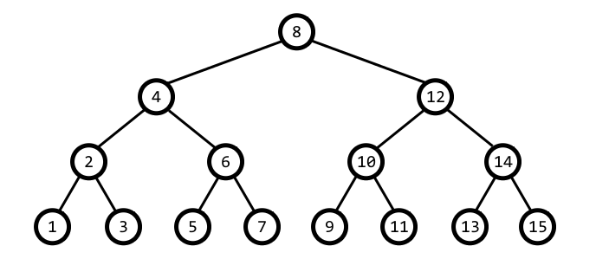
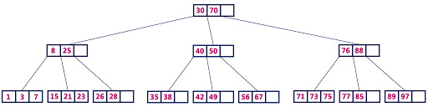
Background

Slide 3
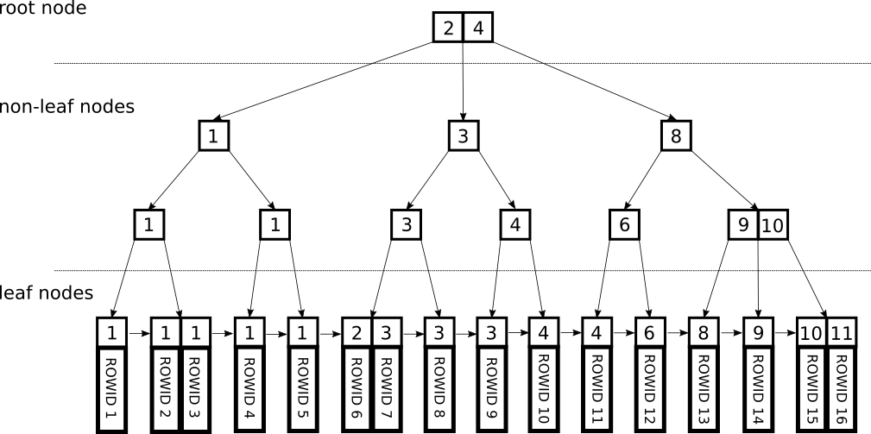
Background
Invented by Rudolf Bayer, and Edward M. McCreight (1972)
Was invented for the purpose of efficiently managing index pages for large random access files.

Slide 4
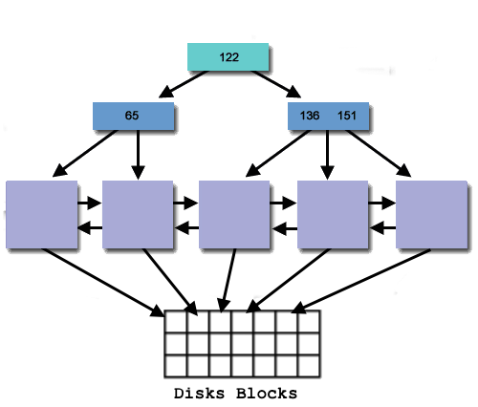
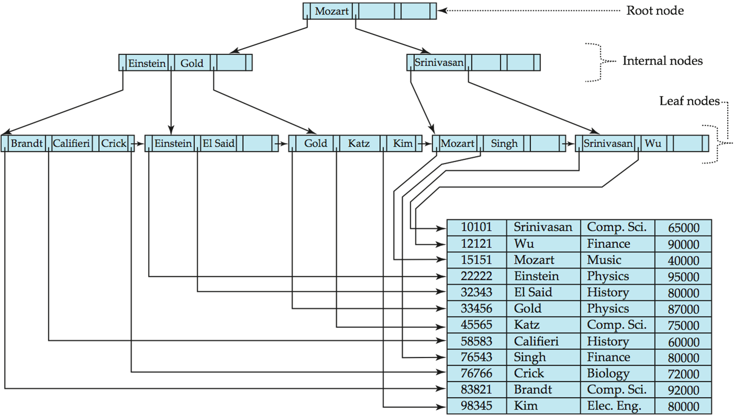
Background
B-tree is a tree data structure that keeps data sorted and allows searches, sequential access, insertions, and deletions in logarithmic time.
Often used as an external data structure, i.e., for data stored on disk
Since hard disks are 1000 – 100,000-times slower than RAM, it is crucial to minimize the number of disk accesses; this is achieved by choosing very large value for number of keys per node (usually so that one node fills one disk page)
It’s normal for a B-Tree to have millions+ of nodes and have a height in the single digits !

Slide 5
Properties
Every node has at most m children (branching factor).
Every non-leaf node (except root) has at least ⌈m/2⌉ child nodes.
The root has at least two children if it is not a leaf node.
A non-leaf node with m children contains m − 1 keys.
All keys of a node are sorted in increasing order. The child between two keys k₁ and k₂ contains all keys in range from k₁ and k₂.
B-Tree grows and shrinks from root (unlike Binary Search Tree).
All leaves appear in the same level.
Like other balanced Binary Search Trees, time complexity to search, insert and delete is O(Log n).

Slide 6
Properties
Every node has at most m children.
out-degree or max-degree and in b-trees its know as a branching factor.
The root node below has four children (m=4) and 3 keys (k=3).
40
70
80
01
03
05
60
65
68
78
82
90

Slide 7
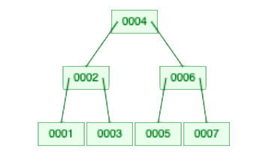
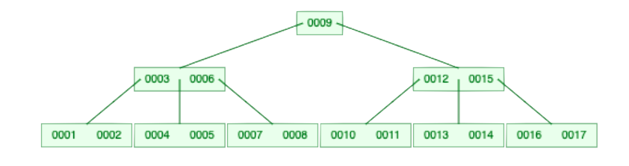
Properties
Every non-leaf node (except root) has at least ⌈m/2⌉ child nodes.
m=3
m=5

Slide 8
Properties
The root has at least two children if it is not a leaf node.
m = 4
When we added 40 to the tree, it split, and created 2 children.
(more on that later)
10
20
30
20
10
30
40

Slide 9
Properties
A non-leaf node with m children contains m − 1 keys.
Root has 4 children, one pointer on each side of a key.
So 3 keys…
Root
40
70
80
01
03
05
60
65
68
78
82
90

Slide 10
Properties
All keys of a node are sorted in increasing order. The child between two keys k₁ and k₂ contains all keys in range from k₁ and k₂.
40
70
80
All less than k₁=40
Grater than k₁ =80
01
03
05
60
65
68
78
82
90
All between k₁ =40 and k₂ =70
Between k₁ =70 and k₂ =80

Slide 11
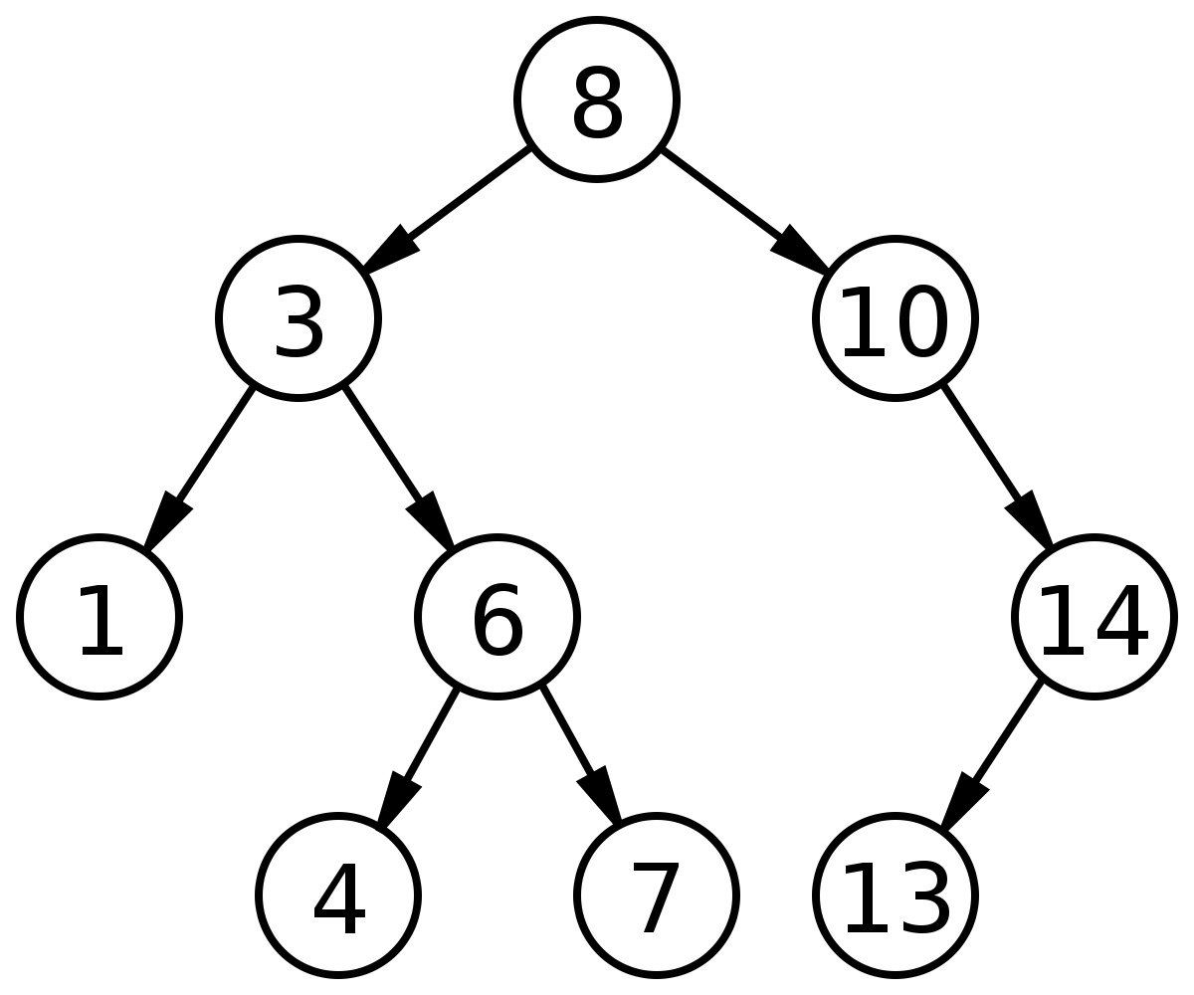
Properties
B-Tree grows and shrinks from root (unlike Binary Search Tree).
Hard to visualize, but I will show you on a visualizations web site. For now:
BST:
Binary search trees simply find a null pointer on a leaf, and add the new value, thereby growing down.

Slide 12
Properties
B-Tree grows and shrinks from root (unlike Binary Search Tree).
B-tree:
20
10
20
30
40
10
30
40

Slide 13
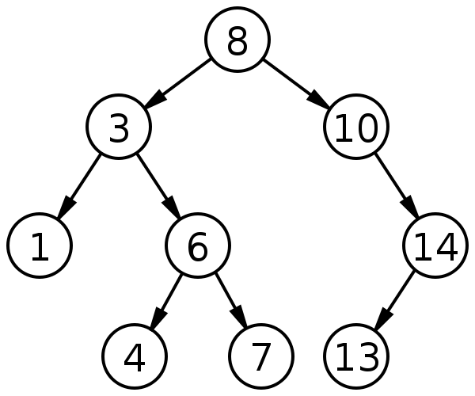
Properties
All leaves are at same level.
Not so much
40
70
80
Nice an even
01
03
05
60
65
68
78
82
90

Slide 14
Properties
Like other balanced Binary Search Trees, time complexity to search, insert and delete is O(Log n).
In Laymen's Terms:
Binary Tree:
A (balanced) Binary search tree has a bounded search of O(Log n)because it is guaranteed to have a height of Log n based on its structure. Each comparison eliminates half the remaining search space as long as we maintain a balanced structure.
B-Tree
The structure of a B-tree also guarantees a bounded height, with a max number of keys and a max number of children in each node.
Because of this structure, we are guaranteed to make no more than O(Log n) comparisons when searching for a value.

Slide 15
B-Tree Operations
Insert
Search
Delete
Fancy Slide ☺

Slide 16
B-Tree Operations
Insert
1) Initialize x as root.
2) While x is not leaf, do following
a) Find the child of x that is going to to be traversed next. Let the child be y.
b) If y is not full, change x to point to y.
c) If y is full, split it and change x to point to one of the two parts of y. If k is smaller than mid key in y, then set x as first part of y.
Else second part of y. When we split y, we move a key from y to its parent x.
3) The loop in step 2 stops when x is leaf. x must have space for 1 extra key as we have been splitting all nodes in advance. So simply insert k to x.

Slide 17
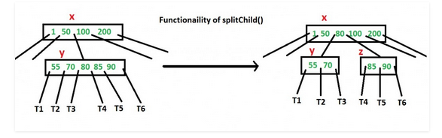
B-Tree Operations
Insert (Split)

Slide 18
B-Tree Operations
Insert
Max Keys = 4
10
Insert 10

Slide 19
B-Tree Operations
Insert
Max Keys = 4
10
20
30
Insert 20,30

Slide 20
B-Tree Operations
Insert
Max Keys = 4
10
20
30
40
To big!
Insert 40
Split
20
10
30
40

Slide 21
B-Tree Operations
Insert
Max Keys = 4
Compare
20
Insert 50
10
30
40
50
Fits fine

Slide 22
B-Tree Operations
Insert
Max Keys = 4
Compare
20
Insert 60
10
30
40
50
60
NOT fine
20
Split
10
30
40
50
60
20
40
copy key up and add pointer
10
30
50
60
Done

Slide 23
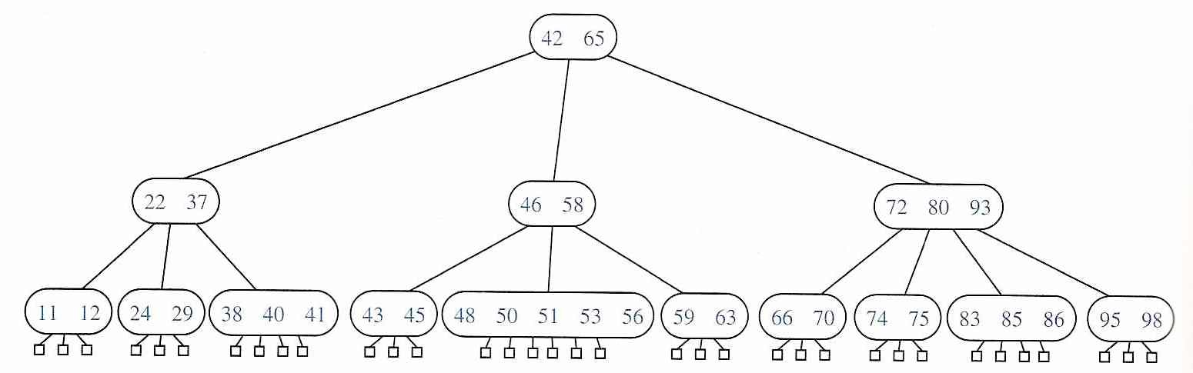
B-Tree Operations
Search

Slide 24
B-Tree Operations
Search
Search 70
70 > 42

Slide 25
B-Tree Operations
Search
Search 70
70 > 65

Slide 26
B-Tree Operations
Search
Search 70
70 < 72

Slide 27
B-Tree Operations
Search
Search 70
70 > 66

Slide 28
B-Tree Operations
Search
Search 70
70 == 70 Key found

Slide 29
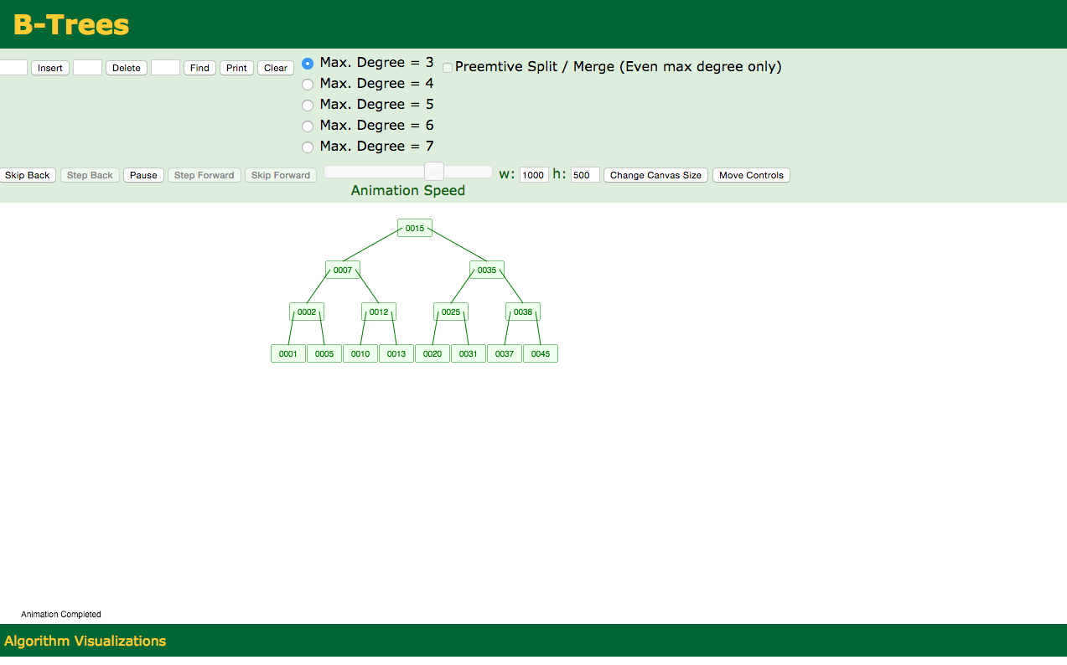
B-Tree Operations
Delete
https://www.cs.usfca.edu/~galles/visualization/BTree.html

Slide 30
Sources
https://en.wikipedia.org/wiki/B-tree
https://en.wikipedia.org/wiki/Binary_search_tree

