Slide 1
Cyber Security
by Vlad Rotariu

Slide 2
Presentation Contents
Need for Cyber Security
Threats:
  Hacking
  Malware
  Phishing
Stay Secure
  Internet Shopping
  Internet Banking
Personal Privacy
  Public Wi-Fi
  Passwords
  Router
  Internet of Things (IOT)
QR Codes
Support & Resources

Slide 3
Why is Cyber Awareness Important?
Cyber crime is a growing trend
Raise awareness of threats
As with most crimes the police can’t tackle this problem alone
To encourage reporting
Promote Government backed scheme ‘Cyber Essentials’
Cyber crime is massively under reported.

Slide 4
How Cyber crime affects the world
Approximately 12.5% of the world economy is online.
It poses a risk if the correct security measures aren’t taken.
In 2016 49% of businesses were breached. It’s not a matter of if but when.
According to an Office for National Statistics Survey, there were almost 6 million Cyber Crime and Fraud offences in 2016, which means these crime types now make up half of all crime in England and Wales. That’s 1/10 of people in England and Wales.

Slide 5

Hacking
Financial (theft, fraud, blackmail)
Political /state (state level/ military)
Fame/ kudos (fun/ status)
Hacktivism (cause)
Pen testers (legal hacking)
Police
Insider
Business

Slide 6
Common threats - Ransomware
Normally loaded onto a computer via a download/attachment/link from an email or website.
Will either lock the screen or encrypt your data.
Once Ransomware is uploaded on your computer/tablet/phone it is very difficult to remove without removing all of the data
Wannacry attack 2017 - One of the biggest cyber attacks to occur.
Is said to have hit 300,000 computers in 150 countries.
Companies affected include; NHS, Renault, FedEx, Spanish telecoms and gas companies, German railways.

Slide 7
How to tackle Ransomware
Back up- Keep a backed up copy of your data. Ensure its not permanently connected to the network.
Patch- Keep your software up to date. Wannacry was successful as those affected computers hadn’t updated. The update contained a fix for the problem.
Attachments- Don’t click on links from emails/SMS as this could easily be from an untrusted source and contain malware like Ransomware

Slide 8
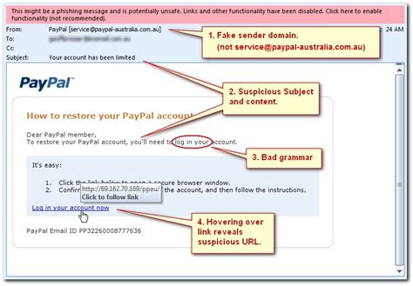
Phishing
Is the attempt to obtain sensitive information by deception.
They will be after your login credentials, payment card details or to upload malware to your computer
The email will normally impersonate a genuine company or person.
How to tackle the problem
Don’t click any links on an email unless you can guarantee who its from.
Use a trusted method of contacting the company via a phone number, app or website.
Mark the email as spam and contact the organisation.

Slide 9
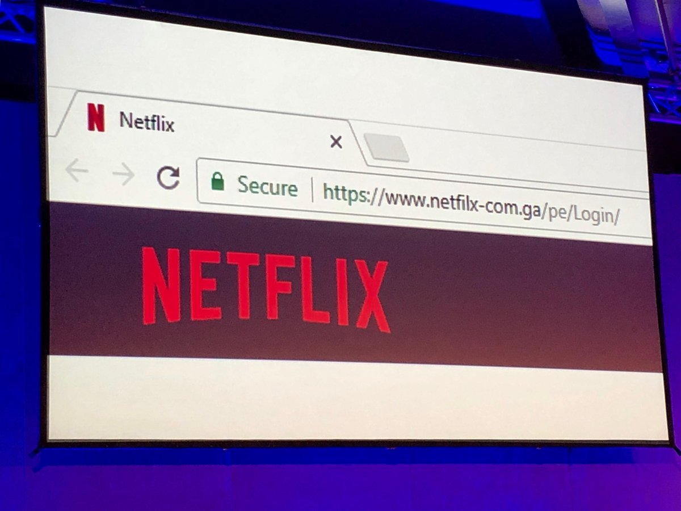
What to look out for when shopping on the internet?
Ensure you’re on the correct website
HTTPS and the padlock- The ‘S’ stands for secure, this means you have a secure connection to the website. This should prevent a ‘man in the middle’ attack. It encrypts your data and the receiver will be able to decrypt it but if it is a fraudulent website they will still obtain your information.
Use a credit card/ PayPal when conducting online transactions.

Slide 10
Public Wi-Fi
May not be trustworthy. They could share your information to other companies who operate in countries without any data protection.
You may not know who is watching you whilst you’re online.
What to do and not do to
Don’t use online banking. Use your own data.
Don’t conduct any purchases
Use a virtual private network (VPN)

Slide 11
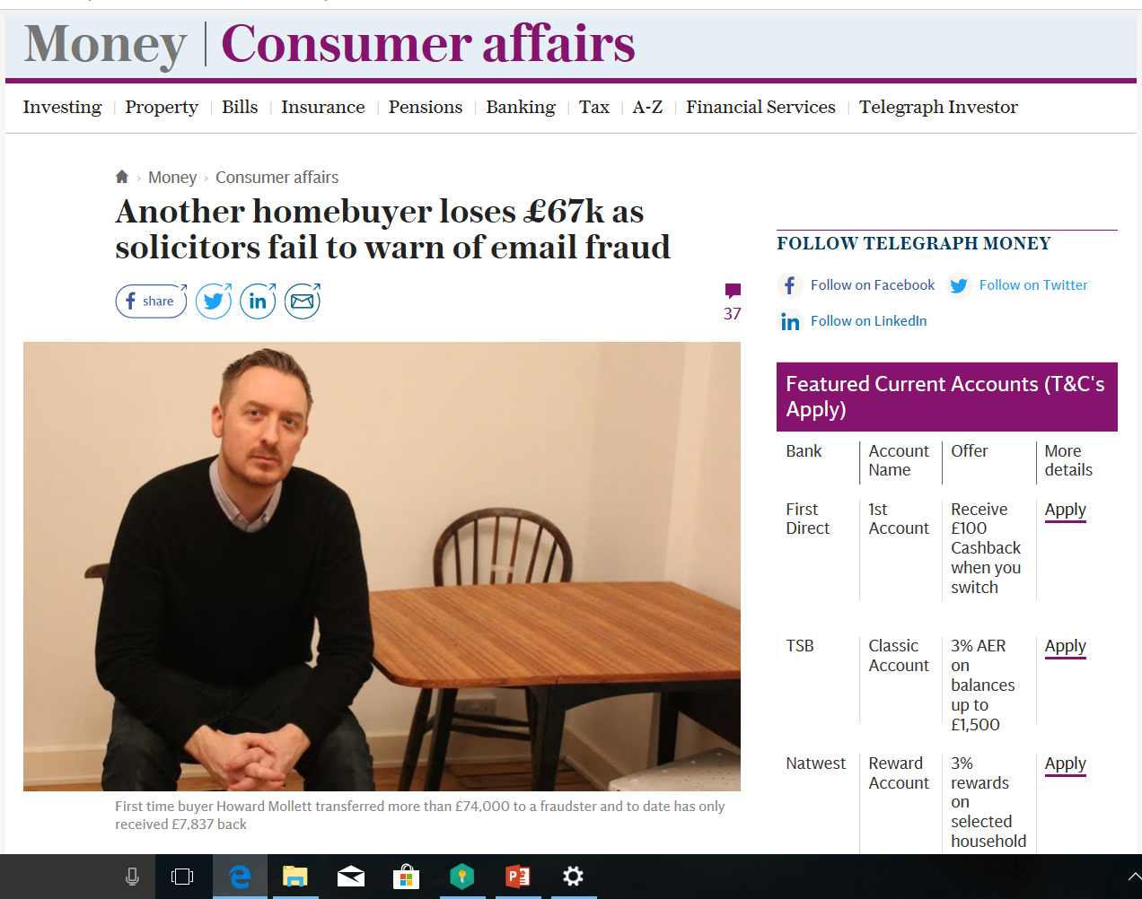

Slide 12
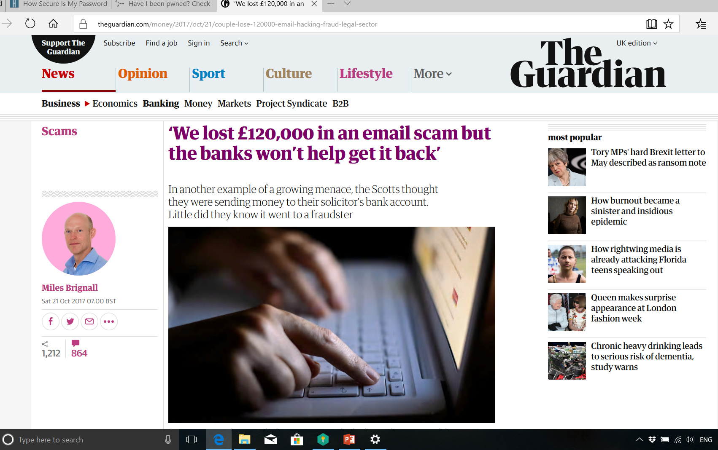

Slide 13
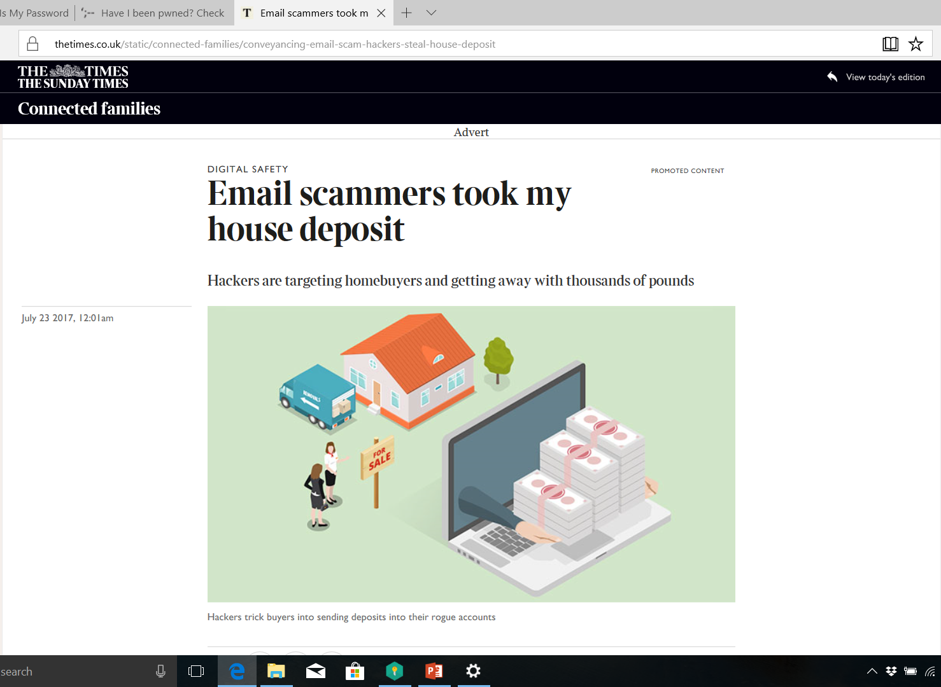

Slide 14
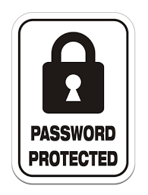
Passwords Advice
Use 1 password per account.
Three random words is the NCSC’s advice. Capitals, special characters and numbers is your own choice.
If you follow this advice your passwords security will be significantly increased against a brute force attack.
Password managers can be helpful to store your passwords.

Slide 15

Advice
In the physical world we’re good at protecting ourselves and our property, we need to replicate this in the digital world.
80% of cyber-crime is preventable.
QR Codes

Slide 16
Advice
Update and migrate
Activate your firewall
Staff awareness
Data encryption
User accounts privileges i.e admin
Cyber insurance
Prepare Plan

Slide 17
You are the best defence!
Technology is only a small part of Cyber Defence
You are the most important person – protect yourself
For businesses the most important and best defence is Cyber Security Aware employees – train your staff
Always be aware!
Always be on your guard!

Slide 18

Reporting Cybercrime
Online fraud is to be reported to Action Fraud. They’re the national reporting mechanism for fraud. Via;
www.actionfraud.police.com

Slide 19




Resources
Cyber essentials (www.cyberaware.com/cyberessentials)
Get safe Online (www.getsafeonline.org)
Cyber Aware (www.cyberaware.com)
National Cyber Security Centre (https://www.ncsc.com/)

Slide 20
Thank you

