Slide 1
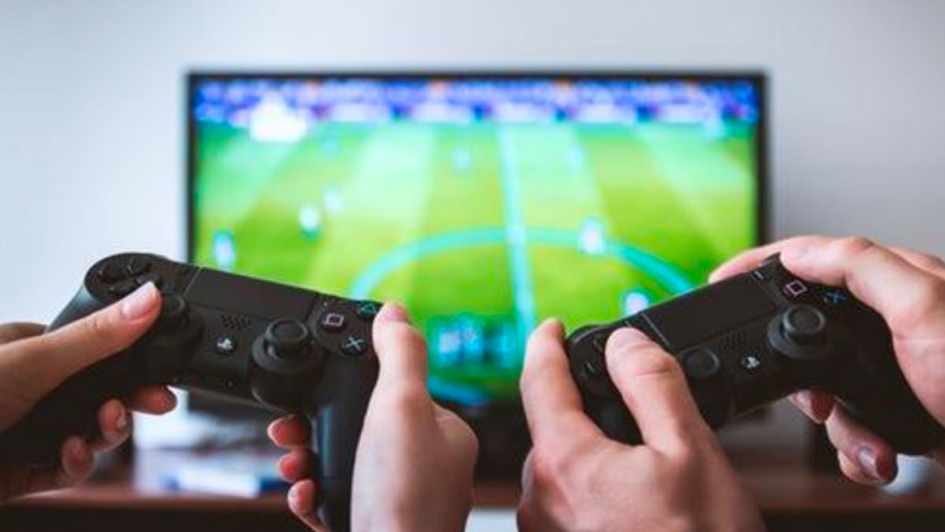
FIFA
Caracteristics
And
Types Of Networks Used
Project Made By:
Boujebha Souhaiel
Bahri Med Yassin

Slide 2

You need to know
1-Principals
2- Matériel Part
3-Fundamental Caractéristiques
4-Implication Of Wlan
5-Advantages
6-Risks
7- Améliorations And How ?

Slide 3

1. Principal (Model)
FIFA is an Esport game known in all parts of the world , The concept is two players using wireless controllers to play with 2 virtual team the football game And these two teams Formed by virtual players using skills and shots , And the winner who end the Match with most goals
Improved player conduct and choice-making: Create greater practical participant behavior and selection-making, together with gamers adapting their methods primarily based on the game state of affairs or combatants' actions.
Enhanced portraits and animation: Used to generate greater practical photographs and animations, including sensible participant actions, facial expressions, and environmental consequences like weather and lighting fixtures.
Personalized gaming experience: Ai can be used to customize the gaming experience for every participant, together with adjusting trouble levels, recommending game modes, or providing tailor-made comments and recommendations.
Real-time records analysis and visualization: Investigate actual-time information from the game and offer visualizations that help players recognize their overall performance, become aware of areas for improvement, and make strategic choices.

Slide 4
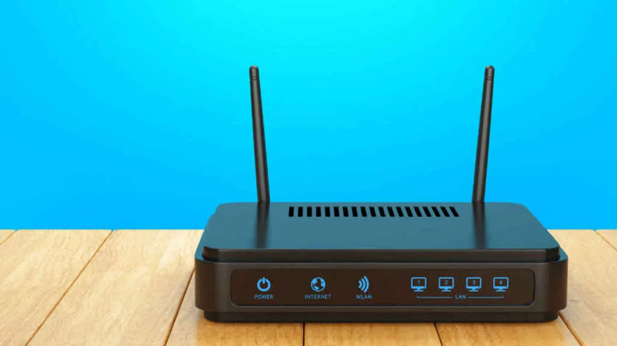
ii- Material Part
To play FIFA You will need a video game console such as PlayStation 4 , Xbox one Nintendo switch ,,, or a Pc
Game Controller is required to play FIFA You Can use the standard one or use the cutomized
Also You Can use the keyboard and mouse if You play on Computer
The Modem :
is an essential component of the communication process in online games. Without it, the game server would not be able to communicate effectively with the players' computers, resulting in disrupted gameplay and poor performance.
-Maintain a continuous and stable connection to the internet.
-Translate network addresses so that online game servers can recognize the IP addresses of the players' computers.
-Handle incoming and outgoing data streams efficiently and accurately.
-To route the data streams from the online game server to the appropriate player.

Slide 5
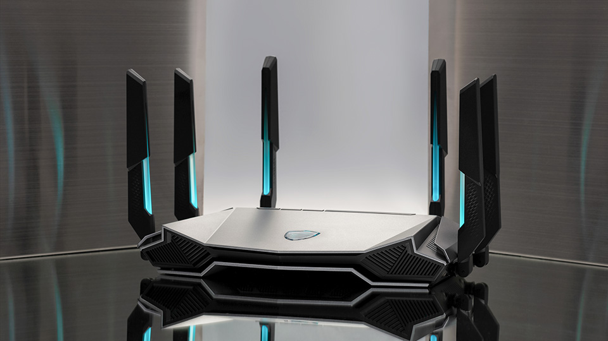
ii- Material Part
The Router : is an essential networking device that enables devices to connect to the internet and communicate with each other. In the context of online gaming, the role of the router is crucial, as it serves as the connection hub for the game console, game devices, and the internet.
Router capabilities and requirements for online gaming: Different types of routers to different online gaming requirements.
Wireless-N standard: This ensures higher data transfer speeds for game files.
VPN capabilities: These enable secure and private online connections, protecting your online gaming activity from potential intruders.
Multi-WAN or Multi-LAN capabilities: These ensure a balanced network traffic load and help avoid bottlenecks during high-traffic gaming sessions.
Strong firewall security: This prevents unauthorized access to your gaming network and protects your sensitive gaming data.

Slide 6
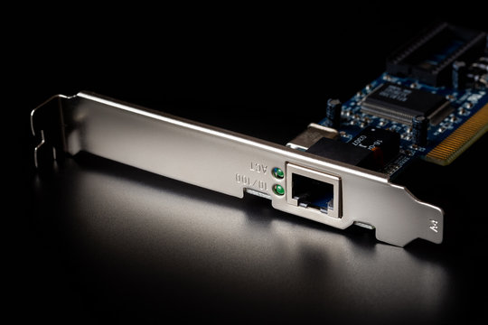
II- Material Part)
The Network Card : also known as a network interface card (NIC), is a crucial component in any computer system that requires a network connection. Online games often involve multiple players working together or competing against one another, which necessitates fast and reliable network connections.
The network card's role in online games extends beyond just connecting to the internet. Within the game, it often functions as a centralized data repository, storing information about the players' in-game characters, inventories, achievements, and more. This information is then accessed by the game server and used to maintain a consistent game state across all players.
In some cases, the network card may also be used to synchronize data between different instances of the game. For example, in a massive multiplayer online (MMO) game, the network card might be responsible for synchronizing the actions of a player's character across different servers, ensuring a consistent gaming experience no matter which server the player is connected to.

Slide 7
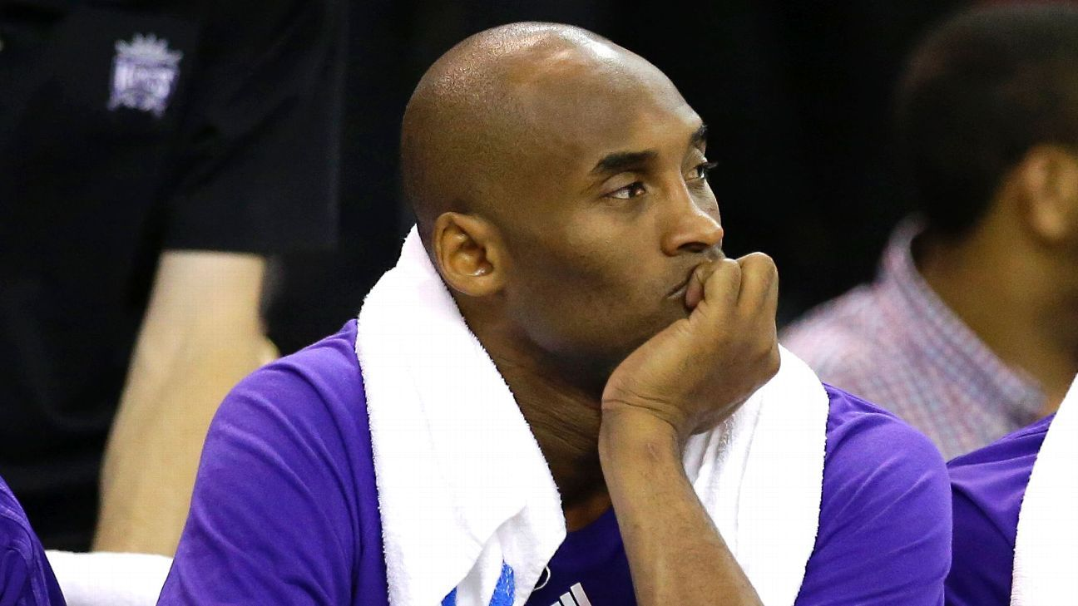
III- Fundamental caracteristics of online video Game networking
Multiplayer Support : It is important that the game can accommodate multiple players, whether locally or remotely. This helps expand the scope of the game and provides an interactive online gaming experience.
Reliable Connection : The game must offer a stable and reliable connection to ensure an uninterrupted gaming experience. This includes handling disconnections and communication errors.
Minimum Delay : For a smooth online gaming experience, it is important to minimize the delay between a player sending an action and other players receiving that action.
Secure Communication : Communication between players and the server must be secure to protect sensitive data and prevent abuse.
Adaptability : The game should be able to adapt to different devices and network environments, ensuring a consistent gaming experience for all players.
Compatibility : between versions: The game must be compatible between different versions, which means that players can continue playing even if a new patch is released.
Resource Optimization : The game should be optimized to minimize the use of computer resources and to ensure a smooth gaming experience.
By combining these fundamental features, a quality online game can be developed to provide a unique and exciting online gaming experience.

Slide 8

IV- Implication Of Wlan
WLAN (Wireless Local Area Network) : is a type of network that enables devices to connect and communicate with each other wirelessly. In online games , Although WLAN is a convenient solution for wireless connectivity, serious gamers may prefer wired connections to minimize latency and maximize connection stability. However, with quality equipment and proper setup, many players can have a satisfying online gaming experience over a WLAN connection.

Slide 9
V- Advantages
It’s a reliable sort of communication, Enhanced Performance: By providing fast and reliable network connections, network cards help maintain a smooth gaming experience for players.
As WLAN reduces physical wires so it’s a versatile way of communication.
Data Security : Network cards can help protect sensitive data by encrypting it during transmission and using strong security protocols to ensure its integrity.
Encryption Protocols: Modern WLANs support robust encryption protocols such as WPA3 (Wi-Fi Protected Access 3),
Authentication Mechanisms: WLANs often implement authentication mechanisms, such as WPA3 ,
Guest Network Isolation: Many WLANs support the creation of guest networks, which are separate from the main network.
Support for Multiple Platforms: Network cards can be used across various platforms, including desktop computers, laptops, and gaming consoles, providing a consistent experience for players regardless of their hardware.

Slide 10
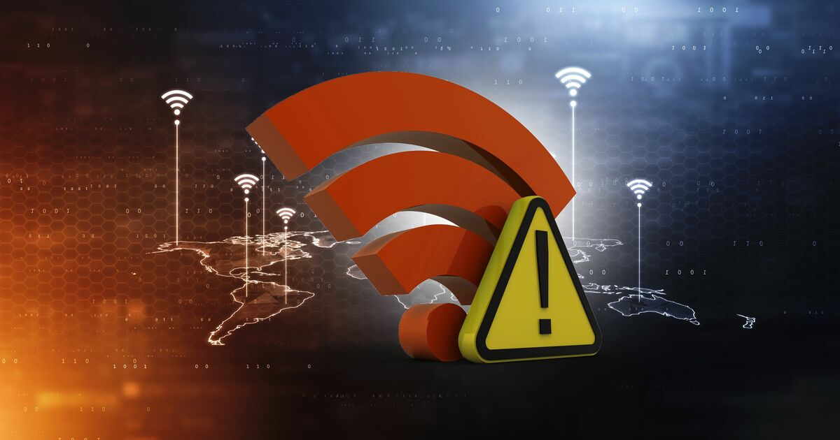
VI- Risks
The Risks :
WLAN requires license.
It’s a limited area to hide.
The Government agencies can control the flow of signals of WLAN and can also limit it if required. this will affect data transfer from connected devices to the web.
If the amount of connected devices increases then data transfer rate decreases.
If there’s rain or thunder then communication may interfere.
Due to Low security as attackers can get access to the transmitted data.
Signal Interference: The use of WLAN technology may introduce the risk of signal interference, leading to reduced or unstable gameplay. For example, WLAN signals can be easily absorbed by physical objects or reflect off metal surfaces, leading to decreased signal strength and potential connection issues.

Slide 11
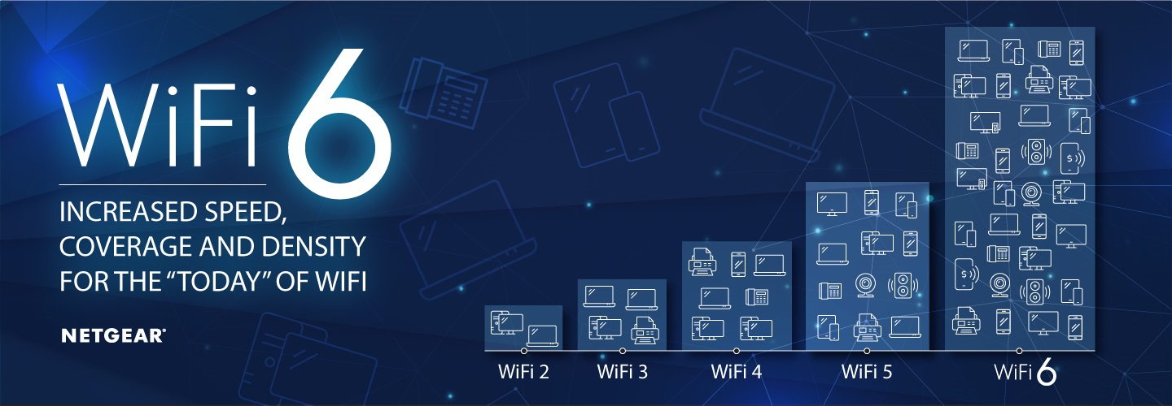
Vii- Improvements And How ?
Next Generation Wireless Local Area Network (WLAN) : As the electric industry continues to see increasing requirements for connectivity to workers and sensors, existing networks may need to be expanded and upgraded. Wireless LAN technology has recently made significant advancements with the completion of Wi-Fi™ 6 (IEEE 802.11ax), the introduction of the latest security standard, WPA3, and new Wi-Fi Location capabilities. For existing and emerging wireless use cases, this next generation WLAN offers a significant improvement. The capabilities can match or exceed 5G in most aspects, typically at a lower cost. While Wi-Fi 6 provides notable improvements in data throughput, the most significant advancements are improvements in efficiency. Wi-Fi 6 works better with large numbers of devices and users. It enables new utility use cases, from wireless sensors to augmented and virtual reality (AR/VR), and can deliver value in the generation plant, in the substation, and across the enterprise..

Slide 12
Vii- Improvements And How ?
Machine learning and deep learning methods for wireless network applications :
Networking optimization : “Network resource optimization with reinforcement learning for low power wide area networks,” A deep learning-aided temporal spectral ChannelNet for IEEE 802.11p-based channel estimation in vehicular communications,
UAV applications : “Improving aerial image transmission quality using trajectory-aided OLSR in flying ad hoc networks,”
Wireless sensor networks : “A bi-population Quasi-Affine Transformation Evolution algorithm for global optimization and its application to dynamic deployment in wireless sensor networks,”
Network security : “Intrusion detection in internet of things using supervised machine learning based on application and transport layer features using UNSW-NB15 data-set,”
Mobile positioning : “New three-dimensional positioning algorithm through integrating TDOA and Newton’s method,”

Slide 13

Viii- references
Sources :
https://www.geeksforgeeks.org/advantages-and-disadvantages-of-wlan/
https://jwcn-eurasipjournals.springeropen.com/articles/10.1186/s13638-022-02196-2
https://www.pfcommunications.com/what-are-the-latest-improvements-in-wireless-access-points-and-wlan-technologies/
https://www.epri.com/research/products/3002022297
https://www.fifa.com/fr/news/fifa-renforce-presence-jeux-video-esport
,,,,

Slide 14
Thanks for your attention

