Slide 1
Pattern Recognition and Labeling with Neural Networks
Ayush Mati ,Ishank Tyagi ,Pratham Pandey, Kasula Pranav
SPIC-2025 Design Presentation
02 July 2025

Slide 2
Overview Of Project
Summary
Develop neural network(NN) based labelling and pattern recognition
Detect cars in aerial traffic scenes
Rationale
Develop skills in Project Management
Learn about NN-based image classification
Technical Approach
Develop training image database D
Design and develop convolutional NN and train on D
Apply NN to aerial imagery to traffic scenes in test set T

Slide 3
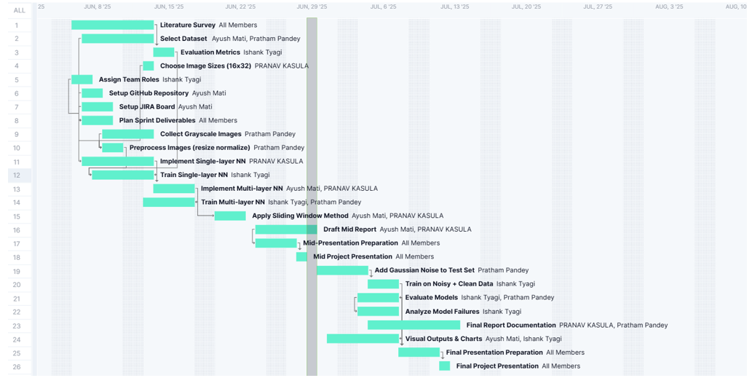
Anticipated Project Schedule

Slide 4
Literature Sources
Theoretical References
H. Alshazly, M. A. Ghoneim, and A. M. E. M. El-Kholy, "Deep Neural Network Based Vehicle Detection and Classification of Aerial Images," ResearchGate, Apr. 2022.https://www.researchgate.net/publication/359980288
A. Khan, A. Sohail, U. Zahoora, and A. S. Qureshi, "A Survey of the Recent Architectures of Deep Convolutional Neural Networks," Sensors, vol. 20, no. 5, p. 1452, Mar. 2020.https://www.mdpi.com/1424-8220/20/5/1452/pdf
Technical References
PyTorch: A. Paszke et al., “PyTorch: An imperative style, high-performance deep learning library,” Advances in Neural Information Processing Systems, vol. 32, 2019.
Matplotlib: J. D. Hunter, “Matplotlib: A 2D graphics environment,” Computing in Science & Engineering, vol. 9, no. 3, pp. 90–95, 2007

Slide 5
ANALYSIS
Metrics
Accuracy = (TP + TN) / (TP + TN + FP + FN) = 0.7001
Precision = TP / (TP + FP) = 0.7001
Recall (Sensitivity / True Positive Rate) = TP / (TP + FN) = 1.0
F1 Score = 2 × (Precision × Recall) / (Precision + Recall) = 0.8236
PD (Probability of Detection) = TP / (TP + FN) = 0.4
RFA (Relative False Alarm rate) = FP / (FP + TN) = 1.0
RM (Residual Miss rate) = FN / (FN + TP) = 0.0

Slide 6
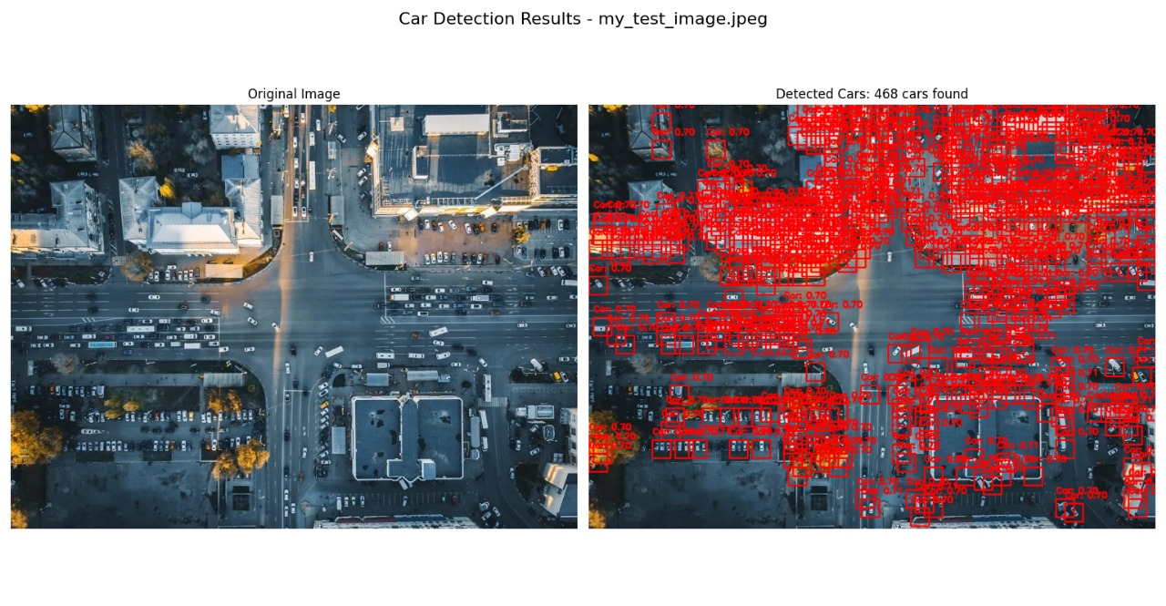
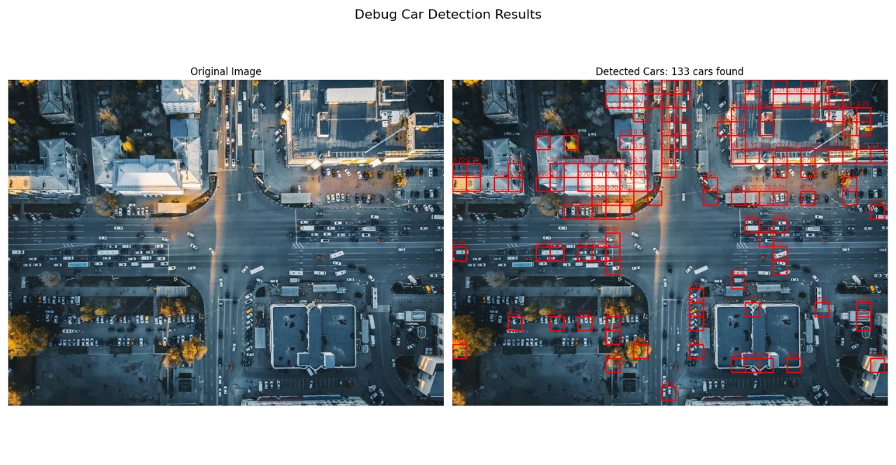
BEFORE
AFTER

Slide 7
Technical Challenges And Solutions
Limited Dataset Availability
Built a small but focused dataset.Used basic augmentation (rotation, flip) to increase variety and reduce overfitting.
Low Familiarity with Noise-Based Testing
Learned to generate Gaussian noise using NumPy and OpenCV.Compared performance between models trained with and without noisy data.
First-Time Error Analysis
Learned to compute meaningful detection metrics:
Pd (Probability of Detection) = TP / (TP + FN)
Rfa (Rate of False Alarms) = FP / (FP + TN)
Rm (Rate of Misses) = 1 – Pd
used ROC Curve (Pd vs. Rfa) to evaluate model performance across thresholds.Identified key issues like high false positives in noisy windows.

