Slide 1

Looking For The Best Chinese Restaurant in China Town
March
2019

Slide 2

Introduction
Background
When new visitors come to Austin china town from China or other US cities, looking for a good Chinese restaurant to have lunch is a necessary thing visitors should consider
Visitors are usually likely to walk around in the China town and want to go somewhere for fun after lunch.

Slide 3
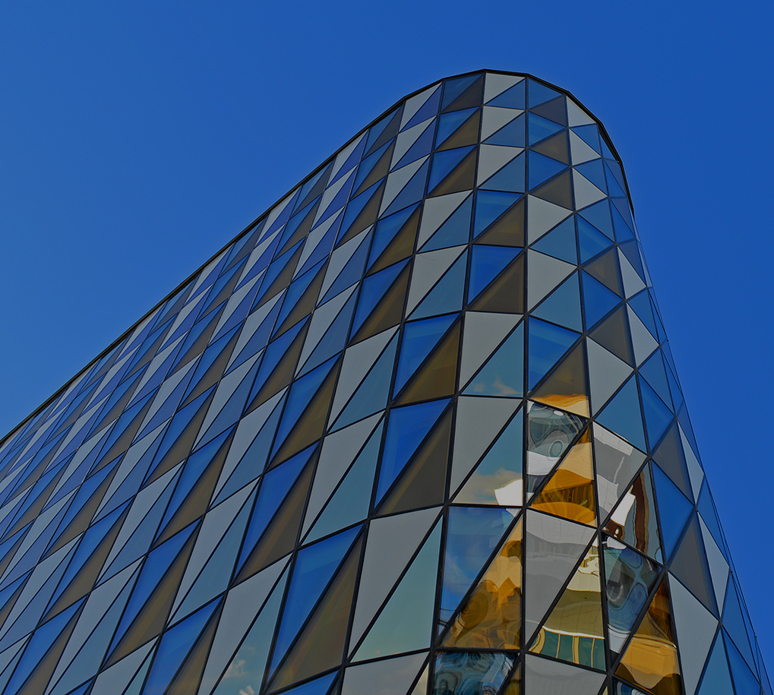
Problem Statement
Which Chinese restaurant is the best option to choose among those restaurants in the China town?
What place should they go for fun after having lunch?

Slide 4
Target Audience
Mainly Chinese visitors from China and other U.S cities
People who is the first time visiting to China town in Austin

Slide 5
Data Source
Address of China town in Austin (10901 N Lamar Blvd, Austin, TX 78753), which will be obtained from Google
Four Square API data using search venue method to find near by Chinese restaurants in China town

Slide 6
Methodology
Four square API search and trending venues
Construct URL to send request to the API to search for a specific type of venues, which is “Chinese”.
send request to explore one of the venues, named New Fortune Chinese seafood restaurant
Explore New Fortune Chinese restaurant and nearby locations
Explore trending venues near New Fortune Chinese restaurant

Slide 7
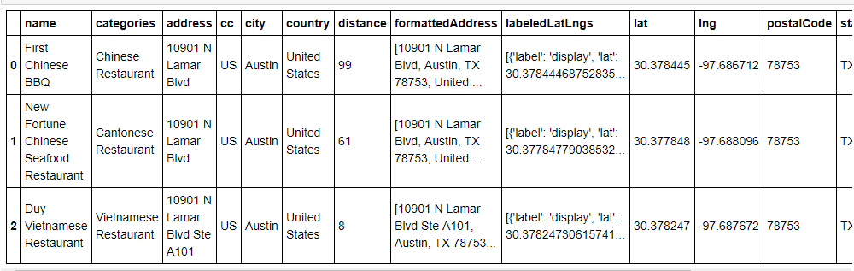
CHART SLIDE

Slide 8
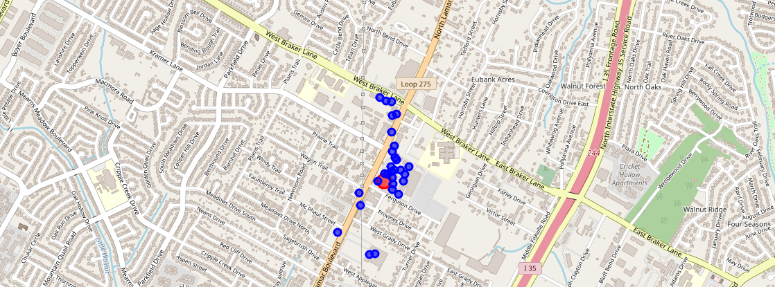
Near by location
Blue dots are locations nearby New Fortune
Red dot is New Fortune Chinese restaurant

Slide 9
Result and Discussion
Two Chinese restaurants and one Vietnamese restaurant are found based on the Search venues method.
New Fortune Chinese seafood restaurant has the highest rating, which is 8.6
There are 29 venues near the New Fortune Seafood restaurant including some Korean and Vietnamese restaurants, maybe visitors can try them.
No trending venues exist near China town

Slide 10
Conclusion
New Fortune Seafood Restaurant is their best option to go if new visitors come to China town in Austin.
They can also choose First Chinese BBQ because its rating is good as well
As no trending venues exist near China Town in Austin, visitors should go to downtown or do some online search to find popular places for fun.

