Slide 1
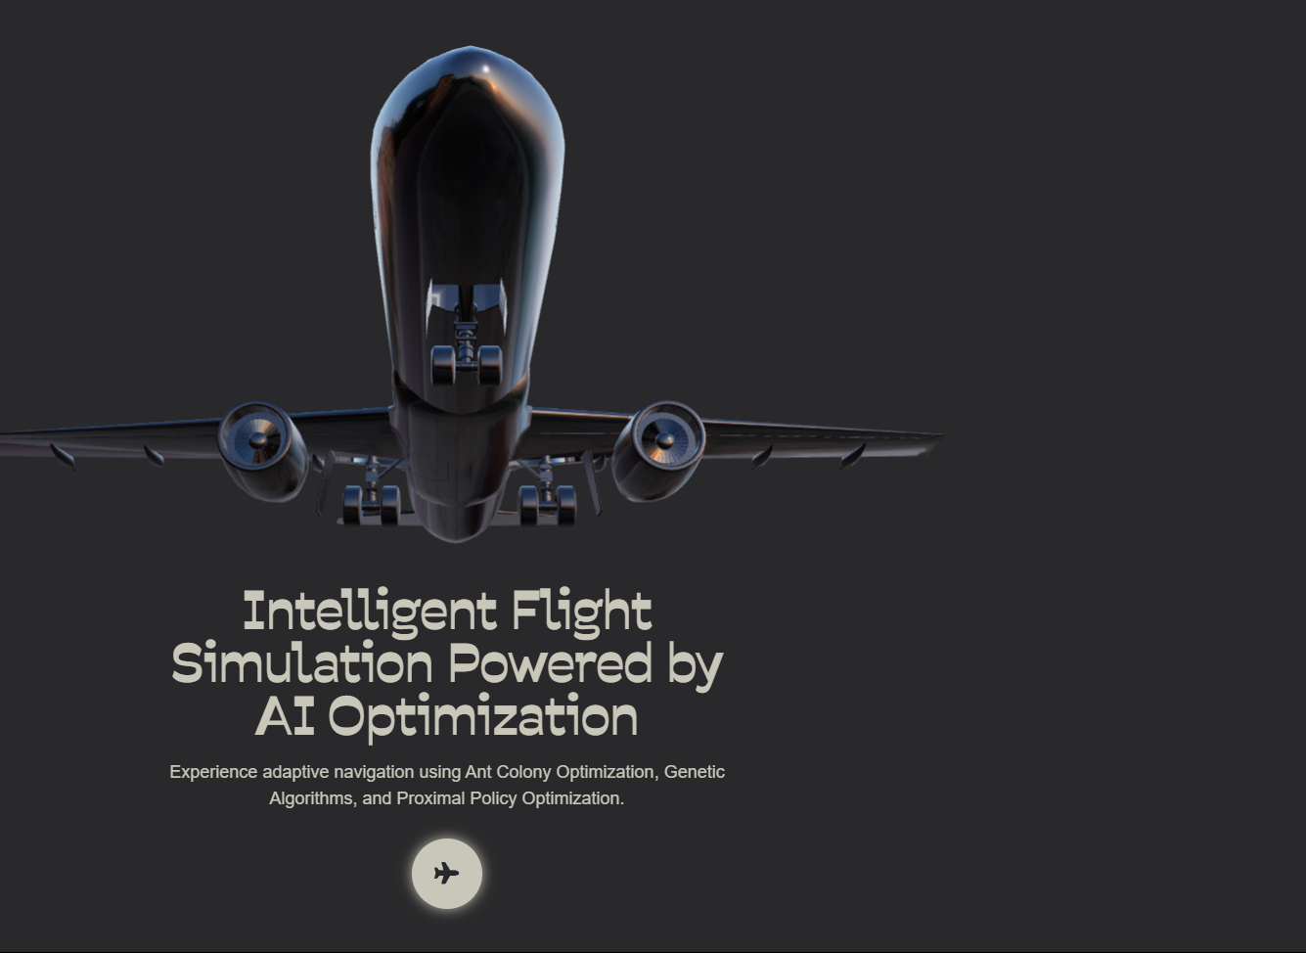
Presented by Soumyadip Debnath (University Roll: 34230921009) Sreejan Naru (University Roll: 34230921012) Rituraj Debnath (University Roll: 34230921010) Piyali Mukherjee (University Roll: 34230921006)
Guided by
Prof. Sanjoy Bannerjee
BACHELOR OF TECHNOLOGY IN COMPUTER SCIENCE AND ENGINEERING (INTERNET OF THINGS AND CYBER SECURITY INCLUDING BLOCKCHAIN TECHNOLOGY)
Flight-Route Generation, Evaluation & Dynamic Rerouting System

Slide 2
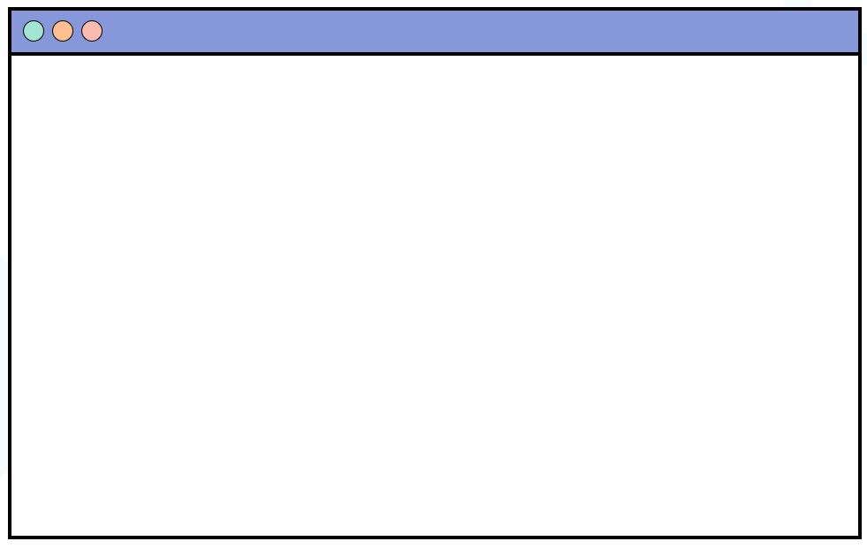
Introduction
Flight Route Optimization is the process of finding the most efficient, safe, and cost-effective path for an aircraft to fly from its origin to its destination.
This forms the core of modern aviation systems — helping airlines save money, reduce emissions, and improve passenger safety and comfort.

Slide 3
Importance
Importance
Saves time
Saves fuel
Motivation
Smart Routing
Static limits
Real World Impact
Reduces delays
Lowers emissions
Improves safety
Traffic rising
Cuts fuel cost

Slide 4
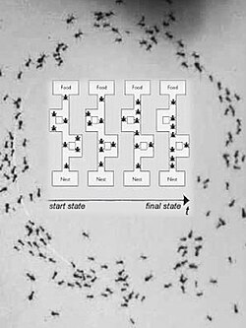
Ant colony Optimization
ACO is a nature-inspired algorithm that mimics how ants find the shortest paths to food. It’s used to solve complex problems like flight route optimization.
Working
Virtual "ants" explore paths
Good paths leave stronger "pheromones"
More ants follow stronger trails → best path emerges

Slide 5
Why ACO for
Flight Route Optimization?
📍 Finds Shortest & Safest Routes Efficiently discovers optimal paths through complex airspaces.
🌦️ Handles Dynamic Conditions Adapts to real-time changes like weather or traffic.
🔁 Continuous Learning Improves routes over time using pheromone-based feedback.
🧩 Solves Complex Problems Ideal for multi-constraint environments (fuel, time, safety).

Slide 6
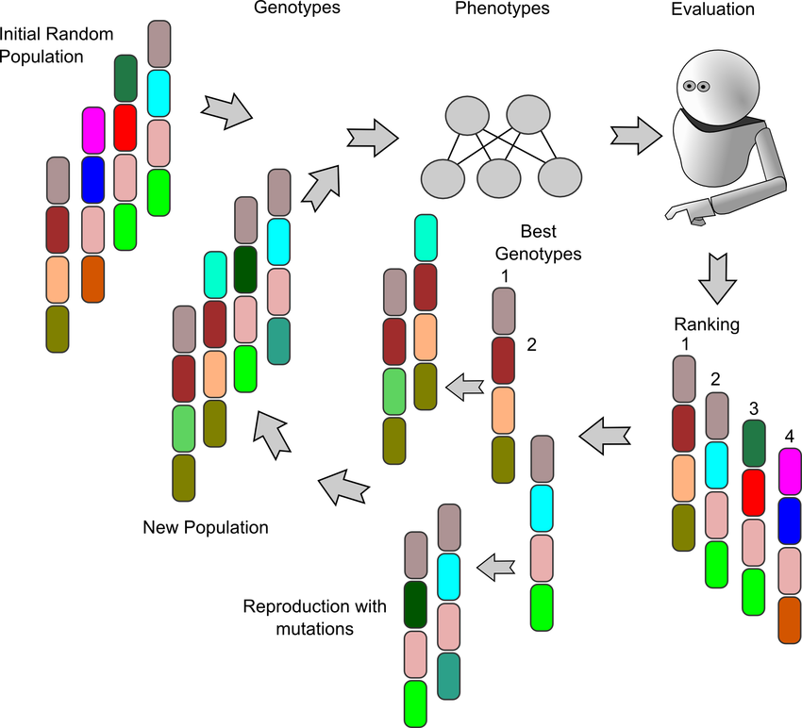
Genetic Algorithm (GA)
What is it? GA is an optimization technique based on natural selection — the fittest solutions survive and evolve.
How it works
🎲 Selection – Choose the best solutions
🔀 Crossover – Mix them to create new ones
🎯 Mutation – Add small changes for diversity
♻️ Repeat – Evolve until the best solution emerges

Slide 7
Why Use Genetic Algorithm for Flight Route Optimization?
🧠 Handles Complex Constraints Optimizes routes considering weather, fuel, time & airspace limits.
🔍 Global Search Power Avoids local optima—finds better, more efficient routes.
🔄 Flexible & Adaptive Adapts to real-time changes like traffic or emergencies.
⚙️ Parallel Exploration Evaluates many route possibilities at once for faster results.
🌐 Works Well in Dynamic Environments Ideal for evolving flight conditions and variable constraints.

Slide 8
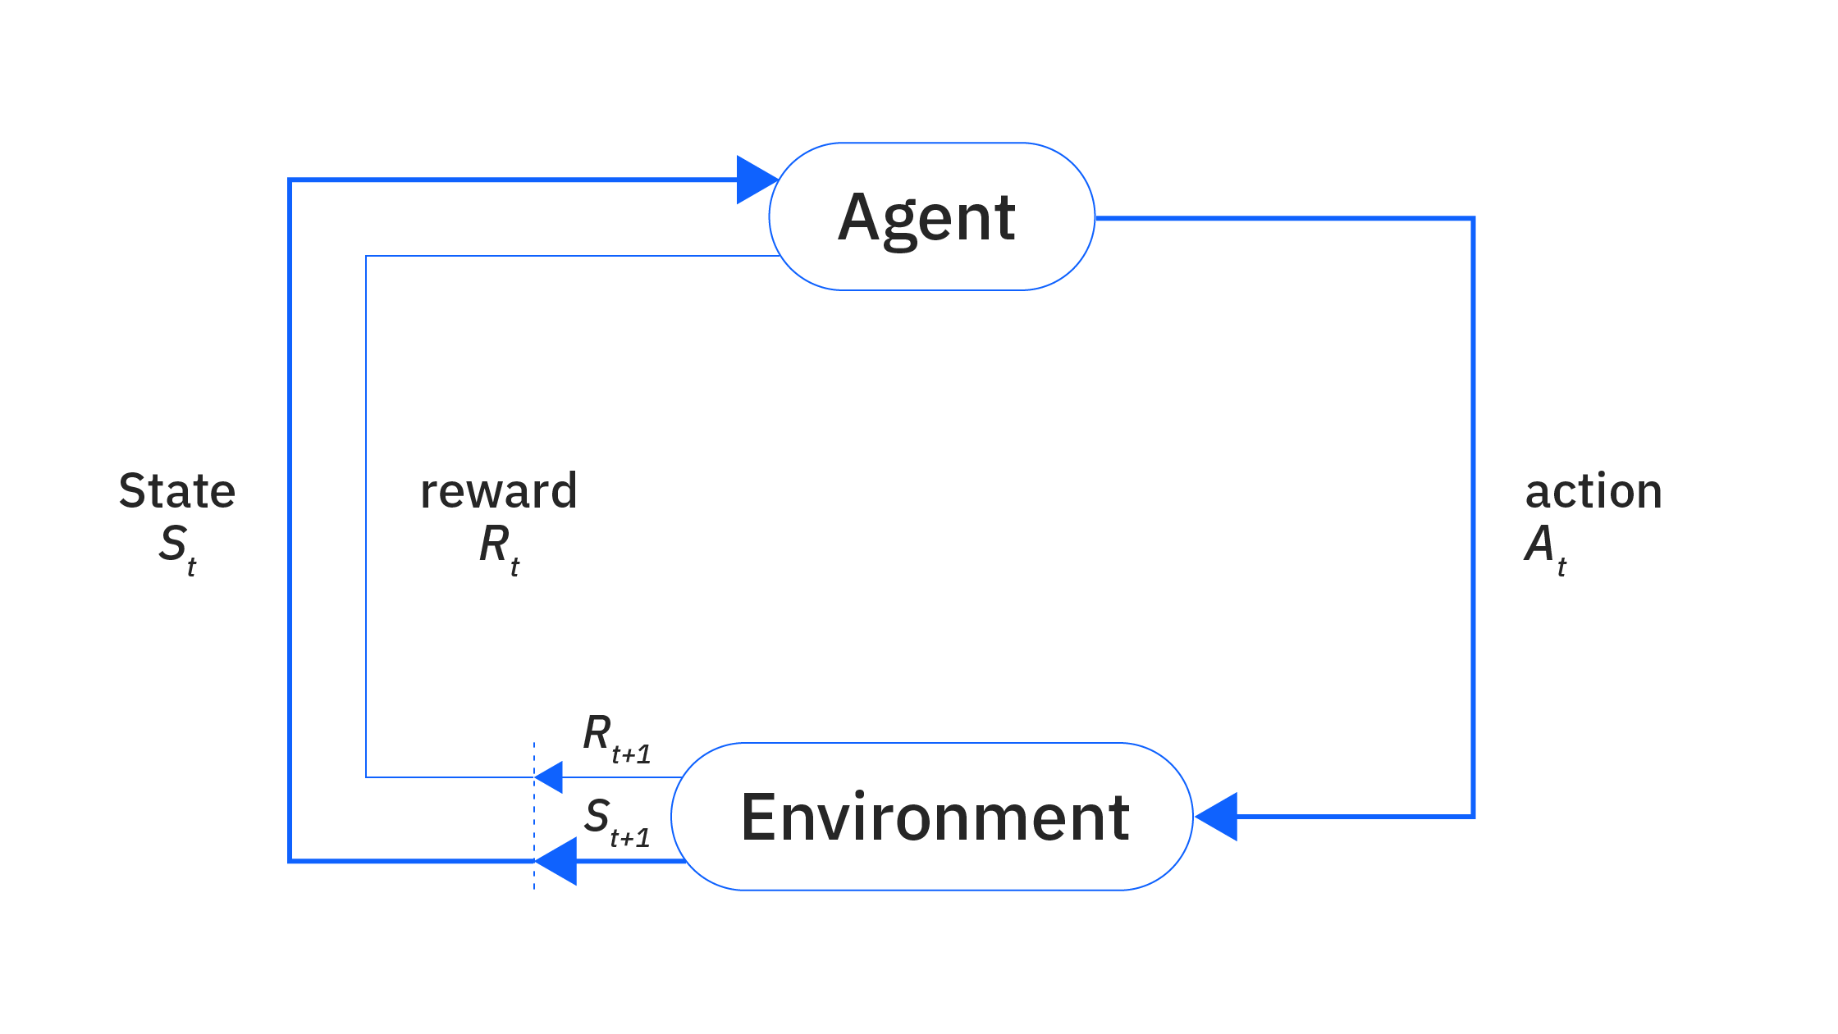
Reinforcement Learning (RL)
Reinforcement Learning is a type of machine learning where an agent learns by interacting with an environment, receiving rewards or penalties for its actions, and improving its strategy over time.
Key Concepts:
🧠 Agent – The decision-maker
🌍 Environment – Where the agent operates
🎯 Goal – Maximize cumulative rewards
🔁 Trial & Error – Learns from feedback to make better decisions

Slide 9
Why Use Reinforcement Learning?
🧠 Learns by Experience Improves decisions over time through trial and error.
🔄 Adapts to Dynamic Environments Perfect for real-time changes like weather, traffic, or emergencies.
🎯 Goal-Driven Optimization Focuses on maximizing long-term rewards (e.g., fuel savings, time efficiency).
🕹️ Autonomous Decision Making Ideal for systems requiring minimal human intervention.
🌐 Scalable & Flexible Works well in large, complex, and variable systems like air traffic networks.

Slide 10
ACO+GA+RL vs Traditional algorithm
The Problem with Traditional Algorithms
Current algorithms (like Dijkstra, A*, or simple heuristics) often:
Assume static conditions (ignoring weather or traffic dynamics)
Struggle with multi-objective trade-offs (fuel vs. time vs. safety)
Lack adaptability to real-time changes (e.g., sudden no-fly zones or weather)
Get stuck in local optima due to limited exploration

Slide 11
ACO+GA+RL vs Traditional algorithm
The Hybrid Advantage:
ACO + GA & RL
Algorithm | Strength
🐜 ACO (Ant Colony Optimization) | Efficient in pathfinding and network traversal, especially in dynamic topologies
🧬 GA (Genetic Algorithm) | Great at multi-constraint optimization and global search, evolves optimal trade-offs
🤖 RL (Reinforcement Learning) | Learns from real-time feedback, adapts to changing environments and conditions

Slide 12
Using hybrid approach
No single algorithm can address all complexities of real-world airspace.
ACO explores efficiently and models path dynamics like congestion.
GA optimizes across constraints like fuel, safety, time, and altitude limits.
RL adapts on-the-fly, reacting to sudden changes (weather, no-fly zones, ATC directives).

Slide 13
Advantages
More adaptable in unpredictable real-world airspace
Balances exploration & exploitation (avoids local optima)
Handles multiple objectives holistically
Scales better with complex global routing data and constraints

Slide 14
Weather Data Integration
Uses Open-Meteo API to fetch weather by latitude & longitude
Retrieves key metrics: 🌡️ Temperature | 💨 Wind | ☁️ Cloud Cover | 🌧️ Rain | 👀 Visibility
Redis Cache used to reduce API calls (10mins TTL)
Falls back to dummy data if API fails
Powers route decisions by factoring in weather impacts

Slide 15
Airport & Route Data Handling
Reads Local Files: 📄 airports.json and routes.json from /data directory
Country Filter: Can filter airports & routes by ISO country code (e.g., "IN")
Airport Fetching
Parses airports into Airport objects
Falls back to .csv if .json fails
Caches results in /cache
Route Fetching
Builds a dict of {origin: [destinations]}
Filters by origin country if specified
Falls back to routes.csv if needed

Slide 16
Tech Stack
Programming Language | Python
Backend Framework | FastAPI
Optimization Models | Ant Colony Optimization (custom implementation) Genetic Algorithms (DEAP)
Reinforcement Learning | PPO (Proximal Policy Optimization) using TensorFlow or PyTorch
Mathematical Libraries | NumPy, SciPy
Weather Data Source | Open-Meteo API (Aviation Weather Bundle)
Geospatial Calculations | Haversine formula, great-circle distance, bearing angle (custom modules)
Data Storage | SON/CSV files (airports, weather), optional MongoDB for persistence
Visualization Tools | Plotly, Matplotlib
Caching Mechanism | In-memory caching (lat/lon-indexed weather lookups, route cache)
API Integration | RESTful endpoints via FastAPI controllers
Optimization Interface | OptimizerFactory module with interchangeable ACO/GA/PPO strategies

Slide 17
🔐 1. Restricted Access to Real Route Data
✈️ Aviation security policies
🌍 Geopolitical sensitivities
🛡️ Airspace control and military regulations
Why using our
custom simulation
🧪 3.Practical Workaround in Simulation
Designed realistic alternate routes mimicking ATC patterns
Ensured routes include multiple waypoints, varying in length, altitude, and path deviation
Preserved the core challenge of multi-constraint route optimization
📉 2. Lack of Precise Coordinate Information
Accurate latitude/longitude for all waypoints
Full route structure across Indian FIRs (Flight Information Regions)

Slide 18
Why not use the existing simulations
1. Limited Data Access
No support for Indian ATS routes or full waypoint networks
Real ATC data is restricted or incomplete
⚙️ 2. Low Flexibility
Hard to inject custom constraints (fuel, weather, traffic)
Limited support for custom optimization logic
🧠 3. No Native AI Support
No built-in support for hybrid algorithms like ACO + GA + RL
Requires deep modifications to test new logic
🧪 4. Not Built for Experimentation
Focused on ATC behavior, not optimization research
Difficult to visualize and debug custom route selection

Slide 19
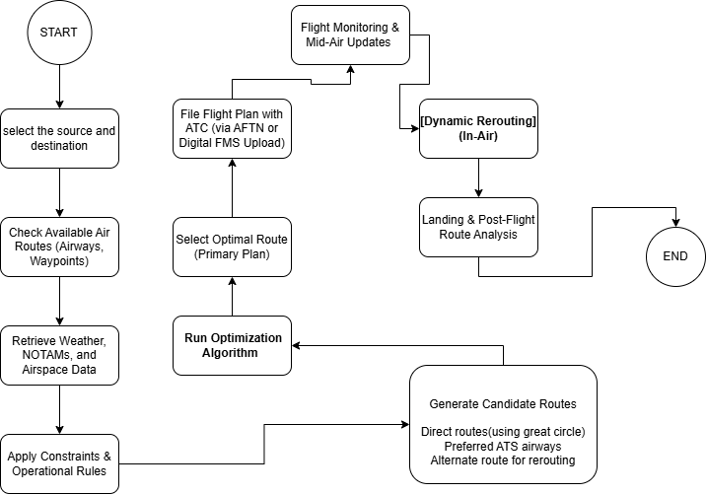
Traditional flight optimization system working flowchart

Slide 20

Ant Colony Optimization + Genetic Algorithm+ Reinforcement Learning working

Slide 21
Source & Destination Selection
The system fetches the coordinates and details for these airports from airports.json.
The user selects the source (origin) and destination airports, typically by name or IATA code.
These airport objects are then used as the start and end points for route and waypoint generation.
Then the user input the flight data based from the aircraft.json

Slide 22
Aircraft data
1. Aircraft Model & Manufacturer.
2. Maximum Take-Off Weight (mtow_kg)
3. Maximum Range (max_range_km)
4. Cruise Speed (cruise_speed_kmh)
5. Fuel Capacity (fuel_capacity_liters)
6. Fuel Consumption Rate (fuel_consumption_rate_kg_hr)
7. Ceiling (ceiling_m)
8. Additional Specs (additional_specs)

Slide 23
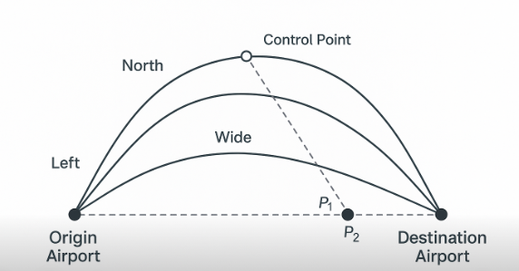
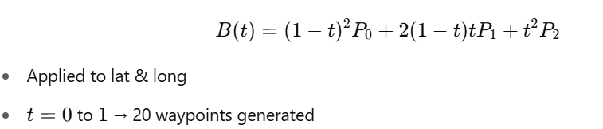
Alternate routes generation
Purpose: Create curved alternate routes (left, right, north, south, wide) for safer, optimized paths.
Curve Points:
P₀: Origin
P₂: Destination
P₁: Midpoint offset in chosen direction (controls curve bend)
No-Fly Zone Handling: Adjust P₁ outward if inside restricted area.
Formula (Quadratic Bézier):

Slide 24
Weather data fetching for each waypoints
1. Collect Locations: Gather lat/long of origin, waypoints, and destination.
2. Check Local Cache: Use cached weather data if available (faster, fewer API calls).
3. Fetch from API (if needed): Call Open-Meteo API for current & hourly aviation weather.
4. Cache New Data: Store fetched data for future reuse.
5. Parallel Processing: Fetch data for all locations simultaneously to improve speed.
6. Fallback Mechanism: Generate mock weather data if API request fails.

Slide 25
ACO-Based Route Optimization
Step 1: Start with Multiple Candidate Routes
Initial paths like direct route, left-side route, right-side route, etc.
Step 2: Ant Simulation
Virtual ants explore these routes
Decision = Pheromone level + Route fitness
Better routes → more ants choose them → more pheromone
Step 3: Pheromone Update
Evaporation 🧪: Slowly reduces pheromone on all routes
Deposit 💧: Adds pheromone to good (low-cost) routes → Helps reinforce successful paths
Step 4: Optimization Loop
Repeated for several iterations & ants
Ants keep exploring, updating pheromones
Best route emerges naturally over time

Slide 26
Genetic Algorithm for Route Optimization
Start: Random population of candidate routes
Evolution per Generation:
Score routes by fitness
Keep top performers (elitism)
Select parents (tournament)
Crossover → choose better parent
Mutation → occasional random replacement
Repeat: Over multiple generations
Final Output: Best route from last generation

Slide 27
PPO Flight Rerouting (Blocked Waypoints)
Detects blocked waypoints (weather/restriction)
Evaluates unused alternate routes
Scores routes by: Total Score=base score+(fuel×fuel factor)+(weather risk×weather factor)
Picks best-scoring path
Returns updated route to destination

Slide 28
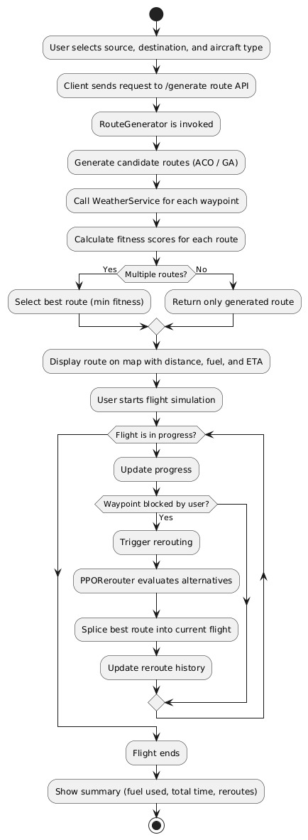
Activity diagram

Slide 29
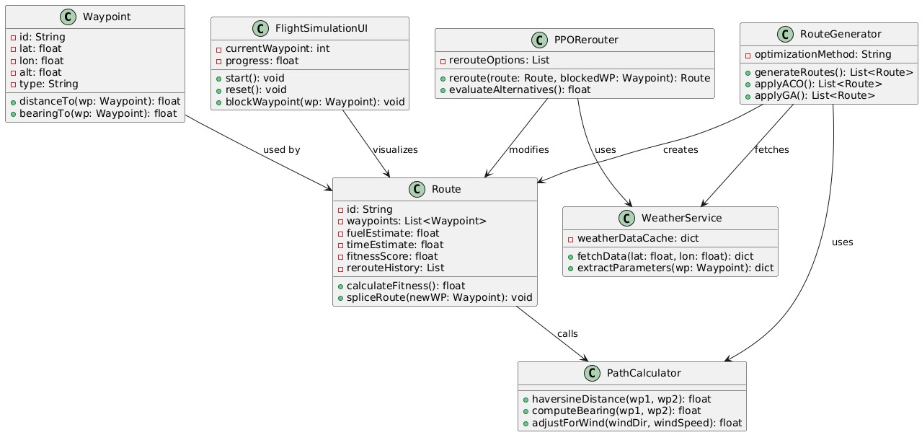
Class diagram

Slide 30
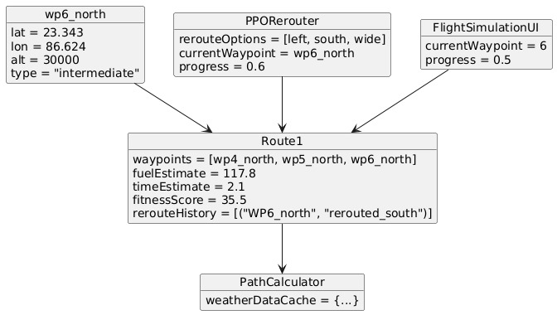
Object diagram

Slide 31
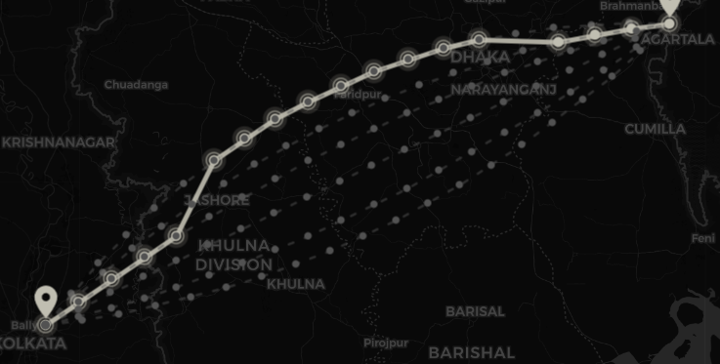
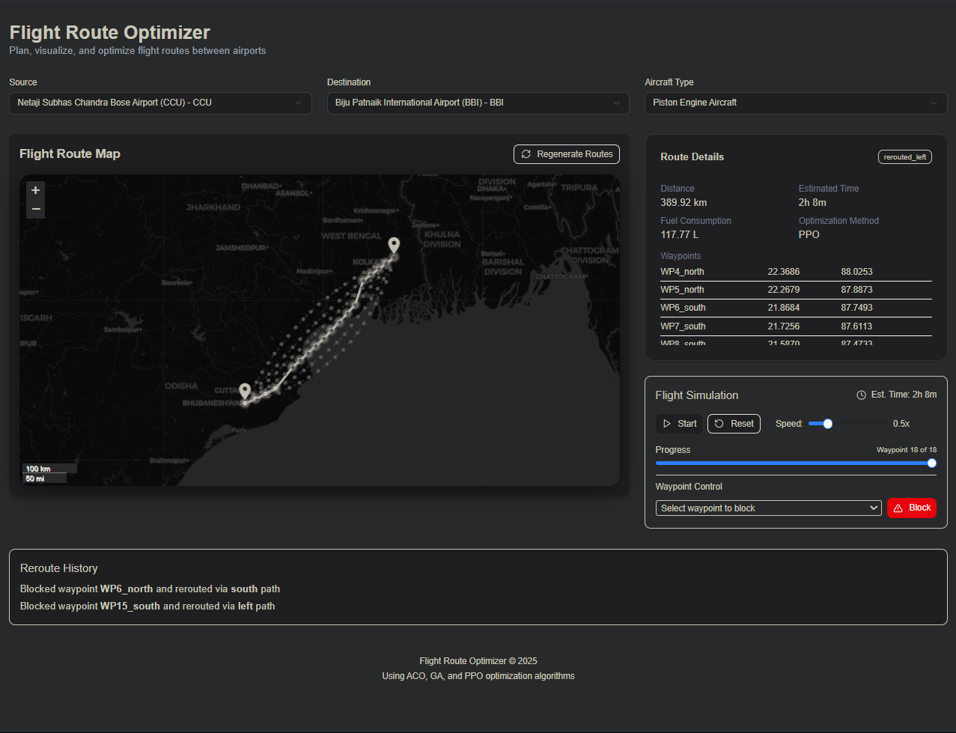
Screenshot of website

Slide 32
Limitations
Lack of Real-World Air Traffic Service (ATS) Route Data
There’s also no live feedback loop from ADS-B or radar data.
Limited Data Sources & Resolution
Not altitude implemented

Slide 33
Future Improvements
Incorporate Real ATS Airways + FIR Constraints
Dynamic Weather-Aware Re-Routing in 3D
Model Aircraft Performance Curves
Altitude-Based Conflict Detection
Export Routes in ICAO/FMS Formats

Slide 34
Conclusion
This project demonstrates the potential of integrating advanced AI techniques—specifically Ant Colony Optimization (ACO), Genetic Algorithms (GA), and Proximal Policy Optimization (PPO)—to solve the complex problem of flight route optimization. Each algorithm contributes uniquely: ACO efficiently finds optimal paths based on heuristic and pheromone data, GA evolves improved solutions over generations, and PPO enables real-time rerouting through reinforcement learning. By combining these methods, the system can adapt dynamically to various constraints such as blocked airways, changing weather conditions, and fuel limitations. This leads to tangible improvements in operational efficiency, including shorter routes, reduced fuel consumption, fewer delays, and a notable decrease in carbon emissions. The modular architecture allows for easy integration with real-world data sources like weather APIs and airline scheduling systems, making it a scalable and practical solution. Overall, this project offers a strong foundation for developing intelligent, responsive, and sustainable flight planning systems in modern aviation.

Slide 35
Thank You

