Slide 1
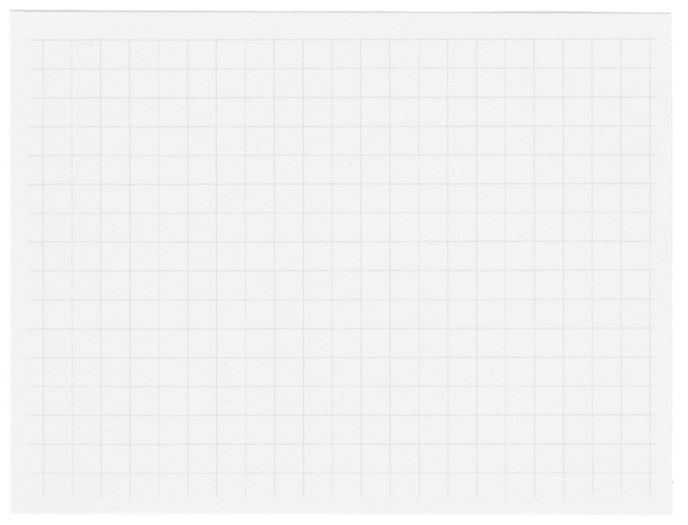
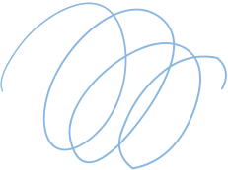












CSE215
Project Presentation
Welcome
TO
GlobalHub
Project: Online Chat Application

Slide 2


Introduction
GROUP 3
FAZLY FARDIN CHOWDHURY - 2322480642
NAYER ALI AHSAN - 2321749642
MD SHAMIULLAH SHEK RAIYAN - 2321180642

Slide 3
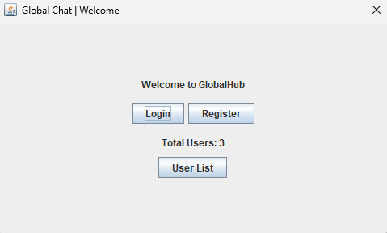
Project Overview
GlobalHub allows users to register, log in, and participate in chat discussions. The application supports functionalities such as message creation, user management, and the ability to view a list of registered users. The application is built using Java, leveraging the Swing library for the graphical user interface (GUI).

Slide 4
Technologies Used
Programming Language: Java
GUI Framework: Swing
Serialization: Java Serialization
Development Environment: VS Code
Version Control: Git

Slide 5
UML Diagram
USER
Message
Hub
-username: String
-password: String
-email: String
-name: String
-age: int
+user:User
+message: String
-users: ArrayList<User>
-messages: ArrayList<messages>
-CurrentUser: User
+create_user()
+authenticate(...): User
+save()
+load()
+match_password(): boolean
-validate_username(): void
-validate_email():void
-validate_age():void

Slide 6
User Interface Design
User Interface screens:
• Welcome View
• Register View
• Login View
• Chat Hub View
• User List View

Slide 7
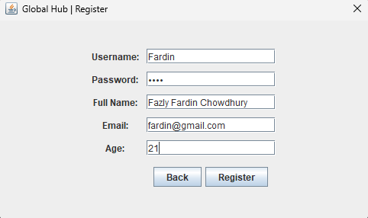
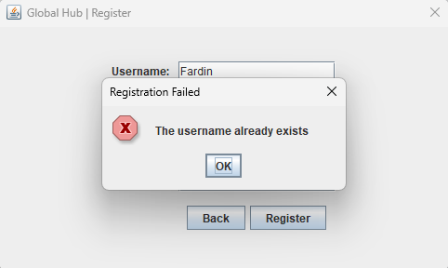
User Registration
The registration process includes validations to ensure the integrity of user data. Users must provide a username, password, full name, email, and age. The username must be unique and adhere to specific rules (e.g., no spaces, minimum length).

Slide 8
User Registration
Hub class ->
create_user(....) ->
validate_username_exist(username)
User u = new User(...) // Creates User object
users.add(u); // Adds the newly created user

Slide 9
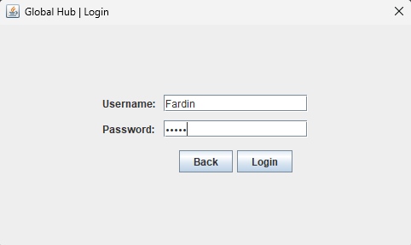
User Login
The authentication method checks the provided username and password against stored user data. If valid, the user gains access to the chat interface.

Slide 10
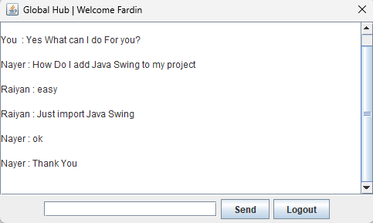
User Message Interface
Messages are created and stored using the Message class, which associates each message with the user who sent it. The system supports continuous loading of messages to ensure users can view the latest communications.

Slide 11
MultiThread
The hub_view(Hub hub) method in the GUI class contains a key multithreading implementation that enables real-time message updates in the chat interface.
Gui Class ->
hub_view(....) ->
new Thread(() -> {
lastMessageCount = hub.get_messages().size()
hub.load() //Load from database
currentMessageCount = hub.get_messages().size()
if(new message found):
messageArea.append(...) // append it to gui
}).start()

Slide 12
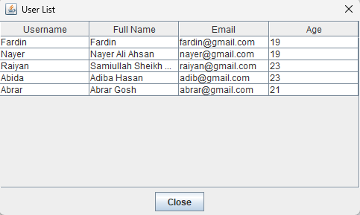
User List View
The User List View is a key feature of the Global Hub Chat Application that allows users to see a list of all registered users within the platform. This feature enhances user engagement and promotes interaction among users.

Slide 13
Conclusion
ChatHub successfully implements a real-time chat application that allows users to communicate effectively. The project demonstrates the ability to manage user data securely while providing an interactive user interface. The application is modular, making it easy to extend and maintain.

Slide 14

Thank You

