Slide 1
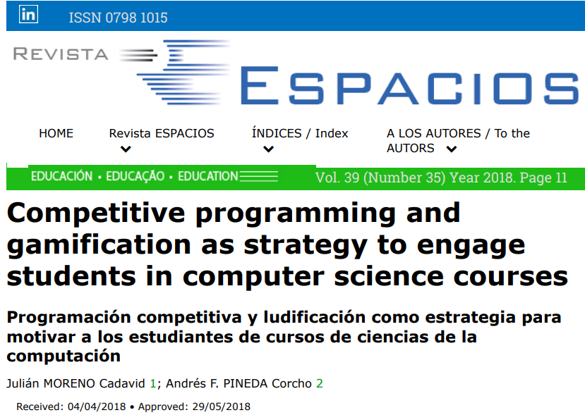

Slide 2
Paper Summary
We can learn programming better
by using competitive programming and gamification.

Slide 3
Why did I choice this paper ?

Slide 4
As you know,
recently, programming skill is essential for researchers.
But, not everyone studied programming in school.
So, students need to study programming
after starting laboratory life.
B3 October

Slide 5
Before using analysis code,
at first, learners should study standard grammar.
But, I think,
just a reading textbook is not good for learners.
I think that
best method for beginners
is …

Slide 6
Before using analysis code,
at first, learners should study standard grammar.
But, I think,
just a reading textbook is not good for learners.
I think that
best method for beginners
is solving problems by coding.

Slide 7
Before using analysis code,
at first, learners should study standard grammar.
But, I think,
just a reading textbook is not good for learners.
I think that
best method for beginners
is solving problems by coding.
Competitive programming

Slide 8
In this paper,
authors used competitive programming
(solving problems by coding)
and gamification
(enjoy it like a game)
in education of programming.

Slide 9
Paper Summary
Authors revealed that…
we can learn programming better
by using competitive programming and gamification.

Slide 10
Contents
Introduction
Method, Result, Conclusion
My Appendix (My opinion)

Slide 11
1. Introduction

Slide 12
In a computer science courses (class, lecture),
teaching computer programming is not an easy task (Bennedsen, 2008).
Pick up main issues faced by student.
（Koffmann & Torsten, 2001; Milne & Rowe, 2002; Lahtinen, Ala-Mutka, & Järvinen, 2005; Mow, 2008; Renumol, Dharanipragada & Janakiram, 2010）

Slide 13
In a computer science courses (class, lecture),
teaching computer programming is not an easy task (Bennedsen, 2008).
Pick up main issues faced by student.
（Koffmann & Torsten, 2001; Milne & Rowe, 2002; Lahtinen, Ala-Mutka, & Järvinen, 2005; Mow, 2008; Renumol, Dharanipragada & Janakiram, 2010）
1) Teaching is not personalized, and students cannot get feedback.

Slide 14
In a computer science courses (class, lecture),
teaching computer programming is not an easy task (Bennedsen, 2008).
Pick up main issues faced by student.
（Koffmann & Torsten, 2001; Milne & Rowe, 2002; Lahtinen, Ala-Mutka, & Järvinen, 2005; Mow, 2008; Renumol, Dharanipragada & Janakiram, 2010）
1) Teaching is not personalized, and students cannot get feedback.
2) Students use incorrect study method, don’t know how to solve problems,
and don’t practice enough to acquire programming skills.

Slide 15
In a computer science courses (class, lecture),
teaching computer programming is not an easy task (Bennedsen, 2008).
Pick up main issues faced by student.
（Koffmann & Torsten, 2001; Milne & Rowe, 2002; Lahtinen, Ala-Mutka, & Järvinen, 2005; Mow, 2008; Renumol, Dharanipragada & Janakiram, 2010）
1) Teaching is not personalized, and students cannot get feedback.
2) Students use incorrect study method, don’t know how to solve problems,
and don’t practice enough to acquire programming skills.
3) Programming requires a high level of abstraction,
and programming languages often have complicated syntax.

Slide 16
In a computer science courses (class, lecture),
teaching computer programming is not an easy task (Bennedsen, 2008).
Pick up main issues faced by student.
（Koffmann & Torsten, 2001; Milne & Rowe, 2002; Lahtinen, Ala-Mutka, & Järvinen, 2005; Mow, 2008; Renumol, Dharanipragada & Janakiram, 2010）
1) Teaching is not personalized, and students cannot get feedback.
2) Students use incorrect study method, don’t know how to solve problems,
and don’t practice enough to acquire programming skills.
3) Programming requires a high level of abstraction,
and programming languages often have complicated syntax.
4) Students are usually not motivated,
feel anonymous during classes, and there is few or no interaction among them.

Slide 17
In order to improve these issues, different strategies have been studied.
Competitive programming and gamification.

Slide 18
Competitive programming (Definition in this paper)
(Revilla, Manzoor & Liu 2008)
Methodology to create environments that allow students
for practicing together and competing in a healthy manner
by solving coding exercises.
競技プログラミングは、学生がコーディング演習を解くことによって、
健全な方法で一緒に練習したり、競争したりできる環境を構築する方法論

Slide 19
Gamification (Definition in this paper)
(Deterding et al., 2011; Schoech et al., 2013)
Use of game elements in non-game environments
to empower engagement and motivation.
モチベーションを高めるために、ゲーム以外の環境にゲーム的な要素を取り入れること

Slide 20
In this paper,
authors used competitive programming
and gamification
in education of programming.
How do these elements affect
programming performance and
motivation of students ?

Slide 21
2. Method, Result, Conclusion

Slide 22
・Institución Universitaria Politécnico Grancolombiano
・In total, 43 freshman (B1) engineering students participated in this experiment.

Slide 23
Control group
24 students
(15 male, 9 female)
Experimental group
21 students
(18 male, 3 female)

Slide 24
・All participants reported no previous experience with programming.
・Before starting this experiment,
pre-test was applied to determine the initial conditions of both group.
This pre-test was mathematical logic test. (pre-test was not programming test.)
・pre-test score scale was 0.0 ～ 5.0

Slide 25
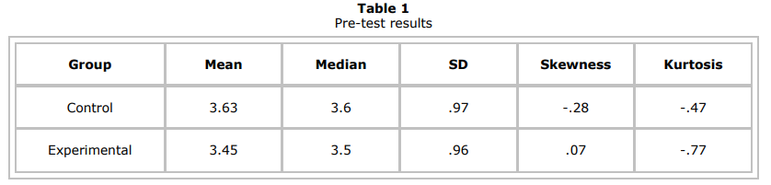
※ Skewness 歪度, Kurtosis 尖度
There was no difference of mathematical logic ability between both groups before starting this experiment.

Slide 26
Control group
24 students
(15 male, 9 female)
・traditional class
Experimental group
21 students
(18 male, 3 female)
・traditional class
・used CPP
・not personalized
・can’t get feedback
・feel anonymous
・no interaction
Both groups shared the exactly same settings:
course syllabus, lectures, teacher, hourly load (授業時間数), etc.

Slide 27
CPP (Programming Practice Center)
・Learning Management Systems (LMS)
・not only provides course contents
but also keeps track of students’ progress.

Slide 28
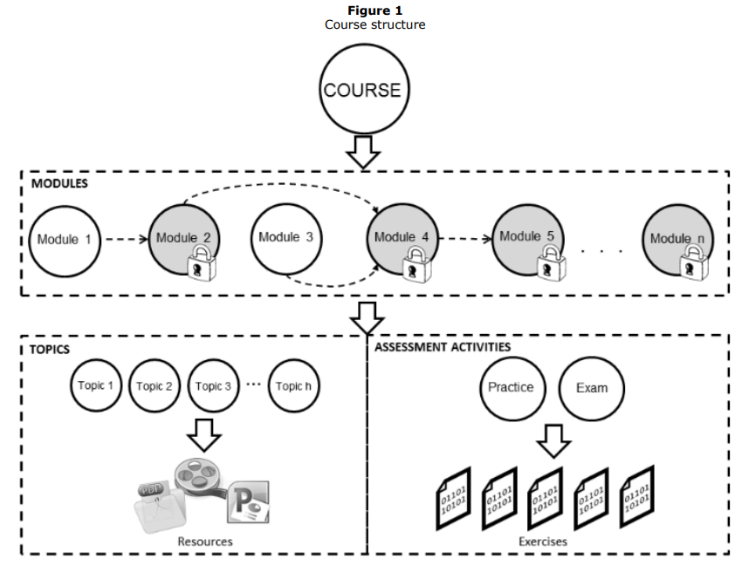
Fig1. CPP Course structure
・Whole course is composed of some modules and a module is composed of some topics.
ex) “Array” module
<topics>
Unidimensional arrays
Multidimensional arrays
etc…
Solve problem
and submit answer program

Slide 29
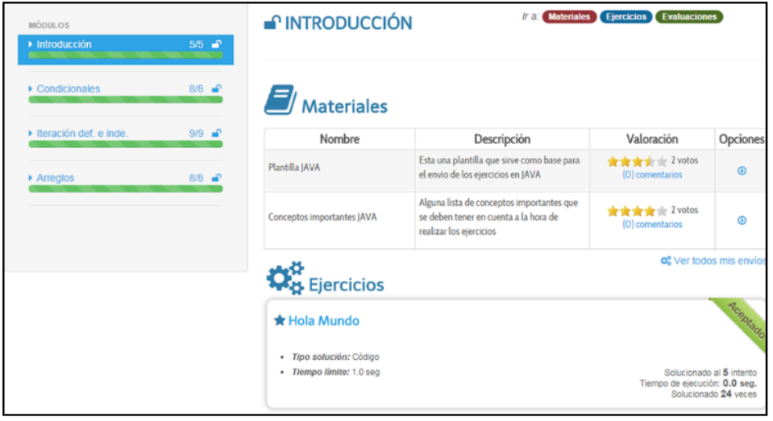
Fig5. Course modules view

Slide 30
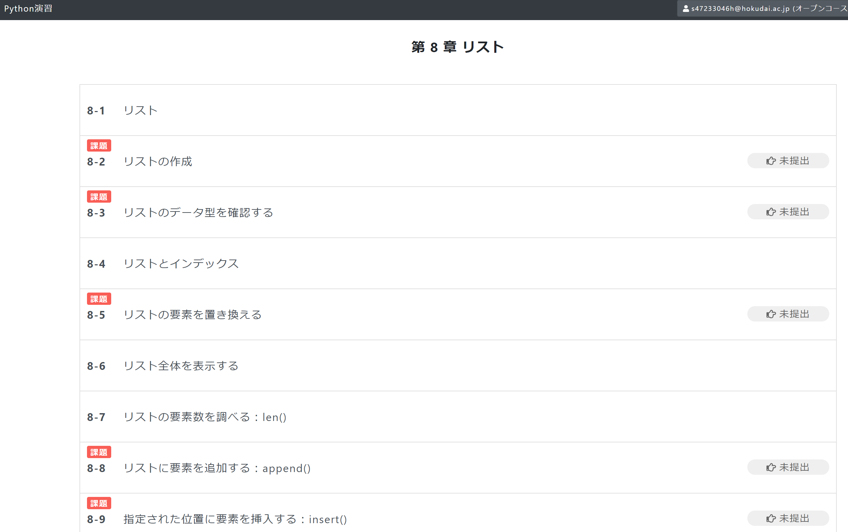
I think CPP is similar to Pythonプログラミング演習(北大情報学Ⅰ)

Slide 31
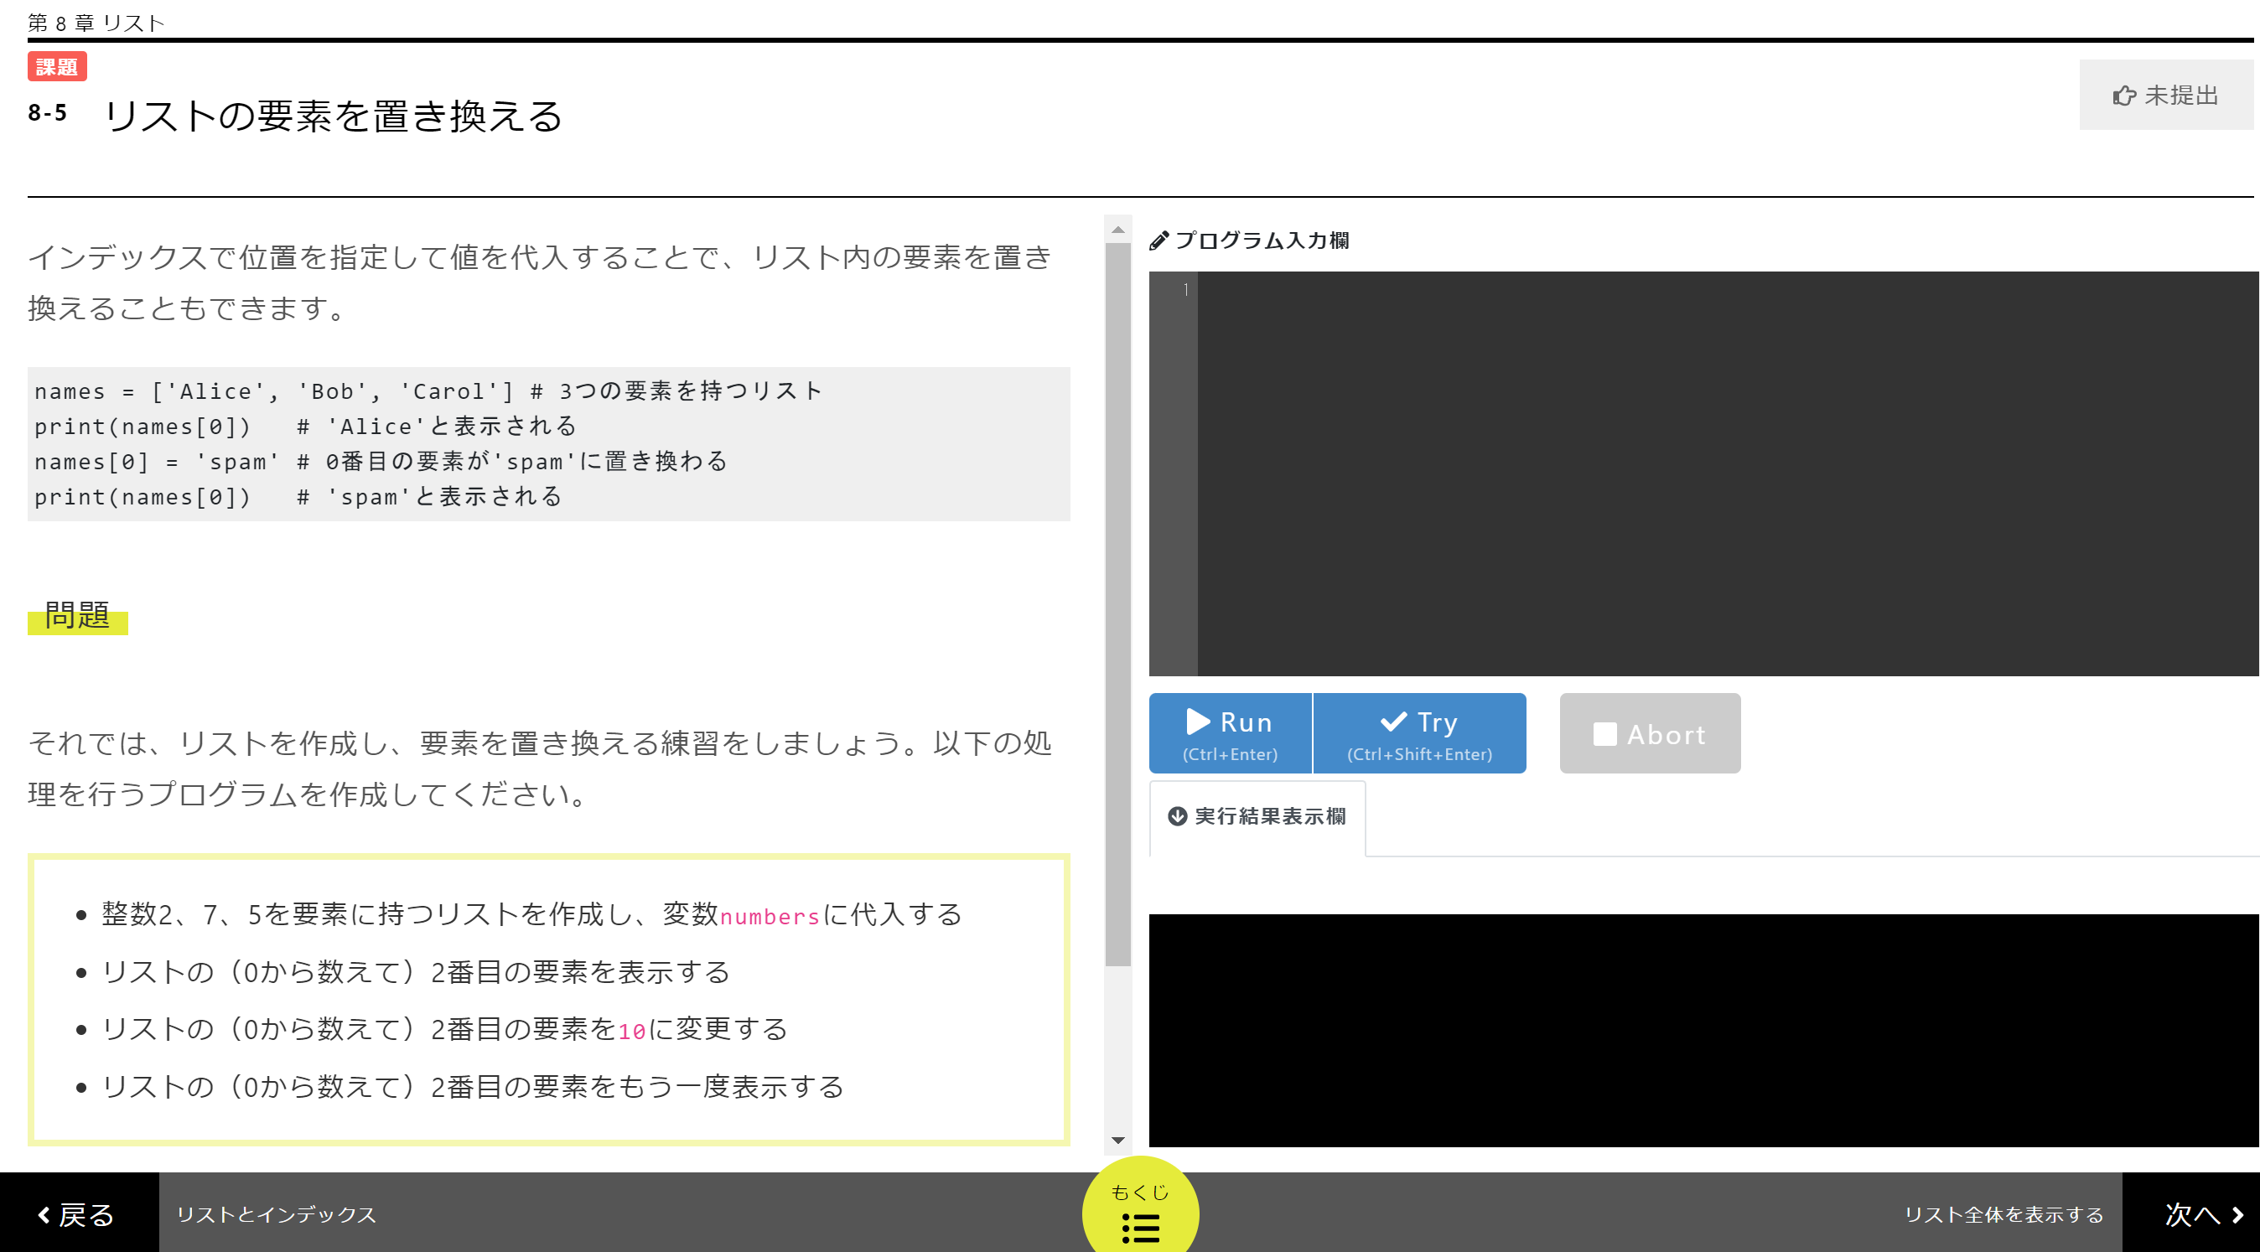
I think CPP is similar to Pythonプログラミング演習(北大情報学Ⅰ)

Slide 32
CPP (Programming Practice Center)
・Learning Management Systems (LMS)
・not only provides course contents
but also keeps track of students’ progress.
・Experimental group used CPP, but control group didn’t.
・The aim of this research was to determine
if there was any difference in the programming performance
between the two groups after the course.
Is CPP useful for studying programming ?

Slide 33
CPP had two aspects :
competitive programming and gamification.
So, if CPP improve programming performance of students,
authors can conclude that
competitive programming and gamification are useful
for studying programming.

Slide 34
CPP had two aspect : competitive programming and gamification.
Competitive programming
・Automatic code judge feedback
Gamification
・MDA (Mechanics, Dynamics and Aesthetics)

Slide 35
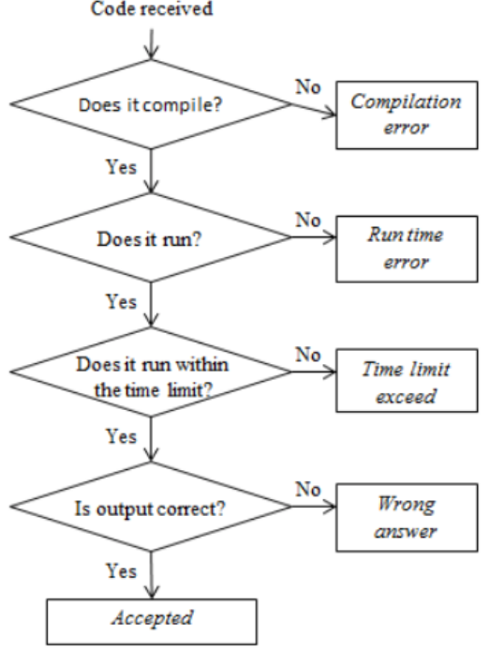
Fig2. Automatic code judge feedback
When students submit
answer program to solve problems,
the program is run in the judge server.
If the program finish during time limit
with no error, and the outputs are correct in all test case,
the program is regarded correct.

Slide 36
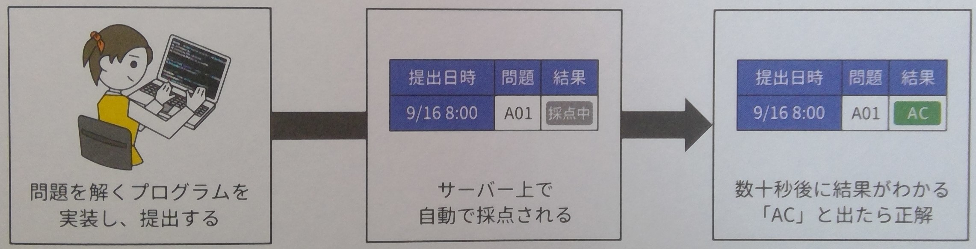
Fig2. Automatic code judge feedback
This system is completely same as
what is called
competitive programming.
「競技プログラミングの鉄則
アルゴリズム力と思考力を高める77の技術」 (米田 優峻)
p17より

Slide 37
Fig2. Automatic code judge feedback
This system is completely same as
what is called
competitive programming.
「競技プログラミングの鉄則
アルゴリズム力と思考力を高める77の技術」 (米田 優峻)
p17より

Slide 38
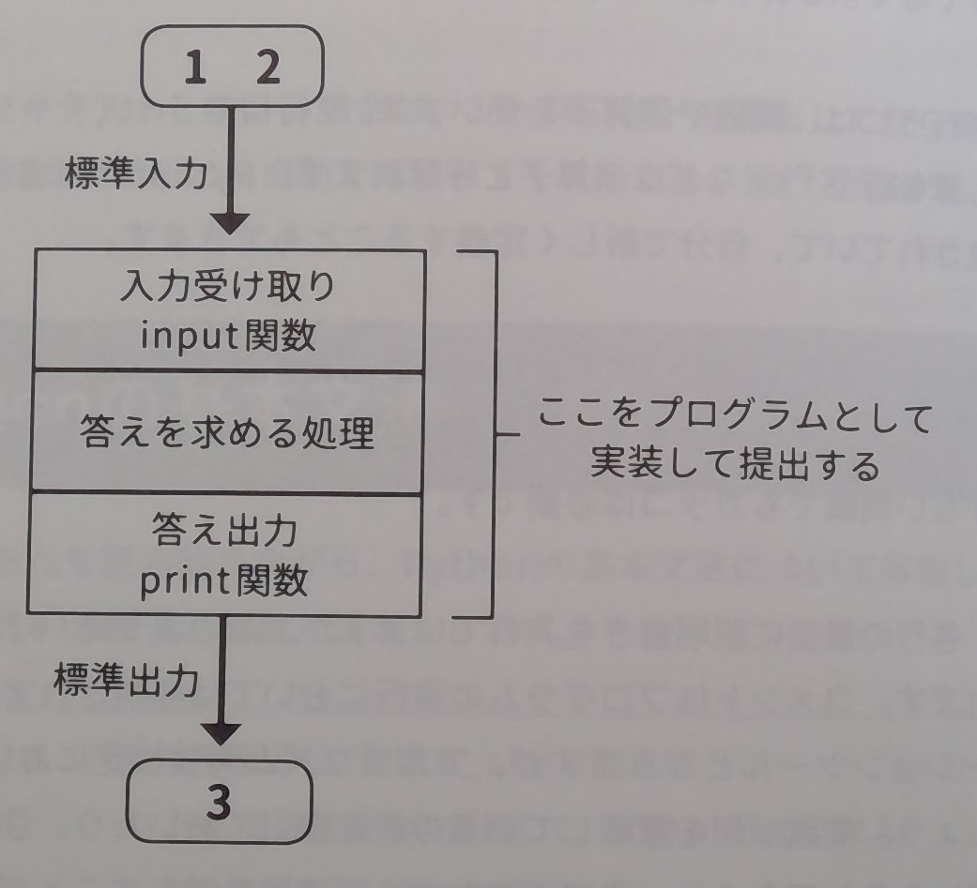
Fig2. Automatic code judge feedback
A + B = ?
「 アルゴリズム実技検定 公式テキスト[エントリー ~ 中級編] 」
(岩下 真也 , 中村 謙弘 )
p44より

Slide 39
Fig2. Automatic code judge feedback
In this way,
students do not need teacher
to validate their solutions.
This system enable students
to practice by themselves.

Slide 40
CPP had two aspect : competitive programming and gamification.
Competitive programming
・Automatic code judge feedback
Gamification
・MDA (Mechanics, Dynamics and Aesthetics)

Slide 41
Gamification
・ Gamification is to integrate game elements into the study
to foster interest and motivation in students.
・ Framework MDA (Mechanics, Dynamics and Aesthetics)
was adopted in this time.
Hunicke, Leblanc, and Zubek (2004)
エスセティック

Slide 42
Gamification (MDA framework)
Mechanics : set of game rules that define the actions for all participants
Dynamics : how those rules perform in motion,
responding to the participants’ actions,
and working with other rules
Aesthetics : the player experience of the game
These definition are very abstract,
so let’s check concrete application to this time experiment.

Slide 43
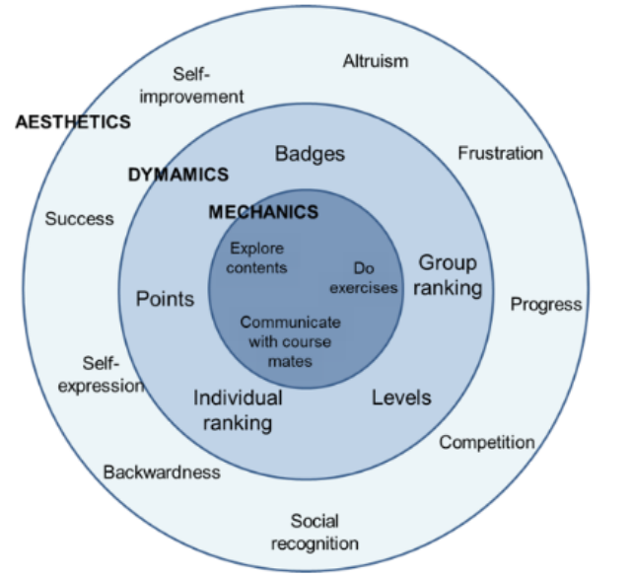
Fig3. MDA model in this experiment
利他的な
遅れ

Slide 44
Fig3. MDA model in this experiment
Students action
・Explore educational contents, materials
・Do (programming) exercise
・Communicate with classmates
(teach each other)
利他的な
遅れ

Slide 45
Fig3. MDA model in this experiment
Game elements
・Students can get points, Badges, Levels
depending on progress of study.
・Students compete by using
their individual or group ranking.
利他的な
遅れ

Slide 46
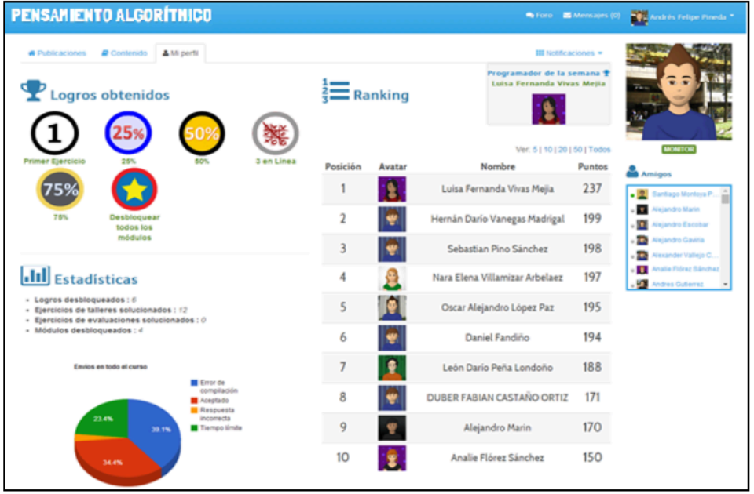
Fig6. Students profile view
Students can view all the information about their progress.

Slide 47
Fig3. MDA model in this experiment
Feeling evoked by gamification
(student experience)
These felling are evoked by CPP.
利他的な
遅れ

Slide 48
CPP had two aspect : competitive programming and gamification.
Competitive programming
・Automatic code judge feedback
Gamification
・MDA (Mechanics, Dynamics and Aesthetics)

Slide 49
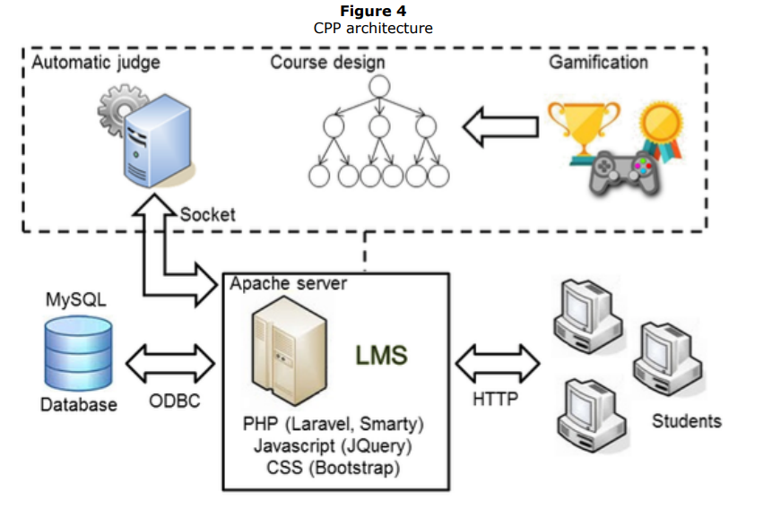
Fig4. CPP architecture
Students access LMS
(Learning Management System).
LMS communicate with Database.
Submitted program is
automatically judged.
Course design has gamification
element.
ODBC : Open Database Connectivity

Slide 50
Control group
24 students
(15 male, 9 female)
・traditional class
Experimental group
21 students
(18 male, 3 female)
・traditional class
・used CPP
Have CPP improved
programming performance of experimental group ?

Slide 51
Result

Slide 52
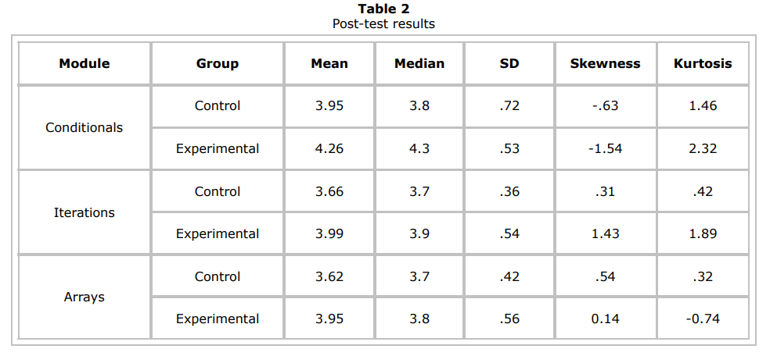
条件分岐
ループ
配列
After finishing course, post-test was done.
In all three modules, experimental group performed better than control group. (p < 0.05)
CPP(competitive programming and gamification) could be useful for studying programming.

Slide 53
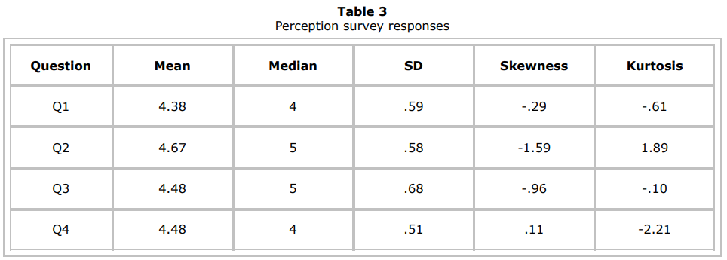
Survey to the experimental group.
Answered 1～5 number. (1=Strongly disagree, 2=Disagree, 3=Neither agree nor disagree, 4=Agree, 5=Strongly agree)
Q1: I feel that the model used in this course is more effective.
(my academic performance was better, than if a traditional course model were used.)
Q2: The course structure (division into modules, resources, and exercises) seemed appropriate.
Q3: The automatic verification and feedback provided when submitting the exercises
were an aid in the learning process.
Q4: Game dynamics, such as points, ranking, and badges, motivated me to study harder.

Slide 54
Conclusion
Authors revealed that…
we can learn programming better
by using competitive programming and gamification.

Slide 55
3. My Appendix
( My Opinion )

Slide 56
Competitive programming (Definition in this paper)
(Revilla, Manzoor & Liu 2008)
Methodology to create environments that allow students
for practicing together and competing in a healthy manner
by solving coding exercises.
競技プログラミングは、学生がコーディング演習を解くことによって、
健全な方法で一緒に練習したり、競争したりできる環境を構築する方法論
“Competitive programming” is defined above in this paper.
But, please be careful that general usage of “Competitive programming”
is different from above definition.

Slide 57
Competitive programming (General usage)
Competition in which players compete to solve problems
fast and accurately within a time limit.
Solving problems means creating a program
that always returns the expected output
for any input that can be given within the constraints.
競技プログラミングとは、参加者が制限時間内に速く正確に問題を解くことを競い合う競技。
「問題を解く」とは、制約内で与えられうるどんな入力に対しても
常に期待される出力を返すようなプログラムを作成することを言う。

Slide 58
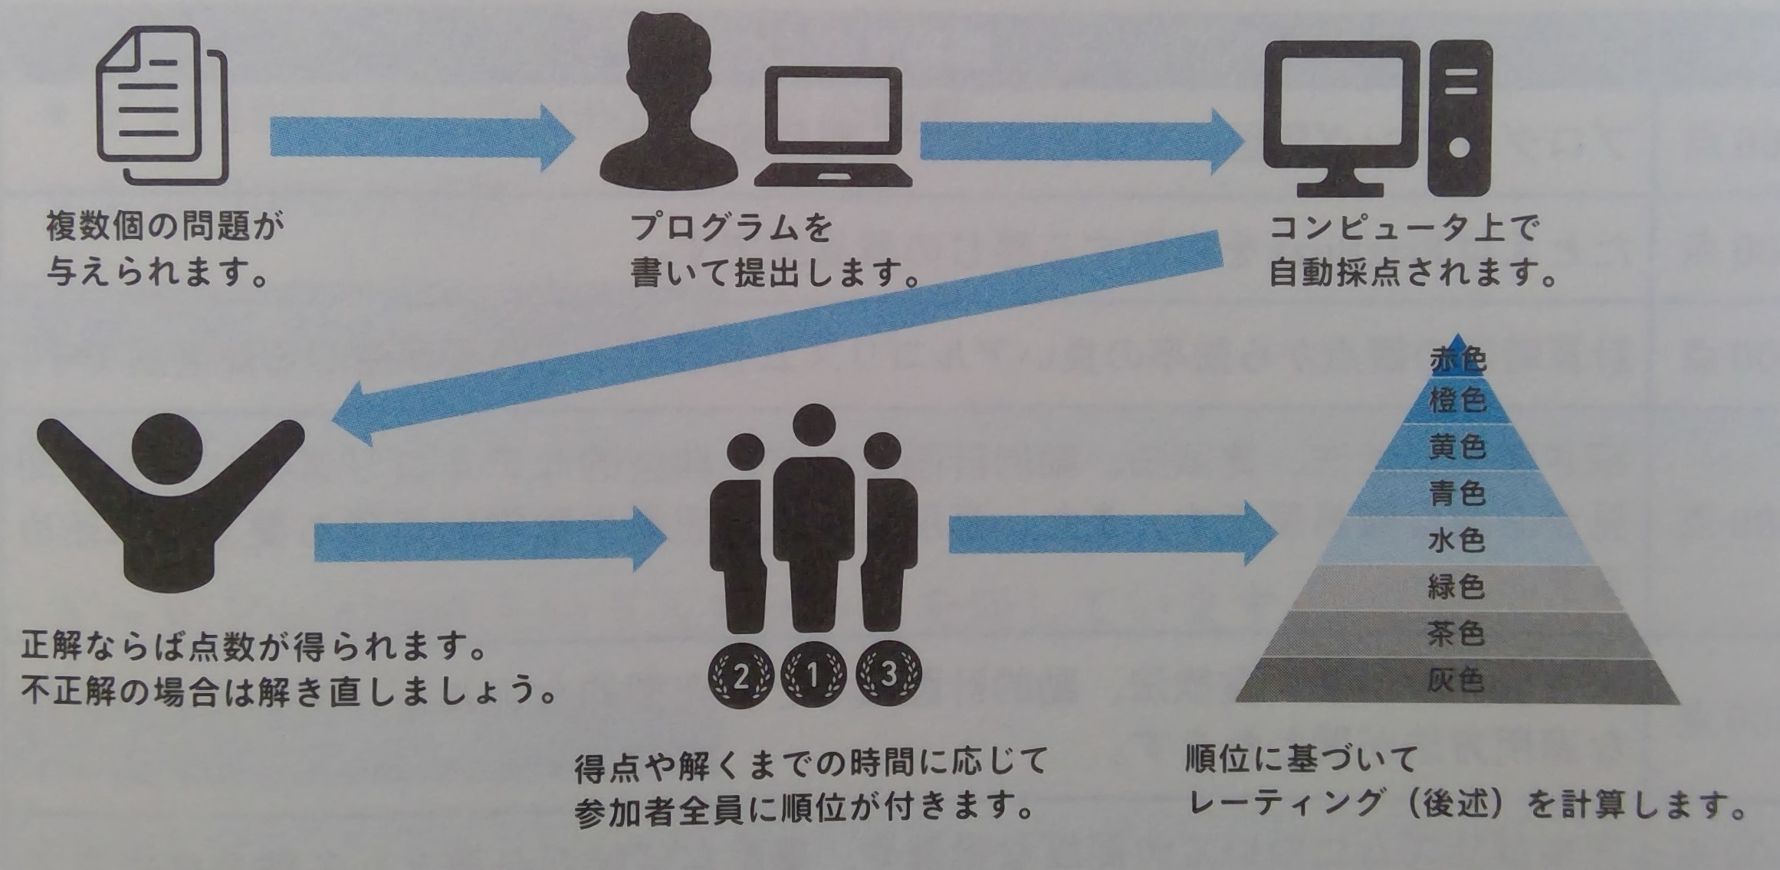
Competitive programming (General usage)
「 アルゴリズム的思考力が身につく! プログラミングコンテストAtCoder入門 」
( 大槻兼資 )
p13より

Slide 59
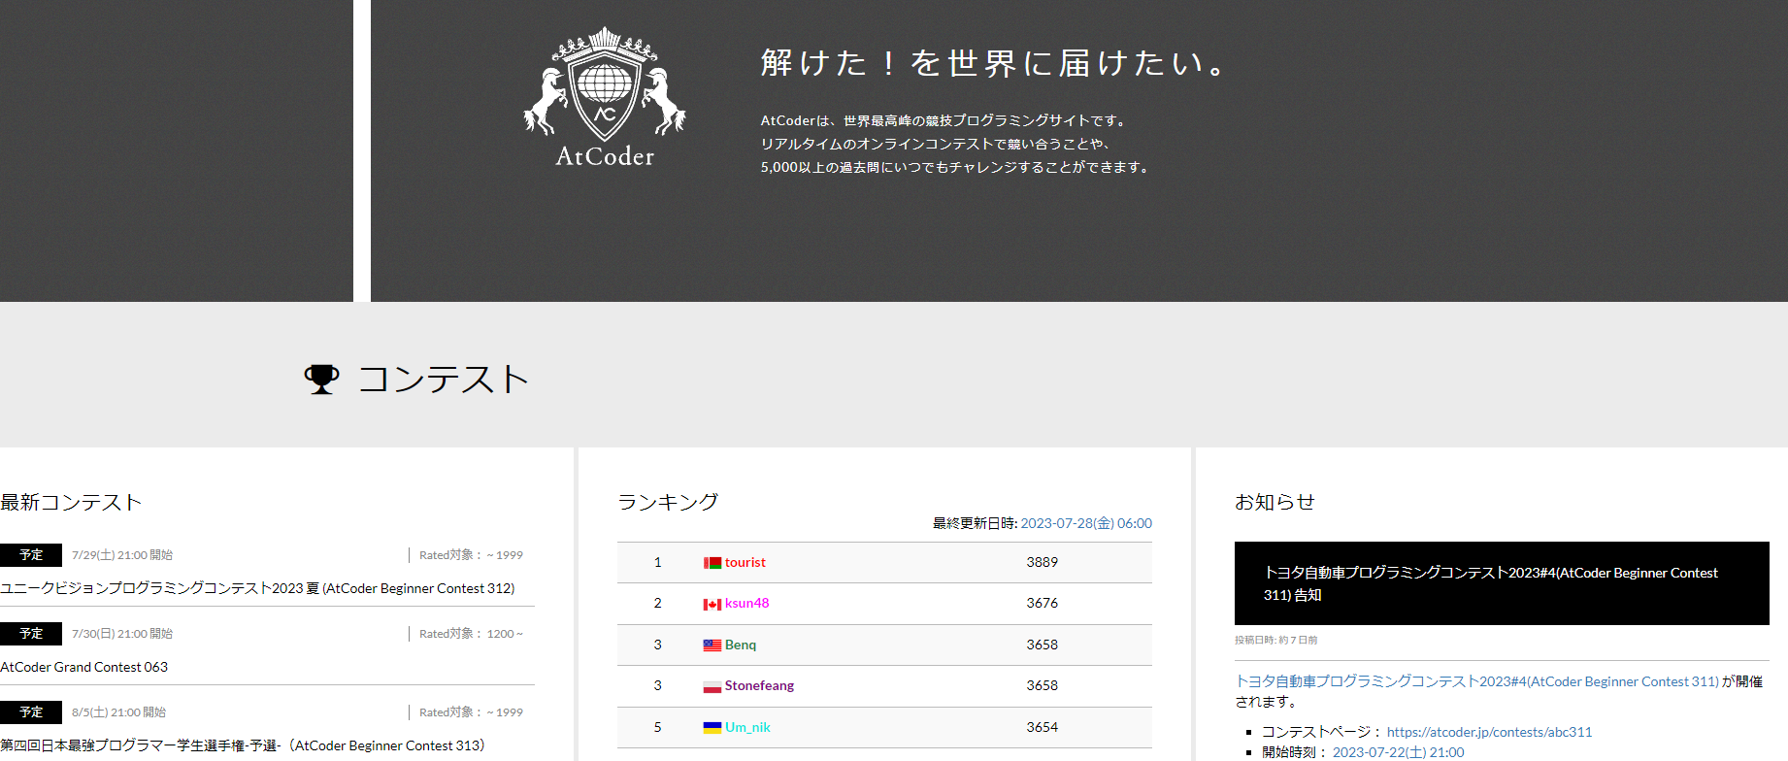
Atcoder is competitive programming contest site which has gamification.

Slide 60
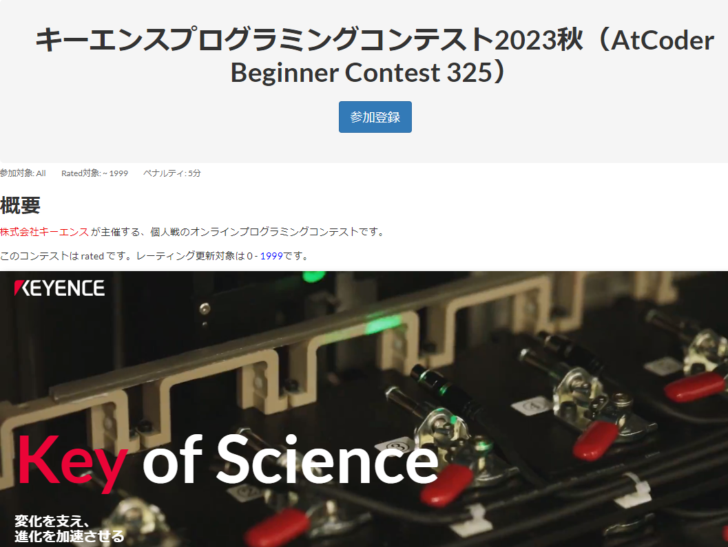
Atcoder is competitive programming contest site which has gamification.
Keyence is sponsor
of next contest .
(10/21 21:00-22:40)
And many other famous
companies open
contests in Atcoder.

Slide 61
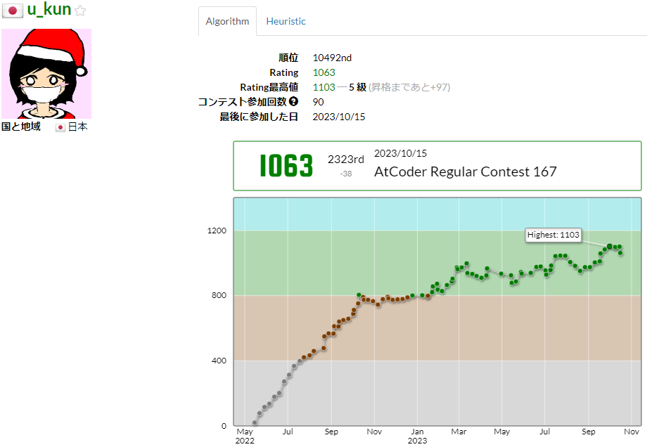
Atcoder is competitive programming contest site which has gamification.
My profile (2023/10/15).

Slide 62
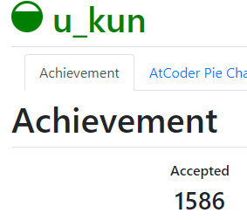
Atcoder is competitive programming contest site which has gamification.
I solved 1586 problems. (2023/10/15)

Slide 63
?
Is competitive programming useful for our research ?
?
?

Slide 64
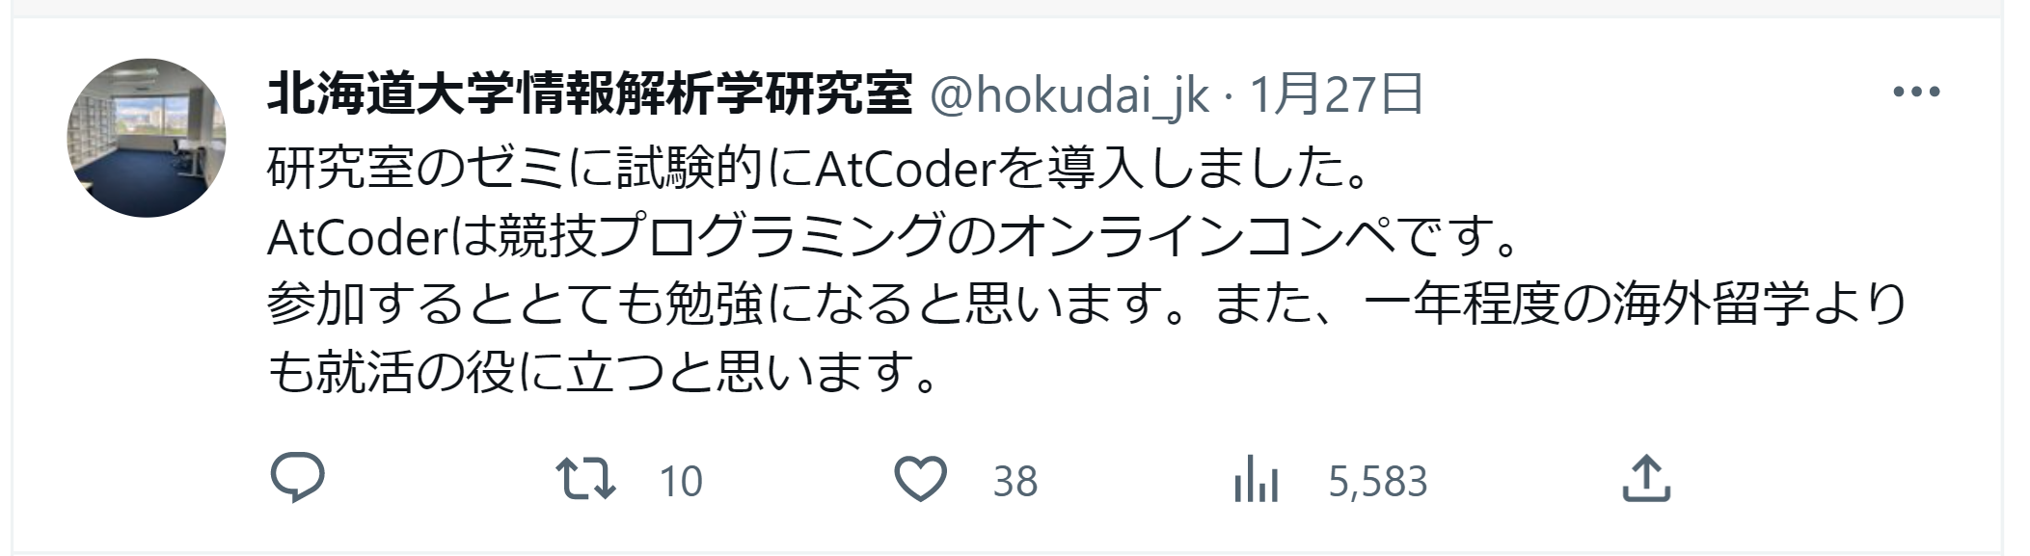
Competitive programming is useful for our research !

Slide 65
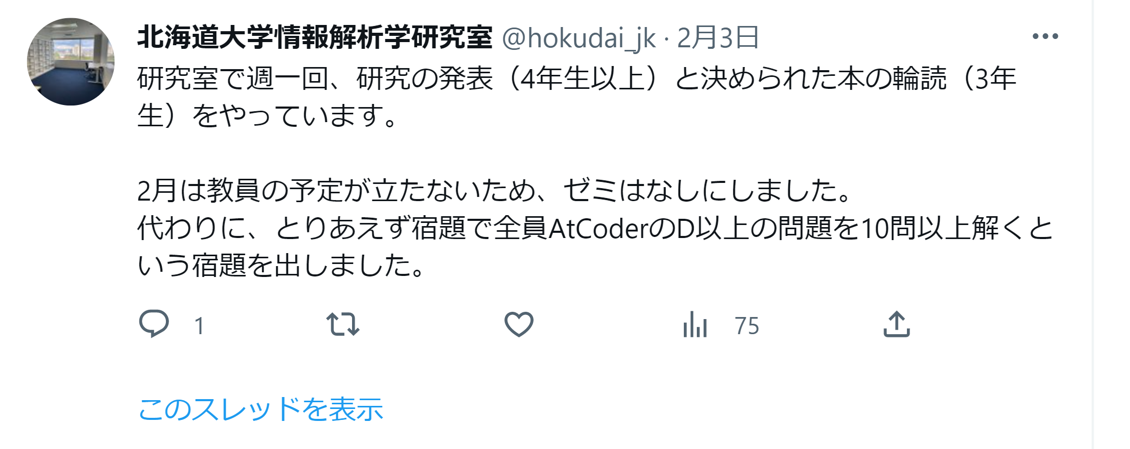
Competitive programming is useful for our research !

Slide 66
What you acquire (競技プログラミングで身につくこと)
・Fast and accurate implementation ability
(速く正確な実装力)
・Knowledge of algorithm and date structure, and use them.
(アルゴリズムとデータ構造の知識と活用)
・Attention of time complexity
(時間計算量の意識)

Slide 67
What you can’t acquire (競技プログラミングで身につかないこと)
・Extensible, maintainable, easy-to-read, clean coding
(拡張性, 保守性の高い 読みやすくきれいなコーディング)
・Ability of reading existing code of others.
(他の人の既存のコードを読む力)
・ How to use specific frameworks and surrounding tools (Git etc..),
which required for on-site development.
(特定のフレームワークや周辺のツール(Gitなど)の使い方など,
現場の開発で必要なノウハウ)
・Data analysis , statistics, machine learning
(データ分析や統計, 機械学習)

Slide 68
Competition in which players compete to solve problems
fast and accurately within a time limit.
Solving problems means creating a program
that always returns the expected output
for any input that can be given within the constraints.
Can you imagine to solve problem ?

Slide 69
I made very easy sample problem (My original problem)
for this presentation.
If you are interested,
please solve or think problem.
Moreover, if you have strong interest,
please submit your answer (program) and let’s discuss !

