Slide 1
Atari game master
Noam Manaker Morag
Itai Bear
Mentored by Dan Rozenbaum
Itai Bear, 325839710, itai.bear1@gmail.com
Noam Manaker Morag, 214726002, noam.school.only@gmail.com
GitHub: https://github.com/ItaiBear/AtariGameMaster

Slide 2
Agenda
Introduction to Project
Primary goals
​Research & Future endeavors
Timeline

Slide 3
Introduction
Deep Reinforcement Learning has seen in the last few years a massive growth in popularity and capabilities, enabling it to achieve results which were once believed to be impossible.
Our project looks to harness the power of deep reinforcement learning in order to teach an AI agent to play Atari games, such as Space Invaders and Pong.
This approach has already been used to play many different games. We will try to find a new game to learn.

Slide 4
Primary goals
play well
Gain insight
Look forward
We will aim to achieve a better result than the average human player.
Have the AI agent figure for himself novel strategies to play in.
Learn and grasp the concept of Deep Reinforcement Learning by training an agent hands-on.
Evaluate the agent using different metrics to gain insight towards improving our understanding.
Try to implement new, cutting edge Deep Reinforcement Learning strategies to improve our results
If we are successful, we may submit our strategy to benefit the scientific community.

Slide 5
timeline
Learn
Nov’ – Jan’
Train
Jan’ – Apr’
Research
Apr’ – Jul’
First we have to study the subject, by completing courses online.
RL Course by David Silver - davidsilver.uk/teaching/
Hugging Face Deep Reinforcement Learning Class - github.com/huggingface/deep-rl-class
Train the AI agent to play the game, using the knowledge we gained before.
Measure the performance of the agent we trained using well-defined metrics.
We will continue to find ways to improve and strengthen our results in a way that will benefit the scientific community.
Study and test new AI technology on the game, to see if it will improve the model

Slide 6
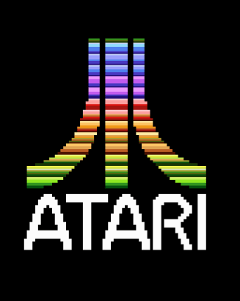
THANK YOU
Itai Bear, 325839710
itai.bear1@gmail.com\
Noam Manaker Morag, 214726002, noam.school.only@gmail.com
GitHub: https://github.com/ItaiBear/AtariGameMaster

