Slide 1
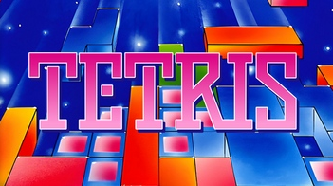

Reinforcement Learning Methods for Tetris NES
Noam Manager Morag Itai Bear
Department of Computer Science, University of Haifa
The objective of our project was to train an AI agent to play the game of original Tetris NES, using Reinforcement Learning methods. We focused on two cases of gameplay, one where the agent controls every movement based on the board and one where the agent only picks the final position of a spawned tetrimino. While the second case was successfully solved using a Particle Swarm Optimization method (PPO), which we reimplement in Python, the second case remains an unsolved and hard problem.
We show that the first case is indeed a hard problem by attempting three methods
We experimented with several methods in the Reinforcement Learning area to train an agent that could play the Tetris NES game.
When none of the methods were successful, a state space reduction was incorporated and an agent was trained using Particle Swarm Optimization.

