Slide 1

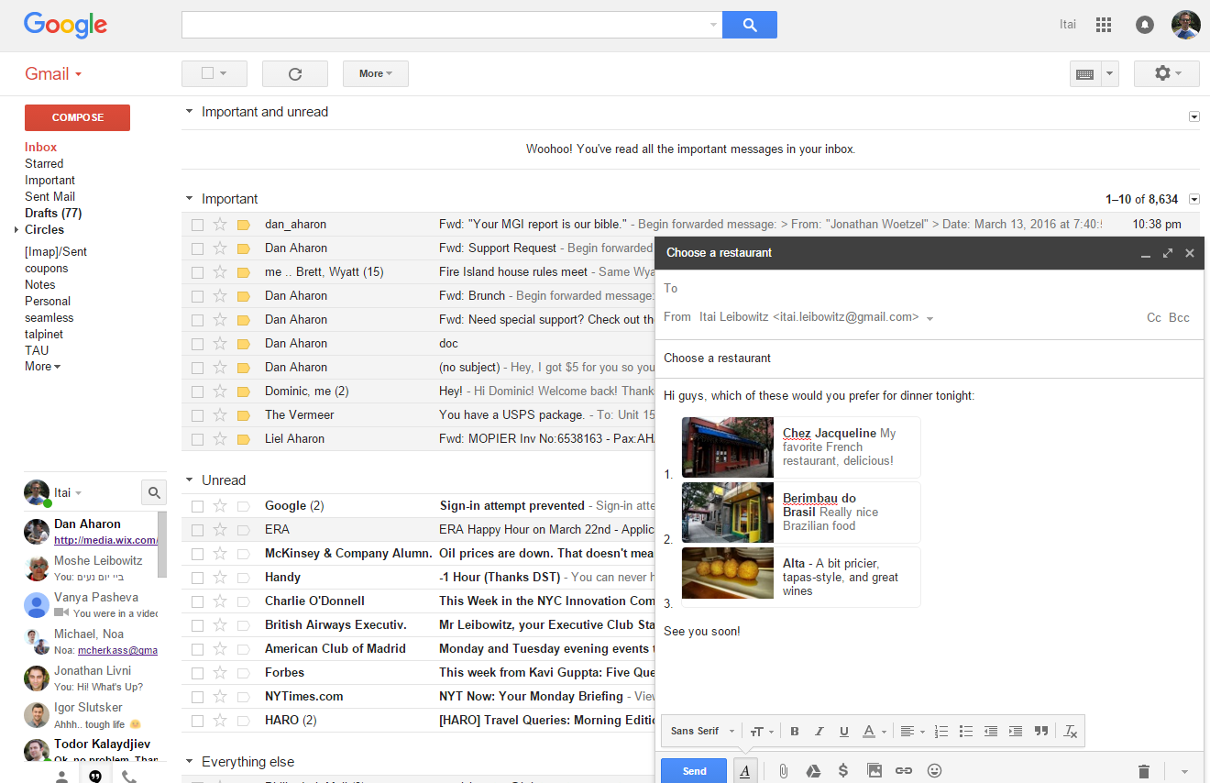
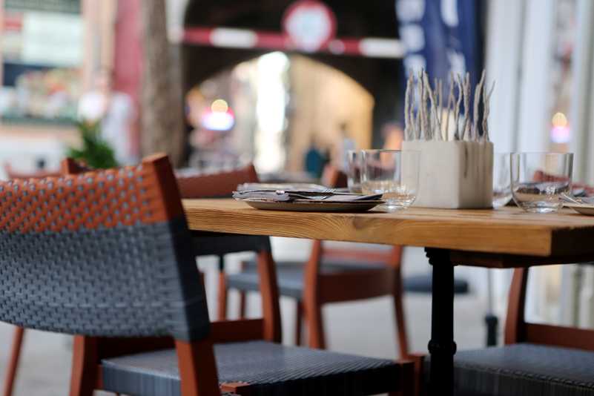

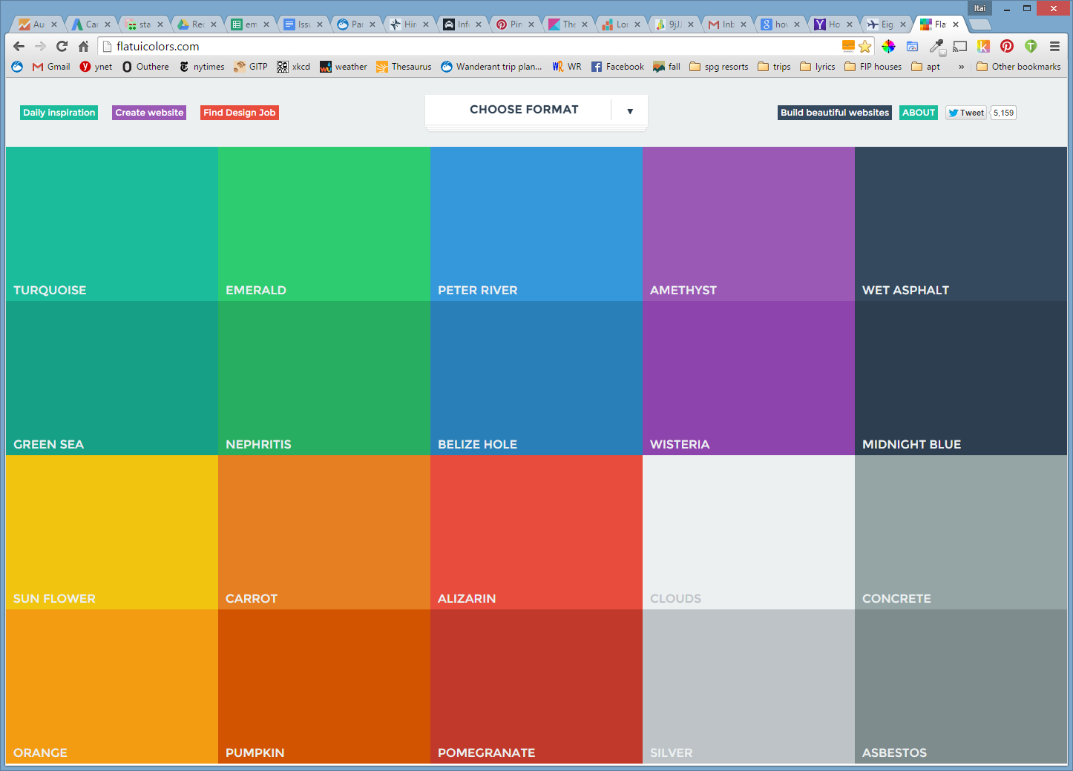
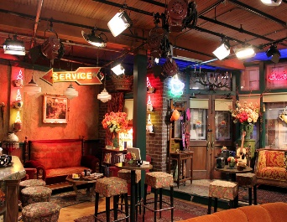

PlaceLinks
Add links to real-world places in your GmailTM messages
Home restaurant: My favorite brunch spot!
Cornelia Café:
Live shows with dinner

Slide 2
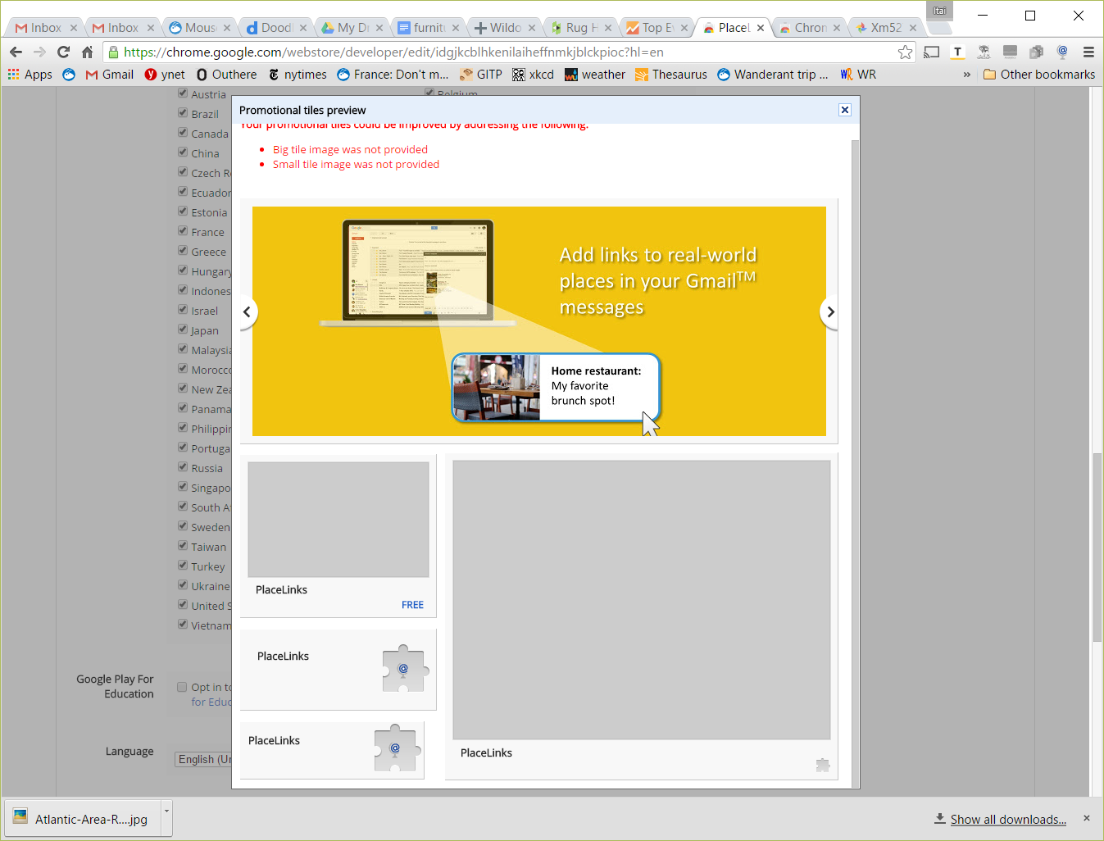

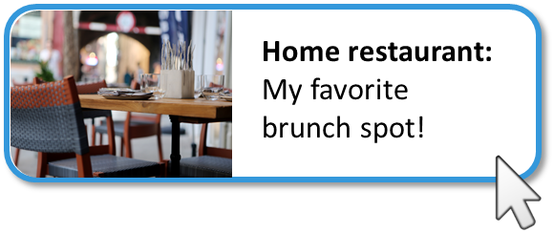
PlaceLinks
Add links to real-world places in your GmailTM messages
Cornelia Café:
Live shows with dinner

Slide 3
Links to real-world places in GmailTM
PlaceLinks
Cornelia Café:
Live shows with dinner

Slide 4

Keeps track of trip research for you.
Trip Mind

Slide 5

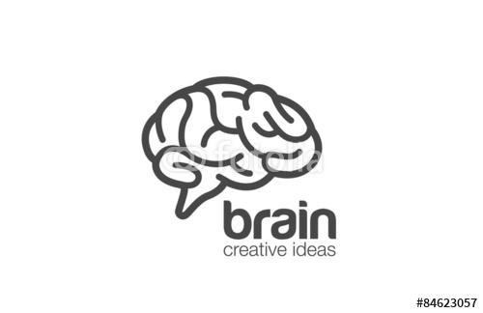
Trip Mind

