Slide 1
Evaluating a label clearing AI algorithm
by Massimo Stefan
Supervisor: Prof. Passerini A.
Co-supervisors: Teso S. & Bontempelli A.

Slide 2
INDEX
Introduction to the problem tackled
ML: Sequential learning
Problem
Solution? Skeptical learning (SKL)
What is a counter-example?
Algorithms description
CINCER
My internship
The missing gap
Project workflow
Example question
Data gathered
Results

Slide 3
ML: Sequential learning
Sequential learning is a type of learning in which one part of a task is learnt before the next.
Example: Understanding how a dog looks like receiving one image at the time

Slide 4
Problem: Label noise
Overall:
decrease model performances predictions
increase the complexity of learning model
New example with wrong label
Learning
Repeat the same error in the future
1
2
Old example with wrong label
New example with similar error
Make the same error + repeat in the future

Slide 5
Solution? Skeptical learning (SKL)
Recognize a suspicious example
Identify an example responsible for the mistake (aka counter-example) explaining why it has been chosen
Correct the example and/or the counter-example
*New features from CINCER
Notes:
SKL permettere alla macchina di contestare l'utente quando riceve delle labels poco credibili e che potrebbero essere rumorose, al che l'utente - se ha sbagliato - puo' correggere il proprio errore;

Slide 6
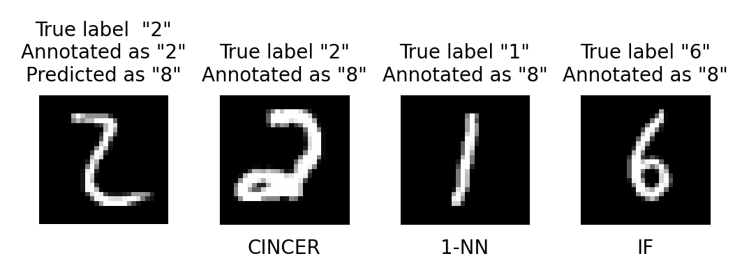
What is a counter-example?

Slide 7
Algorithms description
1-NN (Nearest Neighbor)
IF (Influence function)
CINCER
The simplest one
Uses the Euclidian distance image’s pixels
Counter-examples not necessarily useful to the machine
Focus on counter-examples that influence the most the machine skepticism
Too slow for an interactive enviroment
Approximation of IF
Substitute the Hessian matrix with the Fisher information Matrix (FIM)
Quicker than IF, suitable in an interactive enviroment

Slide 8
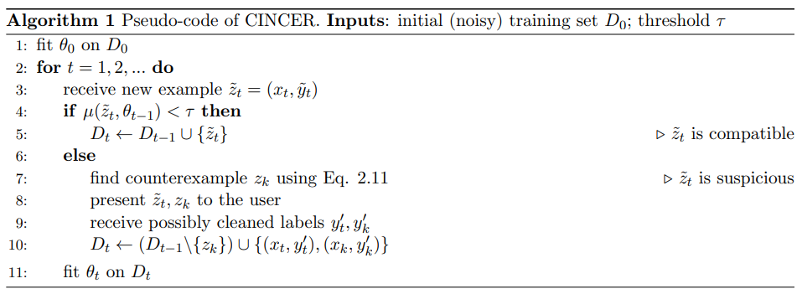
[AI] Ok, it seems a cat to me too
[User] This is a cat
[AI] Not sure… Double-check it and this other example
[User] Yeah, they are both dogs
[User] This is a cat
[AI] All right. Updating…

Slide 9
The missing gap
The evaluation of CINCER has been only simulated!
My internship fill this gap.
I developed a whole process to prove the effectiveness of CINCER in a real enviroment, comparing the performances of CINCER, IFs, and 1-NN with 100 real users.

Slide 10
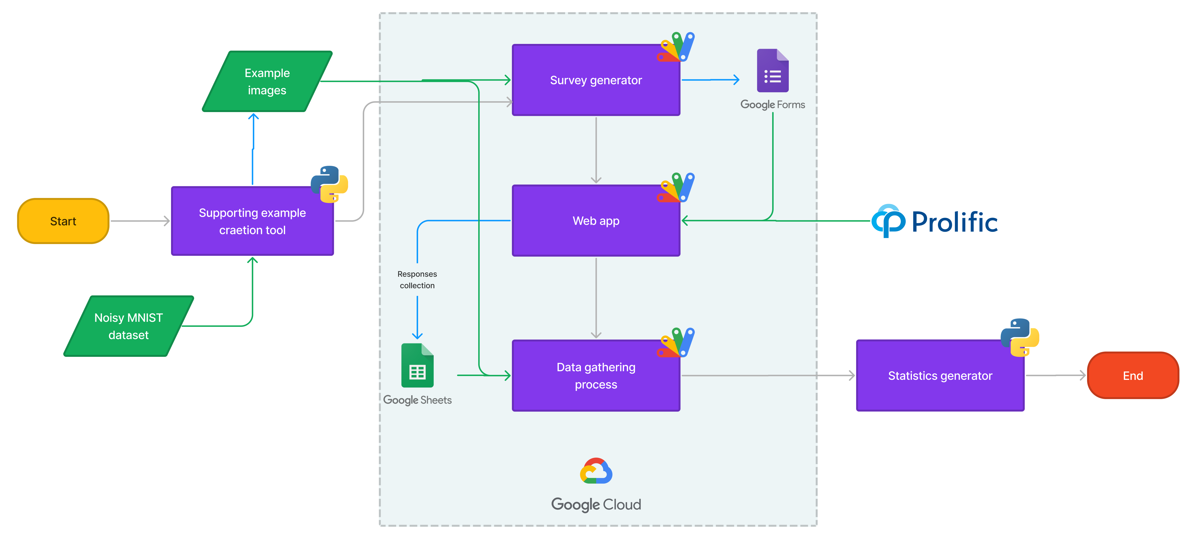
Project workflow

Slide 11
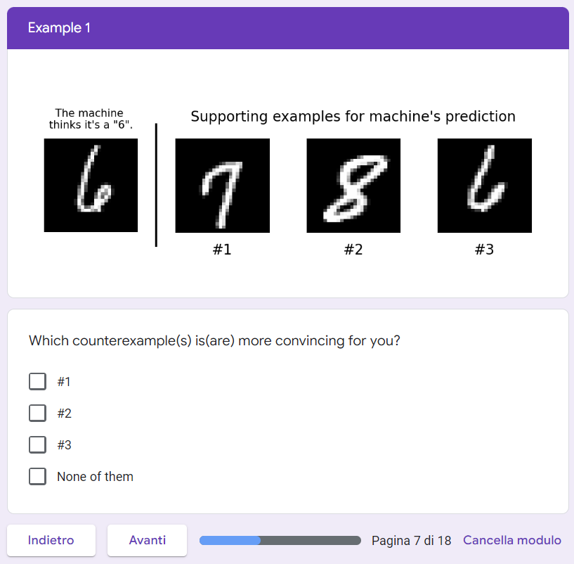
Example question
Structure:
No algorithm to counterexample reference
Multiple-choice question
Sharp separation between example and counter-examples

Slide 12
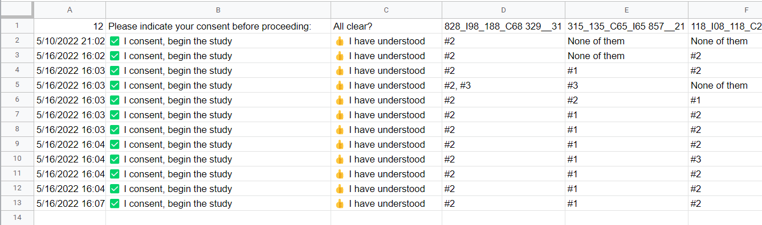
Data gathered
Structure:
Algorithm to choice link
Image link
Anonymized data

Slide 13
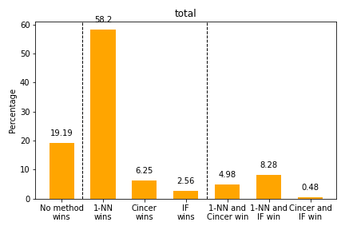
Results: average selection over all the examples
1-NN counter-examples are the closest to the human eye
CINCER counter-examples are more interpretable in respect to IF’s
No instance where the 3 methods are selected together

