Slide 1
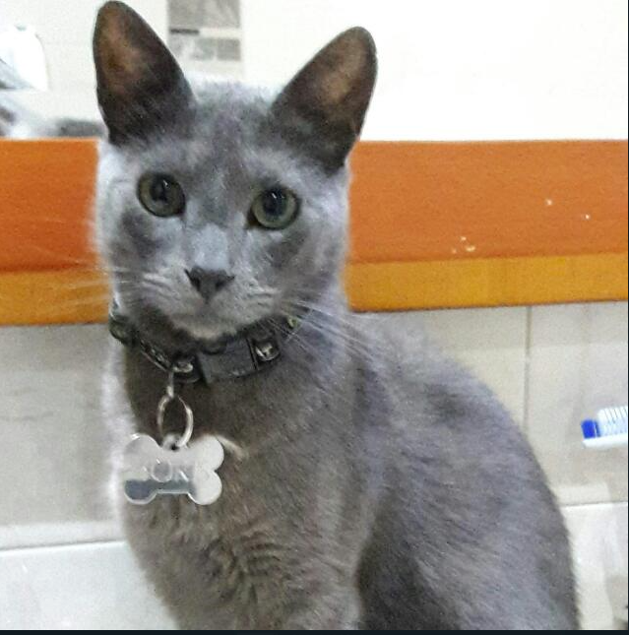
Boris
Bio
He lives in Bogota downtown. He have big family (5), that’s why he really enjoy spending a lot of time with them in different activities like eat wherever he want to go
Core needs
Looking for great places to enjoy his live and experience.
The time he spends in one app to do any it’s so important
don't feel worried about use of functionalities
Age 15
Gender Male
Occupation Bussines Man
Tech literate LOW
Frustrations
Not feel worried if he choose the correct amount of people in the reservation.
Navigate is not easy among the options app offers
“It’s so annoying when I can't understand well something , when currently there are many tool to make the life more easy”

