Slide 1
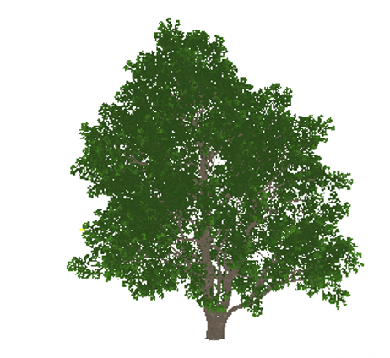
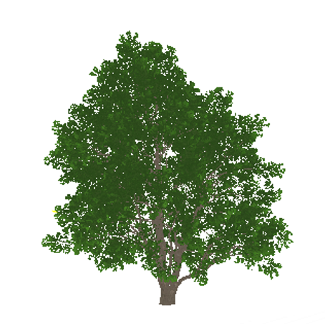
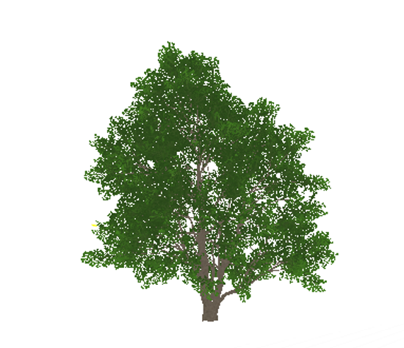
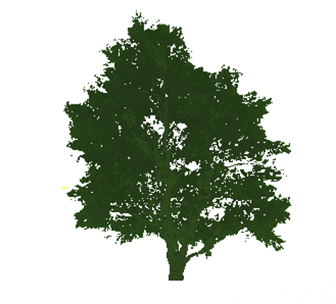
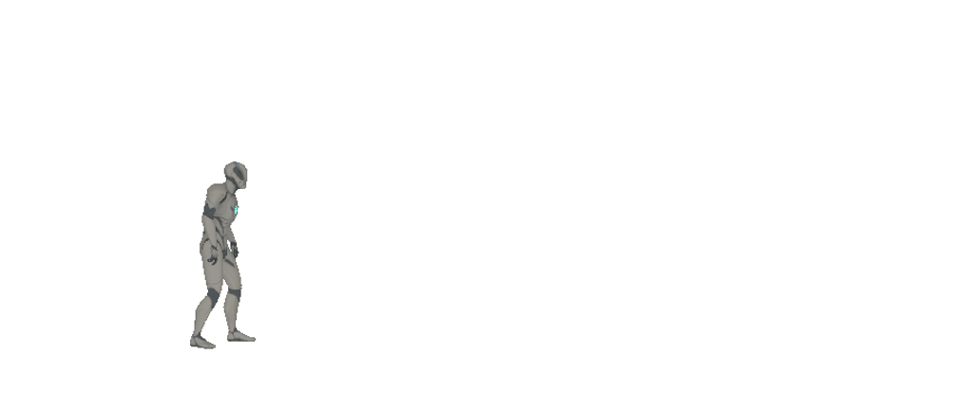
HISM
ISM
Nothing
LOD0
LOD1
LOD2
LOD3
LOD3
+∞
origin
256m
768m
通过地形，雾等遮挡物隔断

Slide 2

LOD0
LOD1
LOD2
LOD3
origin
20m
40m
60m
80m
LOD0
LOD1
LOD2
LOD3
ScreenSize:
1
0.5
0.25
0.125

Slide 3
origin
LOD0
LOD1
LOD2
LOD 过渡区
ScreenSize:

Slide 4




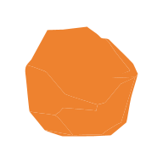

Cell | Cell
Cell | Cell
HLOD1
加载距离
原始Actor边界
地形面片
普通模型
植被
Merge
Merge
HLOD1
Merge + Simplify Again
Merge + Simplify Again
ISM
ISM
Merge +
Simplify
Merge +
Simplify
HLOD1
LandscapeBlock
LandscapeBlock
HISM
HISM
Merge + Simplify Again
ISM
Merge
HLOD1
Merge +
Simplify
LandscapeBlock
LandscapeBlock
HISM
HISM

Slide 5

HLOD1
HLOD1
缩小十倍，无Mipmap，存在锯齿边缘
简单平均数
模糊2
锐化10
HLOD0
HLOD0
HLOD1
HLOD0

Slide 6
HLOD1
HLOD1
无Mipmap，存在锯齿边缘
HLOD0
HLOD0
HLOD1
HLOD0

