Slide 1
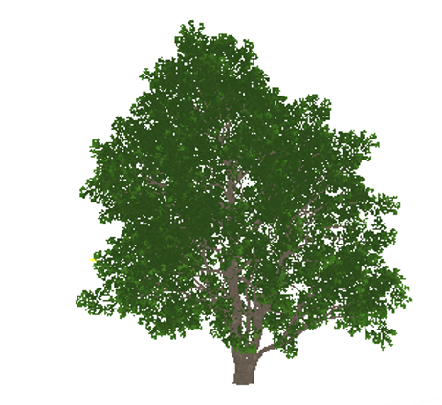
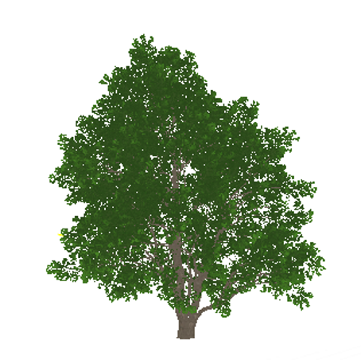
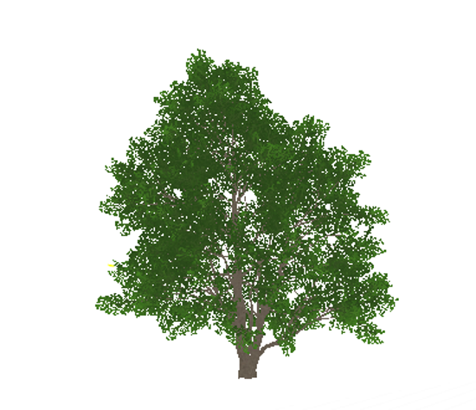
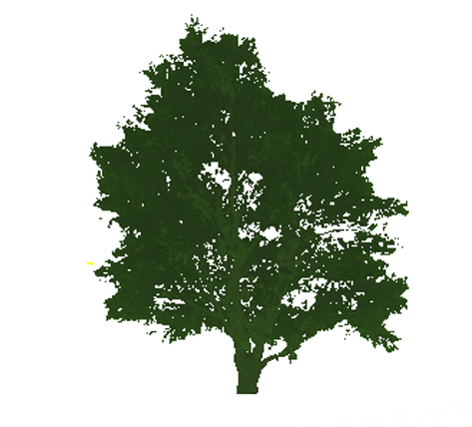

HISM
ISM
Nothing
LOD0
LOD1
LOD2
LOD3
LOD3
+∞
origin
256m
768m
通过地形，雾等遮挡物隔断

Slide 2

LOD0
LOD1
LOD2
LOD3
origin
20m
40m
60m
80m
LOD0
LOD1
LOD2
LOD3
ScreenSize:
1
0.5
0.25
0.125

Slide 3
origin
LOD0
LOD1
LOD2
LOD 过渡区
ScreenSize:

