Slide 1



Layout
Unreal Wallpaper Engine
Assets
Local
Network
Projects
Tools
Wallpapers
TIME
Design
Tasks
Project0
Project1
Project2
Project3
Project4
Project5
Settings
Project6
Project7
Project8
Project9
Project10
Project11

Slide 2
Layout
Unreal Wallpaper Engine
Assets
Local
Network
Projects
Tools
Wallpapers
TIME
Asset Info
Design
Tasks
Project0
Project1
Project2
Project3
Settings
Project6
Project7
Project8
Project9
Download

Slide 3
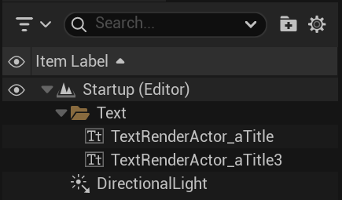
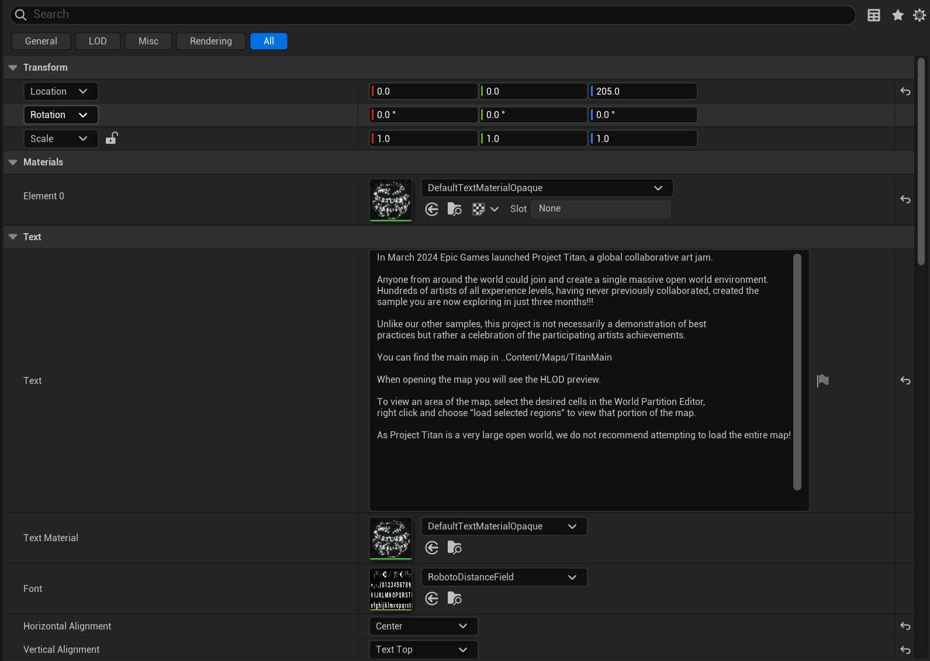
Layout
Unreal Wallpaper Engine
Assets
Outline
New
Save
Share
Design
Download
Settings

Slide 4


Layout
Unreal Wallpaper Engine
Assets
下载中
已完成
Project 0
Design
456 k /s
Project 1
456 k /s
Tasks
Project 1
456 k /s
Settings

Slide 5
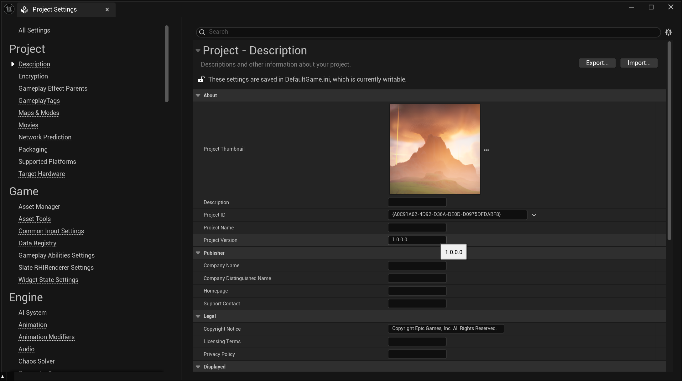
Layout
Unreal Wallpaper Engine
Assets
Design
Tasks
Settings

