Slide 1


SuperWoman
Super Woman
By Özen Beyazsahin, Lea Brock & Isabella Schmidt
Frei verwendbar

Slide 2


Agenda
Vision
Project Management
Use Cases
Architecture
Testing
Vision
Project Management
Use Cases
Architecture
Vision

Slide 3
Vision
Web-based game
Idea: Learn while playing
Improve your mathematical abilities and your power of concentration
Three categories: Word Hunting, Math and History
Vision
Project Management
Use Cases
Architecture
Testing

Slide 4



Project Management
Scrumming on Jira
Git: version control
MS Project
Vision
Project Management
Use Cases
Architecture
Testing

Slide 5
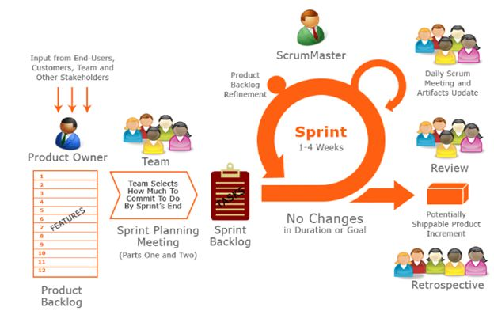
Scrum
Vision
Project Management
Use Cases
Architecture
Testing

Slide 6
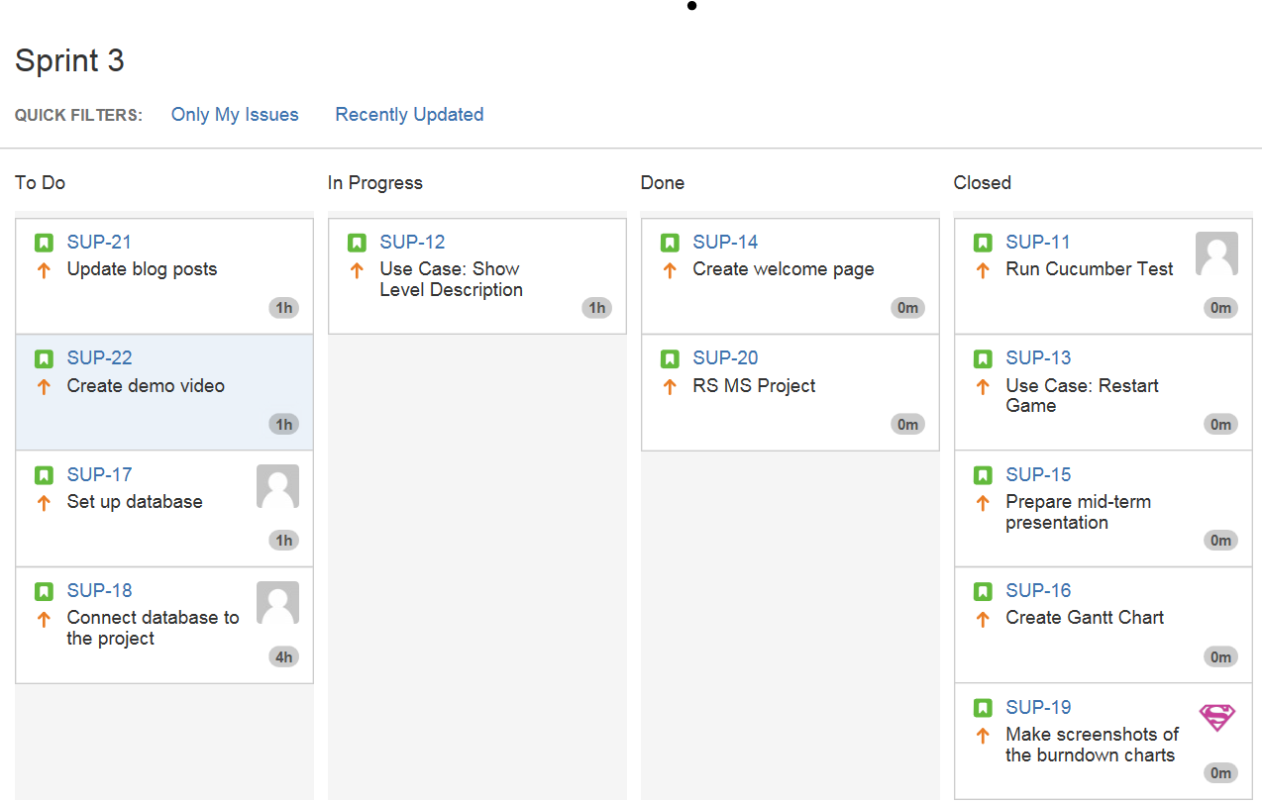
Jira
Vision
Project Management
Use Cases
Architecture
Testing

Slide 7
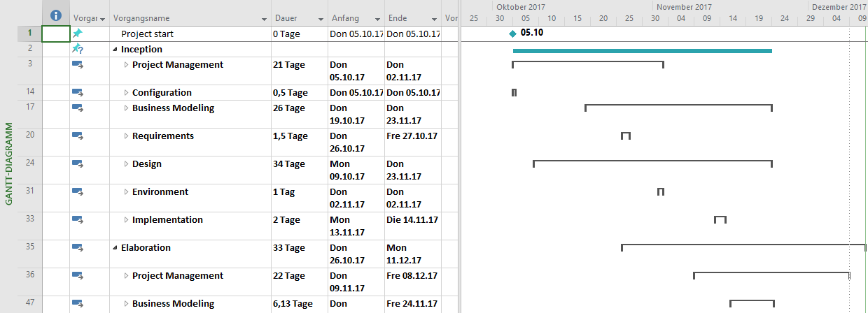
MS Project
Vision
Project Management
Use Cases
Architecture
Testing

Slide 8
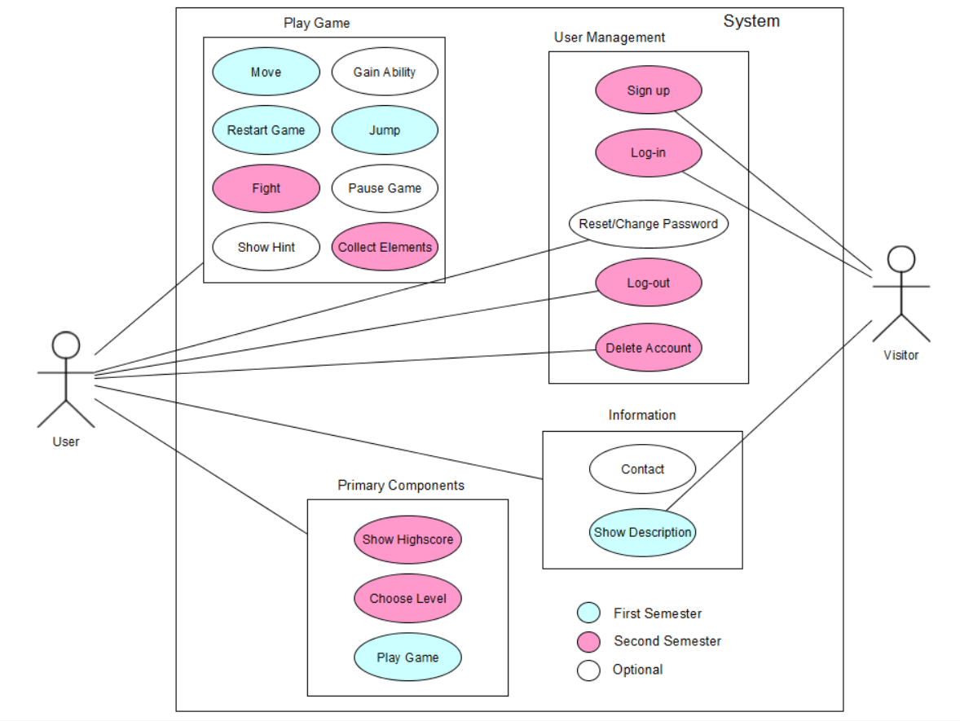
Use Cases
Vision
Project Management
Use Cases
Architecture
Vision

Slide 9

Demo - Game
Vision
Project Management
Use Cases
Architecture
Vision

Slide 10
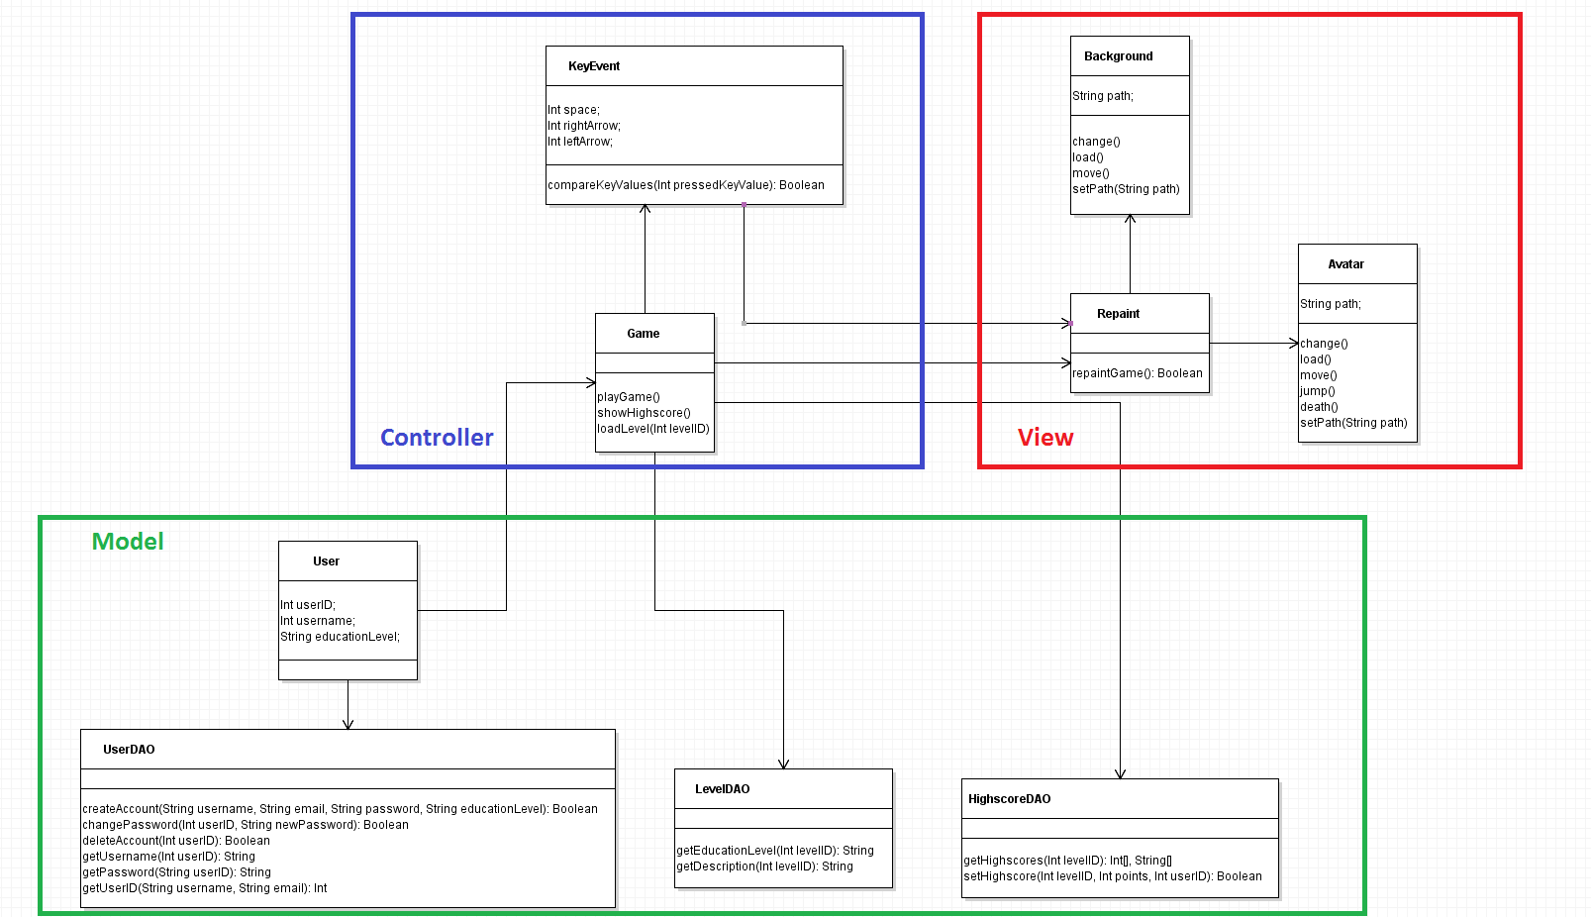
Architecture
Vision
Project Management
Use Cases
Architecture
Testing

Slide 11
Testing
Cucumber Runner
Feature Files:
SignUp
ChooseLevel
Vision
Project Management
Use Cases
Architecture
Testing

Slide 12
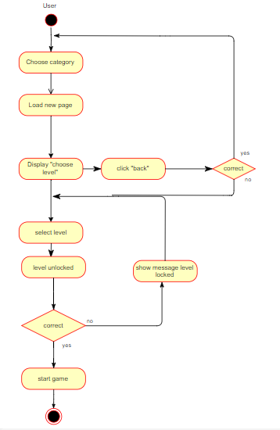
Flow Of Choose Level
Vision
Project Management
Use Cases
Architecture
Testing

Slide 13
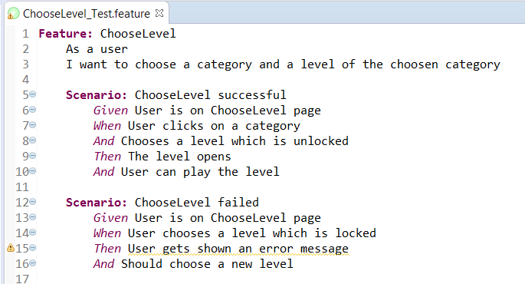
Feature Files - Example
Vision
Project Management
Use Cases
Architecture
Testing

Slide 14
Get smart playing SuperWoman!

