Slide 1
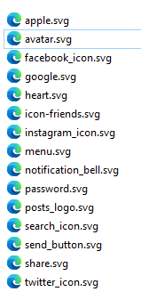


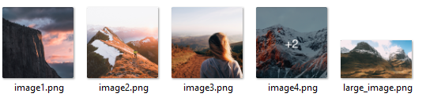

Slide 2
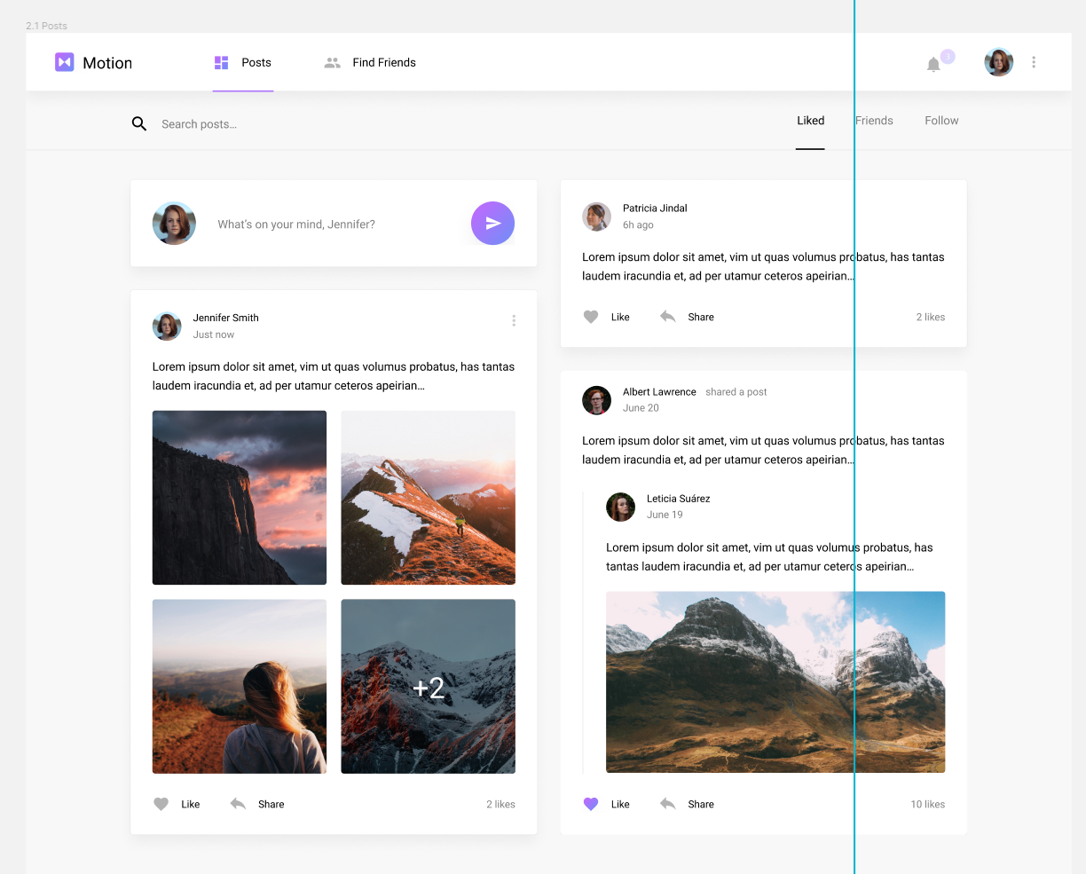
postsNavBar
greyNavBar
comment
commentPosted
(withou images)
commentPosted
Attr: editable=true
commentShared
commentPosted
Attr: editable=false

Slide 3
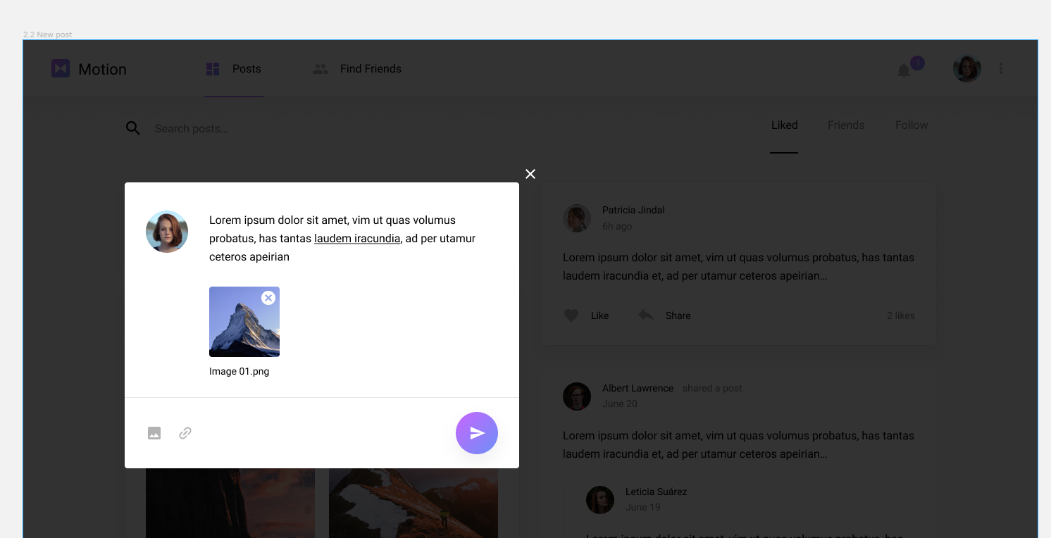
addPhoto

Slide 4

SPLITTING WORK: RICCARDO

Slide 5


SPLITTING WORK: AVIRAN

Slide 6


SPLITTING WORK: ONDREJ

Slide 7
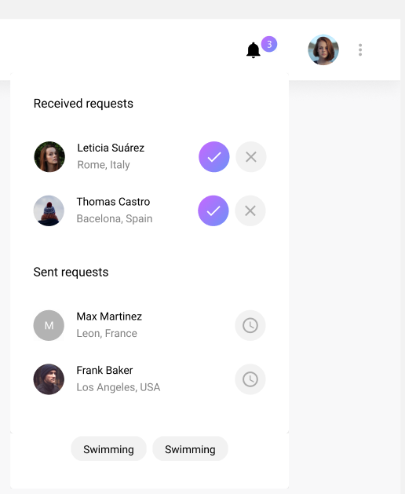

SPLITTING WORK: ONDREJ

