Slide 1
Simulating proton signal with radiational damping and spin exchange

Slide 2
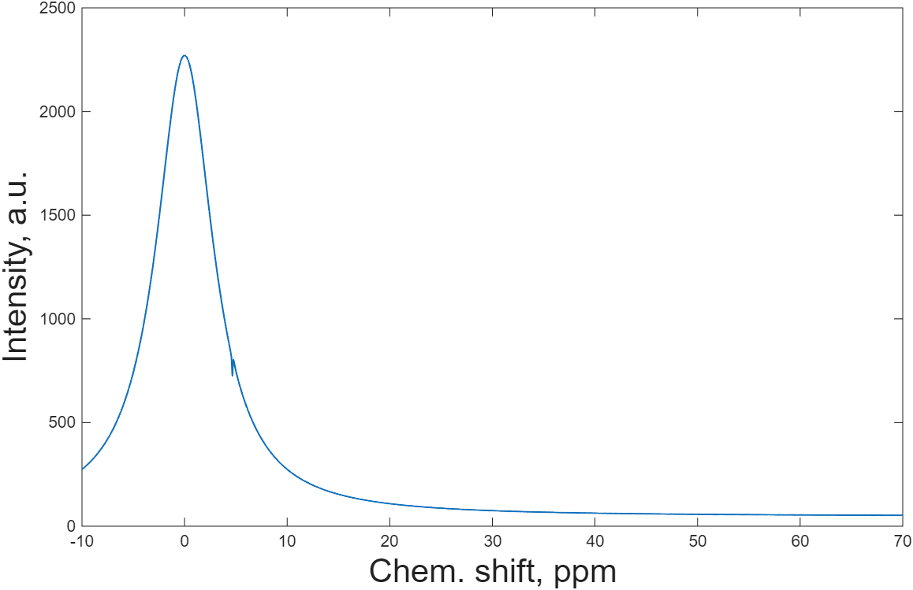

Transition rate – 2[1/s]
Transition rate – 2000[1/s]

