Slide 1
OOP-presentation 1
Itay Gradenwits

Slide 2
Today:
Encapsulation
Java exceptions
Java useful libraries

Slide 3
encapsulation
One of the most important OOP principle
The idea of encapsulation is to hide the inner behavior of the class and publish only necessary methods and details about the class.
In this way – we can change the implementation or design of the class without causing problems to other classes which contact our class
An example of encapsulation is the use of getters and setters instead of publish the class fields.

Slide 4
Code example- rectangle.java

Slide 5
Java useful libraries
Java is known by the great quality and diversity of the libraries that it provide to its programmers.
Those libraries will make our code creation process a lot easier and will save us a lot of time if we’ll use them correctly.

Slide 6
Java useful libraries - Strings
How to create:
Strings s = “hello World”
Important thing to remember:
java string is immutable class – which means we can’t change a sate of an existing object, but we can get another string by using some methods
e.g we can’t change “HI” to “hi” but we can get a new string (“hi”) by using “HI”.toLowerCase()

Slide 7
Java useful libraries - Strings
Useful methods:
Boolean equals(String other) - check the equality of string with given string.
Int length () - returns string length
Char charAt() - returns char value for the particular index
Boolean contains(char c) - returns true or false after matching the sequence of char value.
String replace(char old, char new) – return a new string that replace all the occurrences of the specified char value.

Slide 8
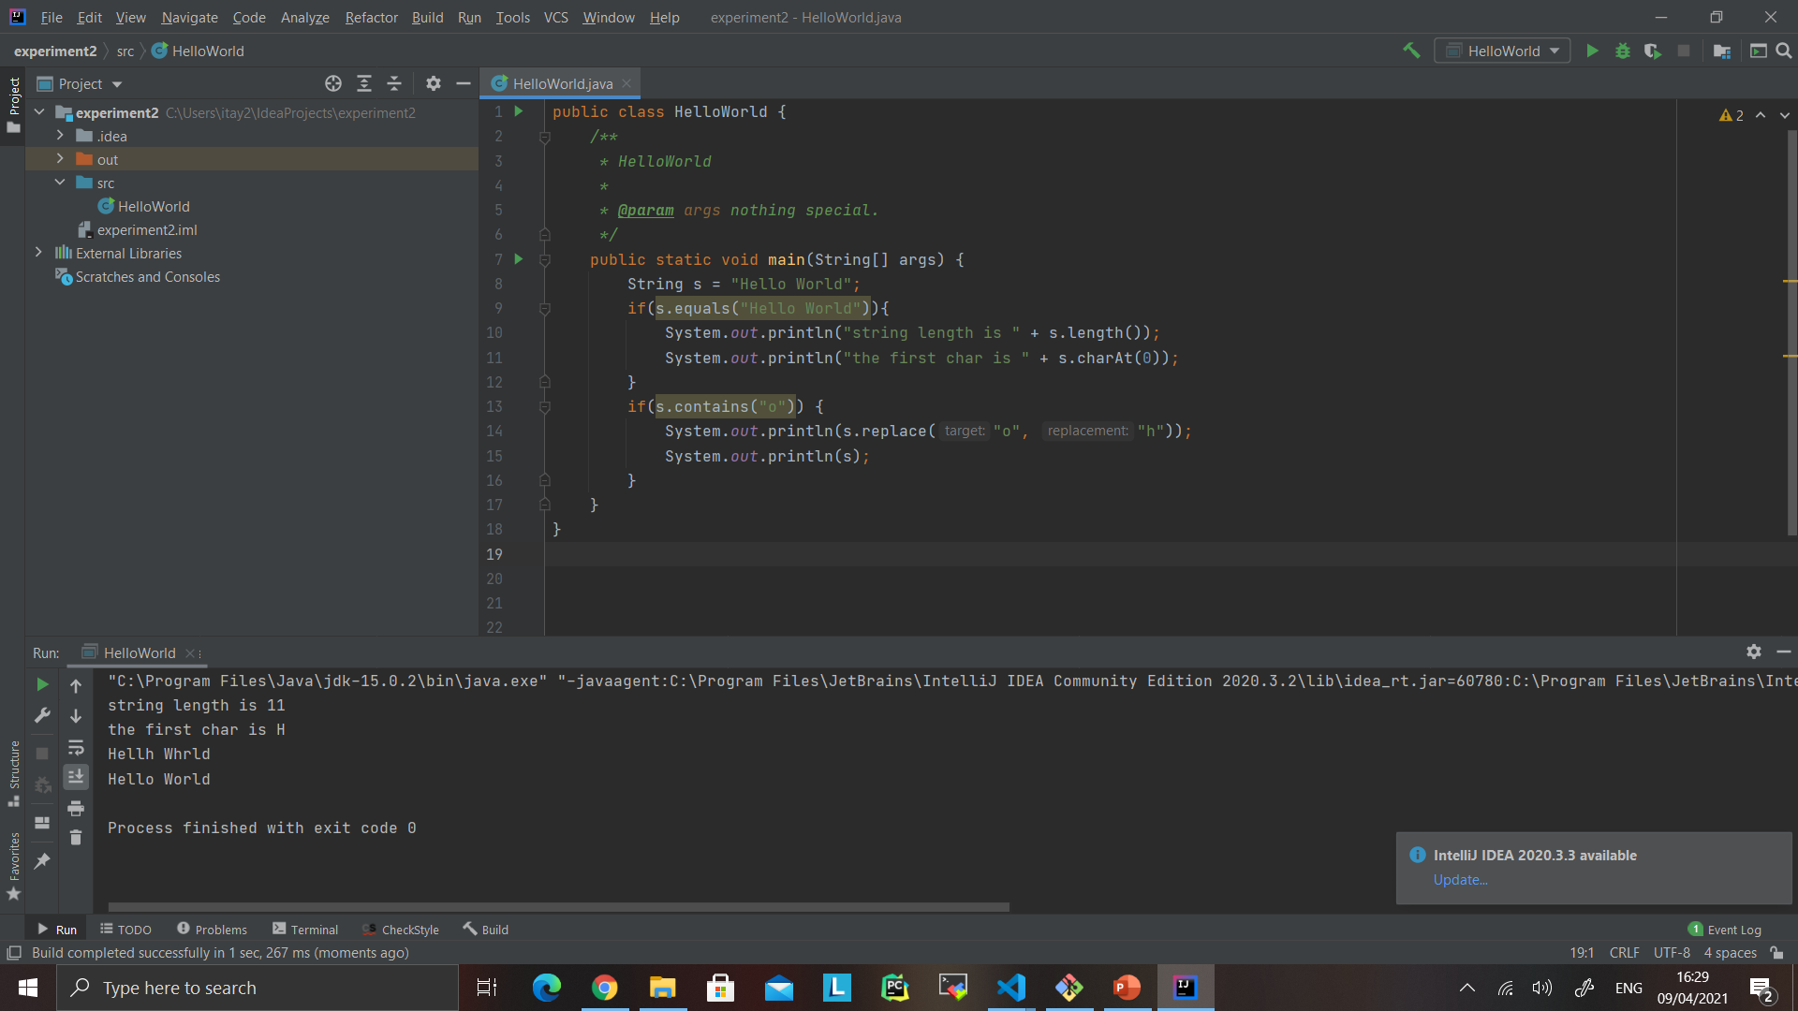
Java useful libraries - Strings
s hasn’t changed after we use “replace” – it just return us a new string.

Slide 9
Java useful libraries - Strings
You can find out a lot of information about Java string here:
https://www.javatpoint.com/java-string

Slide 10
Java useful libraries - Lists
We need to import java.util.List and one of those (java.util.arrayList or java.util.linkedList) in oreder to use this library.
How to create:
List<E> myList = new ArrayList<E>();
E is the type of element we want the list to hold. it can be Double, String or even classes we built but it cannot be a primitive type(e.g int, double).
ArrayList can be replaced with LinkedList - depends on our need. The methods of the list won’t change- only the implementation.

Slide 11
Java useful libraries - Lists
Useful methods:
void add(E e) - Appends the specified element to the end of this list (optional operation).
Void add(int index, E e) - Inserts the specified element at the specified position in this list (optional operation).
Boolean contain(Object o) – Return true if the list contains the specific element.
Boolean isEmpty() – Return true if the list is empty.

Slide 12
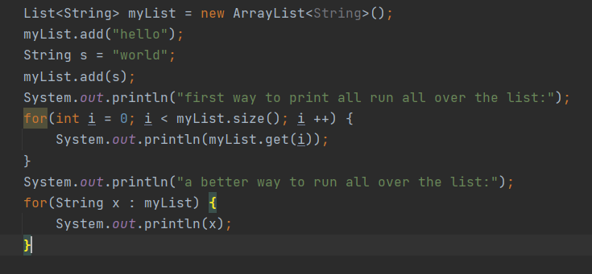
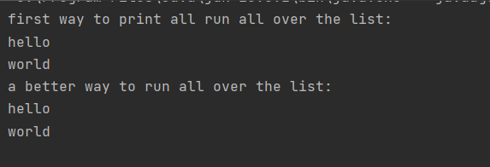
Java useful libraries - Lists
Output:

Slide 13
Java useful libraries - Lists
You can find out more about Java lists here:
https://docs.oracle.com/javase/8/docs/api/java/util/List.html

Slide 14
Exceptions
Java exceptions are tools that provide the programmer a way to deal with errors.
There are 2 types of exceptions:
RuntimeException
Regular Exception

Slide 15
Exceptions - RunTimeException
RuntimeException is meant to crash the program when the programmer asks for.
It can help a lot with debugging but we won’t want to leave it in our final product because we don’t want the user to accidently crash the final product.

Slide 16
Exceptions - RuntimeException
How to use:
The command Throw new RuntimeException() will exit the program.
We can add an error message in the ().
A method who throw a RuntimeException needs to mention it with the statement : “Throws RunTimeException”.

Slide 17
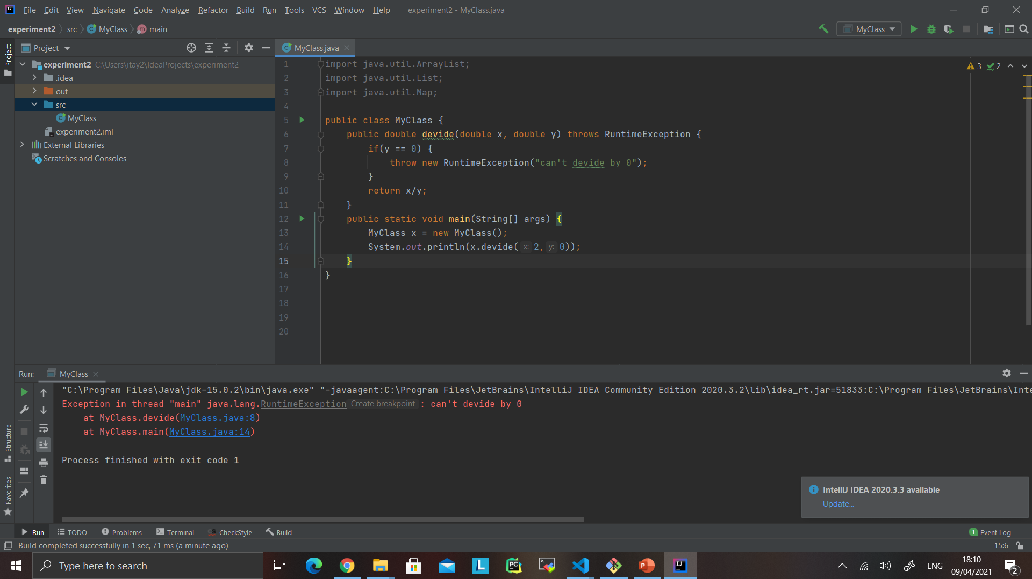
Exceptions - RuntimeException

Slide 18
Exceptions- Regular Exceptions
Exceptions is a very smart tool to handle problems.
If something is not working as expected we’ll throw an exception.
That will cause the current function to exit.
Than the exception will float to the calle function that now ,can handle the exception by “catching it” or ignore it and than the exception will continue to float to the next calle function.
At the end any function has to catch the exception or else the program will crash.

Slide 19
Exceptions- Regular Exceptions
How to use:
Like runtime exception- the throwing function has to mention it with the statement:
“ Throwing Exception”.
When we’ll want to throw an exception we’ll write “Throw new Exception()” we can add a error message in the ().
When we’ll want to catch an exception we’ll write : “catch(Exception e) {}”
Now in the {} field we’ll write what happened in the case of catching an exception – we can use e as an actual object who represent the exception (we can get the error message with e.getMessage())
When you’ll learn about inherit you’ll see some ways to improve this system by creating your own type of exception!

Slide 20
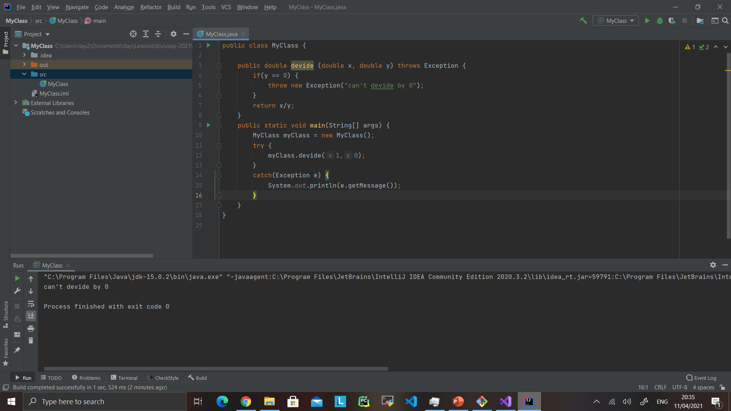
Exceptions- Regular Exceptions

Slide 21
An exercise:
As a hotel manager I would like a program that can hold the id’s for this weekend costumers and calculate the profits.
The information about the costumers will be given to the main programs by this format:
id1,price1,id2,price2
The prices cannot be negative and there cannot be 2 costumers with the same id.
Please handle those exceptions and print a nice error message in case of problem.

