Slide 1
Robust FLOWER Under
Noise Model Mismatch
A controlled study of reconstruction quality
Itay Shorian
Generative Learning and Diffusion Models
October 2026
Notes:
Study of the completed 1,000-reconstruction experiment. The noise standard-deviation ratio controls the likelihood used by FLOWER.
Sources: FLOWER paper (local Flower_main.pdf); config/robustness.json; artifacts/experiments/main/metrics.csv and summary.csv.

Slide 2
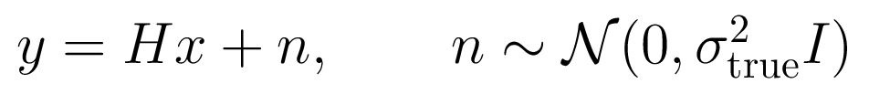
FLOWER: From a Measurement to a Clean Image
Inverse Problem
The Image Prior
We observe a degraded, noisy image and seek the underlying clean image.
A pretrained flow model predicts a clean destination from the current trajectory state.
Three Steps at Every Flow Time
1. Estimate the clean destination
2. Refine it using the measurement
3. Move to the next flow time
Pourya, El Rawas and Unser, FLOWER, ICLR 2026
Notes:
FLOWER combines the velocity network with a measurement-aware proximal correction. This slide summarizes the paper rather than the new robustness experiment.
Sources: FLOWER paper (local Flower_main.pdf); config/robustness.json; artifacts/experiments/main/metrics.csv and summary.csv.

Slide 3
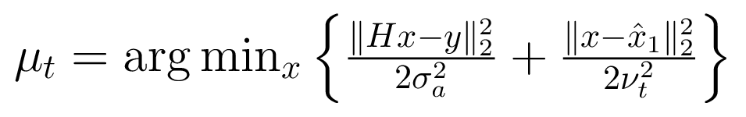
The Noise Level Sets the Refinement Strength
Destination Estimate
Measurement-Aware Refinement
Interpretation
A smaller assumed σ gives more weight to the measurement.
A larger assumed σ gives more weight to the predicted destination.
The paper’s image benchmark uses Flower1-OT with γ = 0
Notes:
The endpoint covariance is approximated by ν_t² I. The refinement minimizes a Gaussian negative log density. Gamma=0 uses the refined mean, while source noise is still injected during progression. The OT practical setting does not meet all assumptions of the ideal posterior-sampling argument.
Sources: FLOWER paper (local Flower_main.pdf); config/robustness.json; artifacts/experiments/main/metrics.csv and summary.csv.

Slide 4
Our Research Question
Noise Calibration
How does reconstruction quality change when FLOWER receives an incorrect noise standard deviation?
r = σassumed / σtrue
r | 0.50 | 0.75 | 1.00 | 1.25 | 1.50
Variance ratio | 0.25 | 0.5625 | 1.00 | 1.5625 | 2.25
Paired Comparison
The image, measurement and source-noise draws are shared across all five ratios. We compare every result with its r = 1 control.
Notes:
Ratios refer to standard deviation, not variance. The actual measurements are generated once. Relative likelihood precision changes by 1/r².
Sources: FLOWER paper (local Flower_main.pdf); config/robustness.json; artifacts/experiments/main/metrics.csv and summary.csv.

Slide 5
Experimental Design
20 fixed CelebA images + 20 fixed AFHQ-Cat images
Inverse problem | True σ | CelebA | AFHQ-Cat
Denoising | 0.20 | Identity | Identity
Gaussian deblurring | 0.05 | 61 × 61, blur σ = 1 | 61 × 61, blur σ = 3
Super-resolution | 0.05 | 2× subsampling | 4× subsampling
Random inpainting | 0.01 | 70% missing | 70% missing
Box inpainting | 0.05 | 40 × 40 central box | 80 × 80 central box
40 images × 5 problems × 5 ratios = 1,000 reconstructions
PSNR ↑ SSIM ↑ LPIPS ↓
Same selected images throughout each dataset. Seed 2026. Noise σ is in model coordinates [-1, 1].
Notes:
Images were selected without replacement from the paper benchmark pools. CelebA resolution 128×128, AFHQ-Cat 256×256. The full step counts and metric implementation conventions are in the report.
Sources: FLOWER paper (local Flower_main.pdf); config/robustness.json; artifacts/experiments/main/metrics.csv and summary.csv.

Slide 6
PSNR Response: CelebA
Main Observation
Denoising loses 2.10 dB at r = 0.50. Super-resolution gains 0.42 dB. Random inpainting changes very little.
Mean paired ΔPSNR vs r = 1. Higher is better. n = 20. Error bars: approximate 95% CI.
Notes:
Native editable chart. Values and paired 95% normal-approximation confidence intervals come directly from summary.csv. The zero value at ratio 1 is by construction. The lines join only the five measured ratios.
Sources: FLOWER paper (local Flower_main.pdf); config/robustness.json; artifacts/experiments/main/metrics.csv and summary.csv.

Slide 7
PSNR Response: AFHQ-Cat
Main Observation
Denoising improves by 0.35 dB at r = 0.75, but loses 1.25 dB at r = 0.50. Super-resolution gains 0.47 dB at r = 0.50.
Mean paired ΔPSNR vs r = 1. Higher is better. n = 20. Error bars: approximate 95% CI.
Notes:
Native editable chart. Values and paired 95% normal-approximation confidence intervals come directly from summary.csv. The zero value at ratio 1 is by construction. The lines join only the five measured ratios.
Sources: FLOWER paper (local Flower_main.pdf); config/robustness.json; artifacts/experiments/main/metrics.csv and summary.csv.

Slide 8
SSIM Response Across Both Datasets
Denoising
Gaussian deblurring
Super-resolution
Random inpainting
Box inpainting
What the Metric Adds
Underestimating noise can damage structure even when PSNR changes little. Super-resolution improves in both datasets.
Mean paired change vs r = 1. Higher is better. n = 20. Error bars: approximate 95% CI.
Notes:
Both panels share the same vertical scale. LPIPS uses the public implementation convention, documented explicitly in the report appendix. Absolute LPIPS values should not be compared with a differently normalized pipeline.
Sources: FLOWER paper (local Flower_main.pdf); config/robustness.json; artifacts/experiments/main/metrics.csv and summary.csv.

Slide 9
LPIPS Response Across Both Datasets
Denoising
Gaussian deblurring
Super-resolution
Random inpainting
Box inpainting
What the Metric Adds
At r = 0.50, AFHQ-Cat denoising improves LPIPS while PSNR and SSIM worsen. Perceptual and pixel fidelity can disagree.
Mean paired change vs r = 1. Lower is better. n = 20. Error bars: approximate 95% CI.
Notes:
Both panels share the same vertical scale. LPIPS uses the public implementation convention, documented explicitly in the report appendix. Absolute LPIPS values should not be compared with a differently normalized pipeline.
Sources: FLOWER paper (local Flower_main.pdf); config/robustness.json; artifacts/experiments/main/metrics.csv and summary.csv.

Slide 10
All Tasks: Mean PSNR Change (dB)
Cells compare a mismatched reconstruction with its r = 1 control
CelebA
AFHQ-Cat
Task | 0.50 | 0.75 | 1.25 | 1.50
Denoising | -2.10 | 0.00 | -0.66 | -1.43
deblurring | -1.51 | -0.07 | -0.32 | -0.72
Super-resolution | +0.42 | +0.30 | -0.37 | -0.77
Random inp. | +0.02 | +0.01 | -0.02 | -0.05
Box inp. | -0.56 | -0.12 | -0.04 | -0.14
Task | 0.50 | 0.75 | 1.25 | 1.50
Denoising | -1.25 | +0.35 | -0.70 | -1.43
deblurring | -0.09 | +0.09 | -0.12 | -0.30
Super-resolution | +0.47 | +0.26 | -0.29 | -0.60
Random inp. | +0.02 | +0.02 | -0.03 | -0.06
Box inp. | -0.31 | -0.07 | -0.02 | -0.07
Reading the Table
Positive values mean better PSNR. Overestimation lowers the mean in every tested dataset–task setting.
Each cell averages 20 paired image differences. The r = 1 column is zero by definition.
Notes:
Editable data tables. Background colors indicate sign and magnitude qualitatively, while exact numbers are printed. Unlike the report heatmap, this slide does not claim a continuous color scale.
Sources: FLOWER paper (local Flower_main.pdf); config/robustness.json; artifacts/experiments/main/metrics.csv and summary.csv.

Slide 11
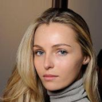
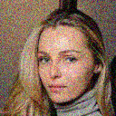
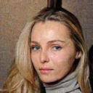


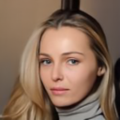

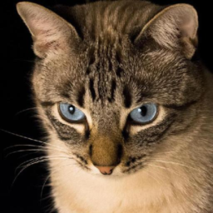
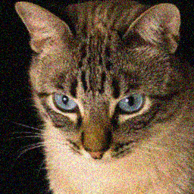

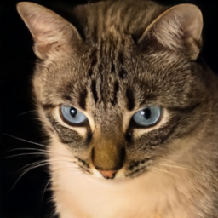



Visual Comparison: Denoising
Ground truth
Measurement
r = 0.50
r = 0.75
r = 1.00
r = 1.25
r = 1.50
CelebA
29.72 / 0.803
0.097
31.77 / 0.913
0.033
31.85 / 0.928
0.020
31.34 / 0.920
0.028
30.70 / 0.909
0.037
AFHQ-Cat
29.78 / 0.813
0.043
30.87 / 0.868
0.057
30.57 / 0.846
0.111
29.89 / 0.812
0.162
29.15 / 0.774
0.203
Observation
Underestimation preserves stronger fine-scale variation. Overestimation smooths it. The metrics determine whether this is detail or residual noise.
Numbers: PSNR (dB) / SSIM, then LPIPS. Fixed examples; blue frame = correct noise. Measurement = Hᵀy.
Notes:
Displayed images are the saved qualitative examples: CelebA 182702.jpg and AFHQ pixabay_cat_001348.jpg. The metrics beneath tiles refer to these individual images. Text about aggregate behavior uses summary.csv. The same measurement is used within each row.
Sources: FLOWER paper (local Flower_main.pdf); config/robustness.json; artifacts/experiments/main/metrics.csv and summary.csv.

Slide 12






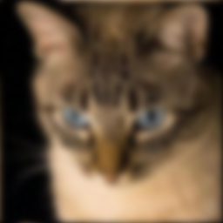
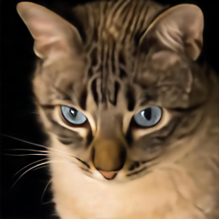




Visual Comparison: Gaussian deblurring
Ground truth
Measurement
r = 0.50
r = 0.75
r = 1.00
r = 1.25
r = 1.50
CelebA
31.64 / 0.866
0.075
32.94 / 0.925
0.026
33.12 / 0.941
0.019
32.86 / 0.939
0.025
32.53 / 0.934
0.030
AFHQ-Cat
26.17 / 0.724
0.296
26.45 / 0.722
0.310
26.52 / 0.712
0.326
26.34 / 0.699
0.339
26.10 / 0.685
0.346
Observation
The two datasets respond differently to underestimation. Kernel width and image content differ between them.
Numbers: PSNR (dB) / SSIM, then LPIPS. Fixed examples; blue frame = correct noise. Measurement = Hᵀy.
Notes:
Displayed images are the saved qualitative examples: CelebA 182702.jpg and AFHQ pixabay_cat_001348.jpg. The metrics beneath tiles refer to these individual images. Text about aggregate behavior uses summary.csv. The same measurement is used within each row.
Sources: FLOWER paper (local Flower_main.pdf); config/robustness.json; artifacts/experiments/main/metrics.csv and summary.csv.

Slide 13
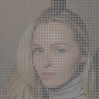






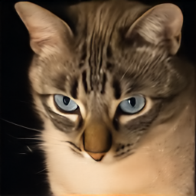



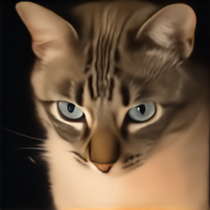
Visual Comparison: Super-resolution
Ground truth
Measurement
r = 0.50
r = 0.75
r = 1.00
r = 1.25
r = 1.50
CelebA
31.34 / 0.921
0.016
31.29 / 0.924
0.018
31.13 / 0.922
0.022
30.90 / 0.917
0.026
30.64 / 0.911
0.030
AFHQ-Cat
25.57 / 0.663
0.247
25.46 / 0.643
0.271
25.33 / 0.624
0.292
25.16 / 0.606
0.308
24.97 / 0.590
0.324
Observation
Both datasets gain PSNR and SSIM and reduce LPIPS at r = 0.50 in the 20-image average.
Numbers: PSNR (dB) / SSIM, then LPIPS. Fixed examples; blue frame = correct noise. Measurement = Hᵀy.
Notes:
Displayed images are the saved qualitative examples: CelebA 182702.jpg and AFHQ pixabay_cat_001348.jpg. The metrics beneath tiles refer to these individual images. Text about aggregate behavior uses summary.csv. The same measurement is used within each row.
Sources: FLOWER paper (local Flower_main.pdf); config/robustness.json; artifacts/experiments/main/metrics.csv and summary.csv.

Slide 14
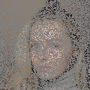





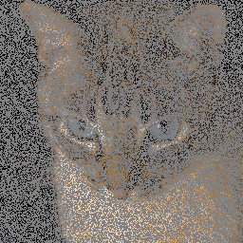





Visual Comparison: Random inpainting
Ground truth
Measurement
r = 0.50
r = 0.75
r = 1.00
r = 1.25
r = 1.50
CelebA
32.06 / 0.939
0.014
32.06 / 0.939
0.014
32.05 / 0.940
0.015
32.04 / 0.940
0.015
32.03 / 0.939
0.015
AFHQ-Cat
30.58 / 0.892
0.049
30.57 / 0.892
0.051
30.57 / 0.891
0.052
30.56 / 0.890
0.054
30.54 / 0.888
0.057
Observation
The reconstruction changes only slightly over this range. This task also has the smallest true noise level, σ = 0.01.
Numbers: PSNR (dB) / SSIM, then LPIPS. Fixed examples; blue frame = correct noise. Measurement = Hᵀy.
Notes:
Displayed images are the saved qualitative examples: CelebA 182702.jpg and AFHQ pixabay_cat_001348.jpg. The metrics beneath tiles refer to these individual images. Text about aggregate behavior uses summary.csv. The same measurement is used within each row.
Sources: FLOWER paper (local Flower_main.pdf); config/robustness.json; artifacts/experiments/main/metrics.csv and summary.csv.

Slide 15
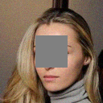
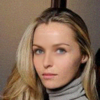
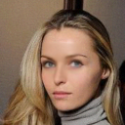



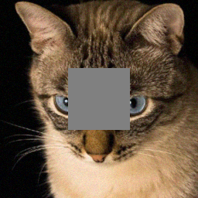
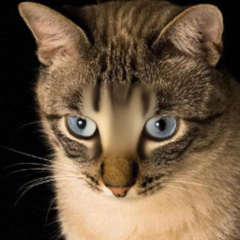

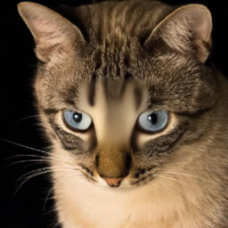


Visual Comparison: Box inpainting
Ground truth
Measurement
r = 0.50
r = 0.75
r = 1.00
r = 1.25
r = 1.50
CelebA
31.40 / 0.905
0.044
31.97 / 0.939
0.029
32.18 / 0.958
0.012
32.10 / 0.959
0.014
31.95 / 0.958
0.016
AFHQ-Cat
23.82 / 0.855
0.081
23.89 / 0.886
0.077
23.90 / 0.895
0.079
23.88 / 0.893
0.085
23.86 / 0.887
0.094
Observation
The data term acts on observed pixels. The prior supplies the missing central region, and later iterations couple both regions.
Numbers: PSNR (dB) / SSIM, then LPIPS. Fixed examples; blue frame = correct noise. Measurement = Hᵀy.
Notes:
Displayed images are the saved qualitative examples: CelebA 182702.jpg and AFHQ pixabay_cat_001348.jpg. The metrics beneath tiles refer to these individual images. Text about aggregate behavior uses summary.csv. The same measurement is used within each row.
Sources: FLOWER paper (local Flower_main.pdf); config/robustness.json; artifacts/experiments/main/metrics.csv and summary.csv.

Slide 16

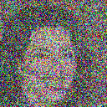
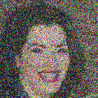
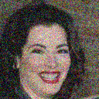
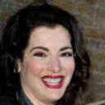







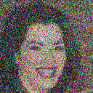


How Mismatch Changes the Trajectory
CelebA denoising, image 182734.jpg
Flow time t
t = 0.2
t = 0.4
t = 0.6
t = 0.8
t = 1.0
r = 0.50
r = 1.00
r = 1.50
Rows share measurement and source-noise draws. Final column: reconstruction. All five ratios are in the report.
Notes:
Stored diagnostic trajectory. The representative image is selected by the capture script using median image-level sensitivity. Early states are noisy by design. The ratio axis and the time axis are different experimental dimensions.
Sources: FLOWER paper (local Flower_main.pdf); config/robustness.json; artifacts/experiments/main/metrics.csv and summary.csv.

Slide 17


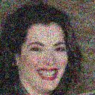






Inside the Three Steps at t = 0.75
Destination estimate
Measurement refinement
Next trajectory state
r = 0.50
r = 1.00
r = 1.50
CelebA denoising, image 182734.jpg. Step 2 uses σ directly. Step 3 adds source noise and advances time.
Notes:
The first-column differences can be induced by earlier refinements. Do not claim the mismatch only affects the second column: it acts directly there, and indirectly changes later network predictions.
Sources: FLOWER paper (local Flower_main.pdf); config/robustness.json; artifacts/experiments/main/metrics.csv and summary.csv.

Slide 18
Interpreting the Evidence
Why the Forward Operator Matters
Denoising changes the measurement weight at every pixel. Masked and subsampled problems constrain only observed locations directly.
Why Correct Noise Need Not Maximize PSNR
The practical solver uses a learned velocity and an approximate endpoint distribution. A different data weight can compensate for their errors on a finite sample.
Limits of the Comparison
20 images per dataset and one paired seed sequence per image–task pair. Paper results use 100 images. Confidence intervals summarize image variation.
These results establish sensitivity on the tested sample; they do not identify a universal optimal noise ratio.
Notes:
Mechanistic explanations are interpretations of the refinement equation. The experiment does not isolate the cause of the super-resolution improvement. Task and true noise level vary together, so operator dependence is not a pure operator-only ablation.
Sources: FLOWER paper (local Flower_main.pdf); config/robustness.json; artifacts/experiments/main/metrics.csv and summary.csv.

Slide 19
Conclusions
Sensitivity Depends on the Task
Denoising is the most sensitive setting. Random inpainting is nearly unchanged over the tested range.
Overestimation Consistently Hurts Mean PSNR
Both r = 1.25 and r = 1.50 reduce mean PSNR in all ten dataset–task settings.
Underestimation Has No Universal Outcome
Super-resolution improves in both datasets. Severe underestimation hurts denoising, and LPIPS can disagree with PSNR and SSIM.
Noise calibration should be evaluated for the task and the metric.
Notes:
Conclusions are restricted to the five tested ratios and the fixed samples. No new reconstruction was run to produce these slides.
Sources: FLOWER paper (local Flower_main.pdf); config/robustness.json; artifacts/experiments/main/metrics.csv and summary.csv.

Slide 20
References and Reproducible Results
M. Pourya, B. El Rawas and M. Unser
FLOWER: A Flow-Matching Solver for Inverse Problems
ICLR 2026
Y. Lipman et al.
Flow Matching for Generative Modeling
ICLR 2023
Project Results
Raw and paired metrics, all 50 summary rows, saved examples, and trajectory captures are in artifacts/experiments/main/.
github.com/ItayShorian07/Diffusion--flower-project
Notes:
Scientific sources and experimental files are cited throughout the speaker notes. Report includes derivations, full result tables, and details of the LPIPS convention.
Sources: FLOWER paper (local Flower_main.pdf); config/robustness.json; artifacts/experiments/main/metrics.csv and summary.csv.

