Slide 1
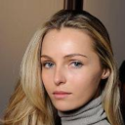
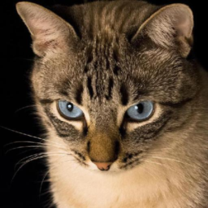
FLOWER Under Measurement
Noise Scale Mismatch
A paired GPU benchmark across five inverse problems and two image domains
1,000 reconstructions PSNR SSIM LPIPS
Itay Shorian 14 October 2026
Notes:
The project measures how the original FLOWER solver responds when the Gaussian measurement-noise standard deviation supplied during reconstruction is wrong.
Sources:
FLOWER paper: https://openreview.net/forum?id=QGd34p02mI
Official code: https://github.com/mehrsapo/Flower

Slide 2
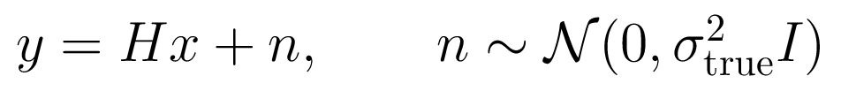
Research question and paired comparison
02
Paired statistic
The measurement is generated once
The operator, noise realization, mask or kernel, model weights, and FLOWER source-noise trajectory remain fixed.
Ratio 1.0 is the correctly specified control for the same image and measurement.
Only the assumed standard deviation changes
The project evaluates the released model and reconstruction rule. It does not train another model.
0.5 0.75 1.0 1.25 1.5
FLOWER measurement noise scale mismatch
20 CelebA + 20 AFHQ-Cat
Notes:
Pairing isolates the assumed noise scale from changes caused by another measurement draw or another stochastic trajectory.
Sources:
Protocol: config/robustness.json

Slide 3
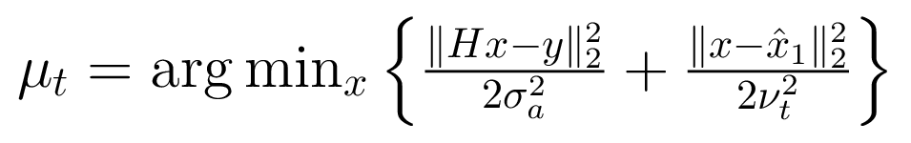
FLOWER uses three steps at every flow time
03
1
Prior destination
2
Measurement refinement
3
Time progression
The velocity network predicts x-hat-1.
The assumed sigma weights the likelihood.
The refined destination advances the trajectory.
Where mismatch acts
A smaller assumed sigma strengthens the data term. A larger value gives the learned prior more influence.
The report gives short proofs for the conditional destination, Gaussian refinement, proximal equivalence, and ancestral transition.
FLOWER measurement noise scale mismatch
20 CelebA + 20 AFHQ-Cat
Notes:
Sigma appears directly in Step 2. Later Step 1 predictions can also differ because previous refinements changed the trajectory state.
Sources:
FLOWER paper, Propositions 1 to 3: https://openreview.net/forum?id=QGd34p02mI

Slide 4
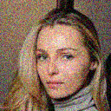

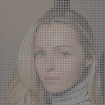
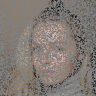
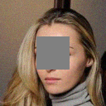
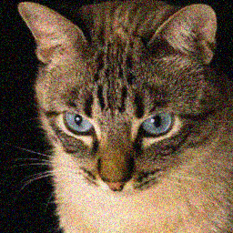
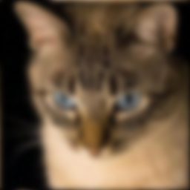
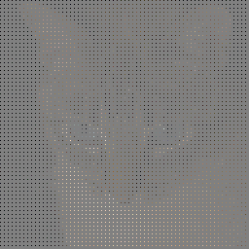
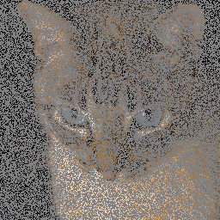
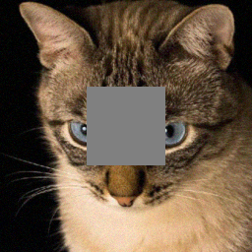
Ten settings cover five operators and two domains
04
CelebA
Denoising
Deblurring
Super-resolution
Random inpainting
Box inpainting
AFHQ-Cat
Denoising
Deblurring
Super-resolution
Random inpainting
Box inpainting
The same 20 selected images pass through every task within a dataset
FLOWER measurement noise scale mismatch
20 CelebA + 20 AFHQ-Cat
Notes:
Measurements shown here use the fixed qualitative image in each dataset. The task-specific sigma and operator parameters match the public paper setup.
Sources:
Generated measurements: artifacts/experiments/main/reconstructions

Slide 5
Task parameters match the public FLOWER benchmark
05
Task | True sigma | CelebA | AFHQ-Cat
Denoising | 0.20 | Identity, 100 steps | Identity, 100 steps
Deblurring | 0.05 | Blur sigma 1, 100 steps | Blur sigma 3, 500 steps
Super-resolution | 0.05 | 2x, 100 steps | 4x, 500 steps
Random inpainting | 0.01 | 70% missing, 100 steps | 70% missing, 200 steps
Box inpainting | 0.05 | 40 x 40, 100 steps | 80 x 80, 100 steps
20 images x 5 ratios x 5 tasks x 2 datasets = 1,000 reconstructions
FLOWER measurement noise scale mismatch
20 CelebA + 20 AFHQ-Cat
Notes:
All five task noise levels are nonzero, so the same ratio sweep is meaningful for every operator.
Sources:
FLOWER paper Section 5.1: https://openreview.net/forum?id=QGd34p02mI
Configuration: config/robustness.json

Slide 6
CelebA paired PSNR response
06
Most sensitive task
Denoising
1.05 dB mean absolute response
Least sensitive task
Random inpainting
0.02 dB mean absolute response
FLOWER measurement noise scale mismatch
20 CelebA + 20 AFHQ-Cat
Notes:
Each line uses the same 20 images and paired control. The report includes 95 percent confidence intervals and the full metric table.
Sources:
Data: artifacts/experiments/main/summary.csv

Slide 7
AFHQ-Cat paired PSNR response
07
Most sensitive task
Denoising
0.93 dB mean absolute response
Least sensitive task
Random inpainting
0.03 dB mean absolute response
FLOWER measurement noise scale mismatch
20 CelebA + 20 AFHQ-Cat
Notes:
Each line uses the same 20 images and paired control. The report includes 95 percent confidence intervals and the full metric table.
Sources:
Data: artifacts/experiments/main/summary.csv

Slide 8
Control results and the paper reference
08
CelebA
AFHQ-Cat
Task | Our control | Paper | Difference
Denoising | 32.22 | 32.28 | -0.06
Deblurring | 34.74 | 34.98 | -0.24
Super-resolution | 32.14 | 32.36 | -0.22
Random inpainting | 32.65 | 33.08 | -0.43
Box inpainting | 30.54 | 31.19 | -0.65
Task | Our control | Paper | Difference
Denoising | 31.31 | 31.69 | -0.38
Deblurring | 27.45 | 28.64 | -1.19
Super-resolution | 26.15 | 26.23 | -0.08
Random inpainting | 32.15 | 32.97 | -0.82
Box inpainting | 26.70 | 26.19 | 0.51
Our control uses 20 fixed images from each paper benchmark pool. The paper values average 100 images, so the differences are contextual rather than exact replication errors.
FLOWER measurement noise scale mismatch
20 CelebA + 20 AFHQ-Cat
Notes:
The ratio 1.0 control provides a sanity check against the published Flower1-OT scale. The image samples differ in size, so paired conclusions rely on within-project deltas.
Sources:
FLOWER Tables 1 and 2: https://openreview.net/forum?id=QGd34p02mI
Data: artifacts/experiments/main/summary.csv

Slide 9
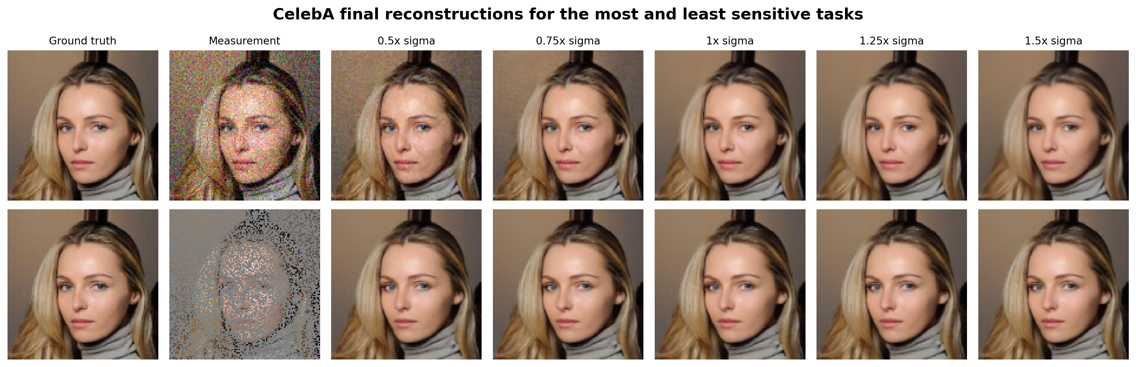
CelebA final reconstructions
09
Top row: denoising (most sensitive). Bottom row: random inpainting (least sensitive). The image was selected before examining results.
FLOWER measurement noise scale mismatch
20 CelebA + 20 AFHQ-Cat
Notes:
Read each row from the same ground truth and measurement through all five assumed noise ratios.
Sources:
Generated figure: artifacts/figures/figure2_celeba_qualitative.png

Slide 10
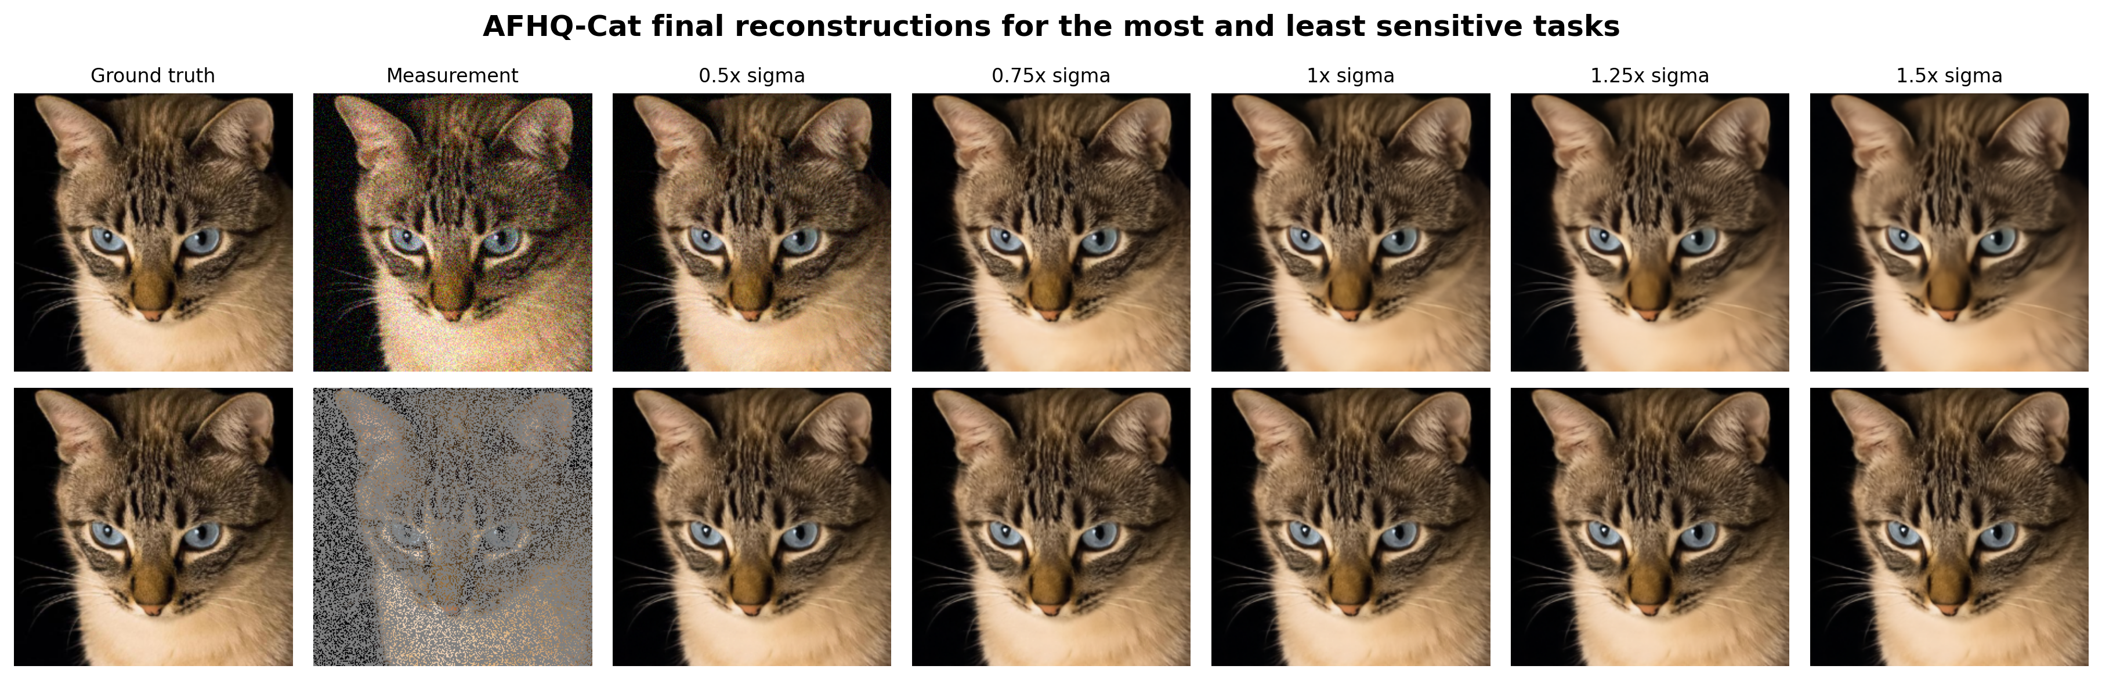
AFHQ-Cat final reconstructions
10
Top row: denoising (most sensitive). Bottom row: random inpainting (least sensitive). The same selection rule is used across domains.
FLOWER measurement noise scale mismatch
20 CelebA + 20 AFHQ-Cat
Notes:
The AFHQ-Cat row uses the same predeclared qualitative image position and task-selection rule as CelebA.
Sources:
Generated figure: artifacts/figures/figure3_afhq_qualitative.png

Slide 11
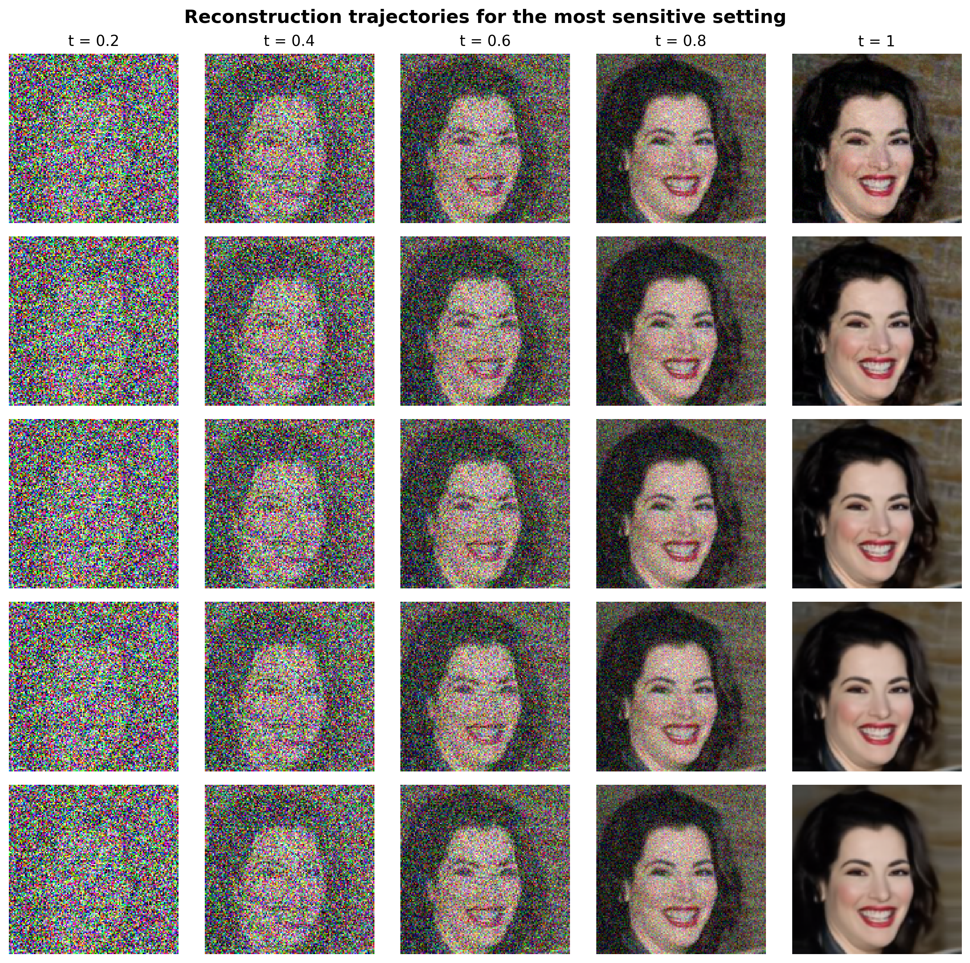
Noise mismatch changes the reconstruction trajectory
11
Rows
0.5x sigma
0.75x sigma
1.0x sigma
1.25x sigma
1.5x sigma
Controlled comparison
Every row shares the same source-noise sequence. Visible separation is caused by the assumed sigma and its downstream effects.
FLOWER measurement noise scale mismatch
20 CelebA + 20 AFHQ-Cat
Notes:
The setting has the highest mean absolute paired PSNR response. Its displayed image is closest to median image-level sensitivity, which avoids selecting an extreme failure.
Sources:
Selection metadata: artifacts/experiments/main/analysis_capture/metadata.json
Generated figure: artifacts/figures/figure4_trajectory.png

Slide 12
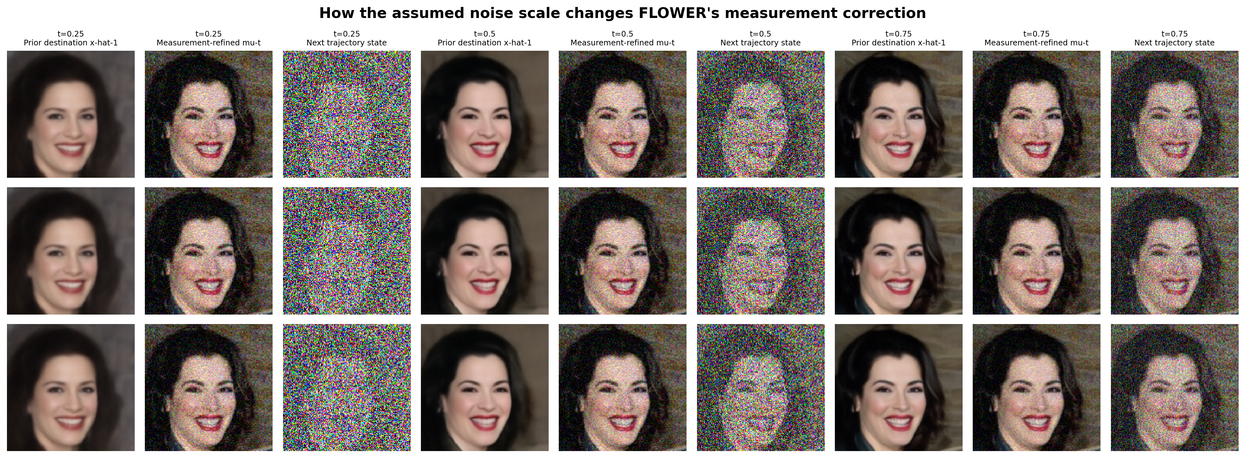
The direct effect appears in measurement refinement
12
Columns compare the prior destination, refined destination, and next trajectory state at three times. Rows compare ratios 0.5, 1.0, and 1.5.
FLOWER measurement noise scale mismatch
20 CelebA + 20 AFHQ-Cat
Notes:
Sigma enters Step 2 directly. Step 1 has no explicit sigma term, although its input state can already differ because of earlier refinements.
Sources:
Generated figure: artifacts/figures/figure5_internal_states.png
FLOWER paper Figure 3 and Proposition 2: https://openreview.net/forum?id=QGd34p02mI

Slide 13
Mismatch sensitivity is task-specific and asymmetric
13
Highest response
CelebA Denoising 1.05 dB
Most tolerant
CelebA Random inpainting 0.02 dB
Underestimation can help
At 0.5x sigma, super-resolution gains 0.42 dB on CelebA and 0.47 dB on AFHQ-Cat.
Evidence boundary
The claims apply to released Flower1-OT checkpoints, five tested ratios, and fixed 20-image samples. No additional model was trained.
Full tables, confidence intervals, mathematical derivations, and limitations are in the report
20 CelebA + 20 AFHQ-Cat
Notes:
The ranking averages the absolute paired PSNR curve response across the four mismatched ratios. Overestimation is consistently harmful here, while moderate underestimation improves super-resolution and several AFHQ-Cat settings. The report gives the paired confidence intervals and cross-metric evidence.
Sources:
Data: artifacts/experiments/main/summary.csv
Report: artifacts/report/flower-noise-scale-mismatch-report.docx

