Slide 1


ITC — Information Technology Colleague
رواد مصر الرقمية
GRADUATION
PROJECT
Manual Testing • API Testing • Automation Testing
Testing
QA Engineering
2025 / 2026
ITC_CAI4_SWD6_S7
Cairo Software Testing
Thanks and appreciation to the initiative's management and to ITC, the company implementing the Software Testing Cairo track.

Slide 2
AGENDA
Overview
What we'll cover today
01 Introduction
This presentation covers our graduation project from inception to delivery — walking through every stage of our QA testing lifecycle, methodology, and final results.
02 Project Scope
03 Testing Strategy
126
126
0
0
04 Test Design
Test Cases
Passed
Failed
Bugs
05 API Testing
06 Automation Testing
07 Results
08 Conclusion

Slide 3
Project Overview
The Team
Project Name
Binance Testing
Ahmed Saleh
John Ayad
A
J
Team Leader
Software Testing
Tech Stack
API by Postman
Automation by Selenium
Lobna Mohamed
Logeen Mohammed
L
L
Software Testing
Software Testing
Supervisor
Basil
Nouran Mohamed
Ahmed Anwer
N
A
Software Testing
Software Testing

Slide 4
PROBLEM
Problem
01
Efficiency
Manual testing requires significant time and effort, especially for large applications and frequent releases.
Statement
Web applications may contain:
Functional defects.
API failures.
UI inconsistencies.
Performance issues.
These problems negatively affect user experience and business reliability.
01 Functional Issues
Incorrect business logic or unexpected behavior.
02 API Issues
Invalid responses or status codes.
03 Regression Risks
New updates may break existing functionality.
02
Quality
Software defects and API failures negatively impact product quality and user satisfaction.
03
Time
Re-testing the entire application after each update delays delivery and increases testing time.

Slide 5
SOLUTION
Proposed Solution
Our team implemented a complete QA process for the Binance platform, starting with requirement analysis and test case design, followed by API testing using Postman and automation testing using Selenium to ensure software quality and reliability.
Proposed Solution
Benefits
Our team implemented a complete QA process including:
Requirement Analysis
Test Scenario Creation
Test Case Design
API Testing using Postman
Automation Testing using Selenium
Early bug detection.
Improved software quality.
Reduced regression risks.
Tools Used
Expected Outcomes
Postman
Selenium
Excel
Chrome Driver
• Improved software quality
• Early bug detection
• Faster regression testing
• Reduced testing effort
• Higher release confidence

Slide 6

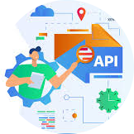
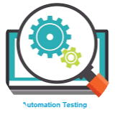
System
1. Test PlanningTest
2. Test Execution
Design
3. Reporting & Automation
Test Design
API Testing
Automation Testing
User Stories
Test Scenarios
Test Cases
Postman Collection
GET Requests
POST Requests
Response Validation
Selenium WebDriver
Test Scripts
Assertions
Test Execution

Slide 7
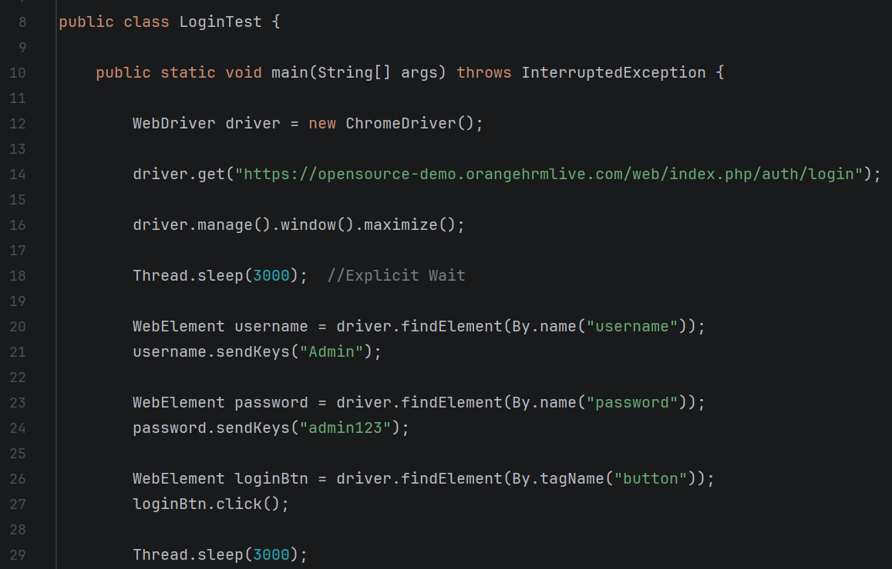
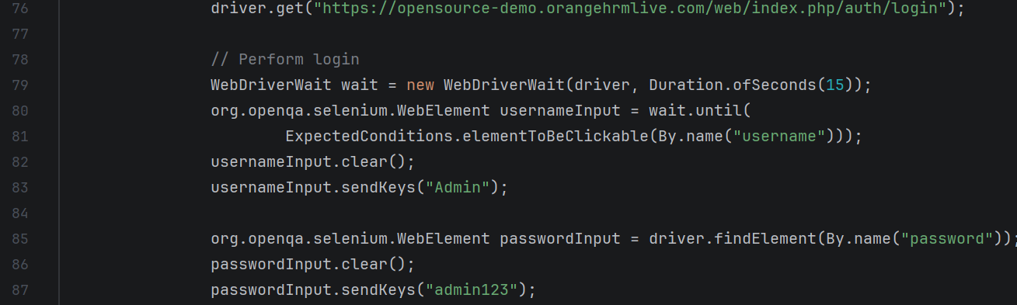
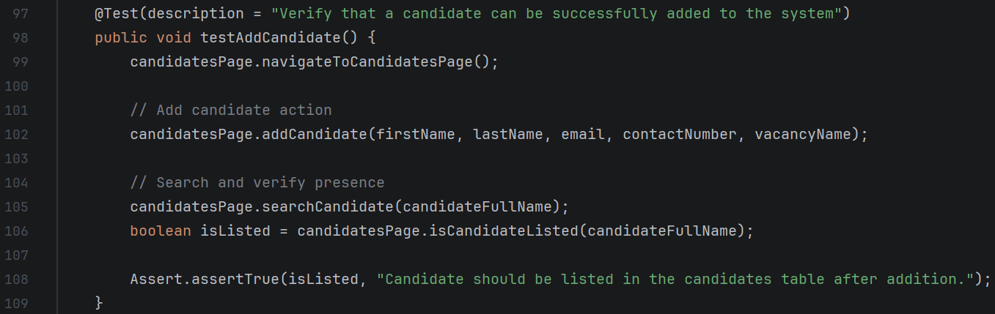
Demo &
Screenshots
Screenshot 1
Screenshot 2
Screenshot 3

Slide 8
QA Results Dashboard
Testing Team — Final Metrics
126
126
0
0
Total Test Cases
Passed
Failed
Bugs Found

Slide 9
Conclusion
Summary
Thank
Successfully validated major functionalities.
Verified API responses.
Automated critical scenarios.
You!
Learnings
Writing effective test cases.
API validation.
Selenium automation framework creation.
ITC Graduation Project
Future Work
Increase automation coverage.
Add performance testing.
Integrate CI/CD pipeline.

