Slide 1




Volt Market
E-COMMERCE WEBSITE PROJECT
Presented by:
Anwar Khaled Abotaleb • Ahmed AbdElghafar Hammad Hussein Khaled Elsharkawy • Mahmoud Abdallah Arnous Habiba Ramadan Elsayed
June 2026
Notes:
Welcome everyone. Today, I'm excited to present "Volt Market," an e-commerce website project developed as part of my graduation requirements. This project focuses on delivering a modern, responsive, and feature-rich shopping experience using cutting-edge web technologies. We'll explore how Volt Market addresses common challenges in online retail, offering a seamless and intuitive platform for users. Let's dive into the project's core.

Slide 2








Project Overview
Introduction
Main Project Goals
Volt Market is a high-performance e-commerce platform delivering a seamless shopping experience that blends fast discovery with user-centric design.
High-speed product discovery and real-time search.
Seamless mobile-first responsive experience.
Purpose
Integrated AI assistant for smart recommendations.
We simplify online purchasing via an intuitive interface, quick product discovery, and secure transaction flows.
Secure and efficient checkout process.
Target Audience
For modern, tech-savvy shoppers who value speed, reliability, and ease in their digital buying journeys.
Notes:
Volt Market isn't just another shopping site; it's a solution tailored for the modern consumer. Our primary goal was to create a platform that feels natural to use, whether you're on a desktop or a mobile device, ensuring that the journey from discovery to purchase is as smooth as possible. We aimed for high-speed product discovery, a seamless checkout, and a mobile-first design. This focus on user experience and performance sets Volt Market apart. Now, let's consider the problems Volt Market was designed to solve.

Slide 3








Problem Statement
The Challenges
Volt Market Solution
Limited Accessibility: Traditional shopping is restricted by location and operating hours.
24/7 Global Access: Shop anytime, anywhere with a mobile-optimized interface.
Inefficient Discovery: Difficulty in comparing products, prices, and reviews across physical stores.
Instant Intelligence: Real-time search and an integrated AI Assistant for product discovery.
Poor Digital UX: Existing platforms often suffer from slow performance and complex navigation.
High Performance: Single-page architecture ensures rapid transitions and zero page reloads.
Notes:
Traditional shopping has its limits, and even many existing online platforms struggle with user retention due to poor performance. Volt Market addresses these issues by offering a lightning-fast interface and an AI-driven chatbot that assists users in finding exactly what they need without manual filtering. We provide 24/7 accessibility and instant search, overcoming the limitations of physical stores and inefficient digital experiences. This approach ensures a superior shopping journey. So, how did we achieve this? Let's look at the core features.

Slide 4







Core Features & Functionality
User Management
Smart Discovery
Dynamic Cart
Secure registration and login system with JWT-based authentication and protected routes for user privacy.
Advanced search functionality with real-time filtering by categories, brands, and price ranges.
Real-time shopping cart management with instant updates, quantity controls, and persistent storage.
Wishlist System
Secure Checkout
AI Assistant
Personalized wishlist allowing users to save favorite products for future purchases with one-click cart transfer.
Streamlined multi-step checkout process with shipping details validation and order summary.
Integrated ChatBot providing smart product recommendations and answering customer queries instantly.
Notes:
We've packed Volt Market with all the essential features of a top-tier e-commerce site. Beyond the standard cart and checkout, we've implemented a Wishlist for future purchases and a smart ChatBot that can suggest products based on user queries, significantly enhancing the user experience. These features, from secure user management to dynamic shopping tools, were designed to create a comprehensive and intuitive platform. Now, let's explore the technical foundation that makes these features possible.

Slide 5






Technical Stack & Technologies
FRONTEND FRAMEWORK
STYLING & UI
STATE MANAGEMENT
React.js
CSS3 & Bootstrap
Context API
Building a dynamic, component-based SPA for a smooth user experience.
Responsive layouts and modern design systems for all screen sizes.
Global state handling for User, Cart, and Wishlist without external libraries.
NETWORKING
VERSION CONTROL
NOTIFICATIONS
Axios
Git & GitHub
React Hot Toast
Seamless REST API integration for real-time data fetching and updates.
Collaborative development and version tracking for project stability.
Real-time feedback and status alerts for user interactions.
Notes:
The technical stack was chosen for its scalability and performance. React.js allows for a smooth, single-page application experience. We used the Context API to manage complex states like the shopping cart across the entire application without the overhead of heavier libraries. This combination of modern technologies ensures a robust and efficient platform. Next, we'll examine how these technologies come together in our system's architecture.

Slide 6






System Architecture
JSON / HTTPS
Query / Response
Frontend SPA
RESTful API
Database
React.js Application Context API State Management Axios Client
RouteMisr E-Commerce API Authentication Middleware Business Logic
Product Catalog User Credentials Order History
STEP 01
STEP 02
STEP 03
STEP 04
User interacts with React UI components.
Axios sends asynchronous requests to the API.
API processes data and returns JSON response.
Context API updates state and re-renders UI.
Notes:
Our system architecture employs a modern decoupled approach, ensuring both scalability and maintainability. The frontend, a React-based single-page application, communicates with a RESTful API. This separation allows us to update or scale either side independently without impacting the other. The data flow is optimized for instant user feedback, making the shopping experience feel incredibly responsive. This robust architecture underpins the seamless user experience we'll discuss next.

Slide 7

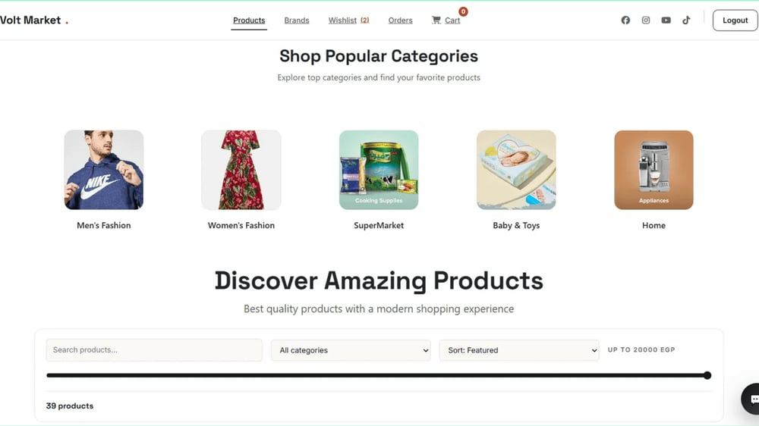
User Interface & UX Design
Visual Identity
Minimalist UX
Interactive Elements
A professional Green and White palette chosen to evoke trust, growth, and cleanliness. High-contrast typography ensures readability across all devices.
Focus on Negative Space to reduce cognitive load. Intuitive navigation patterns allow users to reach any product within three clicks.
Clean product cards with clear Call-to-Action buttons. Real-time feedback via toast notifications for cart and wishlist actions.
Modern Design Implementation
As seen in the Home Page, the UI emphasizes clarity and ease of navigation. The layout is structured to highlight popular categories and products while maintaining a professional, uncluttered aesthetic.
Notes:
Building on our solid architecture, the user interface and experience design were paramount for Volt Market. We chose a professional green and white palette to convey trust and cleanliness, focusing on minimalist design principles. This approach reduces cognitive load and ensures users can navigate intuitively, reaching any product within three clicks. Every element is optimized for responsiveness, guaranteeing a consistent, high-quality experience across all devices. Now, let's explore how these design principles manifest on our key pages.

Slide 8









Key Pages & Navigation
Home & Products
Product Details
The central hub featuring a dynamic product grid, category sliders, and real-time search functionality.
Comprehensive view with high-resolution images, detailed specifications, and related product suggestions.
Cart & Wishlist
Secure Checkout
Streamlined management of selected items with instant quantity updates and "Save for Later" options.
A multi-step, optimized workflow for shipping details and payment processing to ensure high conversion.
Notes:
Each key page in Volt Market is meticulously designed with a specific user goal in mind. The Home and Products pages serve as dynamic hubs for discovery, featuring real-time search and category sliders. The Product Details page offers a comprehensive view with high-resolution images and specifications, providing all the information needed for an informed decision. The Cart and Wishlist pages streamline item management, while our secure checkout ensures a smooth, multi-step payment process. These pages are crucial, but development wasn't without its hurdles.

Slide 9



Development Challenges & Solutions
Technical Challenges
Implemented Solutions
Global State Complexity
React Context API
Managing shopping cart and user authentication across
Established a "Single Source of Truth" for global states,
deeply nested components without prop drilling.
ensuring consistent data across the entire app.
API Synchronization
Axios & Custom Loaders
Handling asynchronous data fetching, loading states,
Utilized Axios for robust networking and developed a
and error management for real-time product updates.
global Loader component for seamless UX.
Performance Optimization
Component Memoization
Ensuring rapid page transitions and efficient rendering in
Applied React.memo and optimized hooks to minimize
a data-heavy single-page application.
unnecessary re-renders and boost performance.
Notes:
Developing Volt Market presented several technical challenges, particularly in managing complex global states like the shopping cart and user authentication. We addressed this by implementing the React Context API, establishing a single source of truth for consistent data across the application. Handling asynchronous API calls and ensuring consistent UI across browsers were also critical. We tackled these with Axios for robust networking and by leveraging Bootstrap's grid system and CSS media queries. These solutions were vital in delivering a high-performing and reliable platform. With these challenges overcome, we can now look to the future.

Slide 10



Conclusion & Future Roadmap
Project Summary
Future Enhancements
Volt Market successfully demonstrates a robust, scalable, and user-centric e-commerce solution built with modern React technologies.
Online Payment Integration (Stripe/PayPal)
Real-time Order Tracking System
The project achieved its core goals of high performance, mobile responsiveness, and seamless data integration.
AI-Powered Recommendation Engine
Advanced Product Review & Rating System
Thank You! Any Questions?
Notes:
In conclusion, Volt Market stands as a robust, responsive, and user-friendly e-commerce solution, successfully demonstrating the power of modern web technologies. We achieved our core goals of high performance, mobile responsiveness, and seamless data integration. Looking ahead, our roadmap includes integrating online payment gateways like Stripe or PayPal and developing a comprehensive admin dashboard. We also plan to enhance the AI with advanced recommendation engines and implement real-time order tracking. Thank you for your time; I'm now ready for your questions.

