Slide 1





DEPI GRADUATION PROJECT
مسار تحليل البيانات | DATA ANALYTICS TRACK
Data Analytics
End-to-End Enterprise Project
هيكل مشروع التخرج المتكامل لمسار تحليل البيانات
Prepared By: ClimateScope Team
Affiliation: ITC / DEPI Initiative

Slide 2








Project Overview
Team • Tech Stack • Supervisor
The Team
Project Name
ClimateScope
Sulaf Mohammad Judah
Basmala Mahmoud Sheba
Team Leader
QA Engineer
Tech Stack
Python, Pandas, NumPy, Matplotlib, Seaborn, Google Colab, Power BI
Hager Mohamed Al Sayed
Mohamed Ragab Abdelwanesr
QA Engineer
QA Engineer
Supervisor
Ahmed Mohammed Ghieth
Dr Eman Ghanem
QA Engineer

Slide 3
Problem
Problem Statement
Problem Statement
Climate change data is often scattered across multiple sources and indicators, making it difficult to understand the relationships between environmental factors such as temperature, greenhouse gas emissions, water resources, agriculture, and natural disasters. Decision-makers and researchers need an integrated platform that transforms complex climate data into actionable insights.

Slide 4
Solution
Proposed Solution
Advantages & Unique Points
Main Solution
Combines six major climate dimensions into a single analytical platform.
Integrates both Business Intelligence (Power BI) and Web Analytics (Streamlit).
Provides interactive dashboards with filtering and cross-indicator exploration.
Covers more than a century of historical environmental data.
Highlights relationships between climate change, resource depletion, disasters, and agricultural sustainability.
ClimateScope is an end-to-end climate analytics platform that integrates multiple global environmental datasets into a unified ecosystem. Through interactive Power BI dashboards and a Streamlit web application, the platform enables users to explore historical trends, analyze correlations, and monitor key climate indicators in an intuitive and data-driven way.
Expected Outcomes
Tools & Technology Stack
Increase understanding of global climate change patterns and their impacts.
Provide evidence-based insights for environmental awareness and decision-making.
Identify trends in emissions, water scarcity, and disaster risks.
Demonstrate the relationships between environmental changes and agricultural sustainability.
Deliver an accessible, interactive platform for exploring climate data and supporting future sustainability initiatives.
Programming Language:* Python
Data Processing:* Pandas, NumPy
Visualization:* Matplotlib, Seaborn
Development Environment:* Google Colab
Business Intelligence:* Power BI
Web Application:* Streamlit
Version Control:* Git & GitHub

Slide 5










Project Roadmap
Strategic Implementation Phases
01. Data Cleaning
02. ML Training
03. Data Modeling
04. BI Dashboard
05. Core Insights
Algorithmic training, model testing, accuracy benchmarks.
Python preprocessing, NaN handling, data normalization steps.
Fact-dim structure, schemas, scalable relationships.
Interactive metrics, interface design, data mapping.
Executive recommendations, analytical summaries.

Slide 6
Phase 01
Analytical Data Preparation
Data Cleaning
تنظيف ومعالجة البيانات باستخدام لغة بايثون
Programmatic scripting pipelines utilizing Python Pandas to process unstructured records and refine datasets.

Slide 7


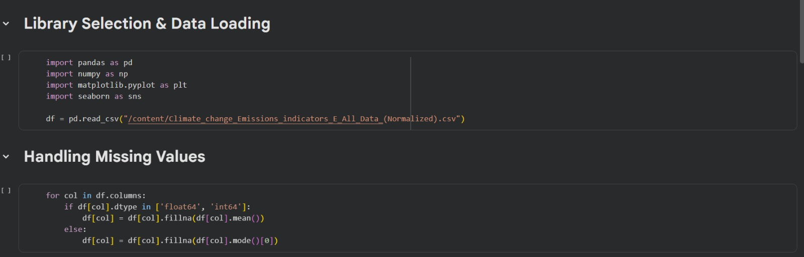
Data Cleaning Framework
Python Pandas Imputation Pipeline
Library Selection and Data Loading
Library Import: Imported core analytical and visualization libraries (Pandas, NumPy, Matplotlib, and Seaborn).
Data Loading: Loaded the climate change emissions indicators dataset from a CSV file into a DataFrame.
Missing Value Handling: Automated the imputation process by looping through all columns:
Filled missing entries in numerical features (float64 and int64) with the column mean.
Imputed missing entries in categorical features using the column mode.

Slide 8
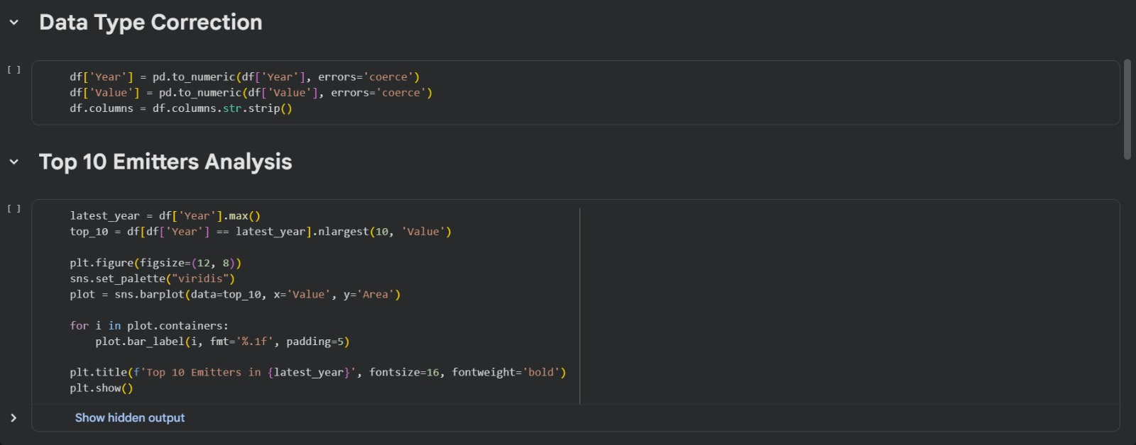
Data Cleaning Framework
Python Pandas Imputation Pipeline
Data Type Correction and Top 10 Emitters Analysis
Data Type Correction: Converted the Year and Value columns to numeric formats, using errors='coerce' to handle malformed entries.
Column Name Cleaning: Stripped leading and trailing whitespace from all column names to ensure smooth text matching.
Top 10 Emitters Analysis: Filtered the dataset for the latest available year to extract the top ten areas with the highest emission values.
Visualization: Plotted a horizontal bar chart using Seaborn's viridis palette, complete with explicit decimal data labels on each bar and a bold custom title.

Slide 9
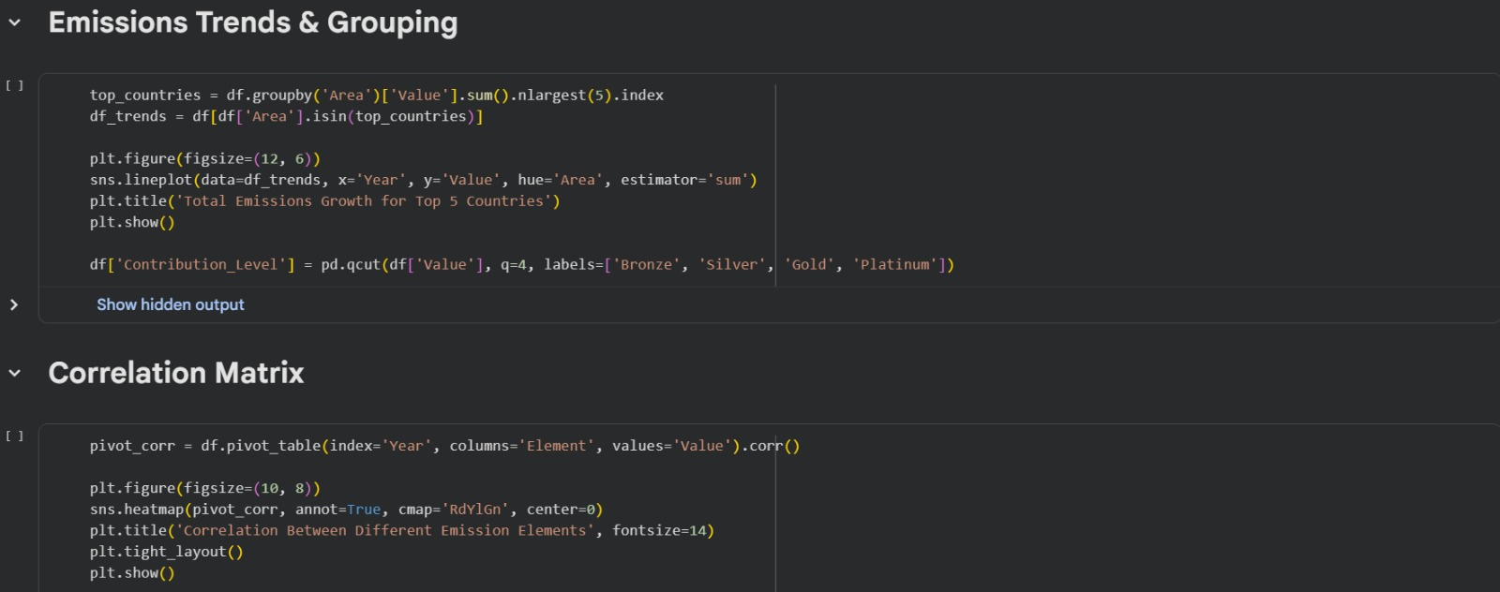
Data Cleaning Framework
Python Pandas Imputation Pipeline
Emissions Trends and Correlation Analysis
Emissions Trends & Grouping: Grouped the dataset by area to calculate total emissions and isolate the top 5 highest-emitting countries.
Generated a line plot to track the total emissions growth of these top 5 countries over time.
Quantile-Based Segmentation: Categorized emission values into four distinct contribution levels (Bronze, Silver, Gold, and Platinum) using pd.qcut.
Correlation Matrix: Constructed a pivot table indexed by year with different emission elements as columns to calculate statistical correlation coefficients.
Heatmap Visualization: Plotted an annotated correlation heatmap using the RdYlGn colormap centered at zero to evaluate how different emission elements interact over the years.

Slide 10
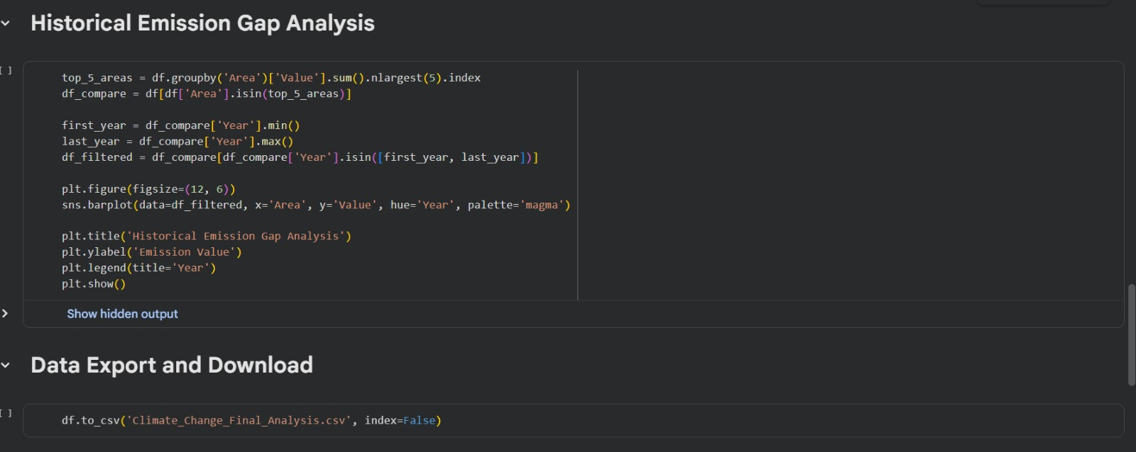
Data Cleaning Framework
Python Pandas Imputation Pipeline
Historical Emission Gap Analysis and Data Export
Historical Emission Gap Analysis:
Grouped the dataset by area to calculate total emissions and isolate the top 5 highest-emitting countries.
Filtered the data to capture only the earliest and most recent available years for these 5 countries.
Plotted a clustered bar chart using Seaborn's magma palette to contrast historical growth and emission gaps over time.
Data Export: Saved the finalized dataset as a CSV file named Climate_Change_Final_Analysis.csv, setting index=False to omit internal DataFrame indices.

Slide 11
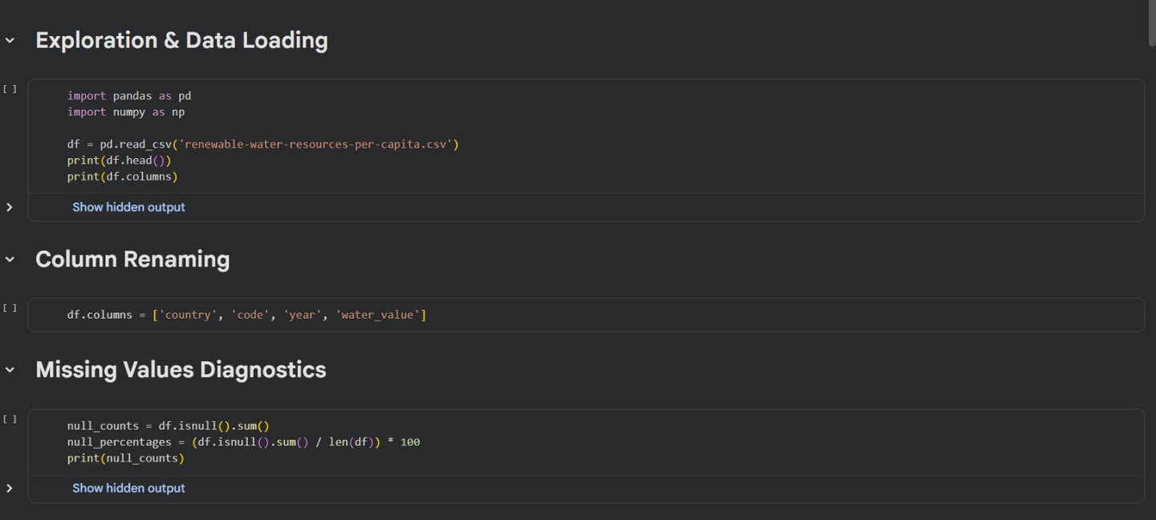
Data Cleaning Framework
Python Pandas Imputation Pipeline
Data Exploration and Preprocessing
Data Loading & Inspection: Used Pandas and NumPy to load the dataset, verify its structural layout, and confirm the data imported correctly.
Column Renaming: Standardized and cleaned column names (country, code, year, and water_value) to improve workflow efficiency.
Data Quality Check: Evaluated the dataset for missing values by calculating exact counts and percentages to determine the best handling strategy.

Slide 12
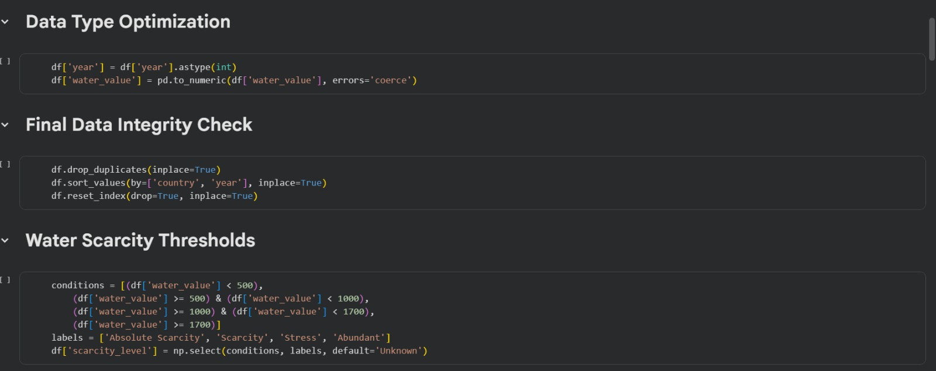
Data Cleaning Framework
Python Pandas Imputation Pipeline
Data Cleaning and Feature Engineering
Data Type Optimization: Converted year to integers and forced water_value into a numeric format, using errors='coerce' to smoothly handle any format mismatches.
Data Integrity & Consistency: Cleaned the dataset by removing duplicate rows, sorting sequentially by country and year, and resetting the dataframe index.
Feature Engineering: Created a categorical scarcity_level feature using np.select to classify the data into global environmental tiers (Absolute Scarcity, Scarcity, Stress, and Abundant).

Slide 13
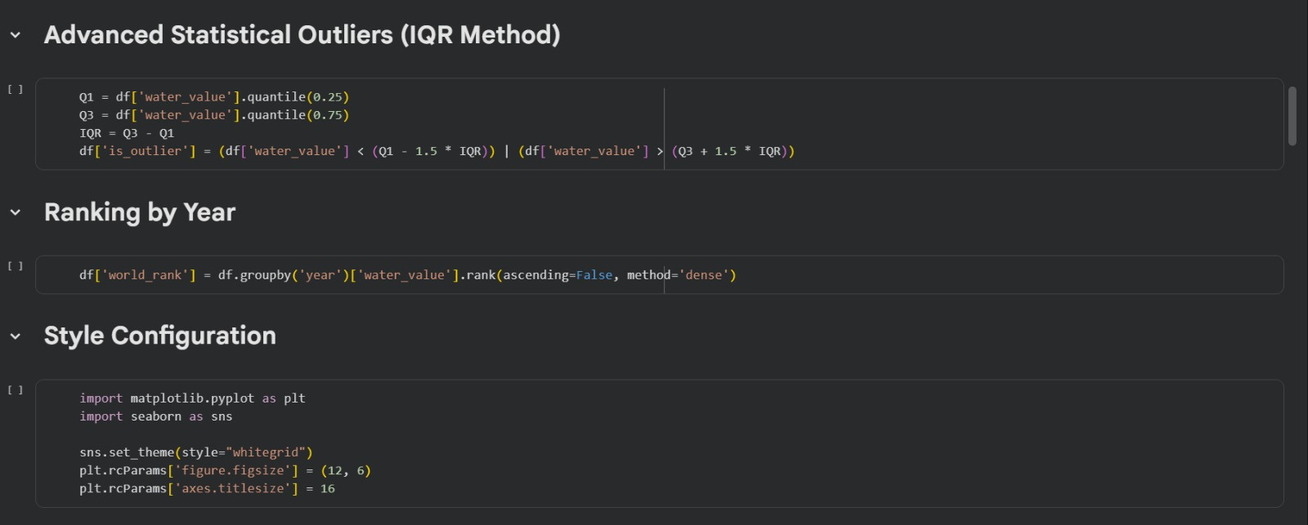
Data Cleaning Framework
Python Pandas Imputation Pipeline
Advanced Analysis and Visualization Setup
Outlier Detection: Used the IQR (Interquartile Range) method, calculating the 25th Q1 and 75th Q3 percentiles of the water_value column to flag statistical outliers outside the (1.5 * IQR) boundaries.
Dynamic Ranking: Grouped the dataset by year and applied dense ranking to order countries by their water values, establishing a clear annual global benchmark.
Visualization Styling: Imported Matplotlib and Seaborn to configure a clean, standardized whitegrid layout with consistent figure sizes and font parameters for all plots.

Slide 14
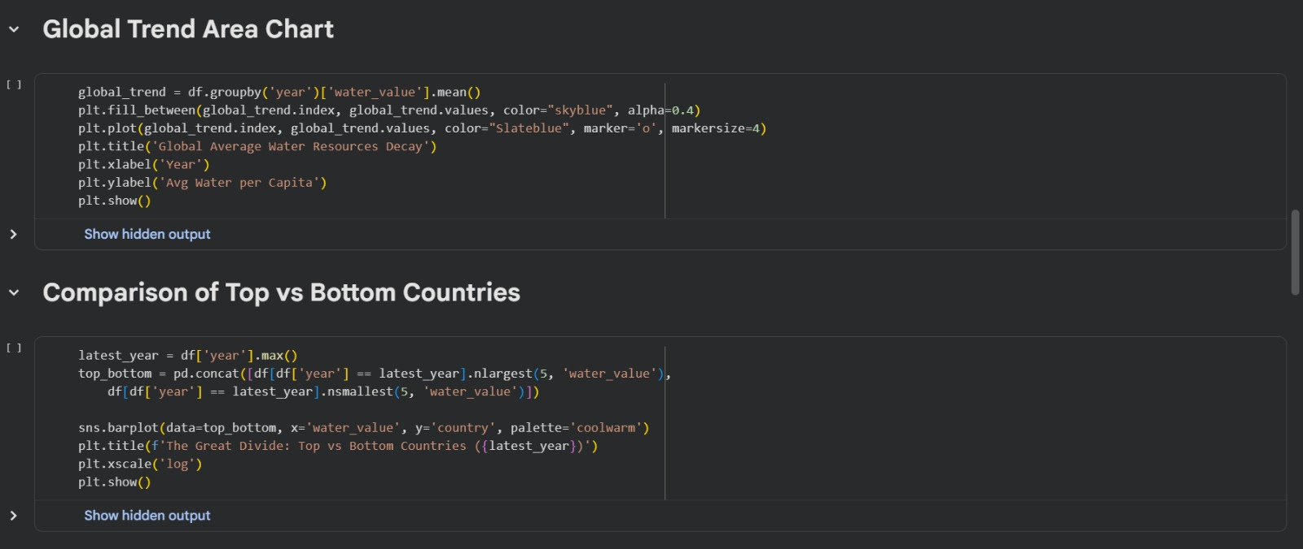
Data Cleaning Framework
Python Pandas Imputation Pipeline
Data Visualization and Trend Analysis
Global Trend Mapping: Grouped historical data by year to calculate the global average of water resources per capita, generating a combined line and area chart to visualize the overall decline over time.
Comparative Extreme Analysis: Isolated the dataset's latest available year to extract and combine the top 5 and bottom 5 countries by water volume into a single subset.
Logarithmic Scale Visualization: Plotted a horizontal bar chart using Seaborn's coolwarm palette, applying a logarithmic x-scale to clearly contrast the extreme gap between the highest and lowest resource-holding nations.

Slide 15
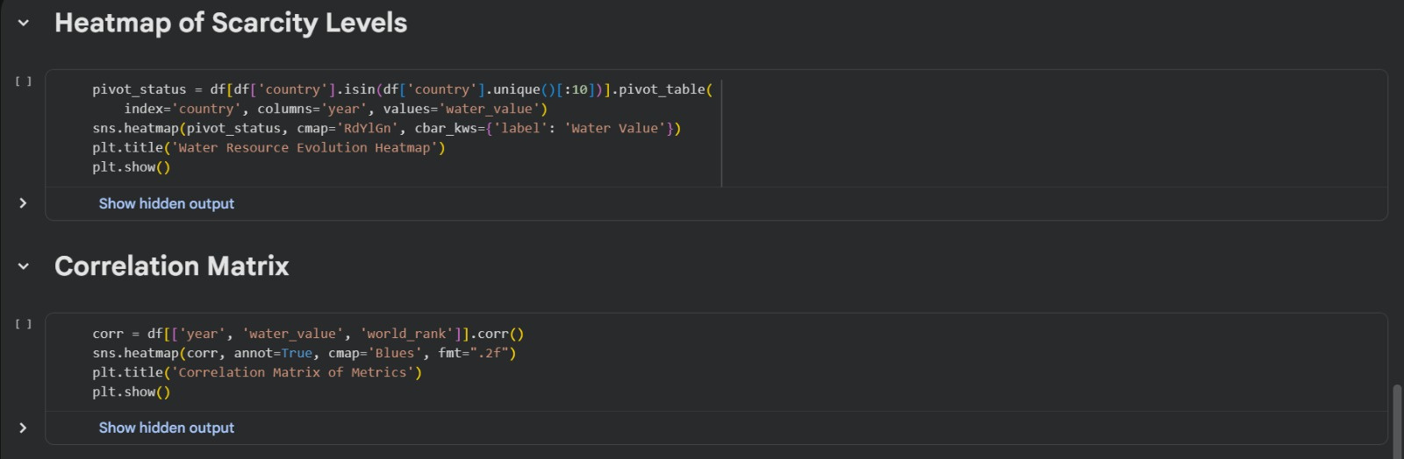
Data Cleaning Framework
Python Pandas Imputation Pipeline
Heatmap and Correlation Analysis
Heatmap of Scarcity Levels: Filtered the dataset for the first 10 unique countries.
Created a pivot table indexed by country with years as columns.
Generated a Seaborn heatmap using the RdYlGn colormap to visualize the evolution of water resource values over time.
Correlation Matrix: Calculated correlation coefficients between the Year, Water Value, and World Rank metrics.
Plotted an annotated heatmap using the Blues colormap with a two-decimal float format to display the statistical relationships.

Slide 16
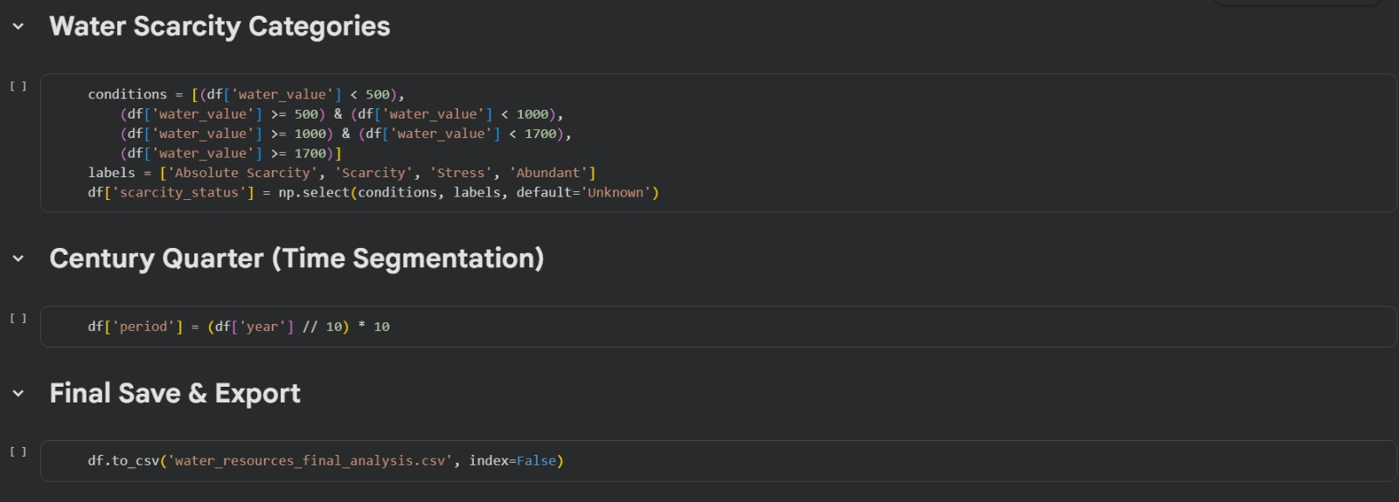
Data Cleaning Framework
Python Pandas Imputation Pipeline
Water Scarcity Segmentation and Export
Water Scarcity Categories: Applied a structured set of conditions based on water values using np.select to create a new classification column (scarcity_status) ranging from "Absolute Scarcity" to "Abundant".
Time Segmentation: Engineered a new feature named period by performing floor division on the year column to group the temporal observations into 10-year decade blocks.
Final Save and Export: Saved the fully processed dataset as a CSV file named water_resources_final_analysis.csv, omitting the DataFrame index to ensure a clean data structure.

Slide 17
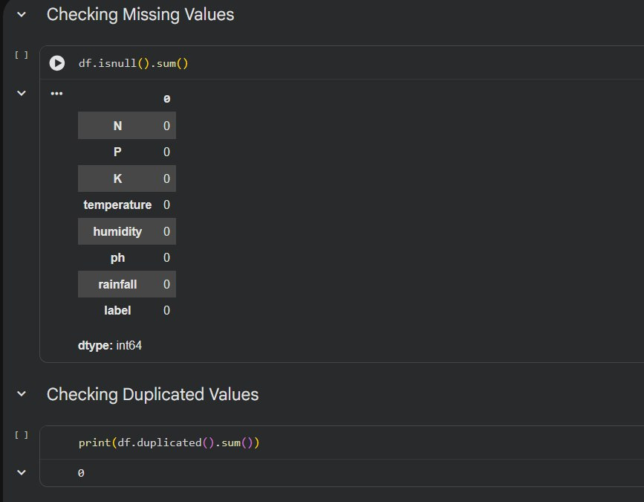
Data Cleaning Framework
Python Pandas Imputation Pipeline
Data Cleaning & Investigation
No Missing Values: Confirmed there are zero missing values across the entire dataset.
No Duplicate Rows: Verified the absence of duplicate rows, reporting 0 duplicates for clean baseline data.

Slide 18
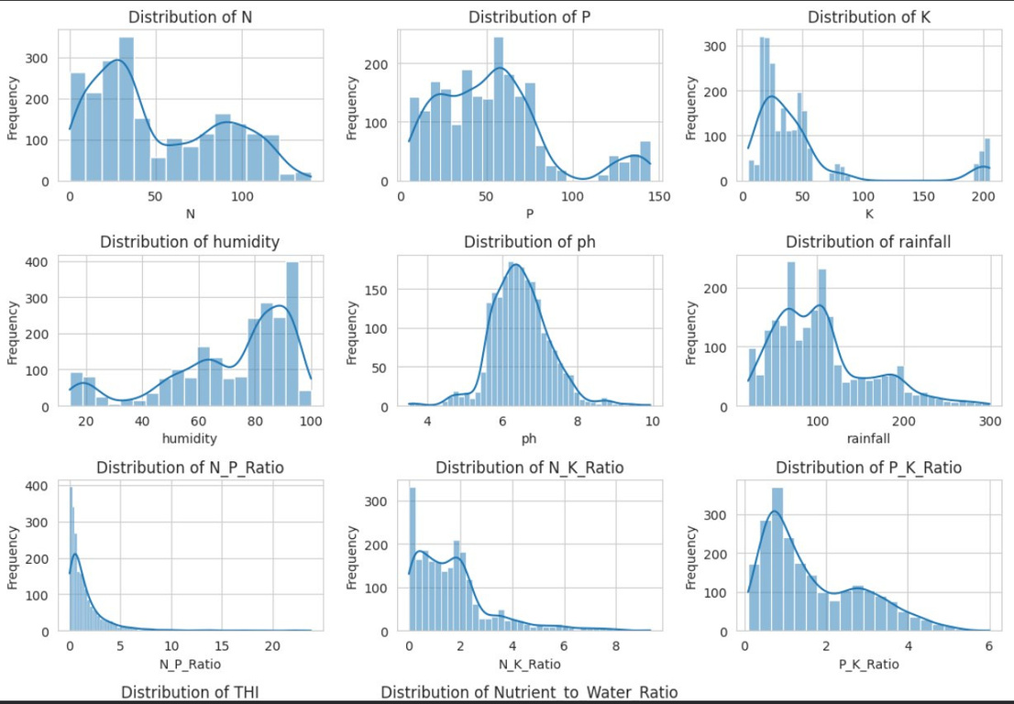
Data Cleaning Framework
Python Pandas Imputation Pipeline
Feature Engineering
Total Nutrients: Created a Total_Nutrients column by summing N, P, and K values.
Nutrient Ratios: Computed N_P_Ratio, N_K_Ratio, and P_K_Ratio (using an epsilon value to prevent division by zero).
Moisture Index: Divided rainfall by temperature to reflect the temperature-rainfall ratio.
Soil pH Categorization: Classed pH values into 'Acidic' (< 6.0), 'Neutral' (6.0 - 7.5), or 'Alkaline' (> 7.5).
Temperature-Humidity Index (THI): Calculated using the formula: temperature + (0.55 * humidity).
Nutrient-to-Water Ratio: Divided Total_Nutrients by rainfall to track nutrient-water balance.

Slide 19
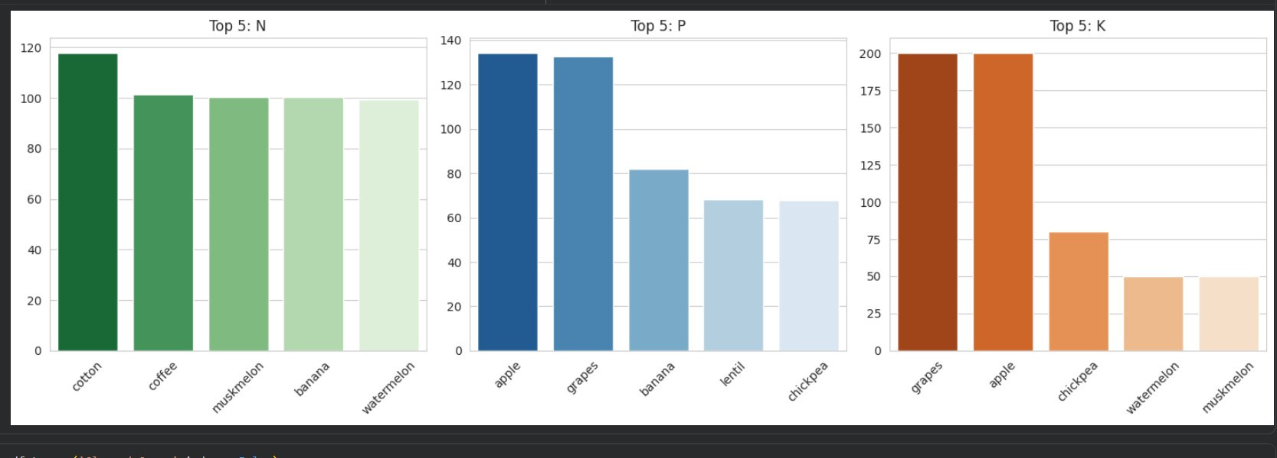
Data Cleaning Framework
Python Pandas Imputation Pipeline
Exploratory Data Analysis (EDA)
Numerical Distributions: Visualized the distributions of all numerical columns using a 4x4 histogram grid.
Correlation Heatmap: Highlighted a very high correlation (0.94) between humidity and THI, showing humidity's strong influence.
Outlier Checking: Analyzed the dataset to identify any outstanding data outliers.
Top 5 Nutrient Requirements: Grouped mean N, P, and K values by crop type, and used bar plots to visualize the top 5 crops requiring the highest amounts of each nutrient.

Slide 20
Phase 02
Predictive & Statistical Modeling
Machine Learning
تطبيق خوارزميات ونماذج تعلم الآلة
Supervised forecasting, clustering, and behavioral predictions built to yield practical enterprise insights.

Slide 21
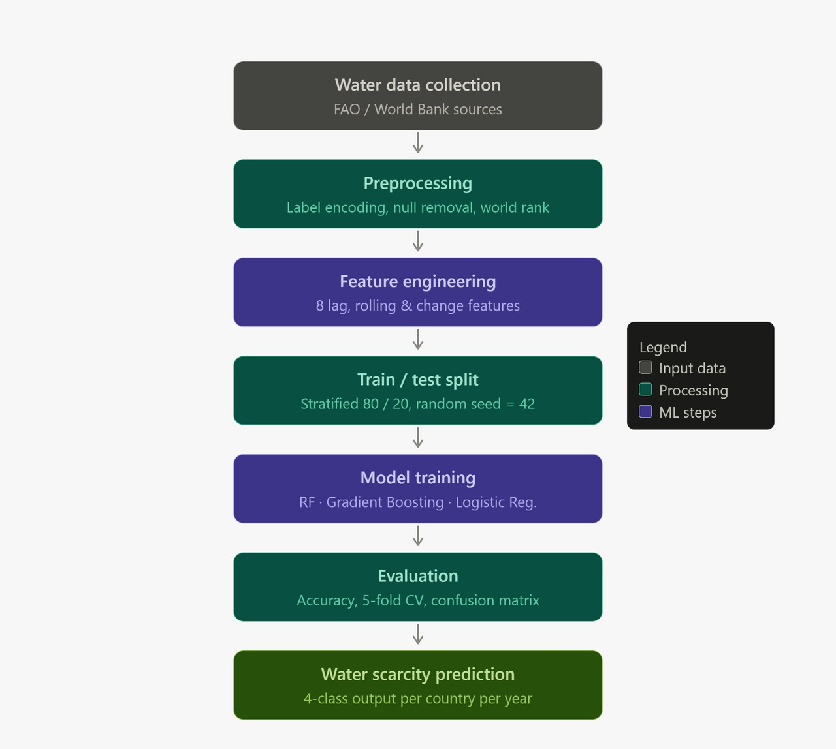
Model Metrics Evaluation
Model Testing Comparison
Machine Learning
Task: Multi-class classification predicting one of 4 water scarcity levels per country per year.
Target variable: scarcity_level — determined by FAO thresholds on water per capita (m³/yr).
8 engineered features built from the raw water_value time series using lag, rolling mean, change, and rank operations.
3 algorithms: Random Forest (recommended — handles class imbalance via class_weight='balanced'), Gradient Boosting, and Logistic Regression as a baseline.
Evaluation: Test accuracy, 5-fold cross-validation, per-class classification report, and confusion matrix.
Here's the pipeline flow from end to end

Slide 22
Phase 03
Relational Mapping & schemas
Data Modeling
بناء مستودع البيانات ونمذجة العلاقات
Designing data models, transaction paths, and structural dimensions built for business queries.

Slide 23
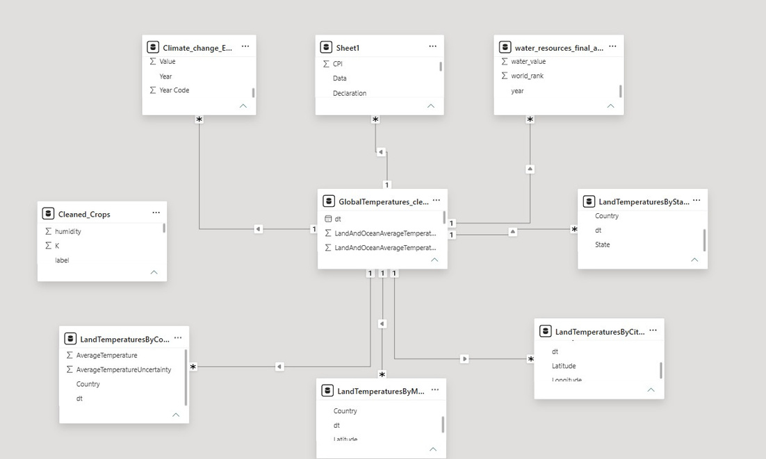
Relational Schema Architecture
Star Schema Enterprise Implementation
Data Schema & Keys Mapping
I mapped my environmental dependencies to outline a scalable star schema structure:
Fact Tables Design: I consolidated global temperature records as my central hub to capture historical climate and environmental performance markers spanning from 1900 to the present.
Dimension Structuring: I established specialized localization dimensions—including country, regional, state, and city levels—alongside dedicated economic, water resource, and climate change dimensions.
Primary/Foreign Mappings: I built stable references using a one-to-many (1:*) cardinality, mapping the unique date configurations (dt or year) from my central hub directly to the surrounding datasets.

Slide 24
Phase 04
Interactive Visualization Design
Dashboard Design
تصميم لوحة البيانات التفاعلية والمؤشرات
Translating dataset rows into visual indicators and dynamic slicers using Power BI or Tableau interfaces.

Slide 25

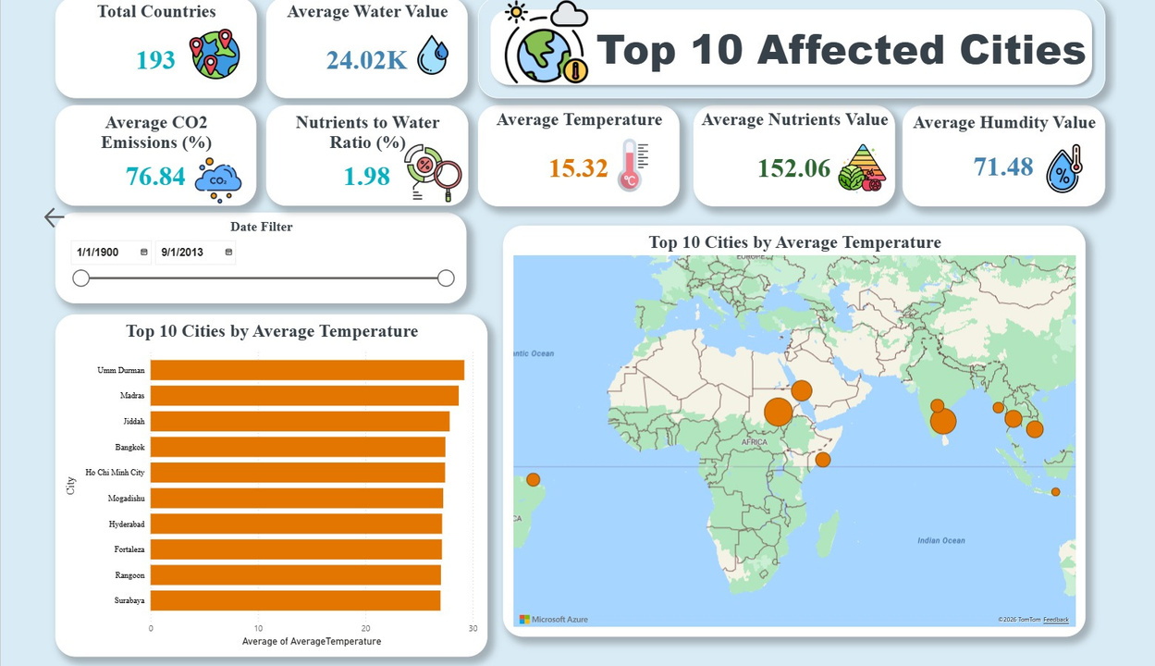
BI Interactive Interface Design
Dashboard Metrics & User Flow
Top 10 Affected Cities
The dataset covers 193 countries, providing a comprehensive global view of climate indicators.
The average global temperature reached 15.32°C, highlighting the continuous warming trend observed worldwide.
The average humidity value of 71.48% indicates significant moisture levels that can influence weather patterns and precipitation.
The average water value of 24.02K shows notable disparities in water resource availability across countries.
The Nutrients-to-Water ratio (1.98%) suggests a relatively low concentration of nutrients compared to water resources, indicating potential agricultural and environmental imbalances.
The highest average temperatures were recorded in cities such as Umm Durman, Madras, Jiddah, Bangkok, and Ho Chi Minh City, demonstrating that regions in Africa, the Middle East, and South Asia are among the most heat-affected areas.

Slide 26
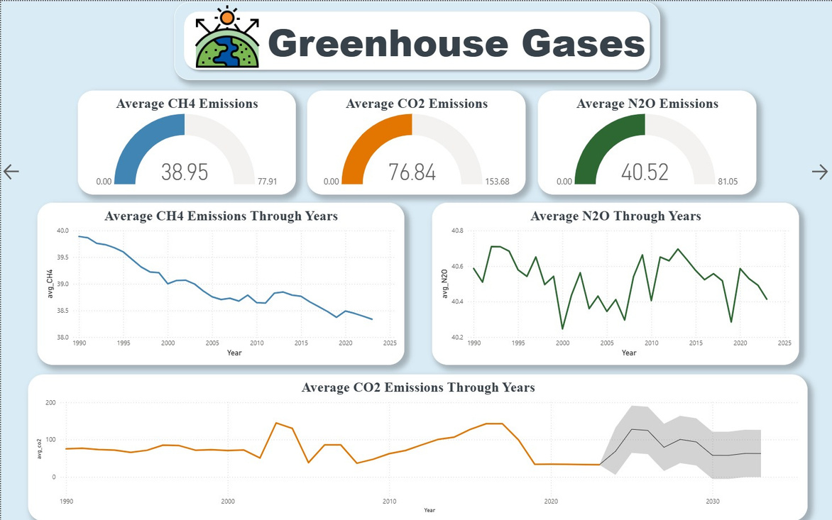
BI Interactive Interface Design
Dashboard Metrics & User Flow
Greenhouse Gases Dashboard
CO₂ emissions are the dominant greenhouse gas, with an average value of 76.84, significantly higher than both CH₄ and N₂O emissions.
Methane (CH₄) emissions showed a gradual decline over the years, indicating improvements in emission management in some regions.
Nitrous Oxide (N₂O) emissions remained relatively stable, with only minor fluctuations.
Historical data shows periods of sharp increases in CO₂ emissions, followed by periods of stabilization, emphasizing the long-term impact of industrialization and energy consumption.

Slide 27
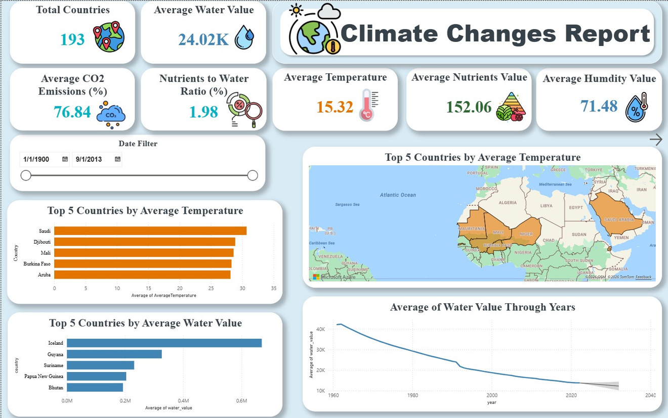
BI Interactive Interface Design
Dashboard Metrics & User Flow
Water Resources & Temperature Dashboard
Countries such as Saudi Arabia, Djibouti, Mali, Burkina Faso, and Aruba recorded the highest average temperatures.
Iceland possesses the highest average water value by a significant margin, followed by Guyana and Suriname, highlighting the unequal global distribution of freshwater resources.
The analysis shows a steady decline in average water values over time, indicating increasing pressure on global water resources.

Slide 28
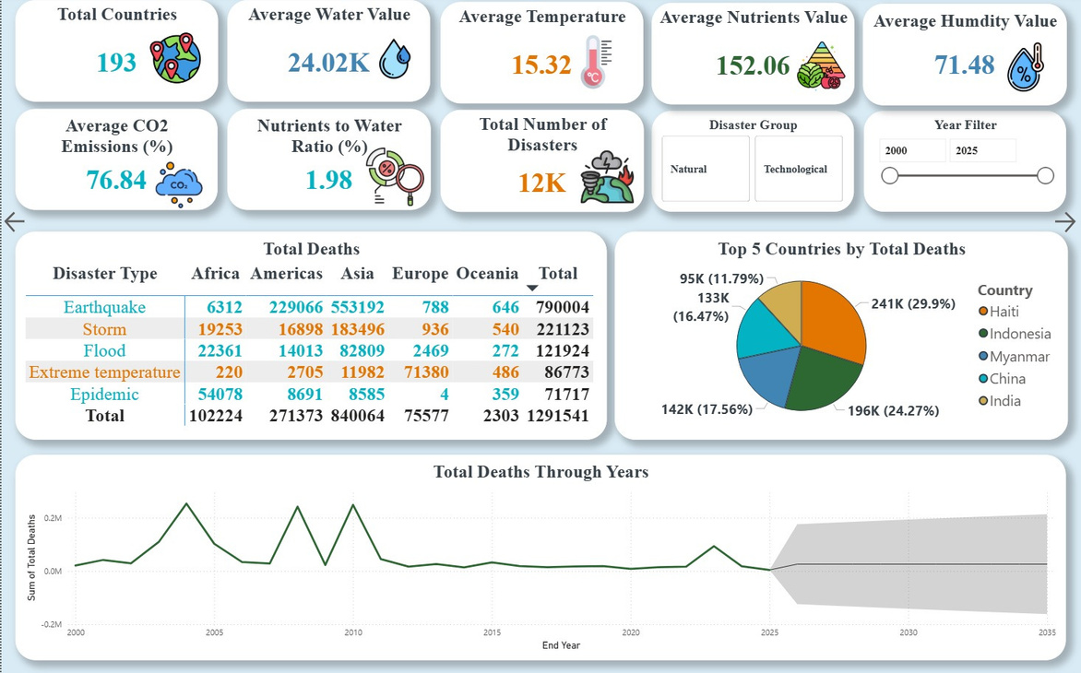
BI Interactive Interface Design
Dashboard Metrics & User Flow
Natural Disasters Dashboard
The dataset recorded approximately 12,000 disasters worldwide, demonstrating the growing impact of climate-related and environmental events.
Earthquakes and storms account for the largest number of deaths globally, followed by floods and epidemics.
Asia experienced the highest number of disaster-related fatalities, making it the most vulnerable region in terms of human impact.
Countries such as Haiti, Indonesia, Myanmar, China, and India experienced the highest disaster death tolls.
The number of disaster-related deaths has fluctuated significantly over the years, with several major spikes caused by catastrophic events.

Slide 29
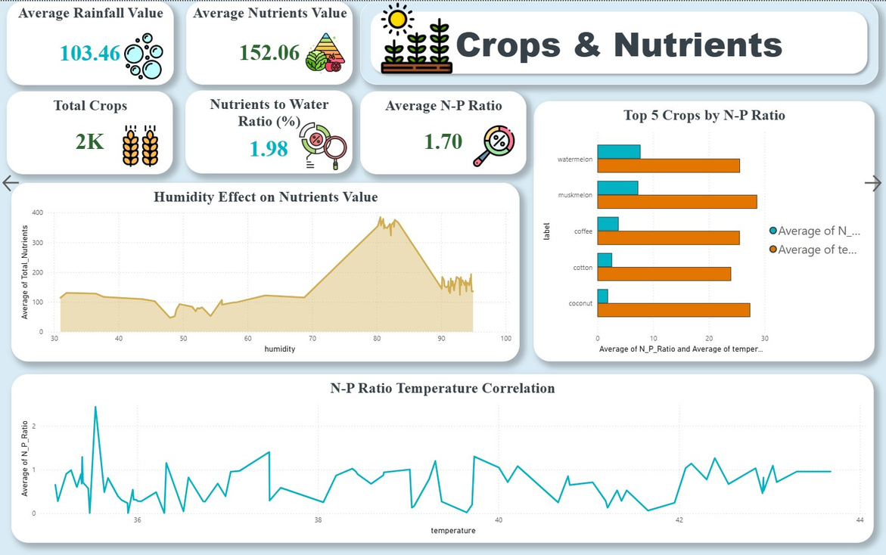
BI Interactive Interface Design
Dashboard Metrics & User Flow
Crops & Nutrients Dashboard
The dataset contains approximately 2,000 crop records, enabling analysis of agricultural patterns and nutrient relationships.
The average nutrient value reached 152.06, while the average N ratio was 1.70, indicating a moderate balance between nitrogen and phosphorus levels across crops.
The average rainfall value of 103.46 highlights the significant role of precipitation in agricultural productivity and nutrient availability.
The analysis shows that nutrient availability generally increases with higher humidity levels, highlighting the importance of environmental conditions in crop productivity.
Crops such as muskmelon, watermelon, coffee, coconut, and cotton exhibited the highest N:P ratios, indicating varying nutrient requirements among different crop types.
The weak correlation between temperature and the N:P ratio suggests that nutrient balance is influenced by multiple factors beyond temperature alone, emphasizing the complexity of agricultural ecosystems.

Slide 30
Phase 05
Analytical Takeaways
Key Insights
النتائج والتوصيات الاستراتيجية للمشروع
Translating transactional outputs into metrics to guide practical stakeholder decisions.

Slide 31



Key Findings & Outcomes
Data-Backed Business Recommendations
Key Finding 1
Key Finding 2
Key Finding 3
Regions experiencing elevated temperatures frequently face significantly higher levels of water stress. This pattern directly underscores the intensifying connection between shifting climate patterns and global water scarcity.
The data reinforces the strong relationship between greenhouse gas emissions and global warming trends. Consequently, prioritizing emission reduction has become a critical environmental necessity.
The findings suggest that climate change and environmental risks continue to amplify the frequency and severity of natural disasters, increasing the need for disaster preparedness and resilience planning.
Overall Conclusion
Global temperatures are increasing while water resources show a declining trend.
Greenhouse gas emissions, particularly CO₂, remain a major contributor to climate change.
Climate-related risks are disproportionately affecting certain regions, especially developing countries.
The analysis highlights the urgent need for sustainable environmental policies, emission reduction strategies, and improved resource management to mitigate future climate impacts.

Slide 32
QUESTIONS & ANSWERS
Closing Session
Any Questions?
شكراً لحسن استماعكم
DEPI Graduation Project Framework

