Slide 1


ITC — Information Technology Colleague
رواد مصر الرقمية
GRADUATION
PROJECT
LUXECART
Frontend development
react
2025 / 2026
GHR4_SWD2_S1
frontend-react الشرقية
شكر وتقدير لإدارة المبادرة ولشركة ITC الشركة المنفذة لتراك react الشرقية

Slide 2
Project Overview
The Team
Project Name
LuxeCart E-Commerce Platform
Shahd Mansour
Rawan Mahmoud
S
R
Team Leader
frontend developer
Tech Stack
React.js, TypeScript, Vite, Tailwind CSS
Bassant Roshdy
Doaa Akram
B
D
UI/UX designer
frontend developer
Supervisor
ITC

Slide 3
PROBLEM
Problem
01
Slow Performance
Statement
Traditional e-commerce sites suffer from heavy page reloads, causing a slow and lagging user experience.
Modern users expect lighting-fast shopping experiences. Traditional web platforms fail to maintain persistence, lack UI responsiveness, and offer generic layouts that don't match premium brand identities.
02
State Loss
Refreshing the browser or navigating between pages often results in losing active cart items and user selections

Slide 4
SOLUTION
Proposed Solution
01
02
Build a responsive and user-friendly e-commerce platform.
Enable Customers to browse products and manage their shopping cart easily.
03
04
Provide a fast and smooth user experience across devices.
Ensure scalability for future backend, database, and payment integration.

Slide 5
System
1. Architecture
2. Components
Design
3. Data Flow
Backend
Database
Frontend
UI Layouts: Fully responsive design built with Tailwind CSS.
Reusable Components: Custom-built buttons, product cards, and navigation lines.
Seamless Routing: Fast, single-page transitions using React Router.]
Client-Side Logic: Core operations simulated via Custom Hooks (useCart, useFavorites).
Auth Simulation: Client-side validation for secure-feel login and checkout forms.
State Control: Centralized application flow management using React state.
LocalStorage: Persistent user data and cart storage across browser refreshes.
Mock Data: Product catalogs structured and served from dynamic JSON files.
Real-time Sync: Instant synchronization of totals, quantities, and user selections.

Slide 6
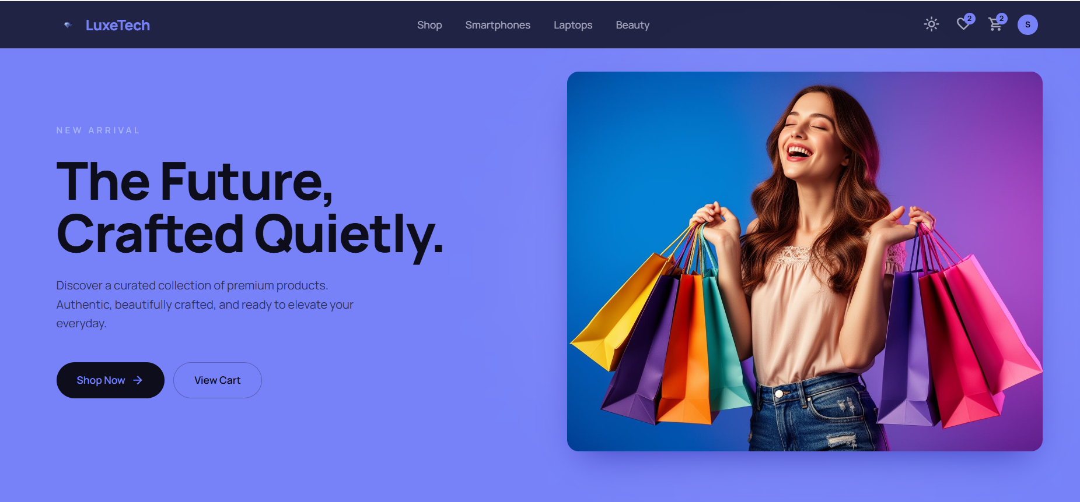
Demo &
Screenshots
Home Page - LuxeCart
Designed a modern, visually engaging user interface (UI) aligned with current web design trends.
Implemented a fully responsive layout to ensure a seamless user experience across all device screen sizes.
Positioned clear and interactive Call-to-Action (CTA) buttons (Shop Now and View Cart) to optimize user navigation.

Slide 7
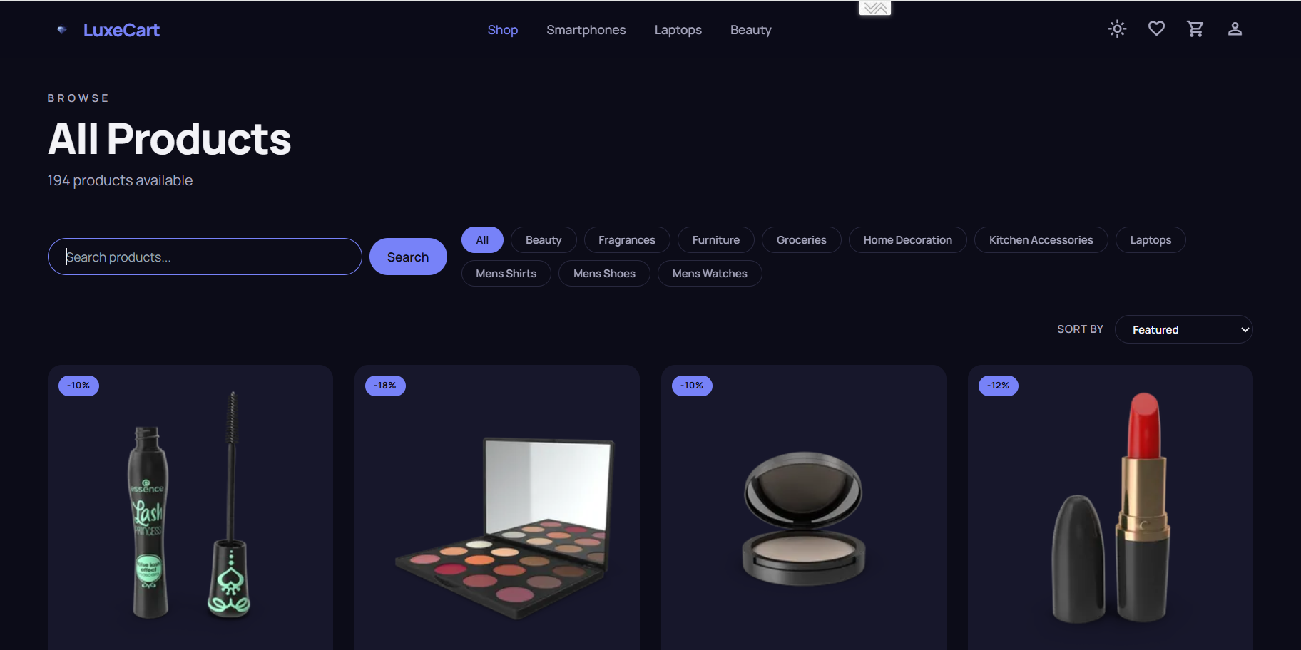
Demo &
Screenshots
Product Catalog & Filtering
Developed a dynamic filtering system allowing users to smoothly browse through categories like Beauty, Fragrances, and Laptops.
Created a clean grid layout for products, highlighting prices, layouts, and discount badges effectively.
Integrated an intuitive search bar to enhance product discoverability and minimize user effort.

Slide 8
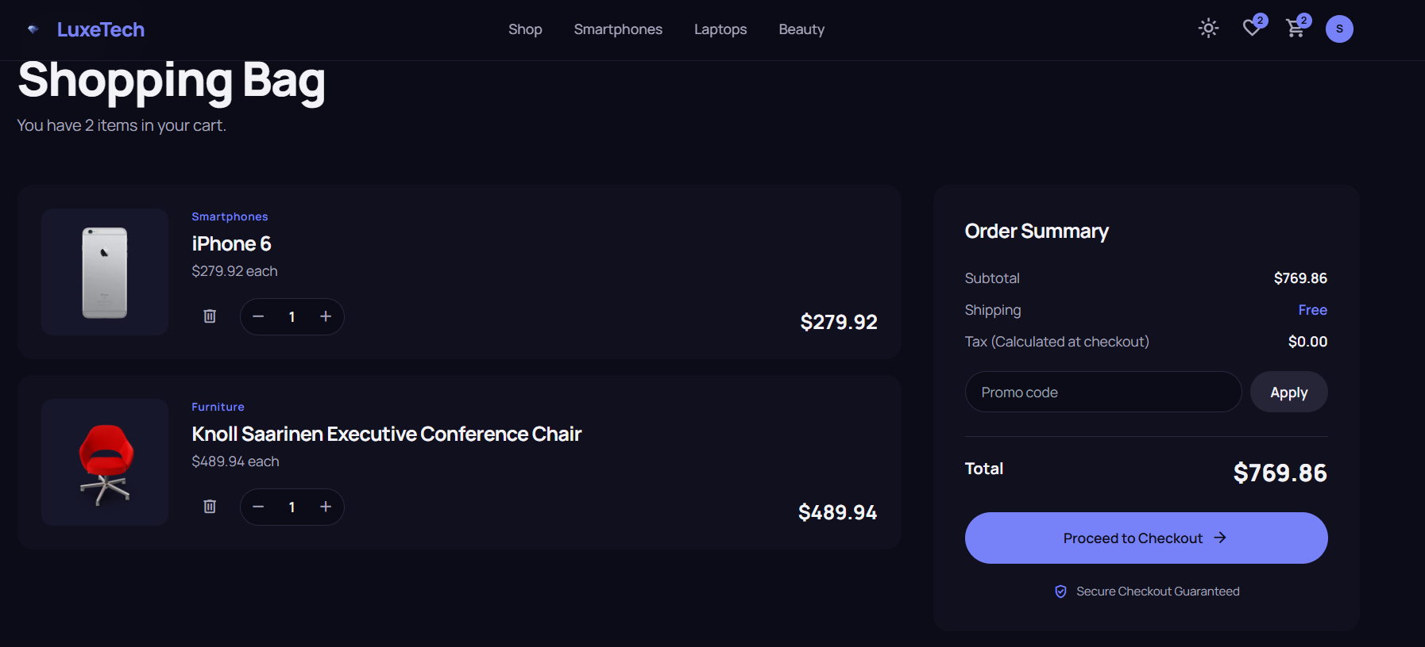
Demo &
Screenshots
Shopping Bag & Order Summary
Built a flexible cart management interface that dynamically updates quantities, prices, and totals.
Structured a detailed Order Summary section that clearly breaks down subtotal, shipping fees, and promo code applications.
Designed a clear, high-contrast path to a secure checkout (Proceed to Checkout) to boost user trust and completion rates..

Slide 9
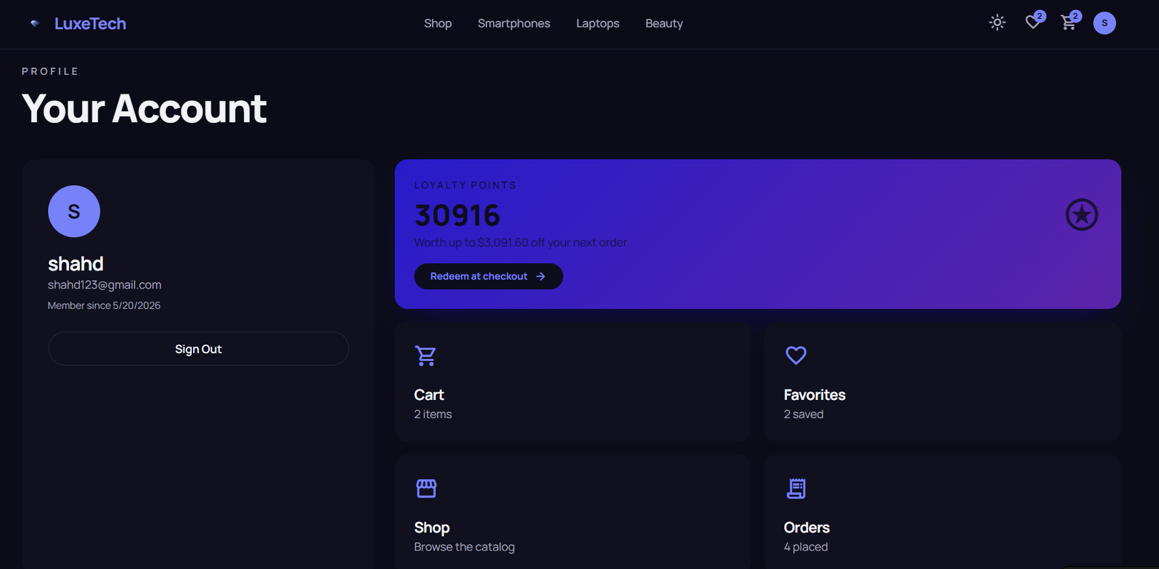
Demo &
Screenshots
User Account & Loyalty Rewards System
• Manage account information and monitor shopping activity from a personalized dashboard.
• Earn loyalty points with every purchase and redeem them for discounts on future orders.
• Access cart items, favorite products, and order history quickly and conveniently.

Slide 10
Conclusion
Summary
Premium e-commerce website built with React, TypeScript, Vite, and Tailwind CSS for a smooth, responsive shopping experience.
Thank
]
Learnings
You!
Improved our React & TypeScript skills
Learned state persistence with LocalStorage
Gained practical experience in GitHub
Shahd Mansour— Team Leader
ITC Graduation Project
Future Work
Add backend & database integration
Support online payments (Stripe / Fawry)
Build an Admin Dashboard

