Slide 1


ITC
ITC — Information Technology Colleague
رواد مصر الرقمية
GITHUB
ANALYTICS
Profile Intelligence Dashboard
React + Vite
Chart.js
GitHub REST API v3
2026
SHR4_SWD2_S1
React Track
Special thanks to the ITC initiative and the frontend development track at ITC

Slide 2
G
ITC
Overview
AGENDA
A comprehensive walkthrough of GitHub Analytics Dashboard — from planning and architecture to implementation, testing, and live demo.
What we'll cover today
01 Project Overview
100+
12
5
10
02 Problem Statement
03 Proposed Solution
Repos
Analyzed
Features
Delivered
Team
Members
Test
Cases
04 System Architecture
05 Features & Requirements
Project Highlights
06 Demo & Screenshots
Pure frontend — no backend required
07 Conclusion
12 features fully implemented & verified
Winner Score formula: Stars×3 + Followers×2 + Repos + Langs×5

Slide 3
G
Project Overview
ITC
Team · Tech Stack · Supervisor · Project Info
The Team
Project Name
GitHub Analytics Dashboard
N
Norhan Elyan
S
Shehab Abdelrahman
Group
Project Lead / FrontEnd
Frontend Developer
ITC_SHR4_SWD2_S1
Alya Abuelmaati
Hassan Elshair
Track
A
H
React Frontend Web Developer
Frontend Developer
Frontend Developer
Tech Stack
Aya Gamal
React · Vite · Tailwind · Chart.js · Axios
A
Frontend Developer
Version
v1.0 • 2026
Supervisor
ITC

Slide 4
G
ITC
PROBLEM
Problem
01
Efficiency
Statement
Manual profile analysis takes too much time and effort.
GitHub profiles contain valuable data, but analyzing them manually is time-consuming and comparing multiple developers without visual tools makes decision-making difficult and inaccurate.
02
Quality
Comparing numbers across developers without charts is error-prone.
Target Audience
Developers Track stats & identify strengths
03
Speed
HR / Recruiters Compare candidates quickly
Reviewing multiple profiles consumes significant time.
Tech Students Benchmark vs other devs
Hackathon Organizers Assess participant skill levels

Slide 5
G
ITC
Proposed Solution
A visual web dashboard that transforms raw GitHub API data into actionable insights — no code required
SOLUTION
Core Solution
Key Benefits
A web dashboard that fetches GitHub data directly and renders it as a Profile Card, visual charts, and a Compare Mode between two users.
Easy to use with no coding knowledge required. Results load in real time with instant side-by-side developer comparison.
Tech Stack Used
Winner Score Formula
React · Vite · Tailwind CSS · Chart.js · Axios · GitHub REST API v3
Stars × 3 + Followers × 2 + Repos + Languages × 5

Slide 6
G
ITC
System
Architecture Style
Pure Frontend — Client-Only
No backend server or database
All data via GitHub REST API v3
Architecture
UI Framework
Charting
Component-based rendering
Bar, Pie, Radar charts
React (Vite)
Chart.js
Styling
Data Layer
Responsive, modular
Fetch user & repo data
Tailwind CSS
GitHub REST API v3
State Mgmt
Build Tool
Local component state
Dev server & bundling
useState / useEffect
Vite

Slide 7
G
Current Features
ITC
All 12 planned features implemented & verified
✅
Search & Fetch
✅
Profile Card
✅
Top Repos Chart
Fetch any GitHub user by username via REST API
Avatar, Name, Bio, Repos, Stars, Forks, Followers
Bar Chart of top 8 repos by star count
✅
Repos Table
✅
Languages Pie
✅
Compare Mode
Sortable table with Stars / Forks / Language
Pie Chart of language distribution + legend
Toggle switch for side-by-side comparison
✅
Head-to-Head Bars
✅
Winner Card
✅
Terminal Log
Visual metric comparison between two users
Score formula: Stars×3 + Followers×2 + Repos + Langs×5
Live log of every API request status in real time
✅
Account Age
✅
Recent Searches
✅
Repo Filter
Years active + Veteran badge for older accounts
Quick-access chips for recently analyzed usernames
Live text filter within a user's repository list

Slide 8
G
Planned Features & KPIs
ITC
Roadmap for v2.0 and success metrics
Upcoming Features
Key Performance Indicators
High
Contribution Graph
API Response
Daily heatmap (activity graph)
< 3 seconds
Pinned Repos
Rate Limit
High
< 60 req/hr
Show profile-pinned repositories
Compare Accuracy
Medium
Language by Bytes
100% correct
Byte count rather than repo count
Task Completion
Low
Export Profile
100% by deadline
Export as PDF or screenshot
Error Coverage
Low
GitHub Token Support
All cases handled
Raise API rate limit with PAT
Code Modularity
Components/hooks/utils

Slide 9
G
Requirements
ITC
User Stories & Use Cases
User Stories
Use Cases
As a Developer
Enter a username to view all GitHub stats and track progress.
UC-01 Search & Fetch Profile
Enter username → click ANALYZE → load data
UC-02 View Profile Card
As a Developer
See most-used programming languages to identify specialization.
Display avatar, bio, stats
UC-03 Browse Repositories
As a HR Professional
Compare two profiles simultaneously to choose the best candidate.
Sortable table with all repos
UC-04 Analyze Languages
View a Radar Chart comparing two users across multiple dimensions.
Pie chart of language distribution
As a User
UC-05 Compare Two Users
Radar Chart + Winner Card
As a User
See Terminal log showing real-time status of data fetching.
UC-06 Monitor Terminal
Live log of each API request

Slide 10
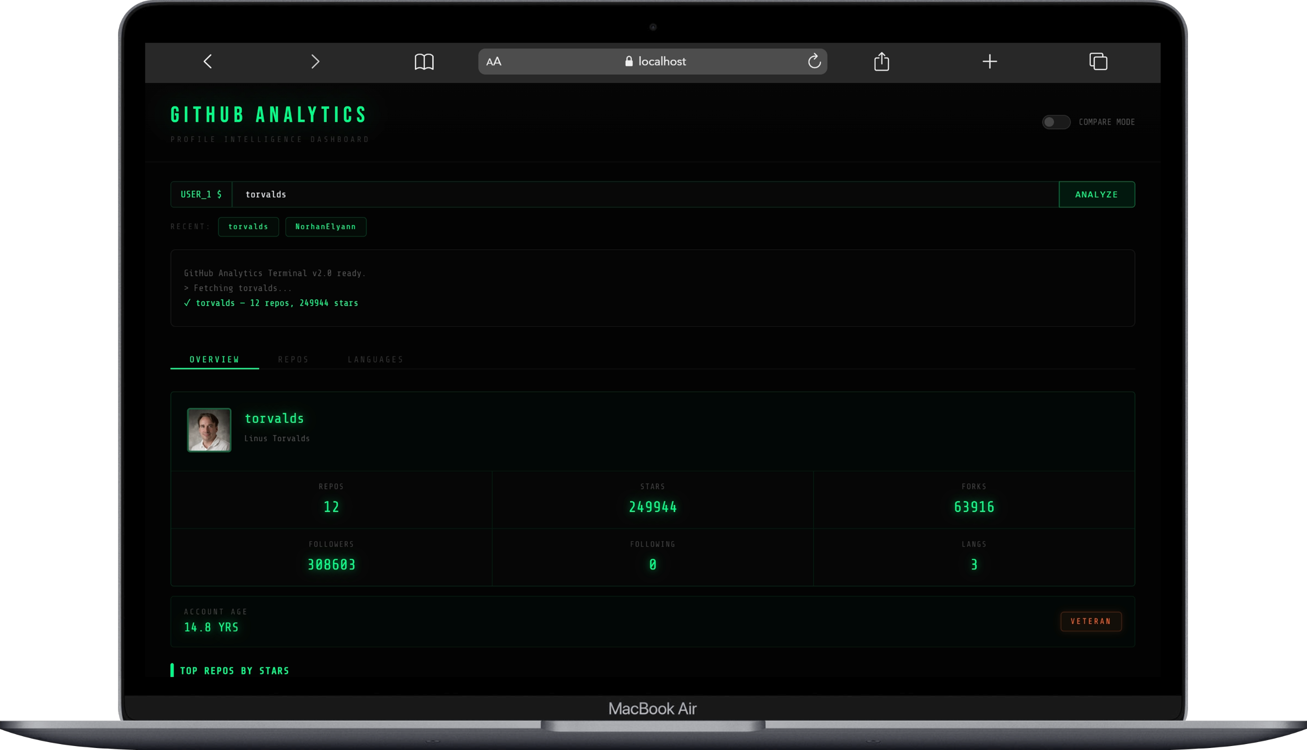
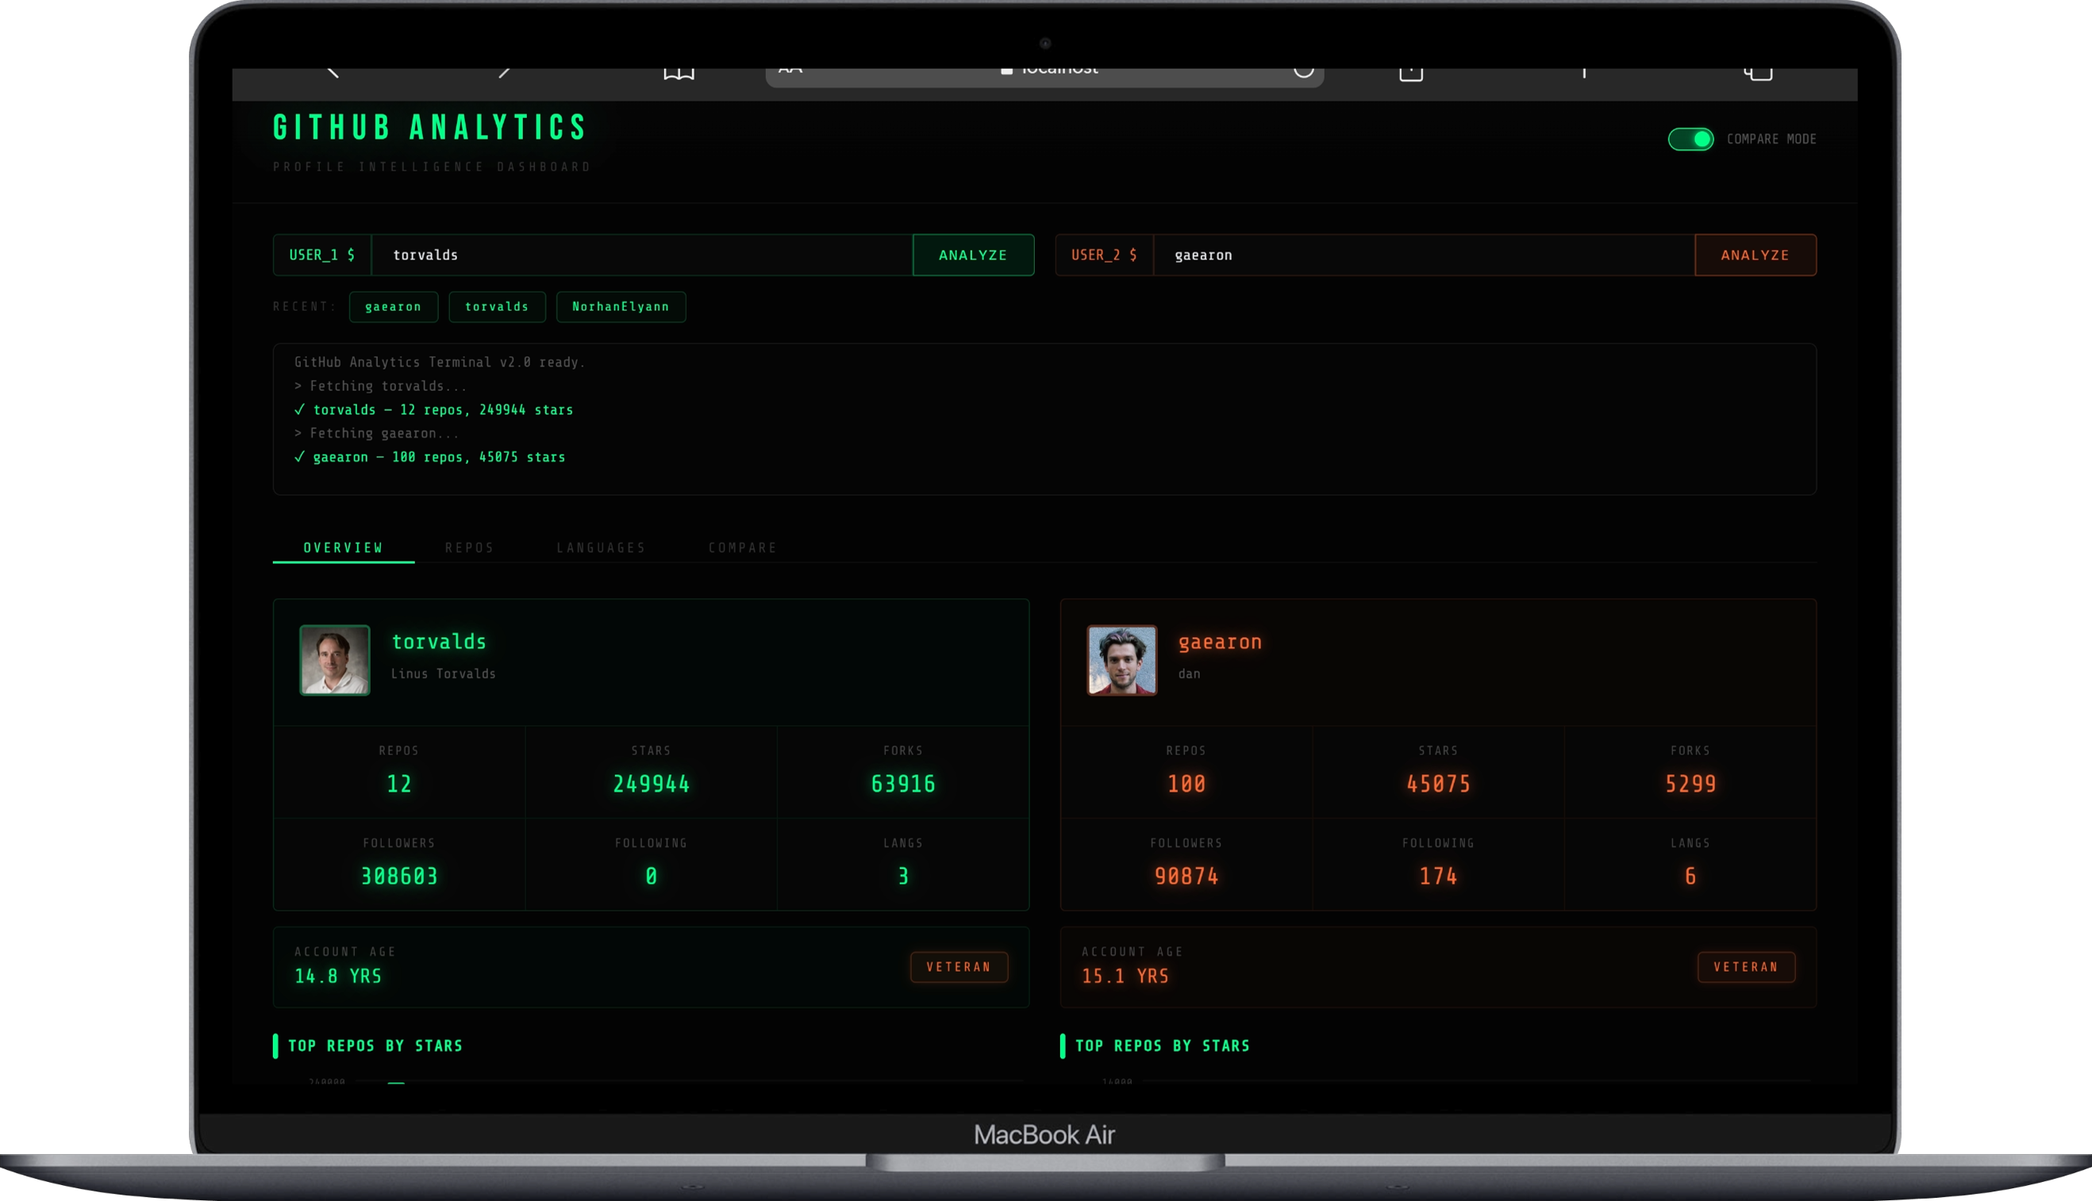
G
ITC
Demo &
Screenshots
6.1
6.2
Overview — Single User
Compare Mode — Two Profiles
User types username → clicks ANALYZE → Terminal log confirms → Profile Card + Charts appear
Two search fields (USER_1 / USER_2) render side by side with matching accent colors

Slide 11
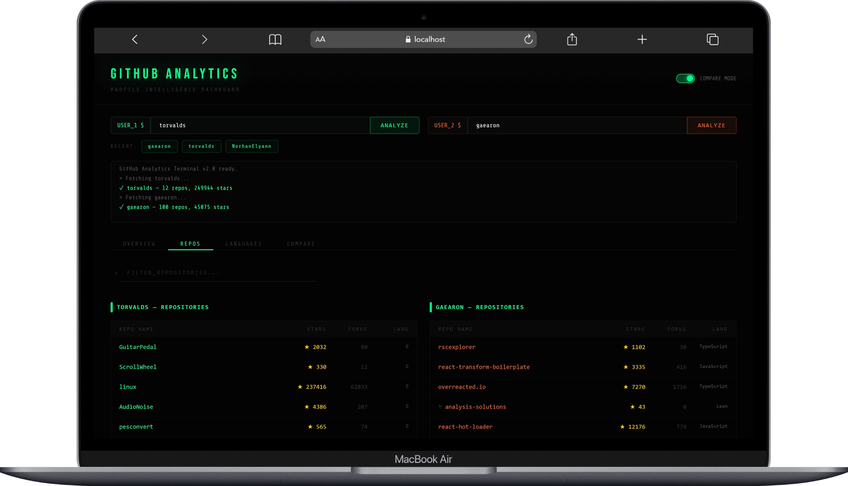
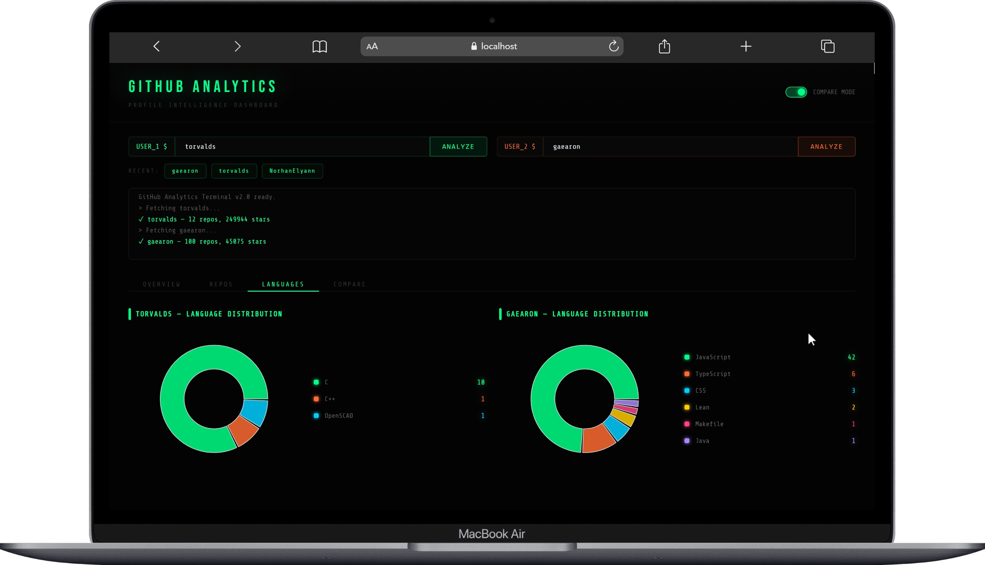
G
ITC
Demo &
Screenshots
6.3
6.4
Repos Tab
Languages Tab
Sortable table with Stars, Forks, Language. Live filter narrows the list by repo name
Donut chart with color-coded legend showing repo counts per language

Slide 12
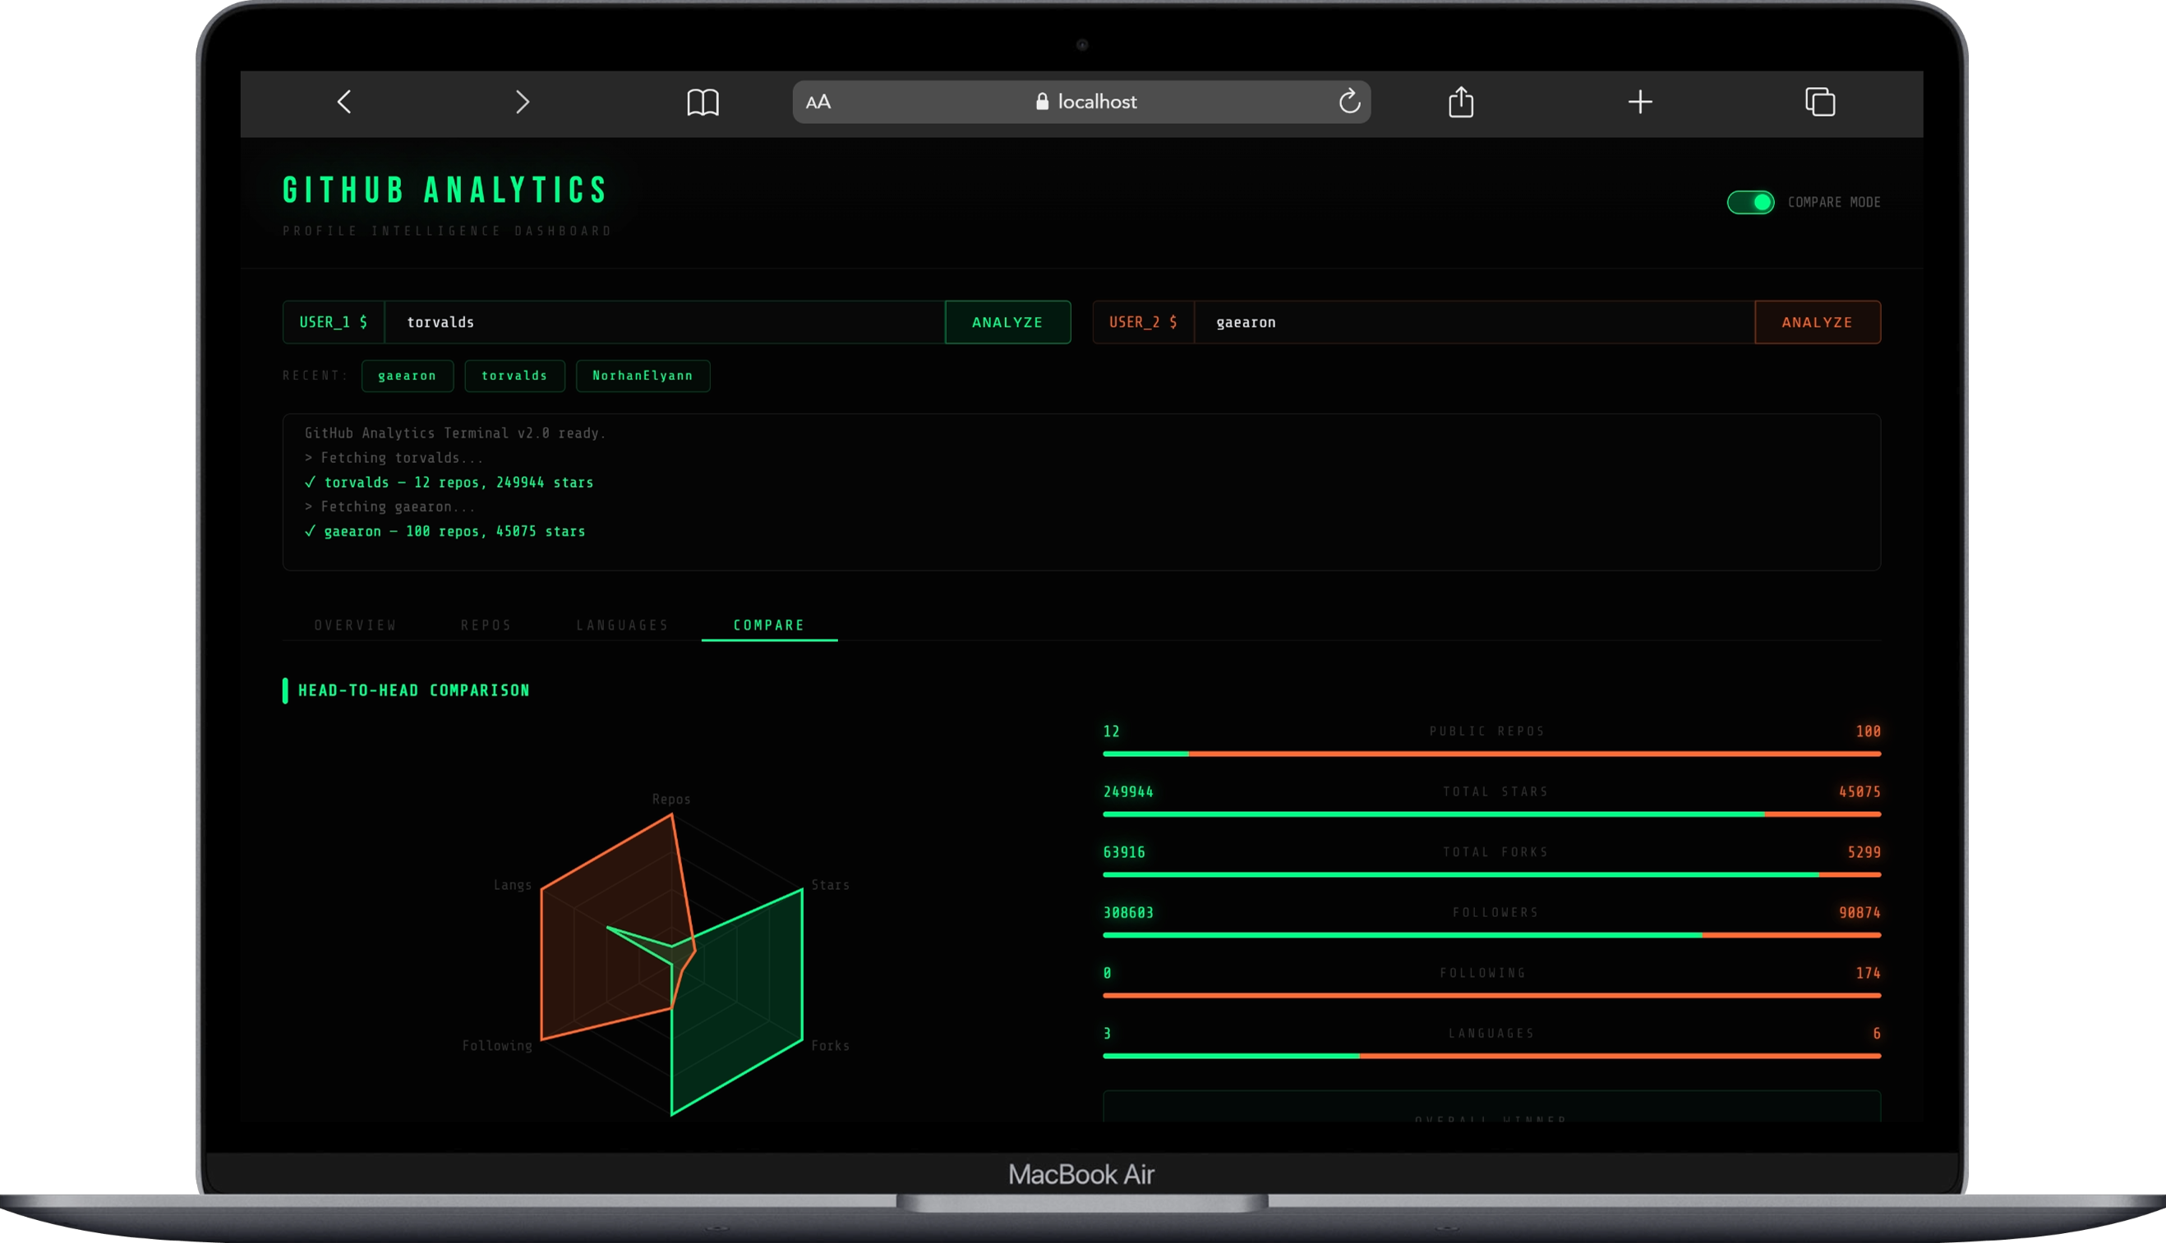
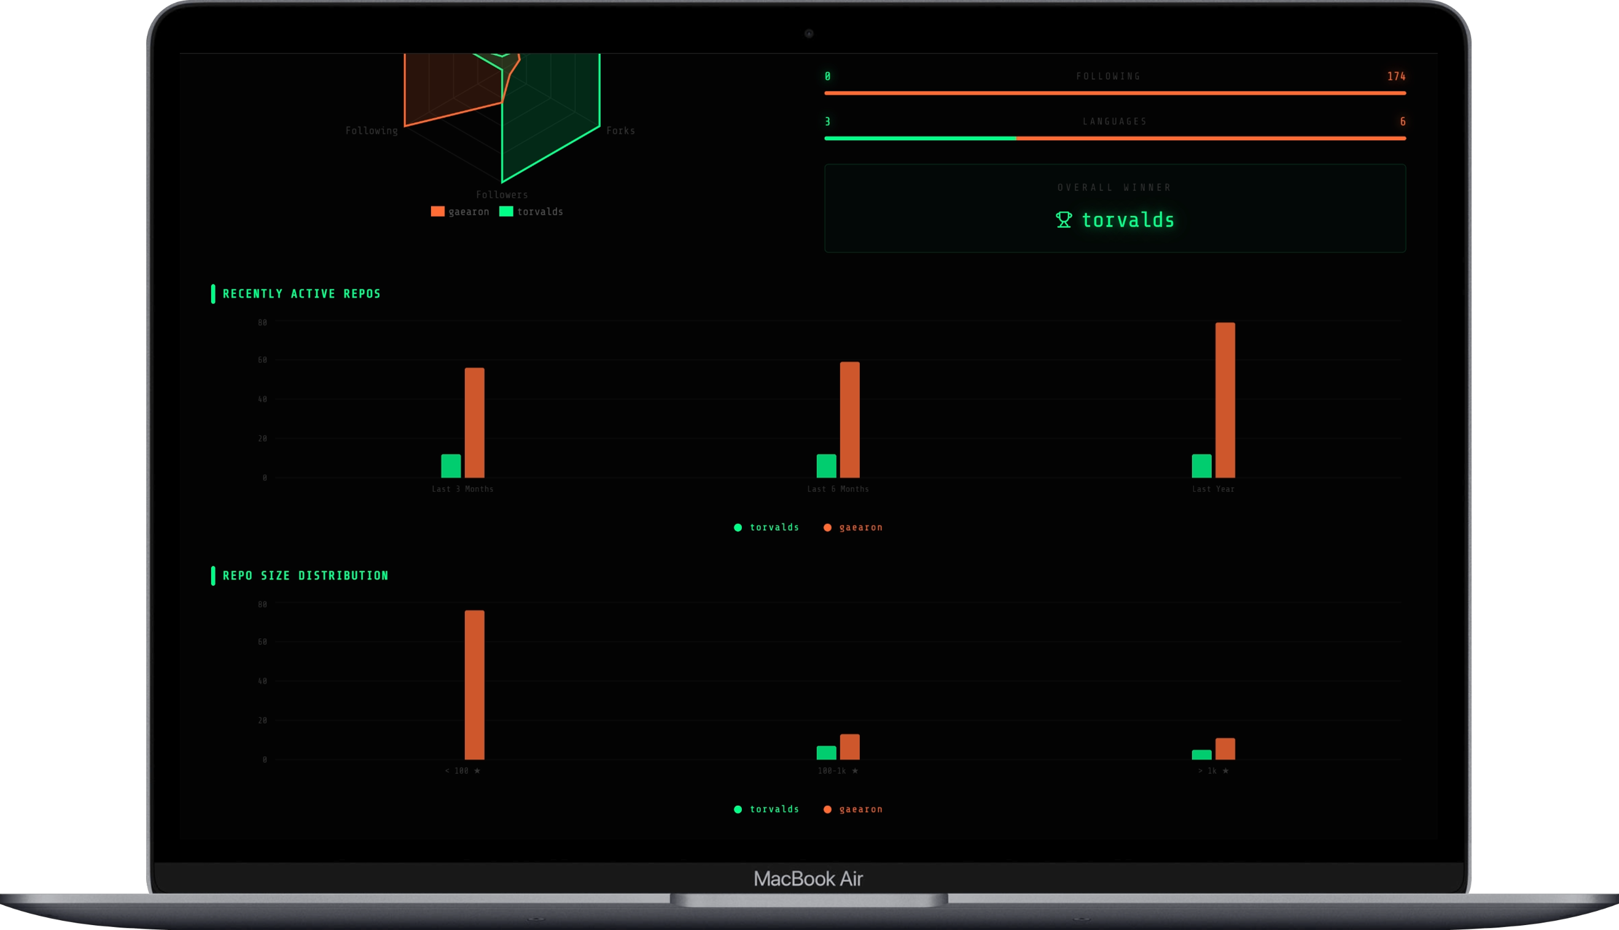
G
ITC
Demo &
Screenshots
6.5
6.6
Compare Tab — Head-to-Head
Compare Tab — Activity Charts
Radar Chart across 6 dimensions + Head-to-Head bars + Overall Winner card
Recently Active Repos bar chart (3/6/12 months) + Repo Size Distribution breakdown

Slide 13
G
Project Metrics Dashboard
ITC
GitHub Analytics Dashboard — Final Build Summary
100+
12
4
5
Repos
Analyzed
Features
Delivered
Chart
Types
Team
Members
Sprint 1
App Shell + API + Search + UI
✅ 100%
Mar 15 – Mar 25
Sprint 2
UserCard + Overview + Repos + Languages
100%
✅ 100%
Apr 1 – Apr 25
Completed
Sprint 3
Header + Compare + Radar Chart
✅ 100%
Apr 30 – May 10
Sprint Completion

Slide 14
G
ITC
Conclusion
Summary
All 12 planned features delivered & verified. Pure frontend, no backend — any username analyzed in under 3 seconds.
Thank
Achievements
You!
GitHub API integration, Compare Mode with Winner Score, Terminal Log, Language charts, and Repo filtering all working.
Norhan Elyan — Project Lead
GitHub Analytics Dashboard
ITC Graduation Project • 2026
Learnings
Coordinating parallel Git branches across a 5-person team with shared UI components as a foundation proved effective.
All 12 features ✅ Delivered
Future Work
0 critical bugs on final build
Contribution Graph, Pinned Repos, Language by bytes, Export to PDF, and GitHub Token support planned for v2.0.

