Slide 1



Smart Clinic
Management System
DEPI Graduation Project • Digital Egypt Pioneers Initiative
Track
Academic Year
Supervisor
Full Stack .NET Development
2025 – 2026
Dr. Mahmoud Raslan
Eng. Ibrahim Mohamed

Slide 2
Team Contributions
Team Member | Primary Role | Main Responsibilities
Anas Mohamed El-sayed | Backend Developer 1 + Team leader | Authentication, User Management, Admin Operations, Doctors Management, Firebase Integration
Yousef Mohamed Ali | Backend Developer 2 | Patients Management, Appointments, Prescriptions, Invoices, Receptionist Operations
Ahmed Ehab | Frontend Developer 1 | Public Website, Home Page, Authentication Pages, Navigation Components
Ziad Nabil | Frontend Developer 2 | Dashboards, Management Panels, Scheduling, Billing & Prescription Interfaces
Asmaa Ashraf | Database & Firebase Developer | Firestore Database Design, Collections Structure, Security Rules, Firebase Configuration
Shared Responsibilities: Documentation, Presentation Preparation, Testing & Quality Assurance were collaboratively completed by all team members.

Slide 3
Agenda
1
Problem Statement
11
Implementation & UI
2
Project Objectives
12
Testing
3
System Users & Roles
13
Deployment
4
Functional Requirements
14
Challenges & Lessons
5
System Architecture
15
Future Work
6
Technology Stack
16
Conclusion
7
Database Design
8
SQL → Firebase Migration
9
Firebase Collections Design
10
Authentication & Security

Slide 4




Problem Statement
Traditional clinics face critical operational challenges
Paper-based Records
Appointment Conflicts
Billing Difficulties
Data Loss Risk
Manual files prone to loss and damage
No real-time scheduling system
Manual invoicing leads to errors
No backup or audit trail
✔ Smart Clinic System digitizes and automates all clinic operations — eliminating manual errors, preventing data loss, and enabling real-time visibility.

Slide 5







Project Objectives
Patient Management
Doctor Management
Appointments
Medical Records
Register, update & track patient records
Manage doctors, schedules & specialties
Real-time booking with conflict detection
Secure digital patient history
Prescriptions
Billing
Analytics
Digital prescription generation
Automated invoicing & payment tracking
Reports and performance dashboards

Slide 6


System Users & Roles
Role-Based Access Control — 4 distinct user roles
Admin
Doctor
Receptionist
Patient
✓ Manage all users
✓ View patient records
✓ Book appointments
✓ View own records
✓ System configuration
✓ Add medical notes
✓ Register patients
✓ Book appointments
✓ View all reports
✓ Write prescriptions
✓ Generate invoices
✓ View prescriptions
✓ View appointments
✓ View invoices

Slide 7
Functional Requirements
Authentication & Authorization
User Management (CRUD)
1
2
Patient Registration & Management
Appointment Scheduling
3
4
Medical Records & History
Prescription Management
5
6
Billing & Invoicing
7
8
Reporting & Analytics
8
10

Slide 8
System Architecture
Multi-layer architecture with Firebase + ASP.NET Core backend
Users (Browser / Mobile)
React + TypeScript + Vite (Frontend)
Firebase Authentication
Firestore Database (NoSQL)
ASP.NET Core Services (Backend API)
⭐ Critical architectural decision — enables scalability and rapid development

Slide 9
Technology Stack
Frontend
Backend
▸ React 18
▸ TypeScript
▸ ASP.NET Core REST API
▸ API Endpoints
▸ Vite
▸ Tailwind CSS
▸ Business Logic Layer
▸ C#
Database
Deployment
▸ Firebase Firestore
▸ NoSQL Collections
▸ Netlify
▸ Firebase Console
▸ Real-time Sync
▸ Offline Support
▸ GitHub CI/CD
▸ Environment Config
Security & Authentication
▸ Firebase Authentication
▸ Audit Logging

Slide 10
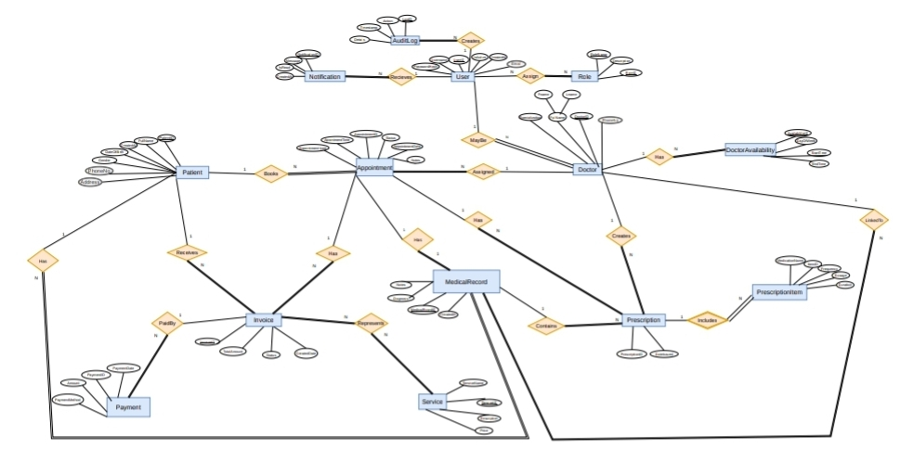
Database Design
View Live Site
Full entity-relationship model of the Smart Clinic database

Slide 11
SQL Server → Firebase Migration
A key engineering decision — showing problem-solving and adaptability
SQL Server
Firebase Firestore
✗ Required relational modeling
✓ Managed infrastructure
✗ Schema changes require migrations
✓ Flexible NoSQL schema
✗ Hosting complexity
✓ Real-time listeners
▶
✗ Longer setup and configuration time
✓ Easy deployment
Migration
✗ No real-time sync
✓ Built-in auth
Result:
Faster development and easier maintenance

Slide 12
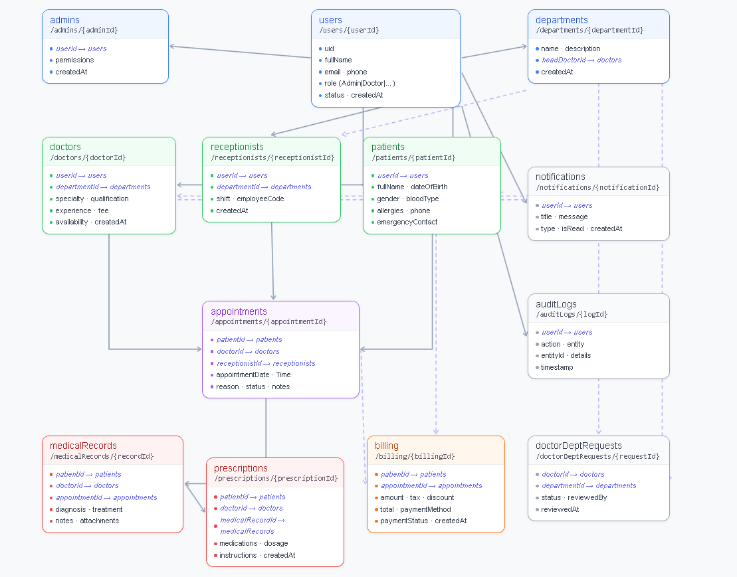
Firestore Collections Design

Slide 13




Authentication & Security
User Login
Firebase Auth
Firebase ID Token Generated
Role Verification
Dashboard Access
Firebase Auth
Role-Based Access Control
Email/password authentication with secure token management and session handling
Four roles with distinct permissions — Admin, Doctor, Receptionist, Patient
Firestore Security Rules
Audit Logging
Server-side rules enforce data access at the database level
All system actions logged with user, timestamp, and action details

Slide 14
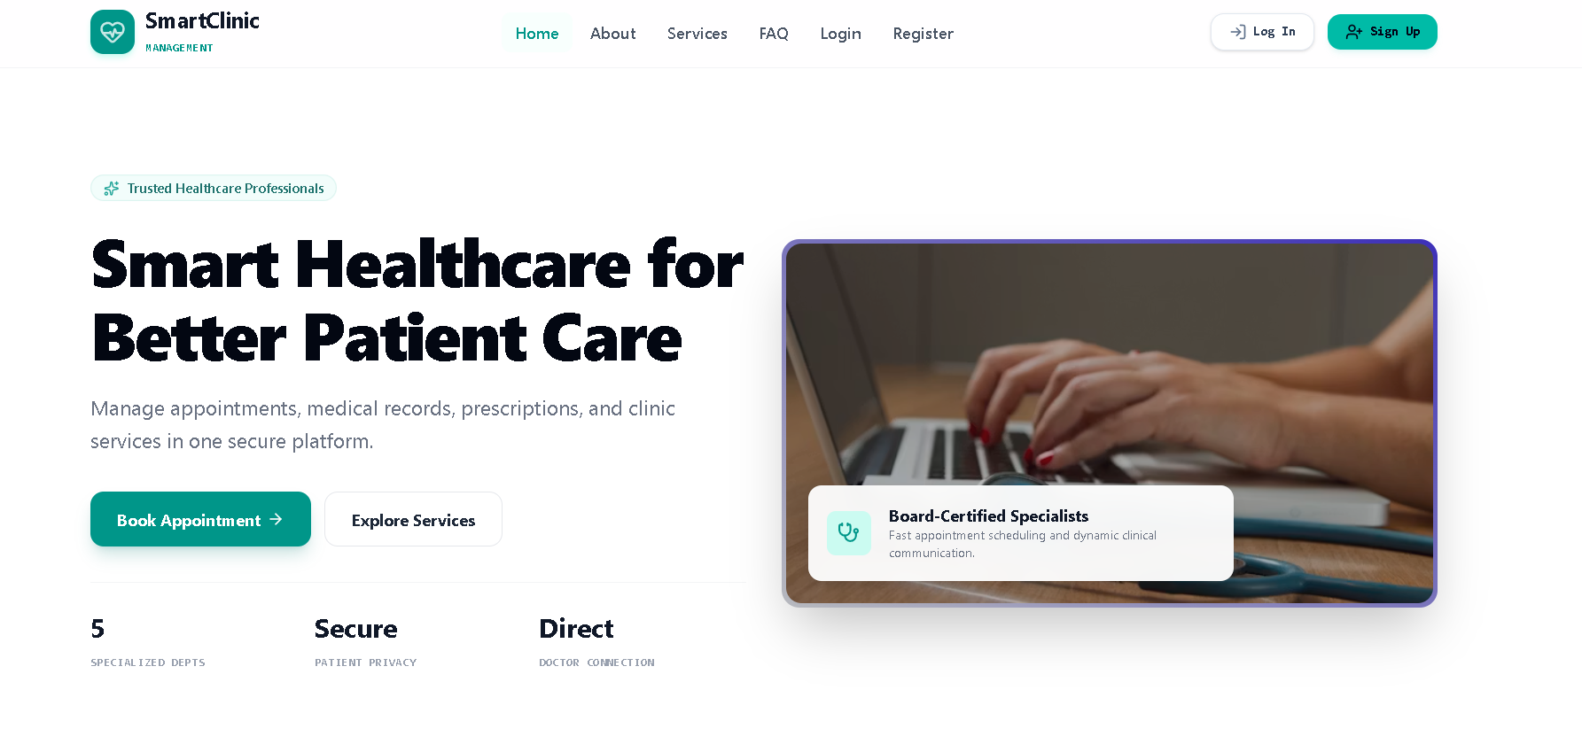
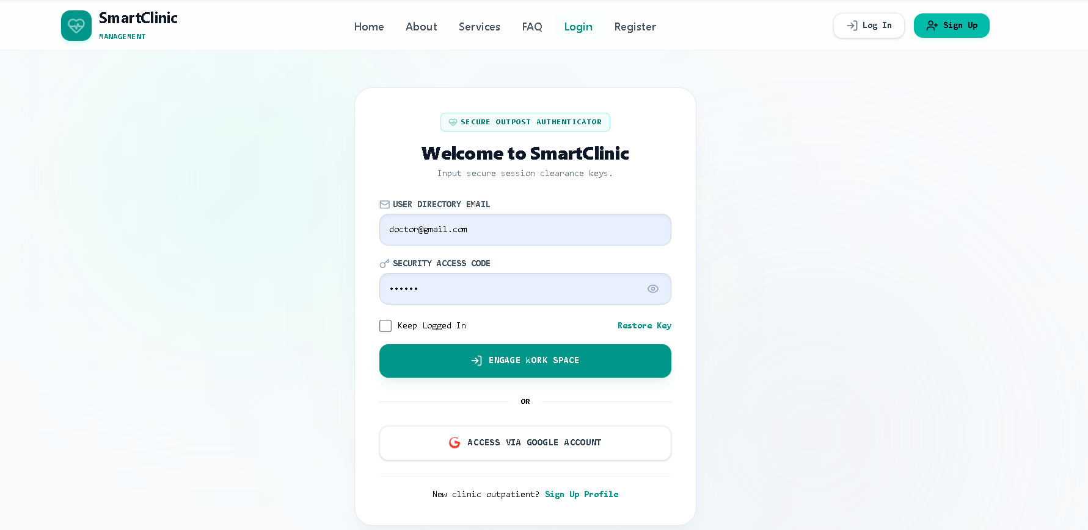
UI — Login & Main page

Slide 15
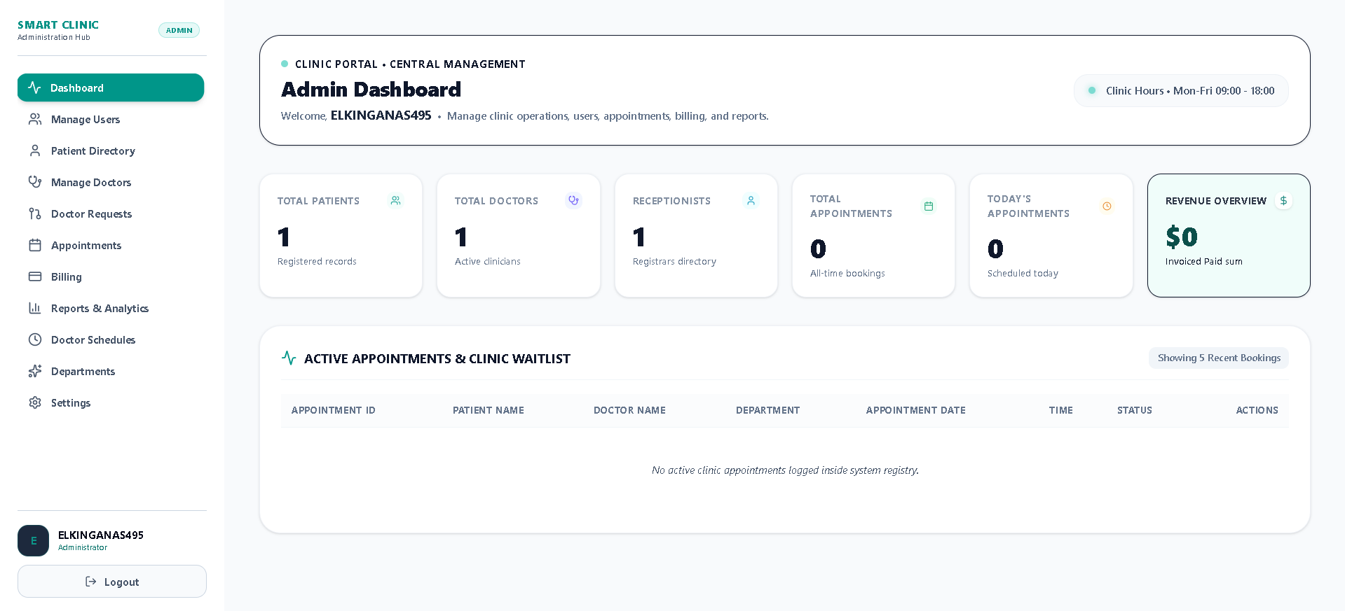
UI — Admin Dashboard

Slide 16
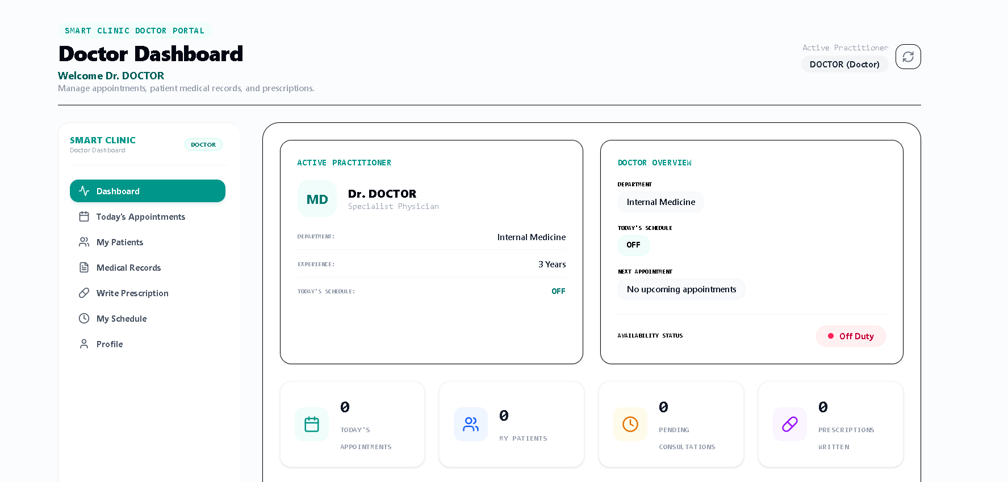
UI — Doctor Dashboard

Slide 17
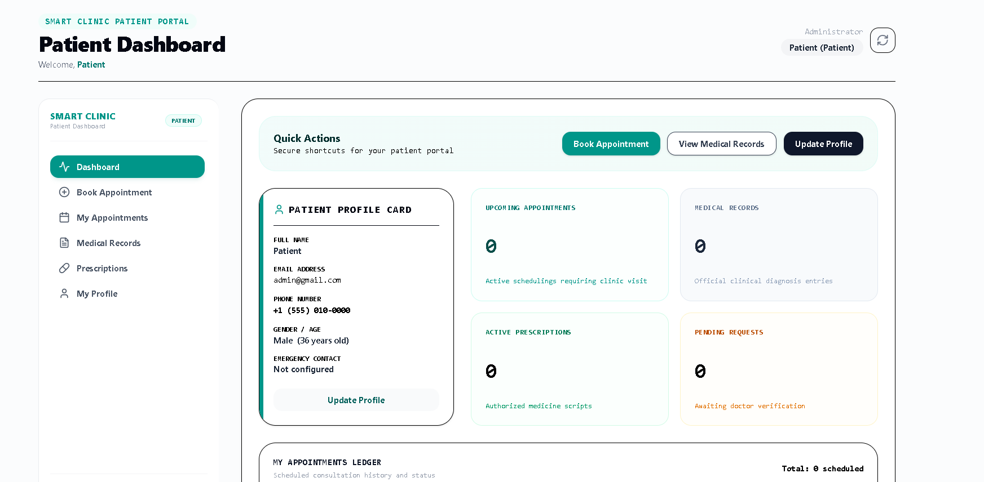
UI — Patient Dashboard

Slide 18
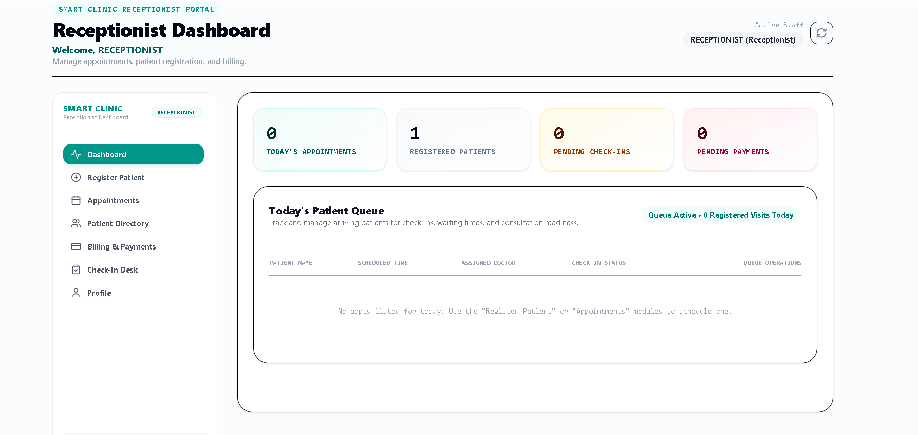
UI —Receptionist Dashboard

Slide 19
Testing Strategy
Functional Testing
Integration Testing
User Acceptance Testing
Each feature tested against requirements
Frontend ↔ Firebase ↔ Backend interactions
Real user scenarios & feedback cycles
Test Case | Expected | Result
User Login with valid credentials | Redirect to dashboard | ✓ Pass
Book appointment (no conflict) | Appointment created | ✓ Pass
Book appointment (conflict) | Error message shown | ✓ Pass
Generate patient invoice | PDF invoice created | ✓ Pass
Access without permission | Access denied | ✓ Pass
Add prescription by doctor | Record saved | ✓ Pass

Slide 20
Deployment Pipeline
CI/CD pipeline from development to production
💻
📦
⚙️
🌐
Developer
(Local)
GitHub
Repository
Netlify
CI/CD
Production
(Live)
Firebase Console
Netlify Dashboard
Authentication • Firestore • Storage
Real-time monitoring & rules management
Automatic deploys
Environment variables management

Slide 21
Challenges & Lessons Learned
Challenge | Lesson Learned
SQL → Firebase migration mid-project | Plan data model before choosing DB; NoSQL needs different thinking
Role-based security with Firestore rules | Server-side rules are essential — never rely on client-only checks
Implementing real-time updates with Firestore | Efficient data synchronization improves user experience and system responsiveness.
Team coordination & task division | Agile sprints + daily standups improved delivery speed

Slide 22





Future Work & Roadmap
Planned enhancements beyond current version
Phase 2
Phase 2
Phase 3
Mobile App
SMS Notifications
Online Payments
React Native / Flutter cross-platform app
Twilio integration for appointment reminders
Stripe / PayPal payment gateway integration
Phase 3
Phase 4
File & Document Management
Multi-Clinic Support
Upload and manage medical reports, scans, and laboratory results using Firebase Storage
SaaS model for multiple clinic instances

Slide 23
Conclusion
Objectives Achieved
11
4
✔ Full-stack clinic management system built and deployed
✔ Role-based access for 4 user types
Collections
User Roles
✔ Real-time data with Firebase Firestore
✔ SQL → Firebase migration completed successfully
10
Live
Deployment
✔ Automated billing, prescriptions & audit logs
Modules
✔ Deployed live on Netlify with CI/CD pipeline
Smart Clinic Management System successfully designed, implemented, tested, and deployed using modern cloud technologies.

Slide 24

Thank You!
Smart Clinic Management System
DEPI Graduation Project • 2025 – 2026

