Slide 1
MTA Traffic Analysis for Women in Tech
July, 2015
Group 7

Slide 2


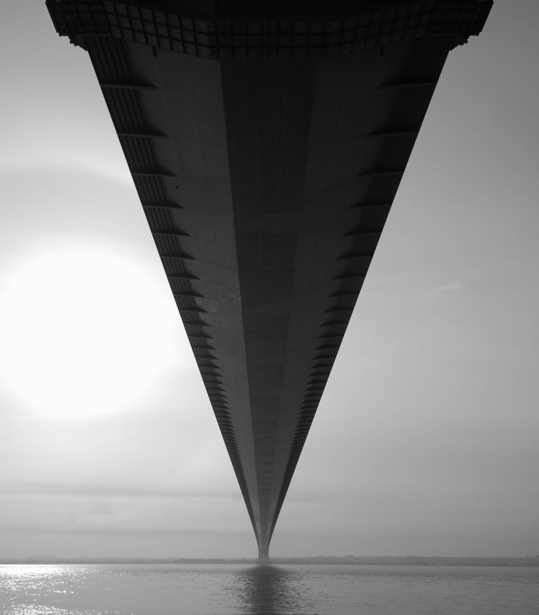
Problem Statement/ Approach/Context
Ty
Ex: limitations for the dataset

Slide 3
Summary of Top Subway Stations (by entries and exits)
Ty
Ex: limitations for the dataset

Slide 4
Summary of Analysis Approach and Assumptions
Data Sources, Key Assumptions, etc
Time Span | We analyzed 4 weeks of MTA turnstile data from April of 2015 (from 4/4 /2015 to 4/15/2015). We assume that April subway traffic is representative of the traffic patterns in the spring, leading up to the gala in the early summer.
Total Subway Stations Analyzed | We analyzed a total of 473 unique subway stations distributed across the five boroughs of NYC. We considered each unique subway stations as a combination of Station Name/Subway Line. For example, the LNQR456 line in 14 ST-UNION SQ is considered one unique station. (There are instances where the subway station names are the same for multiple lines, such as the Canal Street station).
Traffic Volume Results | We analyzed the subway exit volume for the 473 subway stations for four different time periods, and identified the top 5 percentile of subway stations for exits volume. The four time periods are: Early Morning Commute: anytime before 11am. Traffic from this period probably comes primarily from morning commuters. Lunch Period: between 11am and 2pm. Traffic from this period probably comes primarily from the lunch crowd, as well as those working 2nd shifts (those who work from noon to late evenings). Afternoon to Early Evenings: between 2pm and 7pm. Traffic from this period comes

Slide 5

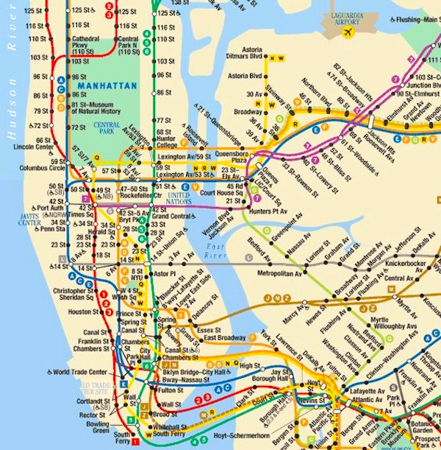
Subway Traffic Flow Summary by Exits
Early Morning Commute (before 11am)
Summary for Top 5 Percent Subway Stations
# | Subway Station Name | Average Exits Per Week
1 | 42 ST-GRD CNTRL 4567S
2 | 34 ST-HERALD SQ BDFMNQR
3 | 47-50 ST-ROCK BDFM
4 | PATH WTC 1
5 | 14 ST-UNION SQ LNQR456
6 | 42 ST-TIMES SQ 1237ACENQRS
7 | LEXINGTON-53 ST EM6
8 | 34 ST-PENN STA ACE
9 | 59 ST 456NQR
10 | FULTON ST 2345ACJZ
11 | 59 ST-COLUMBUS ABCD1
12 | 42 ST-BRYANT PK BDFM7
13 | 5 AVE-53 ST EM
14 | 86 ST 456
15 | 42 ST-PA BUS TE ACENQRS1237
16 | CANAL ST JNQRZ6
17 | W 4 ST-WASH SQ ABCDEFM
18 | WALL ST 23
19 | BOWLING GREEN 45
20 | 77 ST 6
Notes:
*These subway stations are not in the Manhattan island and therefore not plotted on the chart.

Slide 6
Subway Traffic Flow Summary by Exits
Lunch Period (between 11am and 2pm)
Summary for Top 5 Percent Subway Stations
# | Subway Station Name | Average Exits Per Week
1 | 42 ST-GRD CNTRL 4567S
2 | 34 ST-HERALD SQ BDFMNQR
3 | 34 ST-PENN STA ACE
4 | 42 ST-TIMES SQ 1237ACENQRS
5 | 14 ST-UNION SQ LNQR456
6 | 86 ST 456
7 | 59 ST 456NQR
8 | 59 ST-COLUMBUS ABCD1
9 | W 4 ST-WASH SQ ABCDEFM
10 | 47-50 ST-ROCK BDFM
11 | 42 ST-PA BUS TE ACENQRS1237
12 | *MAIN ST 7
13 | 96 ST 123
14 | CANAL ST JNQRZ6
15 | 14 ST-UNION SQ 456LNQR
16 | 72 ST 123
17 | *ROOSEVELT AVE EFMR7
18 | FULTON ST 2345ACJZ
19 | 34 ST-PENN STA 123
20 | *BROADWAY/LAFAY BDFQ6
Notes:
*These subway stations are not in the Manhattan island and therefore not plotted on the chart.

Slide 7
Subway Traffic Flow Summary by Exits
Afternoons to Early Evenings (between 2pm and 7pm)
Summary for Top 5 Percent Subway Stations
# | Subway Station Name | Average Exits Per Week
1 | 34 ST-HERALD SQ BDFMNQR
2 | 42 ST-GRD CNTRL 4567S
3 | 34 ST-PENN STA ACE
4 | 42 ST-PA BUS TE ACENQRS1237
5 | 34 ST-PENN STA 123ACE
6 | 42 ST-TIMES SQ 1237ACENQRS
7 | 86 ST 456
8 | *MAIN ST 7
9 | *UNION TPK-KEW G EF
10 | PATH WTC 1
11 | *ROOSEVELT AVE EFMR7
12 | 14 ST-UNION SQ LNQR456
13 | 34 ST-PENN STA 123
14 | W 4 ST-WASH SQ ABCDEFM
15 | 96 ST 123
16 | *JAMAICA CENTER EJZ
17 | 59 ST-COLUMBUS ABCD1
18 | *BEDFORD AVE L
19 | 72 ST 123
20 | 59 ST 456NQR
Notes:
*These subway stations are not in the Manhattan island and therefore not plotted on the chart.

Slide 8
Subway Traffic Flow Summary by Exits
Late Evenings (from 7pm to Midnight)
Summary for Top 5 Percent Subway Stations
# | Subway Station Name | Average Exits Per Week
1 | *MAIN ST 7
2 | 34 ST-HERALD SQ BDFMNQR
3 | *ROOSEVELT AVE EFMR7
4 | 42 ST-PA BUS TE ACENQRS1237
5 | 86 ST 456
6 | 42 ST-GRD CNTRL 4567S
7 | 42 ST-TIMES SQ 1237ACENQRS
8 | 34 ST-PENN STA ACE
9 | *BEDFORD AVE L
10 | *JAMAICA CENTER EJZ
11 | *145 ST ABCD
12 | 96 ST 123
13 | *CROWN HTS-UTICA 34
14 | *1 AVE L
15 | *JUNCTION BLVD 7
16 | *125 ST ACBD
17 | *CHURCH AVE BQ
18 | *DITMARS BL-31 S NQ
19 | FULTON ST 2345ACJZ
20 | W 4 ST-WASH SQ ABCDEFM
Notes:
*These subway stations are not in the Manhattan island and therefore not plotted on the chart.

Slide 9
Summary of Subway Stations Close to Tech Startups
Naomi, Sean

Slide 10
Recommendations
Team

Slide 11
Appendix

