Slide 1

CAPTURE
THE
FLAG
(CTF)
Maxim A. Kulakov (Vladimir State University)
Email: kulakov_maxim@mail.ru
Twitter: @kulakov_maxim

Slide 2
Information security training/studying problems
University programs on Information security
Too much theory, the lack of practice
DEFENSE – YES, ATTACK - NO
Motivation
No community

Slide 3
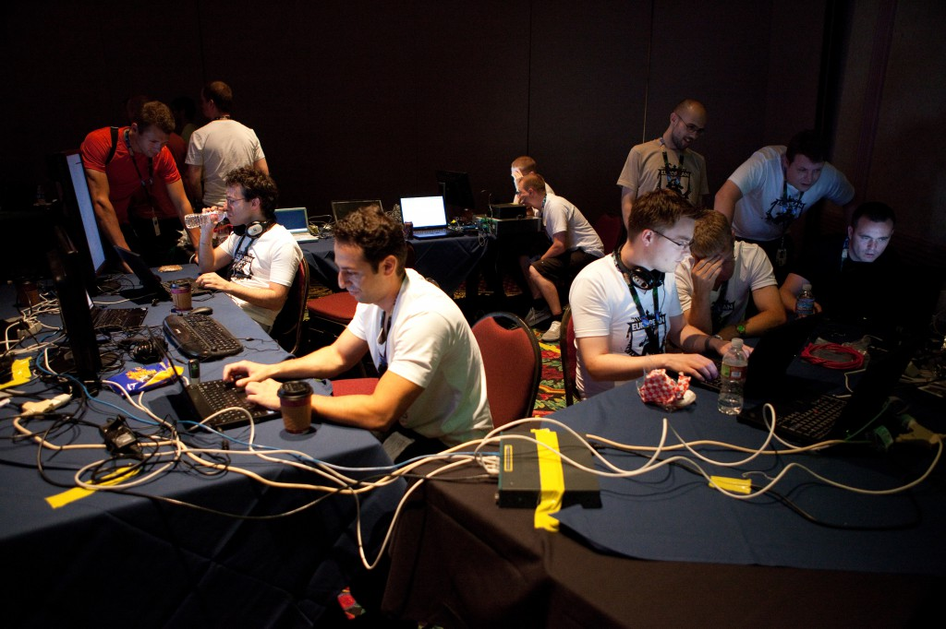
Capture the Flag? What is it?
Capture the Flag (CTF) is a computer security competition.
Originally a children’s game to simulate small team combat, based on defending an immobile flag while trying to capture the flag of the other team.

Slide 4
CTF Styles
CTF Styles:
Attack/defense style (classic)
Jeopardy-style (task-based)
CTF network types:
Online (Internet)
Offline (Local)
Participating style:
Team
Individual

Slide 5
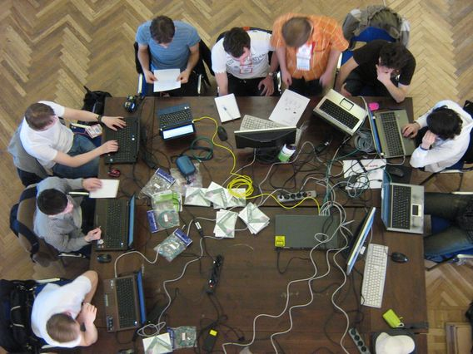
Attack/defense CTF
multi-site, multi-team hacking contest in which a number of teams compete independently against each other

Slide 6
Attack/defense CTF Rules
TEAMS ARE ALLOWED TO
Do whatever they want within their network segment. Most likely the team wouldlike to patch vulnerabilities in their services or block exploitation of vulnerabilities;
Attack other teams.
TEAMS ARE PROHIBITED TO
Filter out other teams' traffic;
Generate large amount of traffic that poses a threat to network stability of organizers facilities;
Generate large amount of traffic that poses a threat to network stability of any other team;
Attack teams outside of the VPN;
Attack the game infrastructure facilities operated by organizers.

Slide 7
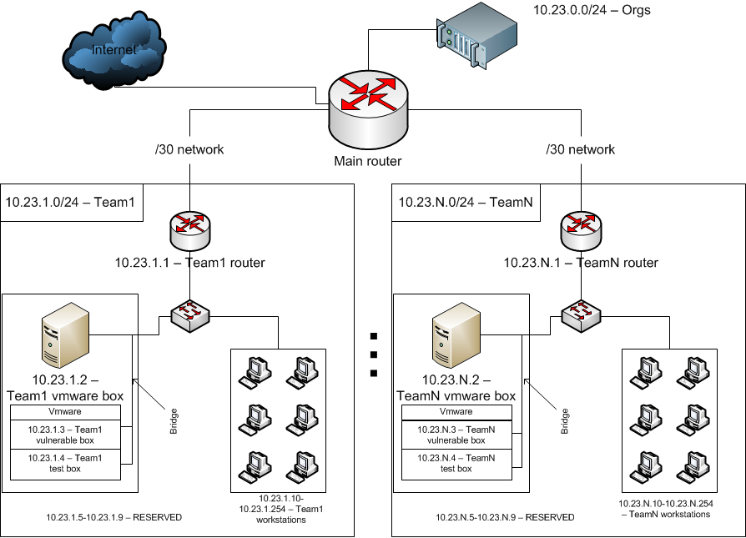
Attack/defense CTF
Network example

Slide 8
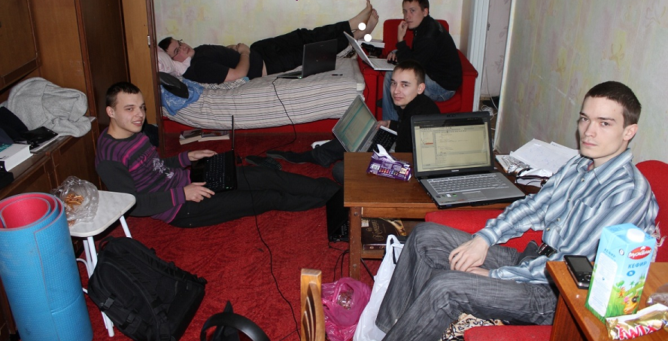
Task-based CTF involve multiple categories of problems, each of which contains a variety of questions of different point values.

Slide 9
Jeopardy CTF
Categories
Main:
PWN
Web Security
Cryptography
Reverse engineering
Digital Forensic
Steganography
Additional:
Miscellaneous
PPC
Admin
Trivia

Slide 10
Jeopardy CTF – Categories
PWN
Remote system/service
X86-32, x86-64, ARM
Sources - NO, compiled binary file - YES
Discover vulnerability and create exploit
Hard for newcomers! (require special knowledge and experience)
Example: find buffer overflow vulnerability in the Linux binary, exploit the remote training system and get the flag

Slide 11
Jeopardy CTF – Categories
Web Security
Remote web application
CGI, PHP, Python, Ruby, Perl, etc.
Sources – SOMETIME
Discover vulnerability and hack the site
Complex and “exotic” vulnerabilities
Example: find SQL-injection vulnerability at the training site and get the flag from the site’s database

Slide 12
Jeopardy CTF – Categories
Cryptography
Cipher text
Symmetric/assymmetric, historical, special cryptosystems
Crypto algorithm/application – SOMETIME
Decrypt cipher text, find weakness in crypto algorithm
Example: analyze cryptosystem and decrypt the cipher text

Slide 13
Jeopardy CTF – Categories
Reverse engineering
Binary file
X86-32, x86-64, ARM, VMs
Windows, Linux, Android, iPhone, etc.
Analyze binary and get the flag
Hard for newcomers! (require special knowledge and experience)
Example: analyze and get registration code (flag) for Windows binary

Slide 14
Jeopardy CTF – Categories
Digital Forensic
Network dump, memory dump, hard disk image, etc.
File systems, network protocols, file formats, forensic software, etc.
Information gathering, data recovering, computer criminalistic expertise, etc.
NOT hard for newcomers!
Example: analyze the hard disk image and recover the deleted file with flag

Slide 15
Jeopardy CTF – Categories
Steganography
Media file (graphic image, sound file, video file), network dump, etc.
Classical or special steganography algorithms
Analyze the source data/container and extract the hidden message
NOT hard for newcomers!
Example: detect the LSB steganography in the BMP image and extract the flag

Slide 16
CTF Competitions
DEFCON (Las Vegas, USA)
iCTF (Internet, Santa Barbara, USA)
CODEGATE (Seul, South Korea)
RuCTFE (Internet, Yekaterinburg, Russia)
CSAW (New York, USA)
rwthCTF (Internet, Aachen, Germany)
PHDays (Moscow, Russia)
Hack.Lu CTF (Internet, Luxembourg)
RuCTF (Yekaterinburg, Russia)

Slide 17
Want to try?
Task-based
  CSAW CTF (19-21 September)
  Hack.Lu CTF (21-23 October)
Attack/Defense style
  RuCTFE (November-December)
  iCTF (November-December)
  rwthCTF (November-December)
Honeypot CTF ☺
  http://h0n3yp0t.ru/forum/trainings/Newcomers_2014/
  Hackquest

Slide 18


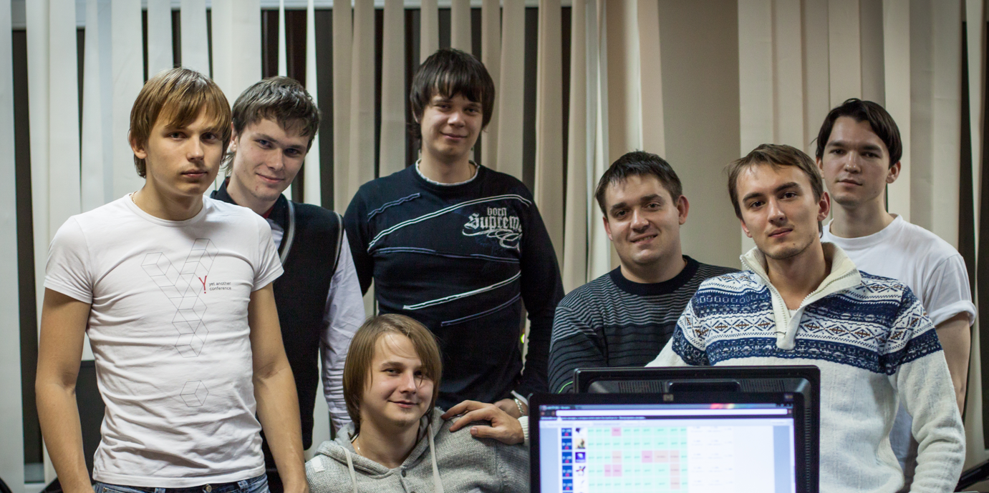
Honeypot CTF Team
(Vladimir State University)
WWW: H0N3YP0T.RU
Twitter: @HoneypotCTF

Slide 19
What CTF can give?
Knowledge
Practice
Research area
Motivation
Friends
Fun

Slide 20
Conclusions
CTF is KNOWLEDGE
CTF is INTERESTING
CTF is USEFUL
CTF is FUN

Slide 21
Hackquest
Tomorrow (13.00 – 16.00)
Simple tasks from all CTF categories
You need notebook + Internet
One team or multiple teams?
Storyline is a paranoid delusion of the author (me ☺)

