Slide 1
Data Analytics Internship Portfolio – ApexPlanet Software Pvt Ltd
Itha Akshaya

Slide 2
Data Storytelling & Statistical Validation.
Analyzing customer transactions to identify sales patterns and validate insights using statistical tests.

Slide 3
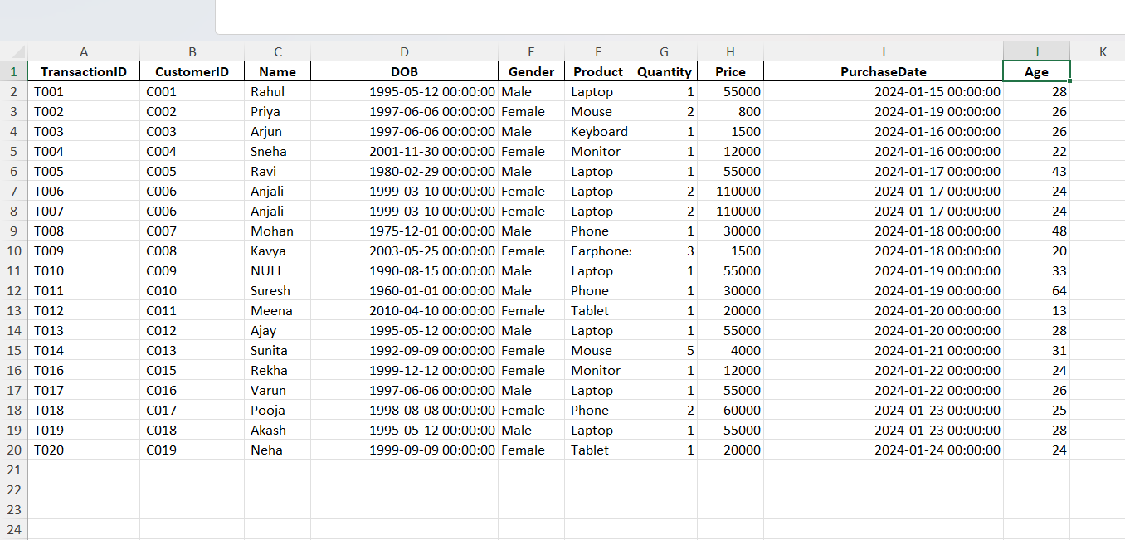
Dataset Overview
19 transactions recorded in January 2024
Customer details include: TransactionID, CustomerID, Name, DOB, Gender, Product, Quantity, Price, PurchaseDate, Age
Age range: 13 to 64 years
Products purchased: Laptop, Phone, Tablet, Monitor, Mouse, Keyboard, Earphones
Balanced gender distribution across customers

Slide 4
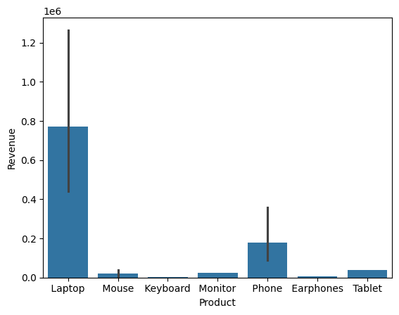
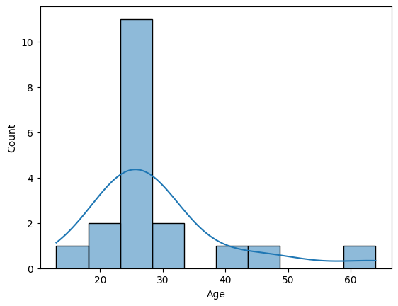
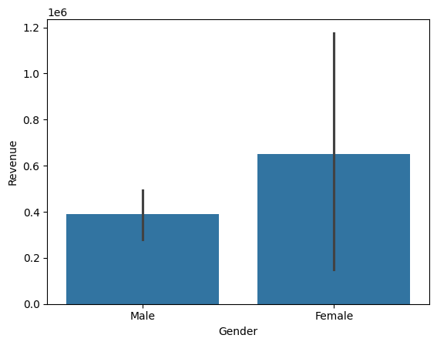
Key Insights
Laptops generate the highest revenue (₹55,000–₹110,000 per purchase)
Younger customers (20–30 years) are frequent buyers
Accessories (Mouse, Earphones) are low-value but repeat purchases
Some customers appear multiple times, showing loyalty patterns

Slide 5
Hypotheses Tested
Hypothesis 1: Laptop vs Phone spending differs significantly
Hypothesis 2: Younger (<30) vs Older (≥30) customers spend differently
Hypothesis 3: Male vs Female purchase frequency differs
Hypothesis 1: Laptop vs Phone Spending
T-statistic: nan
P-value: nan
No significant difference: Laptop and Phone spending are similar.
Hypothesis 2: Younger vs Older Customers Spending
T-statistic: 0.41849641879460275
P-value: 0.6825227063931477
No significant difference: Age does not impact spending.
Hypothesis 3: Male vs Female Purchase Counts
Chi2-statistic: 0.05263157894736842
P-value: 0.8185458083820435
No significant difference: Gender does not impact purchase frequency

Slide 6
Business Impact
Laptops remain the main revenue driver in the dataset
Younger customers show strong buying patterns, but results are not statistically validated
Gender does not impact purchase frequency
Insights are directional, not conclusive due to small sample size

Slide 7
Recommendations
Collect larger datasets for stronger statistical validation
Focus marketing campaigns on laptops (main revenue driver)
Target younger customers with promotions, but validate with more data
Explore loyalty programs for repeat buyers
Build dashboards for continuous monitoring of sales patterns

Slide 8
Key Learnings
Python (pandas for cleaning).
SQL (business queries & joins).
Power BI (dashboards, KPIs).
R (basic visualization).
Storytelling & hypothesis testing.

Slide 9
Reflection
Technical Growth
Learned how to clean and transform raw datasets into analysis-ready formats.
Strengthened SQL query writing for business questions.
Gained hands-on experience with Power BI dashboards and KPI cards.
Practiced hypothesis testing and statistical validation.
Analytical Mindset
Developed the ability to spot patterns and trends in messy data.
Learned to question assumptions and validate insights with data.
Understood the importance of sample size and data quality in analysis.
Business Understanding
Connected technical outputs to business impact (e.g., laptops as revenue driver).
Learned how to translate numbers into actionable recommendations.
Experienced how dashboards and KPIs support decision-making.
Professional Skills
Improved storytelling and presentation skills.
Learned to document work clearly in GitHub for professional portfolios.
Practiced communicating insights to non-technical stakeholders.
Personal Growth
Built confidence in handling end-to-end projects independently.
Experienced the discipline of working with timelines and deliverables.
Strengthened problem-solving skills by handling data inconsistencies.
Learned to reflect on mistakes (like small sample size limitations) and improve.

Slide 10
Thank you

