Slide 1
CareLink Follow-Up
A reliable missed-appointment worklist for connected and offline clinics
ITHAMAR NYANGU
Software Engineer technical assessment
7th October 2026
Notes:
Timing: 35-45 seconds.
Opening: CareLink Follow-Up helps clinic staff identify patients who missed appointments and coordinate outreach. I approached it as both a working vertical slice and a production architecture problem because the national context includes weak connectivity, older computers and sensitive health data.
Transition: I will start with the rule I implemented, then follow the data from a clinic through the proposed national system.

Slide 2
Follow-up rule and assumptions
02
Latest visit controls the current status
1
2
3
4
Visit recorded
Appointment due
7 days late
More than 7 days
23 Aug
29 Sep
6 Oct
7 Oct onward
Next date set
Due date passes
Still missed
Overdue queue
A later attended visit supersedes an earlier missed appointment.
The worklist represents the patient's latest actionable status, not every historical missed date.
Notes:
Timing: 55-65 seconds.
The brief leaves the threshold boundary open. I interpreted "more than seven days" literally. Exactly seven days late remains missed; the patient enters the overdue queue on day eight.
I select the most recent visit for each patient. If a patient later attends, that later visit becomes the current truth, so an older missed appointment disappears from the actionable queue.
Likely question: Why compare calendar dates? Staff reason about appointment days, and calendar comparisons avoid time-of-day and timezone surprises.

Slide 3
Proposed national architecture
03
Facility
In-country national environment
Partner systems
CareLink client
Versioned API + identity
Laboratory system
asynchronous exchange
Encrypted local data
HTTPS when online
Modular application
Reporting platform
Durable sync queue
National relational database
Notes:
Timing: 80-95 seconds.
At a facility, the client reads a minimum encrypted local dataset and stores offline actions in a durable queue. When connectivity returns, it sends small idempotent batches over HTTPS.
Nationally, I propose a modular monolith. This team can deploy and operate one application while keeping follow-up, identity, synchronisation and integrations separated internally. The national relational database is authoritative after validation and conflict handling.
Laboratory and reporting exchange happens asynchronously so partner downtime does not stop a clinician saving work.
Least certain decision: how much clinical data each facility should cache. I would use outage measurements, privacy policy, device capacity and a rural pilot before fixing the retention window.

Slide 4
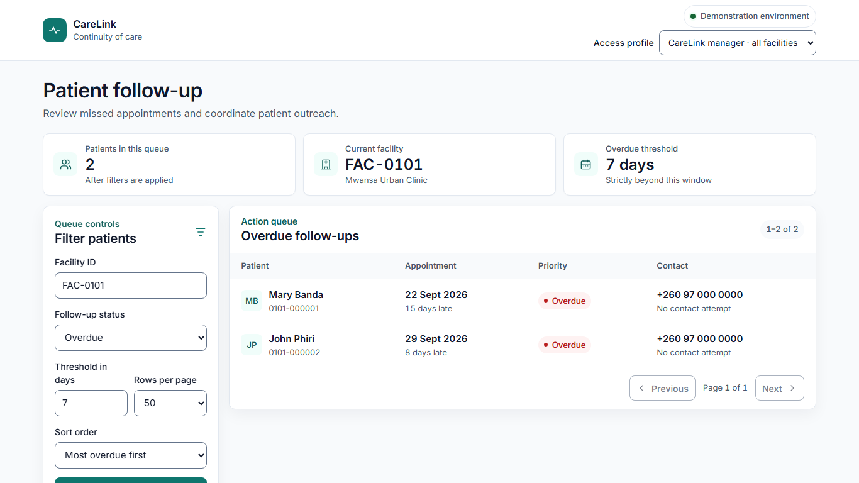
Working vertical slice
04
React + TypeScript
Typed service, explicit states and keyboard-operable filters
.NET 8 API
Validation, access scope, correlation IDs and database pagination
SQLite
Migration plus readable and assessment-scale seeders
LIVE DEMO
Swagger authentication to boundary filters to React error/retry path
Notes:
Timing: 75-90 seconds plus a short live demonstration.
I built both required halves. The React component owns view state, while followUpApi.ts owns HTTP details. The API applies the follow-up rule, status filter, sorting and pagination in SQLite.
Demo order:
1. Swagger at localhost:5214 and confirm carelink.db.
2. Authorize using manager-demo-token.
3. Run overdue_days=7, then explain why an item eight days late appears.
4. Open the React page and switch access profile.
5. If time permits, stop the API briefly to show error and retry, then restart it.
Do not browse the volume database live unless asked; cite the recorded result instead.

Slide 5
Engineering decisions and trade-offs
05
Modular monolith
Microservices
Lower operational cost for a nine-engineer team; modules preserve a later extraction path.
chosen
alternative
Local facility data
Online-only client
Clinic work continues during outages; sync and conflict handling become explicit responsibilities.
chosen
alternative
Database-side query
Load then filter in C#
Indexes, filters and pagination limit memory, bandwidth and records rendered in the browser.
chosen
alternative
Server access scope
Hide facilities in React
API enforcement prevents a user bypassing the interface and requesting another facility directly.
chosen
alternative
Notes:
Timing: 65-75 seconds.
These are trade-offs rather than universal rules. Microservices could scale independently, but the team would pay distributed-system and deployment costs immediately. Online-only would simplify the client, but roughly 1,100 facilities have unreliable or absent connectivity.
For the assessment, SQLite is a deliberate portable relational database, not the proposed national database. It supports the required migration, constraints, indexes and measured dataset without making the panel install Docker.
Likely question: Why backend pagination? The UI cannot protect the server or data by hiding controls. The API must reduce the query and response before records cross the network.

Slide 6
Code review: changes required before merge
06
1
SQL injection and embedded database credentials
Risk: cross-facility disclosure, data alteration and an unrotatable privileged secret.
2
Facility and role supplied by the caller
Risk: a caller can request another facility unless the API uses verified claims and scope.
3
Partial writes and false success
Risk: staff believe an encounter or contact saved when the server rolled back or never received it.
Focused refactor: parameters + trusted identity + one transaction + visible failure
Notes:
Timing: 55-65 seconds.
I ranked issues by clinic consequence, not style. The first backend extract includes a privileged credential and constructs SQL from user input. It also trusts caller-supplied facility and role values.
The encounter save uses two writes without a transaction and catches every exception. That can leave partial data or make a failed save appear successful.
I refactored the backend extract because those failures affect confidentiality and clinical integrity. The refactor uses parameterised SQL, current-user claims, deterministic disposal, a transaction and safe logging.
Frontend merge blockers included uncontrolled polling, request races and mark-contacted showing success before server acknowledgement.

Slide 7
Offline replay and conflict handling
07
1
2
3
4
Save locally
Replay safely
Acknowledge
Review conflict
Persist the action and a stable operation ID before showing local success.
Retries reuse the same ID. The server processes each operation once.
Only acknowledged items leave the queue; partial batches resume from a checkpoint.
A stale version never silently overwrites newer clinical information.
Existing duplicates remain clinical records
A data clerk reviews candidates. Confirmed identities are linked or merged with original identifiers and an audit trail preserved.
Notes:
Timing: 65-75 seconds.
Scenario: a clinic records visits while offline. Connectivity returns, an upload times out halfway through and the client replays the batch.
The client creates one operation ID before the first attempt and keeps it with the request. The server stores that key and result in the same transaction as the visit. A replay returns the original result rather than creating another visit.
An idempotency key does not detect two separately created patients. Existing duplicate identities require candidate matching and authorised human review. We preserve identifiers and audit history rather than casually deleting clinical rows.
For Monday-versus-Tuesday edits, the offline write includes its base version. A mismatch creates a review task; clinical governance decides the truth.

Slide 8
Evidence, limitations and next iterations
100,000
400,000
35 ms
15 / 15
patients seeded
visits seeded
median warm query
automated tests passed
Current limitations
With future version
- Static assessment tokens, not production identity
- Offline sync and partner integrations are designs only
- Contacted POST left as a documented stretch goal
- Implement authorised, idempotent contact recording
- Add production-engine integration and concurrent load tests
Notes:
Timing: 40-50 seconds.
The scale seeder generated the assessment volume. For FAC-0101 the endpoint returned a 50-row page from 222 matches. On my development laptop, ten warm requests had a 35 millisecond median; this is evidence, not a production service-level promise.
All eleven backend and four frontend tests pass.
I have been explicit about what is not implemented. With another week, I would add the contacted write using idempotency and role enforcement, test against a production-target database under concurrent load, and complete the assistive-technology matrix.
Closing: The strongest part of the solution is that the rule, access boundary and scale behaviour are executable and tested. The weakest uncertainty is offline data retention, which needs field evidence and clinical/security agreement.

Slide 9
The End
Thank you.

