Slide 1
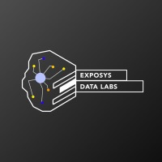
Project presentation Diabetes prediction using python
Presesnted by
K. Vyshnavi
I. Poojitha
N. Bhavya
N. Parameswari

Slide 2
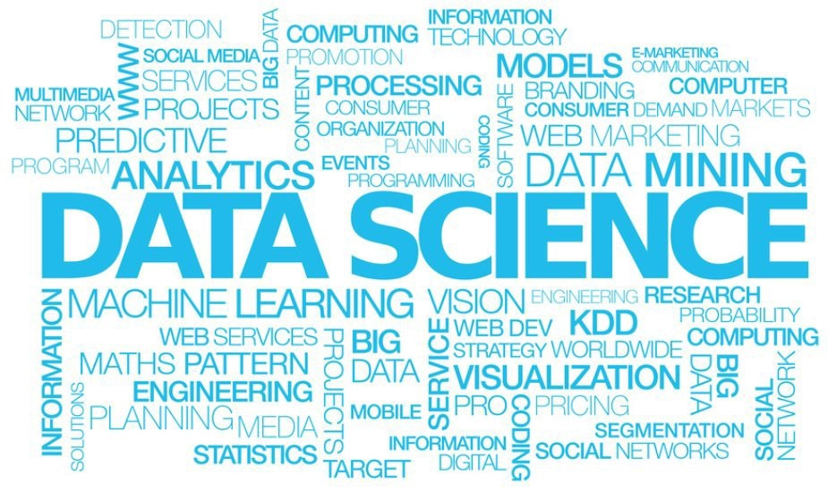

Slide 3
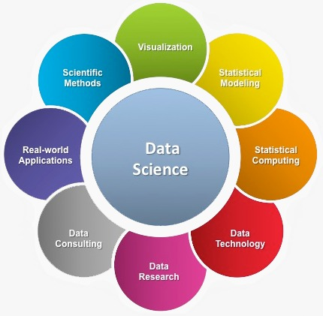

Slide 4
Diabetes prediction using python
Machine learning as the scientific study of algorithms and statistical models that computer systems use to perform a specific task without using explicit instructions, relying on patterns and inference instead. Machine learning focuses on the development of computer systems that can access data and use it to learn for themselves. Using algorithms that learn from data, machine learning allows computers to find hidden insights without being explicitly programmed where to look. This article focuses on diabetes prediction using machine learning.
There are 3 main types of machine learning i.e. Supervised Learning, Unsupervised Learning and Reinforcement Learning. As a subset of Artificial Intelligence (AI), machine learning can be used to solve a myriad of problems such as fraud detection, web search results, credit scoring, customer segmentation, email spam filtering, etc. Currently, there is a rise in the use of AI and this is not going to stop anytime soon.

Slide 5
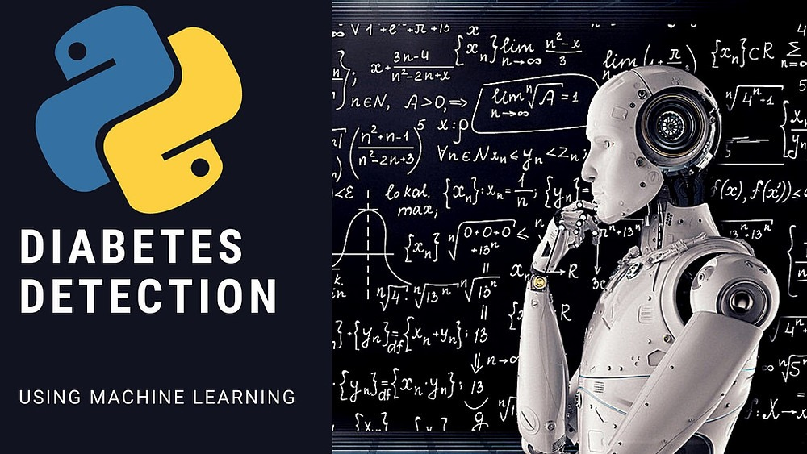
Key Motivation for the Project
I decided to grow my machine learning skills by engaging in diabetes prediction. I did this not only for fun and to learn but also to appreciate the essence of machine learning in solving
some of the problems that plague humanity.

Slide 6

About the Dataset
This dataset is originally from the National Institute of Diabetes and Digestive and Kidney Diseases. It is provided courtesy of the Pima Indians Diabetes Database and is available on Kaggle. Here is the link to the dataset. It consists of several medical predictor variables and one target variable, Outcome. Predictor variables include the number of pregnancies the patient has had, their BMI, insulin level, age, and so on.

Slide 7

The dataset has 9 columns as shown below;
Pregnancies – Number of times pregnant
Glucose – Plasma glucose concentration a 2 hours in an oral glucose tolerance test
BloodPressure – Diastolic blood pressure (mm Hg)
SkinThickness – Triceps skinfold thickness (mm)
Insulin – 2-Hour serum insulin (mu U/ml)
BMI – Body mass index (weight in kg/(height in m)^2)
DiabetesPedigreeFunction – Diabetes pedigree function
Age – Age (years)
Outcome – Class variable (0 or 1) 268 of 768 are 1, the others are 0

Slide 8

Problem Statement
This is a classification problem of supervised machine learning. The objective is to predict whether or not a patient has diabetes, based on certain diagnostic measurements included in the dataset.
0 – Absence of Diabetes
1 – Presence of Diabetes

Slide 9
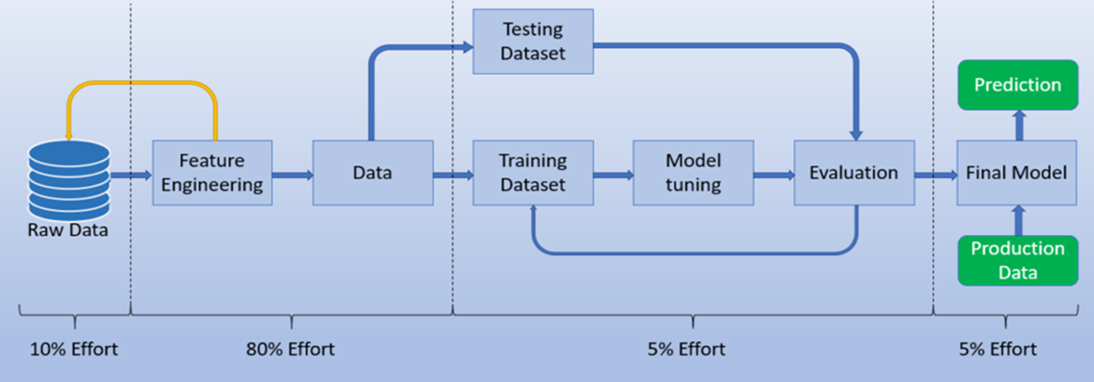
Steps of implementing the model

Slide 10
SOFTWARES AND LIBRARIES REQURIED
Softwares:
Anaconda Navigator -Jupyter notebook.
Kaggle notebook for dataset-PIMA Indian diabetes dataset.
Libraries:
Pandas
Numpy
ScikitLearn.
Seaborn.

Slide 11
Algorithms used
KNeighborsClassifier
SVC
GaussianNb
Random forest classifier

Slide 12
Conclusion
The main aim of this project was to design and implement Diabetes Prediction Using Machine Learning Methods and Performance Analysis of that methods and it has been achieved successfully.
The proposed approach uses various classification and ensemble learning method in which SVM, KNN, Random Forest, Decision Tree, Logistic Regression and Gradient Boosting classifiers are used.
The Experimental results can be assist health care to predict and make early decision to cure diabetes and save humans life.

Slide 13

Thank you

