Slide 1

EDUINSIGHT: ACADEMIC ERP FOR STUDENT RISK ANALYTICS
Final Project Review | Dept. of CSE | KLH CSE Bowrampet Campus
TEAM MEMBERS
2420030568 – AVINASH
2420030571 – ADHITHYA
2420030364 – CHARAN
Guide: Dr. N. Sunanda, Associate Professor | Academic Year: 2026–27
Notes:
Introduce the team and guide. EduInsight is an academic ERP with transparent student-risk analytics. Its contribution is the integration of records, risk rules, model benchmarking and backlog workflows in one portal.

Slide 2

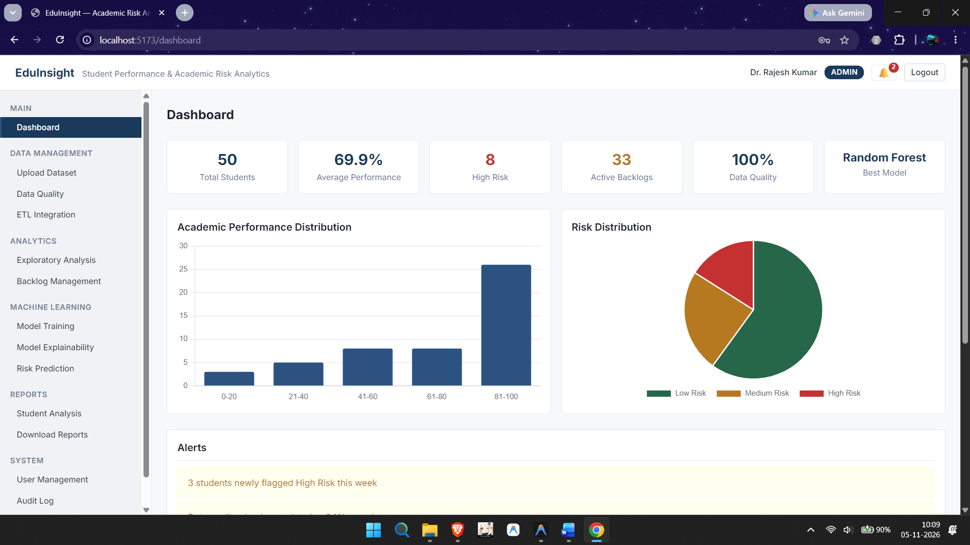


Introduction & Problem Statement
Background
Colleges keep attendance, marks, exam and backlog data in separate sheets and systems, so staff spend effort just assembling a student's current position.
Problem Statement
Early identification of at-risk students is hard: records are scattered, risk scores lack explanations, and a flag is not linked to a mentor action.
Motivation / Need
Students with backlogs or falling attendance are noticed late. Faculty, mentors and students gain one explainable view that leads to timely support.
Notes:
Explain the problem: data lives in separate systems, risk is noticed late, and predictions without explanations are hard for faculty to act on.

Slide 3


Objectives & Scope
Objectives
In scope
1
Develop a role-aware academic ERP with student profiles, semester records and separate administrator, faculty and student workspaces.
Reference prototype on 75 synthetic profiles across 5 departments
Policy risk score and a 4-model benchmark
Backlog, supplementary-exam and reporting workflows
2
Ingest and standardise academic data with quality checks, and support exploratory analysis of attendance, performance and backlogs.
3
Identify risk with a transparent 0–100 policy score and benchmark Logistic Regression, Decision Tree, Random Forest and KNN.
Out of scope
Production security and server-side authorisation
Validated dropout or graduation prediction
Proof that interventions improve outcomes
4
Manage subject-level backlogs and supplementary exams, and generate reports with a traceable audit history.
Notes:
Four objectives: ERP workspaces, data ingestion and EDA, risk scoring plus ML benchmarking, and backlog and exam workflows with reports. Scope: a reference prototype on 75 synthetic profiles; production security and real outcome validation are out of scope.

Slide 4

Literature Survey
S.No | Author(s) & Year | Method / Technique | Key Findings | Limitation / Gap
1 | Cortez & Silva, 2008 | Data mining on academic, demographic and social attributes | Prior performance and attendance help predict results | Secondary-school data; not valid for university backlogs
2 | Romero & Ventura, 2010 | Survey of educational data mining tasks and methods | Foundation for classification and decision support | Broad review; no ERP design or rule validation
3 | Shahiri et al., 2015 | Review of techniques and attributes for prediction | Many methods in use; no single best classifier | Rankings may not transfer to a new institution
4 | Asif et al., 2017 | EDM on undergraduate progression over several years | Earlier academic data signals who needs support | Institution-specific; needs external validation
5 | Lakkaraju et al., 2015 | ML framework to identify students at risk | Treats risk as an operational early-warning task | Prediction alone does not prove an intervention works
Research Gap
Existing work covers prediction, EDM and explainability separately. EduInsight combines academic administration, subject-level backlog workflows, transparent risk scoring and student self-service in one role-aware portal (Objectives 1–4).
Notes:
Five key studies support the design. The gap is not a lack of research in each area but their integration with academic administration and backlog recovery workflows.

Slide 5





Proposed System & Methodology
STEP 1
STEP 2
STEP 3
STEP 4
STEP 5
Define Problem
Ingest & Clean
Risk Logic
Build Portal
Test & Evaluate
Identify the need, scope and success criteria.
CSV / Excel import, standardise, deduplicate, impute, quality checks.
Policy risk score plus four benchmarked classifiers.
React 18 + Vite workspaces for admin, faculty and student.
Holdout metrics, edge-case and workflow tests.
Key Novelty / Contribution
Integrates ERP workflows, transparent policy scoring, ML benchmarking and subject-level backlog recovery in one portal. The novelty is workflow integration, not a new algorithm.
Notes:
Walk through the five steps left to right. End with the novelty: integration of administration and analytics with explainable risk.

Slide 6
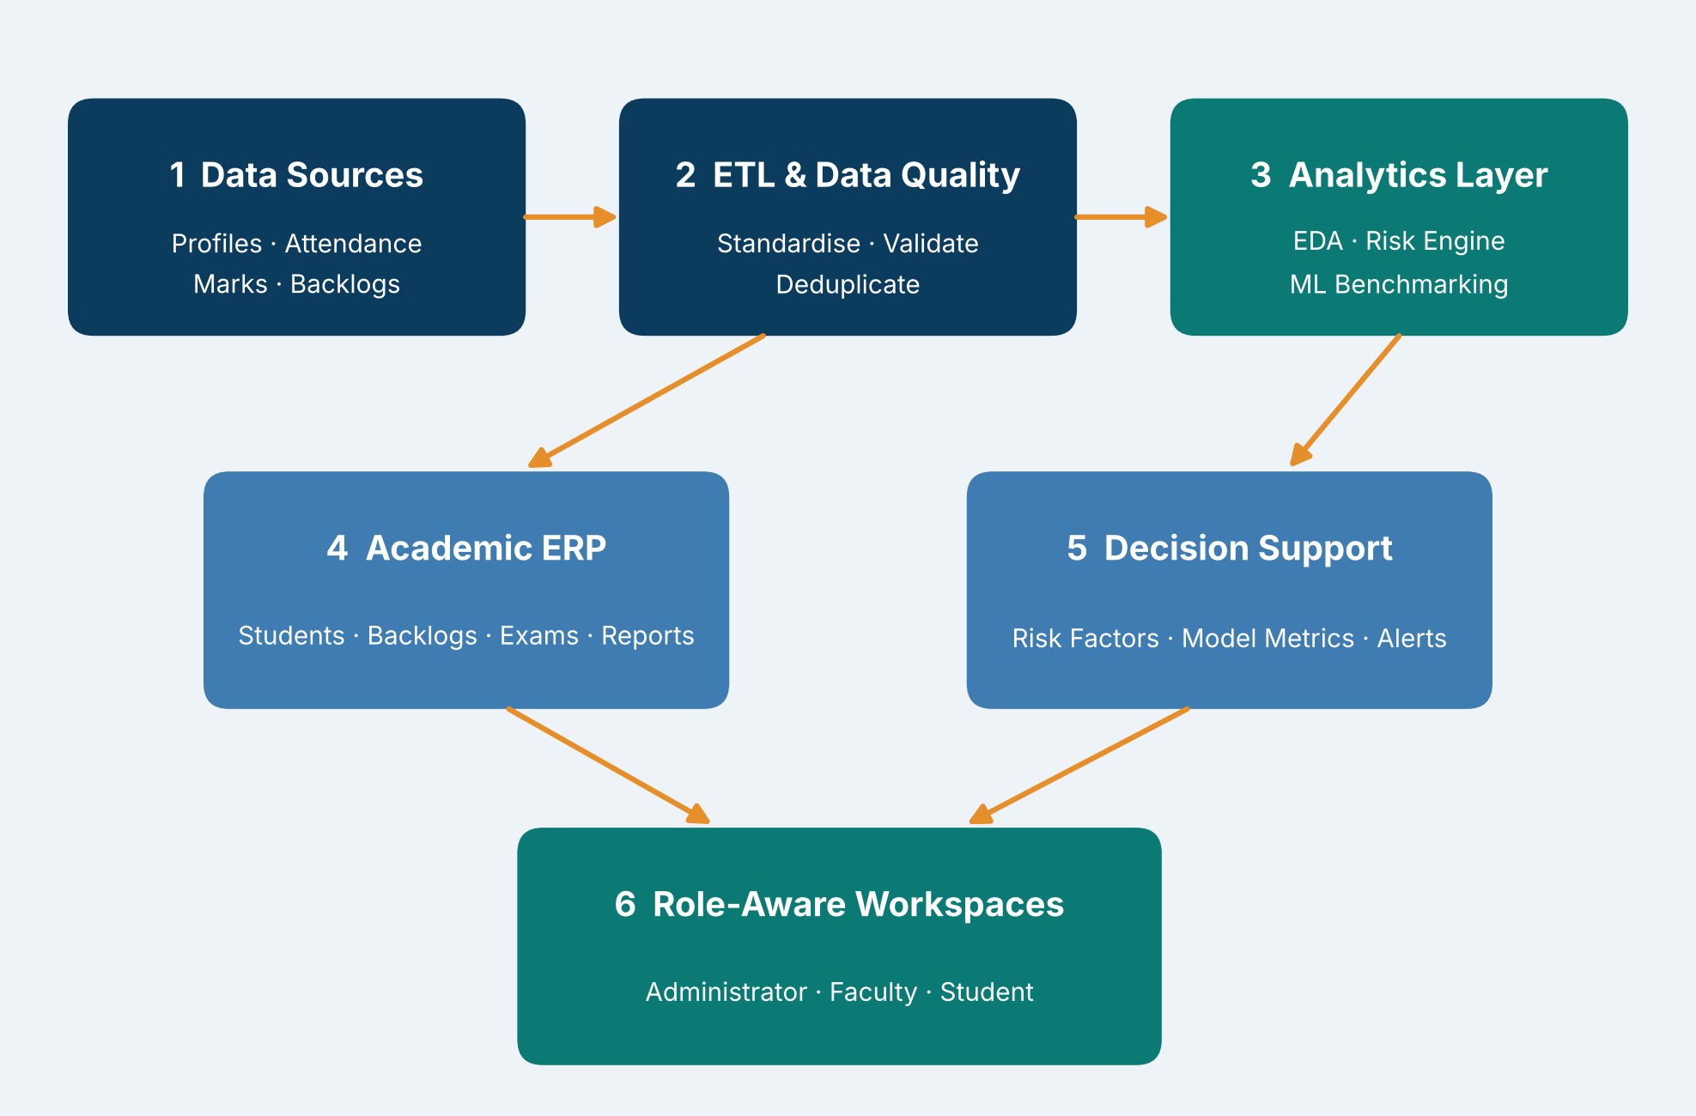
System Architecture
Components
1
Data Ingestion & Quality
Standardise, validate and deduplicate records
2
Analytics Layer
EDA, risk engine and ML benchmarking
3
Academic ERP
Students, backlogs, exams, reports and audit
4
Role-Aware Workspaces
Administrator, faculty and student views
Notes:
Data flows from sources through ETL and quality checks to the analytics layer. ERP workflows and decision support both surface in role-aware workspaces.

Slide 7


Hardware & Software Requirements
Hardware
Software & Tools
Libraries / Frameworks
Standard laptop / desktop; no GPU required
Browser storage for prototype persistence
Modern web browser
Print / PDF output for reports
Any OS that runs Node.js
JavaScript (React 18 JSX)
Vite build and dev server
Git / GitHub
React 18, React Context
Chart.js, react-chartjs-2
PapaParse (CSV), read-excel-file
Browser storage (no backend yet)
Deployment / Platform: Local browser-based prototype; secure backend planned for production
Notes:
The prototype is intentionally lightweight: a browser app with no production backend, so hardware needs are minimal.

Slide 8
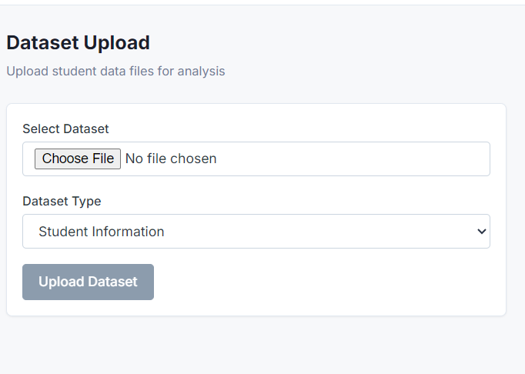
Dataset / Data Understanding
75
5
Student profiles
Engineering departments
3
4
Risk classes
ML models benchmarked
Source: synthetic profiles generated for the project (no real student data)
Features: CGPA / SGPA, internal marks, attendance, backlogs, attempts, fee status; target = risk band
Quality: schema, completeness, ID uniqueness, referential integrity, outliers
Notes:
75 synthetic profiles across CSE, ECE, Mechanical, IT and Civil. Synthetic data avoids exposing real records and lets us test edge cases such as missing values and multiple backlogs, but it cannot prove external validity.

Slide 9
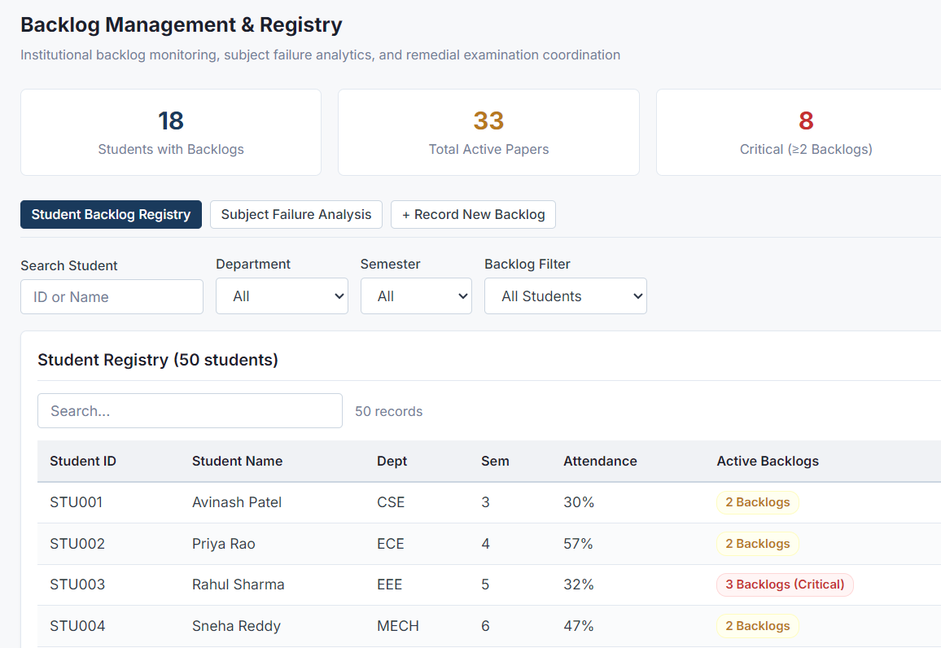
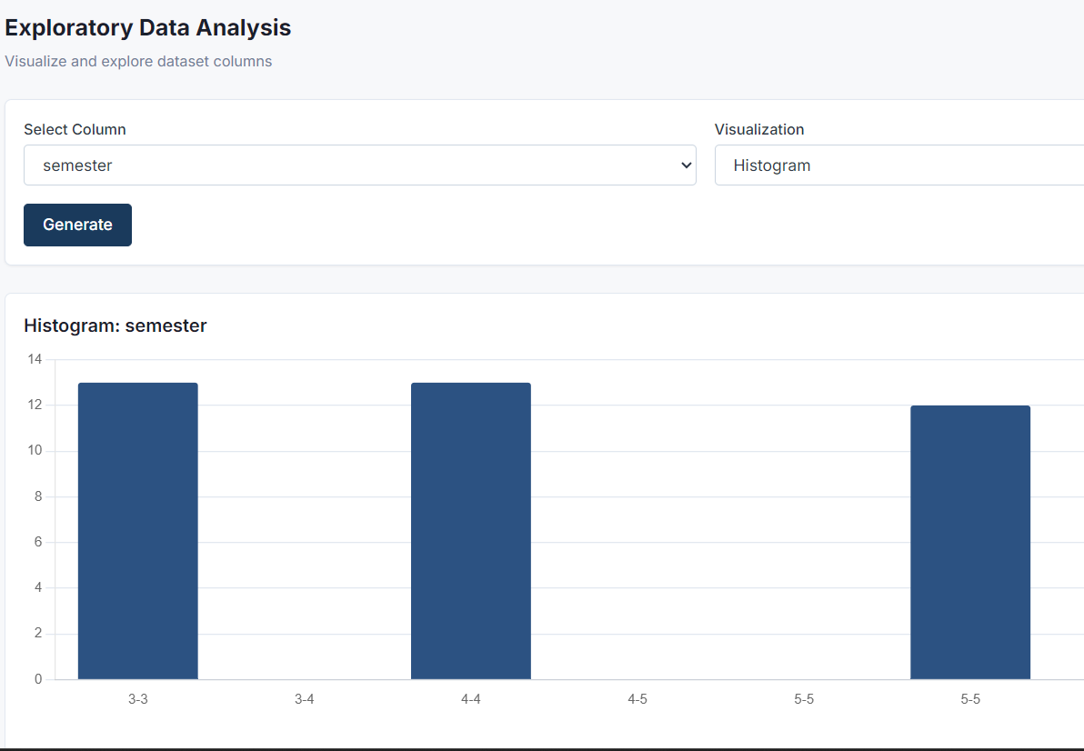



Data Preprocessing & Exploratory Analysis
Cleaning
Transformation
Feature Selection
Remove exact duplicates, impute missing numbers, flag outliers.
Normalise columns, join on student ID, prepare numeric values.
4 policy inputs; permutation importance for ML models.
Notes:
Quality checks run before analysis because an accurate-looking model can still mislead when inputs are incomplete. Learned preprocessing such as imputation is fitted on training data only.

Slide 10
Module-wise Description
1
Data Ingestion & Quality
2
Risk Engine
Purpose: Standardise and validate academic records
Input → Output: CSV / Excel files → clean, quality-checked data
Developed by: Team EduInsight
Purpose: Score risk with visible component contributions
Input → Output: Nb, Pa, Mi, Gp → score R (0–100) and band
Developed by: Team EduInsight
3
Model Laboratory
4
ERP & Student Portal
Purpose: Benchmark four classifiers on a common pipeline
Input → Output: Feature table → metrics, confusion matrix, importance
Developed by: Team EduInsight
Purpose: Manage records, backlogs, exams, reports and audit
Input → Output: Student records → role-based views and reports
Developed by: Team EduInsight
Notes:
Four modules. Each can be demonstrated separately: ingestion, risk engine, model lab and the ERP workflows.

Slide 11

Algorithms & Technologies Used
Policy Risk Score
LogReg & Decision Tree
Random Forest & KNN
Why chosen
Transparent and deterministic; shows which factor drives a flag
Key parameters
Caps 54 / 25 / 15 / 15; Low < 25, Medium 25–49, High ≥ 50
Why chosen
Interpretable baselines: probabilities and easy rule splits
Key parameters
Common features; stratified train–holdout split
Why chosen
Ensemble captures non-linear patterns; KNN adds a distance-based check
Key parameters
Permutation feature importance; ROC-AUC, F1, recall
Selection criteria: Compared on accuracy, precision, recall, F1 and ROC-AUC; recall for at-risk students is prioritised over false alarms
Notes:
The policy score is the operational first-line indicator. The ML models are benchmarked separately; the comparison is the goal, not algorithmic novelty.

Slide 12
Implementation / Model Building
Feature Selection
Code snippet / pseudocode
Nb, Pa, Mi, Gp: backlogs, attendance, internal average, previous GPA
// Policy risk score (capped components)
B = min(54, 18 * Nb)
A = min(25, 1.25 * max(0, 75 - Pa))
I = min(15, 0.6 * max(0, 50 - Mi))
S = min(15, 5 * max(0, 6 - Gp))
R = min(100, B + A + I + S)
band = High if R >= 50
Medium if R >= 25
Low otherwise
Preprocessing Pipeline
Normalise columns, join on student ID, deduplicate, impute
Data Splitting
Stratified train–holdout split; temporal split planned
Configuration
Common feature set for all 4 models; bands at 25 and 50
Notes:
The policy score in pseudocode: four capped components summed and bounded at 100, then mapped to Low, Medium or High. The dashboard shows each component so mentors can see what drives the band.

Slide 13
Results & Risk Score Analysis
Component | Rule | Max | Input
Backlogs | min(54, 18×Nb) | 54 | Nb
Attendance | min(25, 1.25×max(0, 75−Pa)) | 25 | Pa
Internal marks | min(15, 0.6×max(0, 50−Mi)) | 15 | Mi
Prev. GPA | min(15, 5×max(0, 6−Gp)) | 15 | Gp
Total R | min(100, B + A + I + S) | 100 | —
Bands: Low < 25 | Medium 25–49 | High ≥ 50
Weights are project-defined demonstration rules, not validated coefficients.
Notes:
The policy score caps each component, so backlogs can contribute at most 54 of 100 points. ML benchmark metrics (accuracy, precision, recall, F1, ROC-AUC) come from the Model Laboratory; because labels are policy-derived they measure rule reproduction, not future failure prediction.

Slide 14
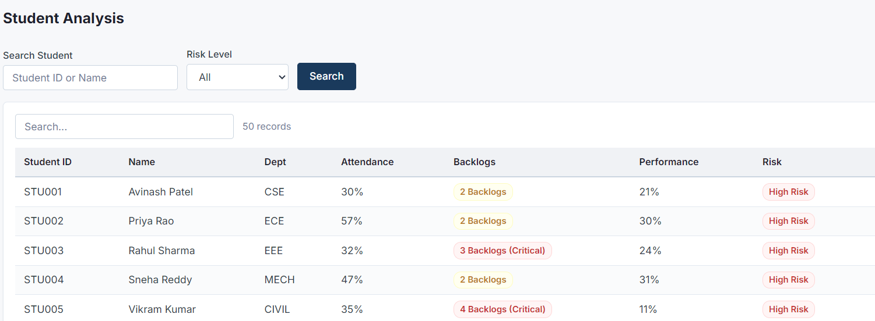
Analysis & Key Findings
54 / 100
Maximum risk points from active backlogs, the largest single driver
Interpretation: Each flag shows its four components, so mentors see why a student is High Risk.
Error analysis: ML labels come from the policy itself, so high agreement shows rule reproduction, not future prediction.
Key drivers: Backlogs (max 54), attendance (25), internal marks (15), previous GPA (15).
Notes:
Be candid: the benchmark reproduces the project rule, so it is not evidence of predicting real failure or dropout. A stronger evaluation needs an independently observed outcome such as failing a course next semester.

Slide 15

Testing & Validation
Test ID | Test Description | Expected Result | Actual Result | Status
TC-01 | Student with 3 active backlogs, otherwise healthy | R = 54 → High Risk | [Observed output] | [Pass / Fail]
TC-02 | Attendance 55%, no backlogs, good marks | R = 25 → Medium Risk | [Observed output] | [Pass / Fail]
TC-03 | Clean record: 0 backlogs, 85% attendance, GPA 8 | R = 0 → Low Risk | [Observed output] | [Pass / Fail]
TC-04 | Import with duplicate rows and missing marks | Duplicates removed; missing values imputed | [Observed output] | [Pass / Fail]
Functional Testing
Validation Method
Performance Testing
Import, validation, role restriction and report correctness
Stratified holdout; temporal split recommended
Faculty task time, usability, audit reliability (planned)
Notes:
Expected results are calculated from the policy formula. Record the observed outputs from the app and mark each case Pass or Fail before the review.

Slide 16


Challenges & Limitations
Challenges Faced
Limitations
Scattered records → one student model with ingestion and quality checks
Black-box scores → transparent policy score with visible components
Sensitive data → synthetic profiles to test edge cases safely
Synthetic data (75 profiles), so no external validity
Risk weights are unvalidated and ML labels are policy-derived
Frontend-only access control and browser storage are not production-grade
Notes:
Also mention: the small dataset gives unstable holdout metrics, and backlog-clearance simulations are scenario analysis, not proof of graduation eligibility or intervention effect.

Slide 17

Conclusion
Built EduInsight, a role-aware academic ERP (React 18 + Vite) on 75 synthetic profiles across 5 departments.
1
Final Outcome
A transparent 0–100 risk score plus four benchmarked classifiers; the contribution is integration, not a new algorithm.
4 / 4
2
Objectives implemented in the prototype
Objectives achieved: 4 of 4
One workflow from data quality to mentor action; real-world accuracy still needs observed outcomes.
3
Notes:
Revisit each objective and state whether it was met. Do not claim predictive accuracy: the labels are policy-derived and the data is synthetic.

Slide 18



Future Scope & Applications
Improve Performance
Independent outcome labels, temporal validation, SHAP / LIME
Applications
Early-warning review in college ERPs
Mentor follow-up and intervention tracking
Backlog recovery and supplementary exam planning
Universities, departments and mentors
Expand Data / Features
Real cohorts with governance, consent and de-identification
Deploy & Build an Interface
Secure backend with authenticated identity and DB authorisation
Scale & Secure
Encrypted transport, audit storage, ERP / LMS integration
Notes:
Next steps tie to the limitations: real outcome labels, a secure backend, and a faculty study to test whether explanations improve review quality. Intervention effectiveness should be studied separately from prediction.

Slide 19
Team Contribution
Reg. No. | Name | Contribution / Modules Handled
2420030568 | Avinash | [Modules and implementation]
2420030571 | Adhithya | [ report sections]
2420030364 | Charan | [Modules and tasks]
Notes:
Every member should be ready to explain their own module and report sections.

Slide 20

References
[1] P. Cortez and A. M. G. Silva, “Using data mining to predict secondary school student performance,” in Proc. FUBUTEC, 2008, pp. 5–12.
[2] C. Romero and S. Ventura, “Educational data mining: A review of the state of the art,” IEEE Trans. SMC-C, vol. 40, no. 6, pp. 601–618, 2010.
[3] A. M. Shahiri, W. Husain, and N. A. Rashid, “A review on predicting student’s performance using data mining techniques,” Procedia Comput. Sci., vol. 72, pp. 414–422, 2015.
[4] R. Asif et al., “Analyzing undergraduate students’ performance using educational data mining,” Comput. Educ., vol. 113, pp. 177–194, 2017.
[5] H. Lakkaraju et al., “A machine learning framework to identify students at risk of adverse academic outcomes,” in Proc. 21st ACM SIGKDD, 2015, pp. 1909–1918.
[6] C. Romero and S. Ventura, “Educational data mining and learning analytics: An updated survey,” WIREs Data Mining Knowl. Discovery, vol. 10, no. 3, e1355, 2020.
[7] M. T. Ribeiro, S. Singh, and C. Guestrin, “Why should I trust you? Explaining the predictions of any classifier,” in Proc. 22nd ACM SIGKDD, 2016, pp. 1135–1144.
[8] S. M. Lundberg and S.-I. Lee, “A unified approach to interpreting model predictions,” in Adv. NeurIPS, vol. 30, 2017, pp. 4765–4774.
Project Links
GitHub: [add URL]
Dataset: Synthetic data (generated in-project)
Demo video: [add URL]
Notes:
IEEE style, numbered in order of citation in the research paper.

Slide 21
THANK YOU
Questions & Discussion
Team: Avinash | Adhithya | Charan – KLH CSE Bowrampet Campus
Guide: Dr. N. Sunanda, Associate Professor, Dept. of CSE
Notes:
Leave this slide up during questions.

