Slide 1
LibraPulse: Scalable Library Pipeline with PySpark
Made By:
Vivek Prasad - 2420030350
D Teja - 2420030737
Adhithya - 2420030571

Slide 2
PROJECT ABSTRACT
Project Overview & Problem Statement
Project Title: LibraPulse: Scalable Library Pipeline with PySpark
Subject: Fundamentals of Data Engineering (FDE)
Team Size: 3 Members
Problem Statement: Modern library systems generate scattered checkout logs, member records, and digital catalog data. Traditional relational databases struggle with high-throughput processing, inconsistent record formats, and slow analytical reporting across these raw datasets.
Proposed Solution: An end-to-end data pipeline built in VS Code using PySpark and a Medallion Data Architecture (Bronze, Silver, Gold) to automate ingestion, clean noisy records, and deliver real-time circulation analytics.

Slide 3
System Architecture & Data Engineering Lifecycle
Source Systems (Bronze Layer): Raw checkout logs (JSON) and book catalog metadata (CSV) ingested via Python data generation scripts.
Orchestration: Apache Airflow schedules and triggers batch ingestion jobs inside containerized Docker environments.
Transformation Core (Silver Layer): PySpark cleans missing ISBNs, removes duplicate checkout records, enforces strict schema types, and standardizes date formats.
Aggregation & Storage (Gold Layer): PySpark computes key metrics (top circulated genres, peak checkout hours, overdue fine totals) and writes analytics-ready tables to PostgreSQL.
Serving Layer: Interactive Metabase/Power BI dashboards connected directly to PostgreSQL for visual reporting.

Slide 4
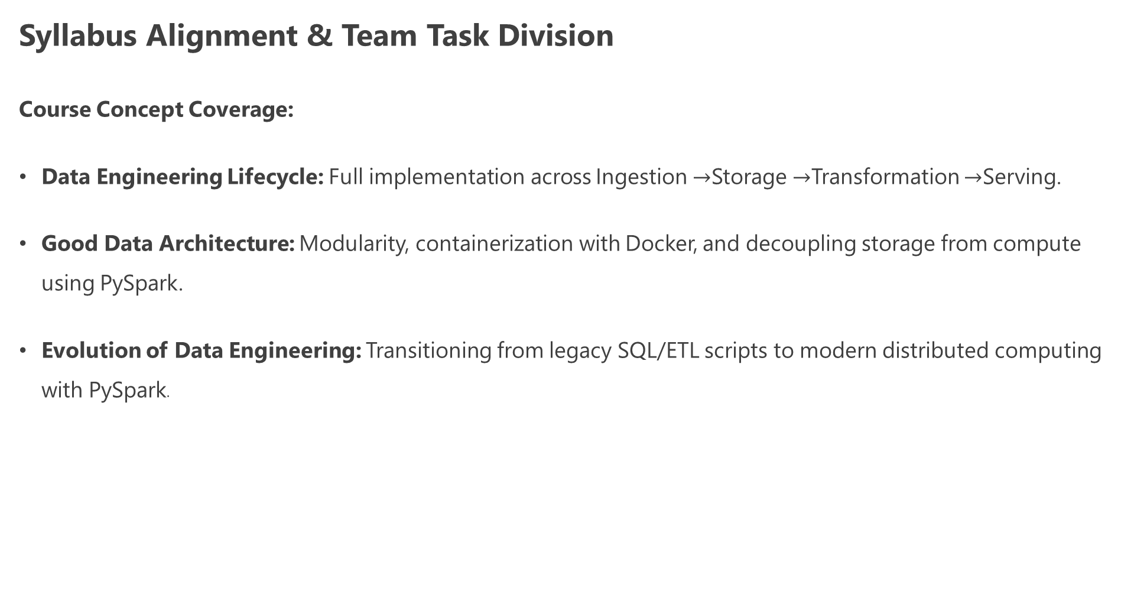
Syllabus Alignment & Team Task Division
Course Concept Coverage:
Data Engineering Lifecycle: Full implementation across Ingestion $→$Storage $→$Transformation $→$Serving.
Good Data Architecture: Modularity, containerization with Docker, and decoupling storage from compute using PySpark.
Evolution of Data Engineering: Transitioning from legacy SQL/ETL scripts to modern distributed computing with PySpark.

Slide 5

Team Responsibilities:
Member 1 (Ingestion): Data generation scripts + Apache Airflow DAGs.
Member 2 (Processing): PySpark Bronze $→$Silver $→$Gold transformation logic.
Member 3 (Storage & BI): PostgreSQL schema setup, dashboard visualization, and documentation.

Slide 6
THANK YOU

