Slide 1



Building a Basic Calculator in Python
This presentation explores the development of a basic calculator project using Python programming language. We'll delve into the importance of basic data structures and cover key aspects of the project, including setting up the development environment, defining functionality, handling user inputs, and implementing arithmetic operations.
By :- Mukul
11022210101
Btech C.S.E (DS & AI)
3rd Year

Slide 2

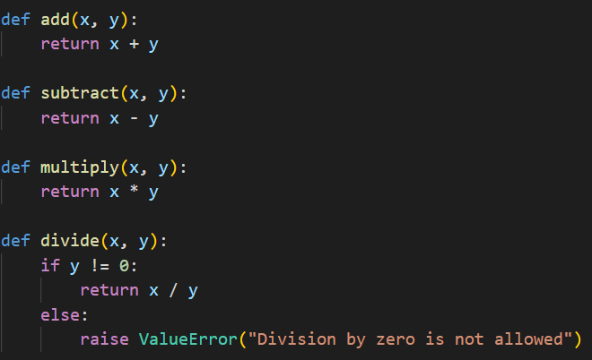
Defining the Calculator's Functionality
Addition
The calculator should perform the addition operation, taking two numbers as input and returning their sum.
Subtraction
The calculator should perform the subtraction operation, taking two numbers as input and returning their difference.
Multiplication
The calculator should perform the multiplication operation, taking two numbers as input and returning their product.
Division
The calculator should perform the division operation, taking two numbers as input and returning their quotient.

Slide 3


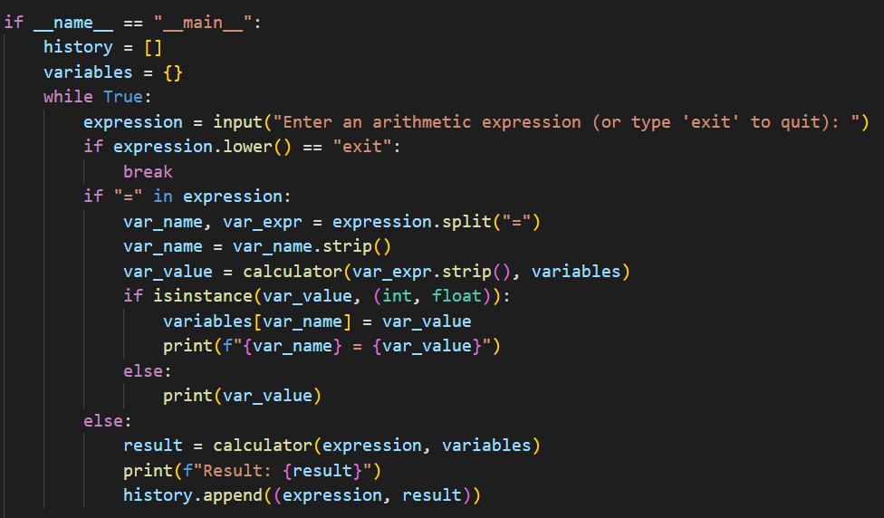


Handling User Inputs
Prompt for Input
Use the `input()` function to prompt the user for their desired operation and numbers.
Data Validation
Verify that the input is valid. Ensure that the user provides numbers and an appropriate operator.
Data Conversion
Convert the user's input from strings to numerical data types (integers or floats).

Slide 4

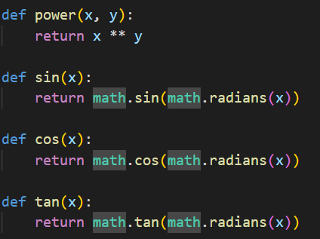
Performing Arithmetic Operations
Operator
Symbol
Operation
Addition
+
Sum of two numbers
Subtraction
-
Difference between two numbers
Multiplication
*
Product of two numbers
Division
/
Quotient of two numbers

Slide 5

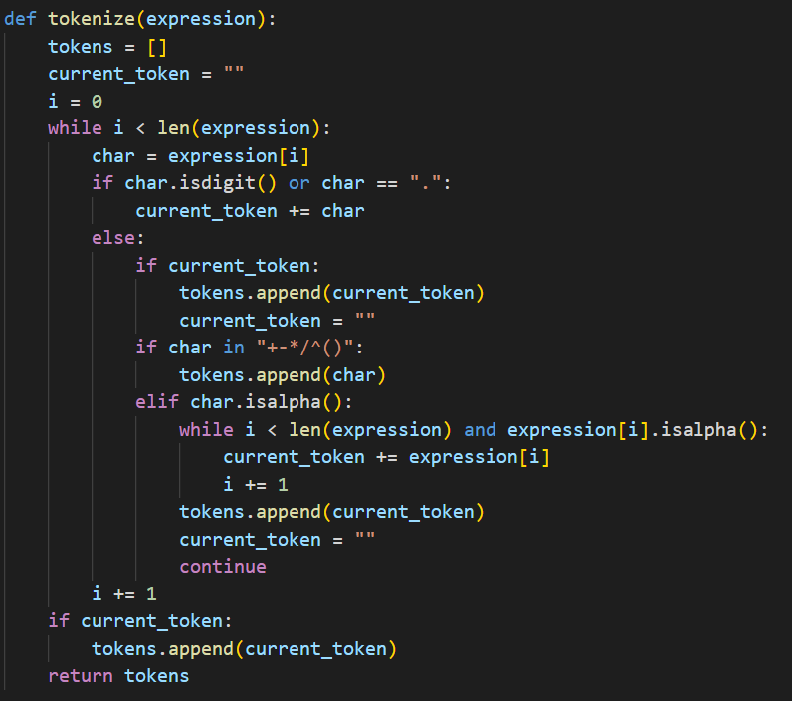



Handling Edge Cases and Error Handling
Division by Zero
Prevent division by zero by handling this case separately and displaying an error message.
Invalid Input
Handle invalid input, such as non-numeric characters or incorrect operator symbols, by displaying appropriate error messages.
Unexpected Errors
Implement general error handling mechanisms to catch and display unexpected errors that may occur during calculations.

Slide 6

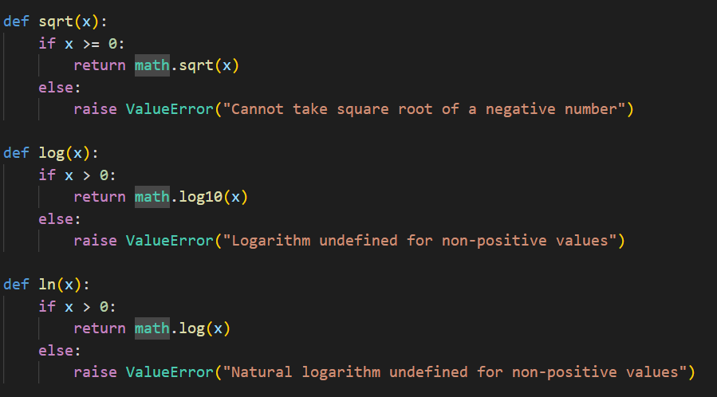
Enhancing the Calculator with Additional Features
1
Exponents
Implement the exponentiation operation, which raises a base number to a given power.
2
Square Root
Include the square root function, which calculates the square root of a given number.
3
Memory Functions
Add memory functions to store and recall previous results for convenience.
4
Trigonometric Functions
For more advanced functionality, consider adding trigonometric functions like sine, cosine, and tangent.

Slide 7

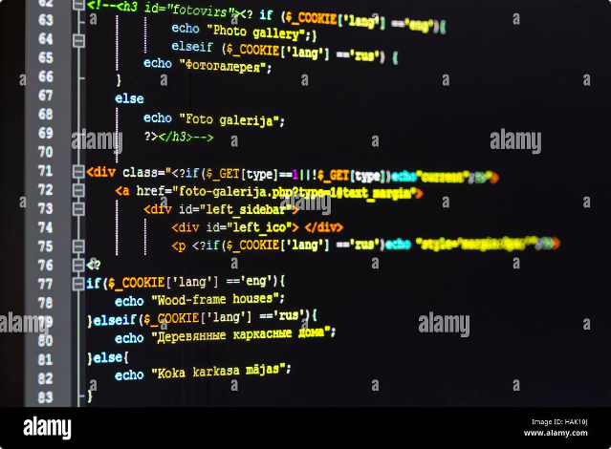
Conclusion and Next Steps
This calculator project provides a foundation for learning about basic data structures and programming in Python. You can expand on this project by adding more complex features, exploring different programming paradigms, and experimenting with graphical user interfaces.

Slide 8
THANK YOU
Mukul
11022210101
B.Tech C.S.E
(DS & AI)
3rd Year

